Slide 1
Cambridge Core- Ebook purchasing models, discoverability and key information
Cambridge University Press

Slide 2
What is Cambridge Core?
Cambridge Core is the academic platform bringing together over 32,000 ebooks and 380 journals.
Why?
To Bring together our journals and books content into a single platform
To Redesign to create the best user experience
And to Create a stable and high performing technology base to support current needs and future growth
Notes:
Cambridge Core was launched in September this year after over three years of research and platform development. It brings together over 32,000 ebooks and 380 journals on a combined platform for the first time

Slide 3
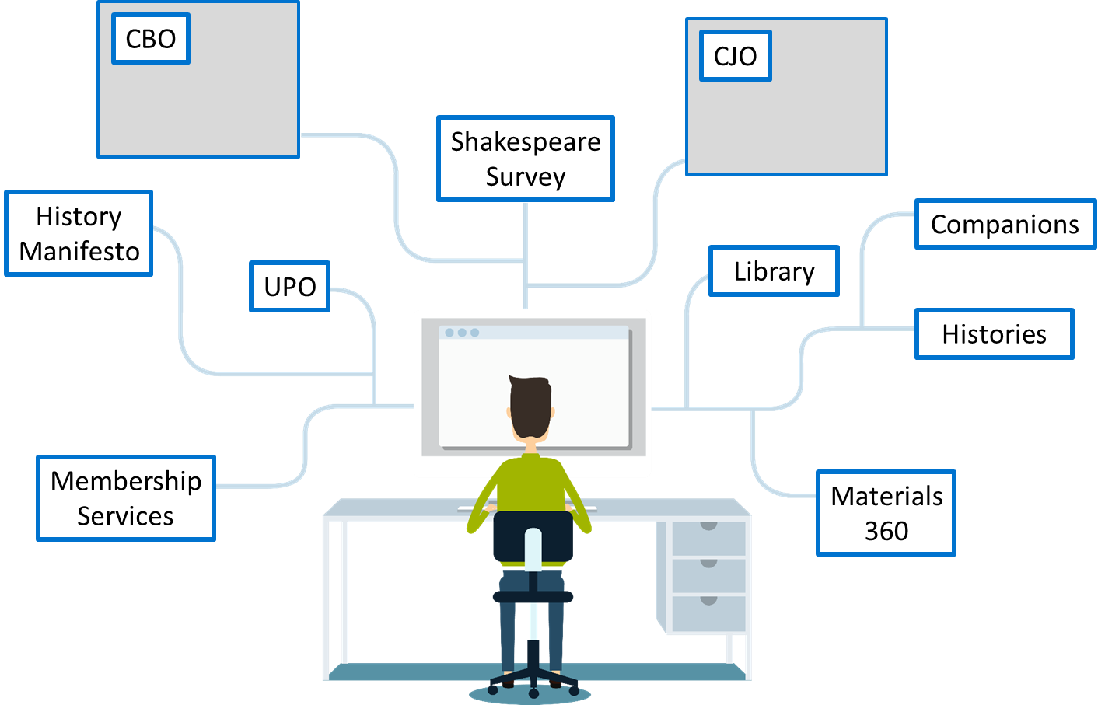
Content previously on multiple platforms
Notes:
Cambridge have published books for over 425 years, but online really began in 1997 with launch of Cambridge Journals Online. Cambridge Books Online followed in 2010. Over the years we’ve launched multiple platforms, but with greater understanding of researcher needs, having content located in the same place to improve discoverability and save researchers time began to make more sense.

Slide 4
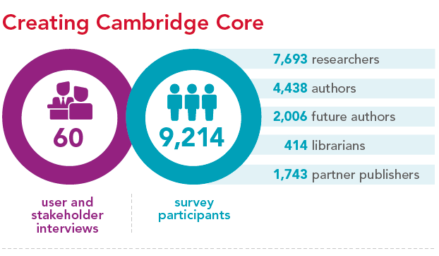
How was Cambridge Core built?
Market research included 50+ user interviews and survey of 9,000+ people
The needs of our users informed the creation of the platform with regular user testing and feedback throughout the development
Notes:
Cambridge Core is a user-centric platform and built with the needs of our users in mind. This involved the creation of personas to better understand the different needs of librarians, researchers, authors and society partners.
The initial Market research included over 50 interviews and survey of 9,000+ people
The needs of our users informed the creation of the platform with regular user testing and feedback throughout the development

Slide 5
What’s on Cambridge Core?
Over 1.4 million articles and 740,000 chapters across 30 subjects
Ebooks previously on Cambridge Books Online, partner publisher titles, Cambridge Histories, Cambridge Companions, Shakespeare Survey
Cambridge journals and the Cambridge Journal Digital Archive

Slide 6
What does Cambridge Core offer librarians?
Turnaway data
COUNTER4 Reports
Improved Accessibility
Single location for reporting
User-guides and support material
Advanced security measures
MARC Records, and OCLC control numbers
KBART lists

Slide 7
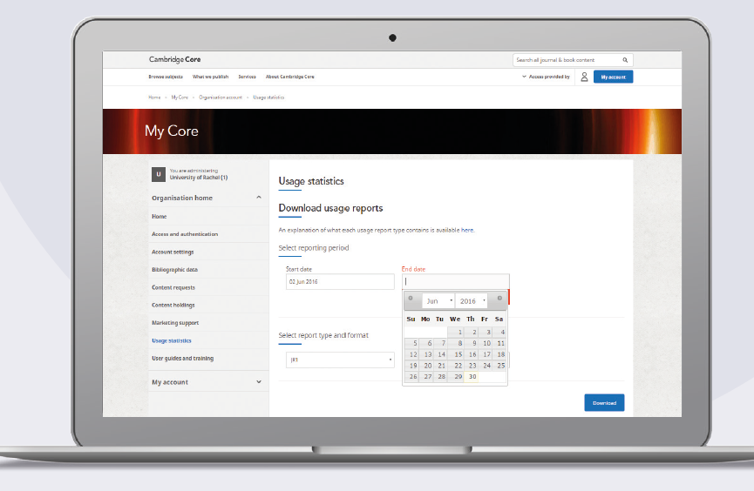
Improved reporting functionality
Dedicated area for librarian administrators- ‘My account’
COUNTER Reports including ebooks, journals, OA and platform usage
Single location for ebooks and journals reports
Notes:
We’ve created the ‘My Account’ area of Cambridge Core for librarian administrators to log in.
From this area librarians can download COUNTER reports including on usage for ebooks, journals, journal archive, Open Access and total platform usage
The Past 5 years of CJO and CBO usage is available
We hope that this makes the librarians reporting easier- as reports for ebooks and journals are now in one place

Slide 8
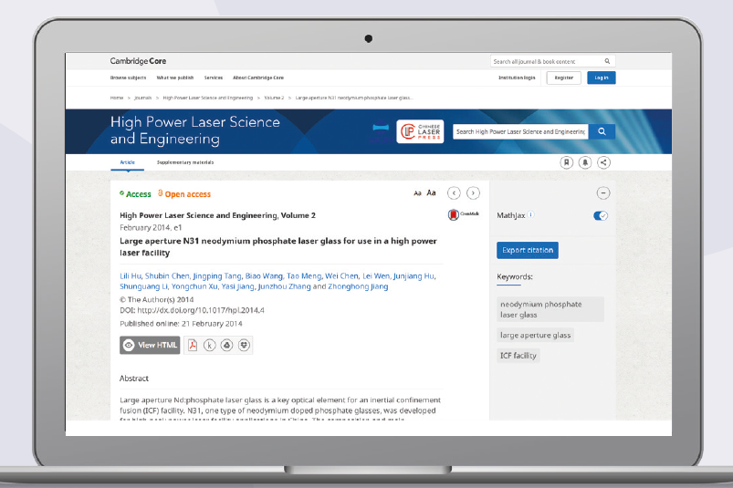
Improved Accessibility
Accessible to as many users as possible including visually impaired
Skip links for screen readers
Clear and consistent navigation and page structure
Easily increase text size
Notes:
A big focus on the build of Cambridge Core was to create a platform accessible to as many users as possible. Core includes Alternative text for images and non-text elements plus skip links for screen readers, for users who are visually impaired as well as Clear and consistent navigation and page structure
The image displayed shows larger text, which you can easily change on Core using the Aa letters at the top of the article.

Slide 9
What does Cambridge Core offer researchers?
Exact title match for searches
Advanced facetted search option
Accessibility
features for visually impaired
Responsive site for mobiles and tablets
Userguides and support material
Cambridge Core Reader with HTML functionality
Download multiple items or multiple citations
Send content to DropBox, Google Drive and Kindle
Ebooks and journals in a single location
Easy citation with EasyBib

Slide 10
Ebook purchase models on Cambridge Core

Slide 11
Key information that applies to all models
All models offer perpetual purchase rights
All models offer unlimited user concurrency
All models are DRM free
All models require an annual hosting fee of 300 GBP
Hosting fees can be waived each year if:
you subscribe to journals or any other databases from CUP
You purchase at least one additional ebook title that year

Slide 12
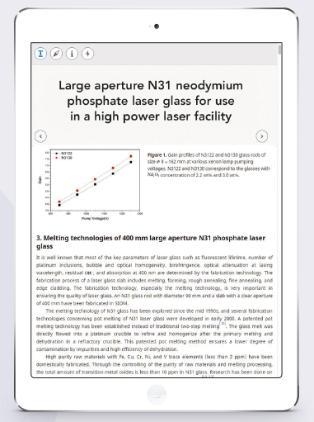
Ebook purchase options
Options available include:
Title-by-title
Collection building (Existing subject and other collections)
Advance Ordering & Librarian Self-service
Evidence Based Acquisition

Slide 13
1. Title-by-title ebook purchase
Ebooks are available to purchase individually when you need them
Simple pricing structure depending on type of book
Why choose this option
quick purchase for reading lists
Ideal when small number of books needed or for occasional purchases
In response to monthly turnaway data or demands from faculty
Notes:
Price structure
Books for Research: £85 GBP, $135 USD, €105 Euro, $158 AUD
Coursebooks: £135 GBP, $210 USD, €165 Euro, $248 AUD
Cambridge Library Collection: £50 GBP, $80 USD, €65 Euro, $99 AUD
Textbooks: £300 GBP, $500 USD, €375 Euro, $594 AUD

Slide 14
Price structure
Books for Research: £85 GBP, $135 USD, €105 Euro, $158 AUD
Coursebooks: £135 GBP, $210 USD, €165 Euro, $248 AUD
Cambridge Library Collection: £50 GBP, $80 USD, €65 Euro, $99 AUD
Textbooks: £300 GBP, $500 USD, €375 Euro, $594 AUD

Slide 15
2. Collection building- by subject
Choose to buy all ebooks in a certain subject or sub-subject
Across 30 subject areas
Choose recent publications, series or full collections
Why choose this option
Build ebook collection for particular faculty
When there’s a new course running in an area you haven’t previously purchased ebooks
Min 10% discount on pre-defined collections
Notes:
By downloading the ebook price list you can easily filter on the main subject to look at all books- for example- filter on subject 1 for just law books, and then on subject 2- for areas within law such as Humanitarian Law, Human Rights, International Trade Law and other options. You can also filter on publication date to choose just recent titles
If you’re interested in a certain series you can also filter on this column to buy all titles within a series

Slide 16
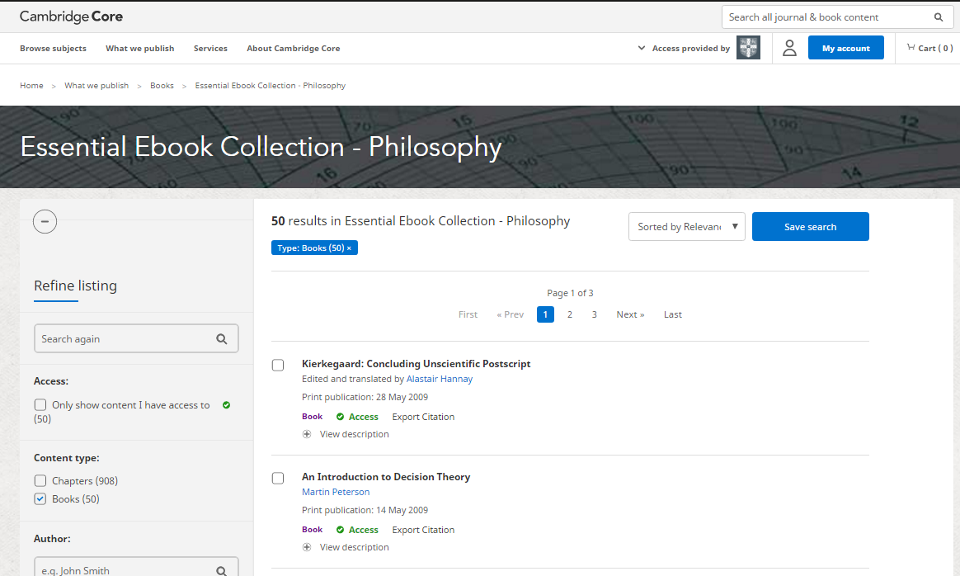
Special collections- Essential ebooks
Features 50 most popular ebooks in a particular subject
Available across 15 key subjects from Astronomy to History to Politics
Notes:
Why choose this option
Ideal collection for new ebook customers
Popular and established titles
Helpful to see usage of popular titles before making other ebook purchases

Slide 17
Special collections- Hot Topics
Notes:
These are a series of bespoke ebook collections comprising titles from across a wide range of subjects, created to reflect the latest research and technology trends. Drawing from the humanities and social sciences, in addition to the science, technology and medical disciplines, the collections highlight Cambridge’s strength and depth in new areas of publishing.
Often looking beyond what would be considered the ‘typical’ fields of study, the Topics provide a complete multidisciplinary offering for those studying or conducting cutting-edge research, or working with new techniques or technology.
Why choose this option
Specially selected collection by Editorial experts that span other subjects too. For example the Energy collection includes books within Economics from the angle of Energy Policy and governance as well as titles in Earth and Environmental science that consider the Scientific basis. The Neuroscience collection also includes language titles looking at the multilingual mind.
These are great collections for new cutting edge disciplines and new courses

Slide 18
3. Advance Ordering & Librarian Self-service
Advance Ordering- get access to all Cambridge ebooks as soon as they become available
Librarian self-service enables you to buy titles directly on Cambridge Core without having to speak to your Cambridge University Press contact.
This is ideal if you want immediate access to selected titles
Perfect for selecting titles requested by your faculty or looking at turnaway data

Slide 19
4. What is Evidence Based Acquisition (EBA)?
Institutions are given access to an extensive online collection of Cambridge and partner press ebooks, before they make decisions about which titles to buy access to in perpetuity at the end of the subscription period.

Slide 20
How does EBA work?
Notes:
We will talk through the stages of implementing an EBA

Slide 21
Payment
Upfront payment – no extra fees
Flexible and discounted pricing based on
book collection size
length of access
Notes:
No extra fees. Libraries do not pay for the subscription access. All funds deposited are spent on the titles the library purchase in perpetuity at the end of the EBA.
So there is no cost for items you use but do not go on to purchase later in perpetuity.
No set up fee.
Generally people tend to go for 12 months as it’s most useful for them. But you can do 6 months etc.

Slide 22
Access
Access can be granted any time after payment
6 or 12 month duration
FREE full MARC Records provided
DRM free, unlimited concurrency
Newly published titles added monthly
32,000+ online titles available
Notes:
WE DON’T RUSH YOU - YOU COULD PAY IN JULY AND START ACCESS IN SEPTEMBER
Unlike some other EBA deals, with CUP you do get access to newly published titles added to your monthly access.
Customers have fed back to us that this has been useful for discoverability as students are drawn to the newly added content.
Over 1000 titles are added each year.

Slide 23
Statistics
Usage statistics provided at any time
Final statistics provided at end
Detailed data
Notes:
We don’t suddenly cut your access during decision making month - Usage stats avail at any time. We usually send these monthly.
Cambridge Core provides a report for you but we can provide additional information for you.
Detailed data
Year of publication
Subject
Usage patterns
Percentage of list used i.e. 30%
Series i.e. how many books in a series you currently have and then purchase any holes.

Slide 24
Decision making
Choose books with your prepayment
Access is maintained while choices are made
You are in control!
Statistics provided
also other criteria:
reading lists
current stock
course knowledge
Publication date
Notes:
NO ADDITIONAL FEE FOR HIGH USAGE
YOUR ORIGINAL FEE IS WHAT YOU PAY FOR YOUR EBA
IF YOU GET HIGH USAGE, GOOD FOR YOU!
You do not have to purchase the most downloaded titles. It’s completely up to the library which titles they choose to purchase at the end.
REMEMBER: IT’s NOT AUTOMATED PURCHASE after x amount of downloads (LIKE PDA)

Slide 25
MARC Records, third party discovery services and discoverability

Slide 26
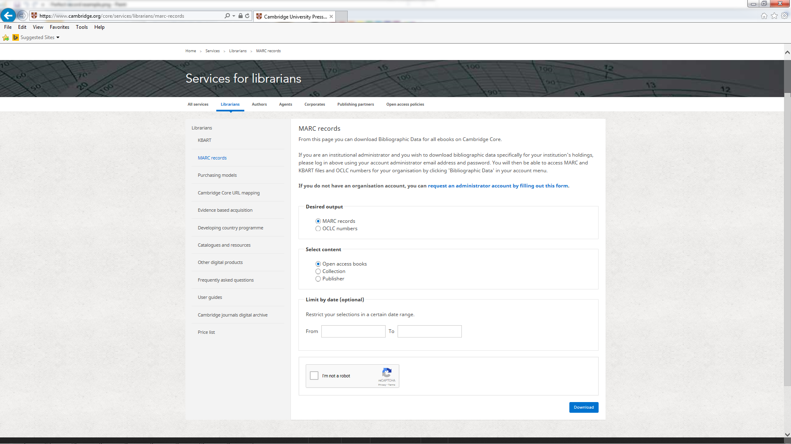
How to extract MARC Records
Notes:
Option 1- In the SERVICES FOR LIBRARIANS area our MARC Records are freely available to everyone. without logging in to the administrator account you can extract MARC Records by date. These might not be publications you own. But can be used if you want to download MARC Records for OA books, for a particular collection or publisher

Slide 27
How to extract MARC Records for titles you have access to
Organisational administrators can log in to their account to access MARC Records in the ‘My Core’ area
In the left hand menu select Bibliographic data
You can now download MARC Records for books you have access to, plus OCLC Control numbers and KBART files

Slide 28
Which Discovery Partners do we work with?
Discovery Platform Providers
Notes:
We work with a large number of 3rd party suppliers to make sure we have the formats needed to enable discoverability at your institution

Slide 29
The Information Supply Chain:
Publisher
Library Data Analyst to help manage relationship between Publisher and Discovery Platform Providers
Generate data associated to content
Discovery Platform Providers
DATA
Retrieve from Academic Platforms
Provide content to libraries
Provide an interface by which end-users can access collections
Libraries
Notes:
We’ve created the position of library data analyst (Concetta) to help manage relationship between publisher and discovery platform providers. This is to make sure we have the correct format and data needed, and that these are updated and ingested into relevant systems quickly and seamlessly.
Concetta can also help with any issues you have with your MARC Records of other metadata formats

Slide 30
Usage and resources for your libraries

Slide 31
EBA Resource bank
cambridge.org/EBAresources
Notes:
Marketing materials available from CUP if your library takes an EBA with us
These are banners for the library website.

Slide 32
EBA Resource bank
cambridge.org/EBAresources
Notes:
We can also provide posters for your library to make researchers aware of the content available

Slide 33
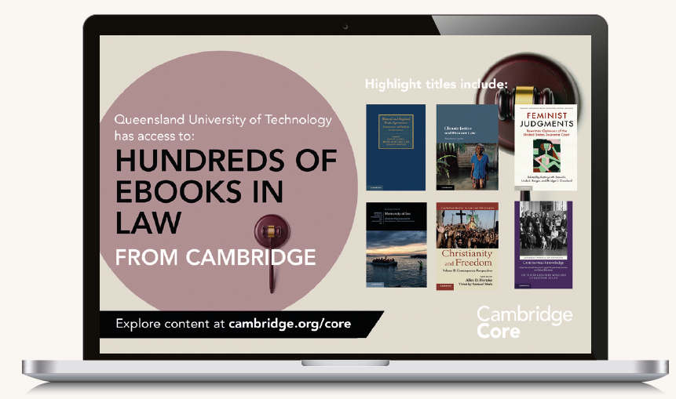
Customised desktop screens
Notes:
Australia example- different requirements for different territories

Slide 34
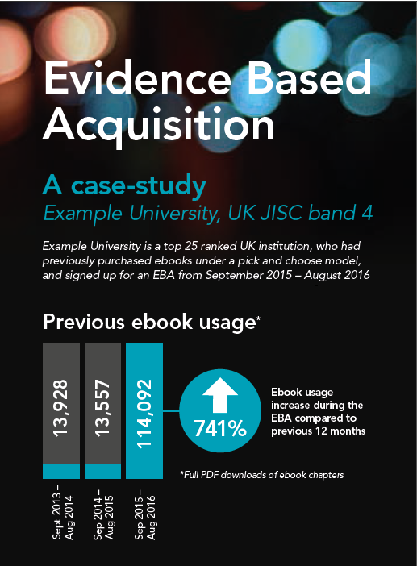
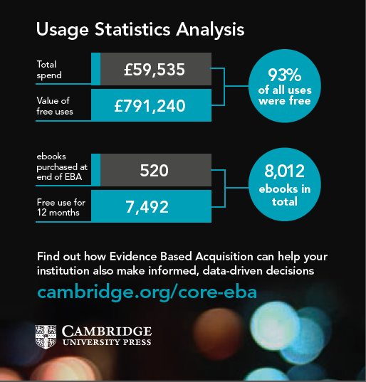
Visualising data
Notes:
We can provide very detailed analytics at the end of the EBA such as this that we did for a UK institution.

Slide 35
What’s next for Cambridge Core?
Further development and improvements
Migration of additional products
Adapting to future needs
Notes:
1) Further development - we will continually undertake research to ensure the platform continues to meet the needs of our users.
We’ve already had requests for improvement including
Clearer navigation labelling
Library tool improvements - including SUSHI, MARC
2) Additional products – we aim to bring together additional contents which is currently hosted on separate Cambridge platforms, and are working on a roadmap for the migration of these, for example products like Cambridge Law Reports will move onto Core
3) Adapting to future needs - Cambridge Core is built around an agile methodology meaning we can incorporate new features and developments according to the needs of our users

Slide 36
Any questions?

