Slide 1

Creative Commons
Introduction webinar for librarians
Gwen Franck (EIFL)
Ilkay Holt (Creative Commons Turkey)

Slide 2
In this webinar:
What is open licensing and why is it important?
What is Creative Commons?
How does Creative Commons work?
  How to apply a license
  How and where to find openly licensed content
Q & A

Slide 3


Slide 4
What is open licensing and why is it important?

Slide 5


“All rights reserved”

Slide 6
Traditional copyright system
Based on the ‘all rights reserved’ principle
Based on 19th century Berne Convention
Works remain in system until x amount of years after death of longest living author/ rights holder
Automatic – no action required
Access via Exceptions and Limitations as set out in national copyright law
Fair use / Fair dealing (common law countries such as US)

Slide 7
A flawed system:
Protection period evolved from lifespan author to more than 70 years (tendency to be even more increased)
Exceptions are not harmonised
Automatic – it is difficult to abstain from your rights even if you want to
Orphan works: difficult to decide copyright status
Not adapted to reality in 2017
Any re-use (except when L&E apply or fair use): permission required
Public domain under pressure
Copyright reform: a complicated, long process

Slide 8
The Public Domain
Everything on which no copyright applies
  Protection has expired
  The content has never been copyrightable
  All rights have been waived by the rights holder
Public Domain works:
  All re-use is permitted
  You can ‘remix’ Public Domain works and claim (c) on the new work, but the original stays in the Public Domain!

Slide 9
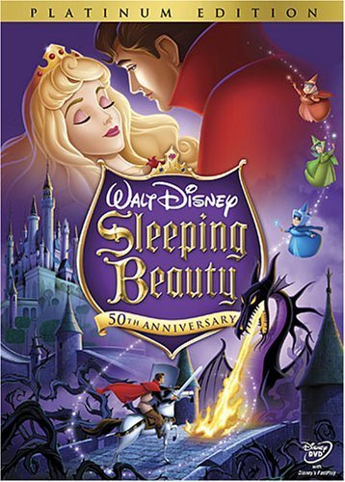
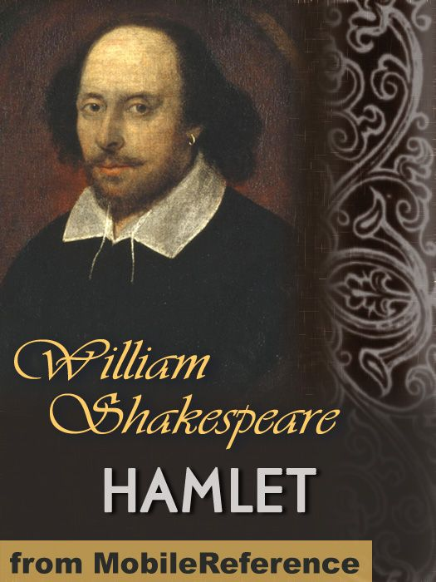
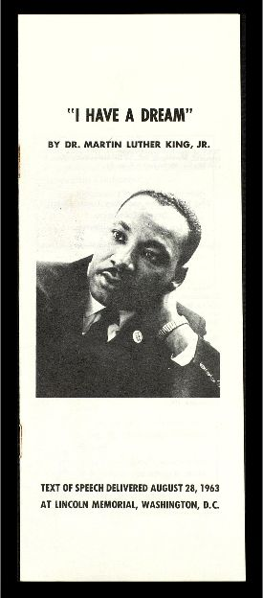
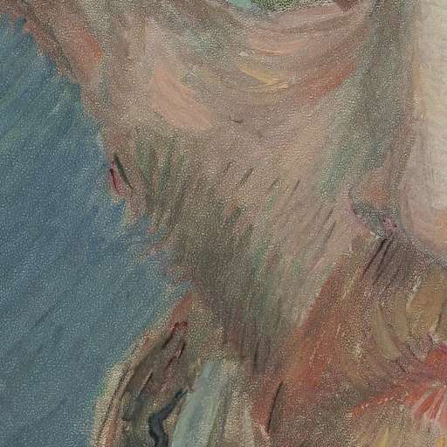
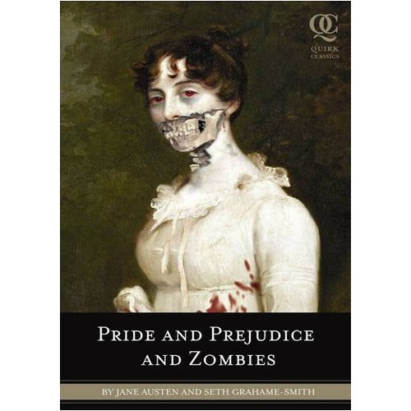
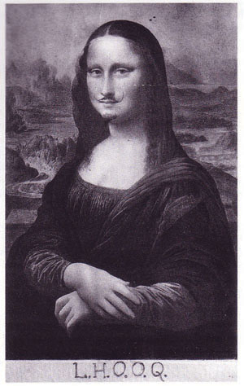
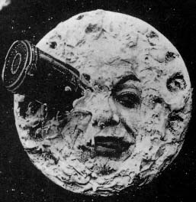
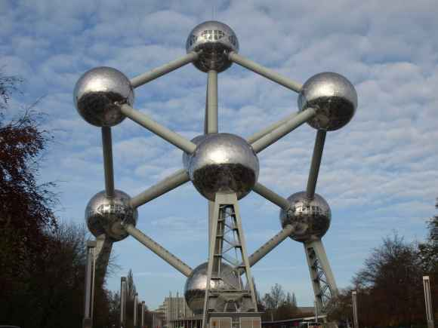

Slide 10
Public domain status:
Often difficult to determine whether Public Domain or not
  Variations per jurisdiction
  Author(s) unknown
  Copy or adaptation?
Rights holders undertake action when (c) expires

Slide 11
Open licensing: a ‘quick’ fix
“Some rights reserved”
  Middle ground between full (c) and Public Domain
Author/rights holder:
  Predefines manners of permitted re-use
  User does not need to ask for permission when re-using the content (for most open licenses)
‘Simplification’ of author rights
Legally valid
  Creator still retains author rights (unless they have put the work into the public domain)
  Non-compliance with license is a copyright infringement
Different licenses for different types of content
  Great variation in requirements and permissions

Slide 12
What is Creative Commons?
One of the most well-known all round open licenses
Over 1 billion works licensed
US-based non-profit, working with a small staff and a world-wide network of volunteers who educate about ‘open’ issues, the licenses, create license translations, advise on license-related issues, ...
Used on well known platforms: TED, Medium, Flickr, PLoS, Wikimedia ...
6 variations and two public domain dedications
www.creativecommons.org

Slide 13
How does Creative Commons work?

Slide 14
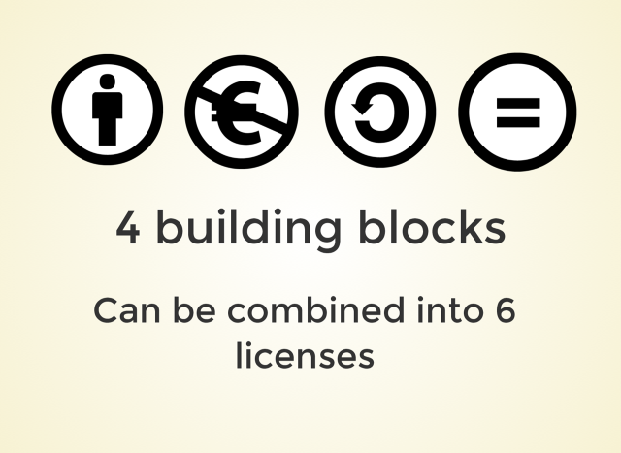

Slide 15
All licenses have in common:
Attribution — You must give appropriate credit, provide a link to the license, and indicate if changes were made. You may do so in any reasonable manner, but not in any way that suggests the licensor endorses you or your use.
No additional restrictions — You may not apply legal terms or technological measures that legally restrict others from doing anything the license permits.
ADDITIONAL CONDITIONS: SA, NC, ND or combination
You do not have to comply with the license for elements of the material in the public domain or where your use is permitted by an applicable exception or limitation.
No warranties are given. The license may not give you all of the permissions necessary for your intended use. For example, other rights such as publicity, privacy, or moral rights may limit how you use the material.

Slide 16

‘BY’ – attribution
Share — copy and redistribute the material in any medium or format
Adapt — remix, transform, and build upon the material
for any purpose, even commercially.

Slide 17

‘SA’ – ShareAlike
Share — copy and redistribute the material in any medium or format
Adapt — remix, transform, and build upon the material
for any purpose, even commercially.
ShareAlike — If you remix, transform, or build upon the material, you must distribute your contributions under the same license as the original.

Slide 18

‘NC’ - NonCommercial
Share — copy and redistribute the material in any medium or format
Adapt — remix, transform, and build upon the material
for any purpose, even commercially.
NonCommercial — You may not use the material for commercial purposes.

Slide 19

‘ND’ - NoDerivatives
Share — copy and redistribute the material in any medium or format
Adapt — remix, transform, and build upon the material
for any purpose, even commercially.
NoDerivatives — If you remix, transform, or build upon the material, you may not distribute the modified material.

Slide 20





https://creativecommons.org/licenses/

Slide 21




Slide 22
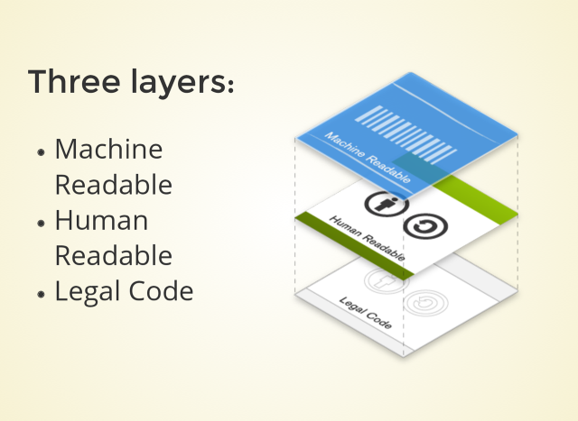

Slide 23
How to apply a Creative Commons license?

Slide 24
Applying a Creative Commons license
Copy paste applicable license text/image/code from www.creativecommons.org
Paste it in the object or in the metadata
A lot of platforms have a dedicated license chooser when uploading content, adding the license information to the metadata automatically

Slide 25
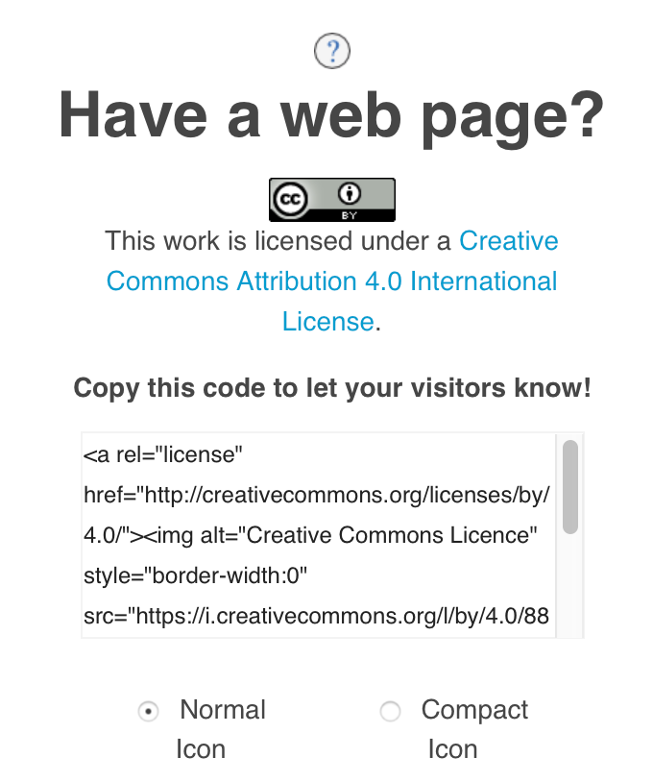
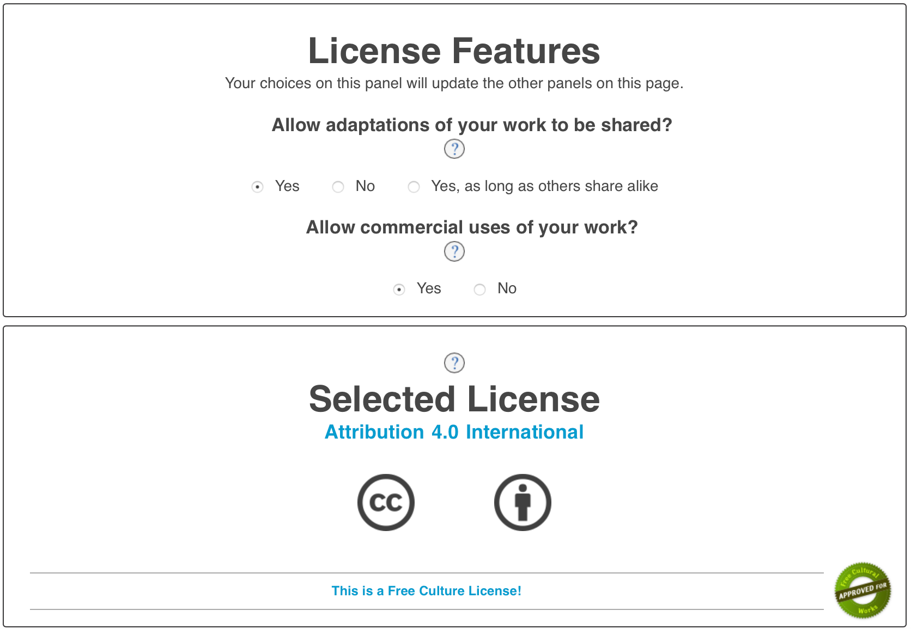
www.creativecommons.org

Slide 26
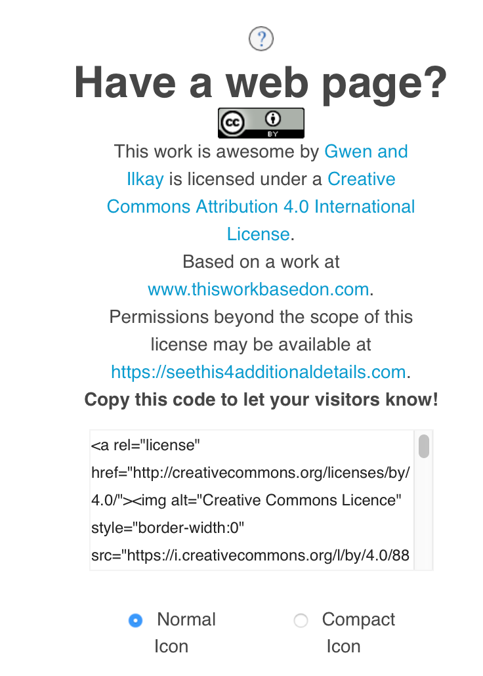
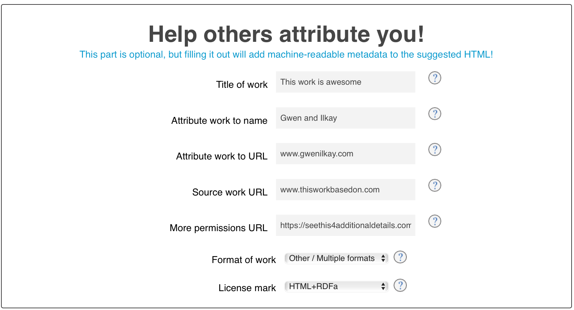
Attribution

Slide 27
Additional considerations
Combining licenses
  Not all licenses combine together (especially when ‘no derivatives’ or ‘non commercial’
Don’t commit ‘Copyfraud’
  Do not apply a CC license when you don’t have the author rights
  Do not apply CC licenses on an (unaltered) Public Domain work

Slide 28
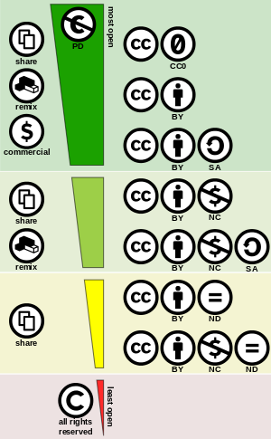

A license is irrevocable, so think before you apply:
  No Derivatives:
    does not allow translations
    even minor edits are not allowed (such as a colour filter, cropping,...)
  Non Commercial :
    no use on .com websites
    difficult to define!
  NC-ND: not a lot of difference with traditional copyright

Slide 29
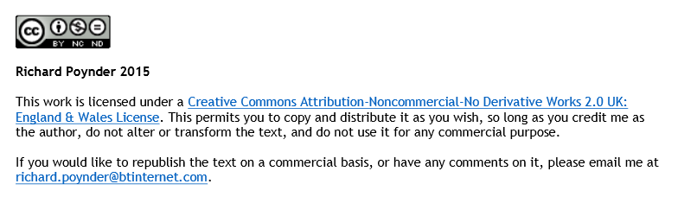
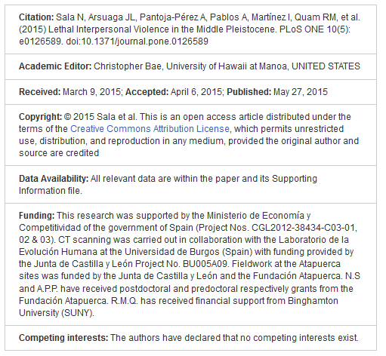
Citation
This presentation ‘Creative Commons’ by Gwen Franck and Ilkay Holt is licensed under a CC BY-SA license.

Slide 30
Where are Creative Commons licenses used?

Slide 31
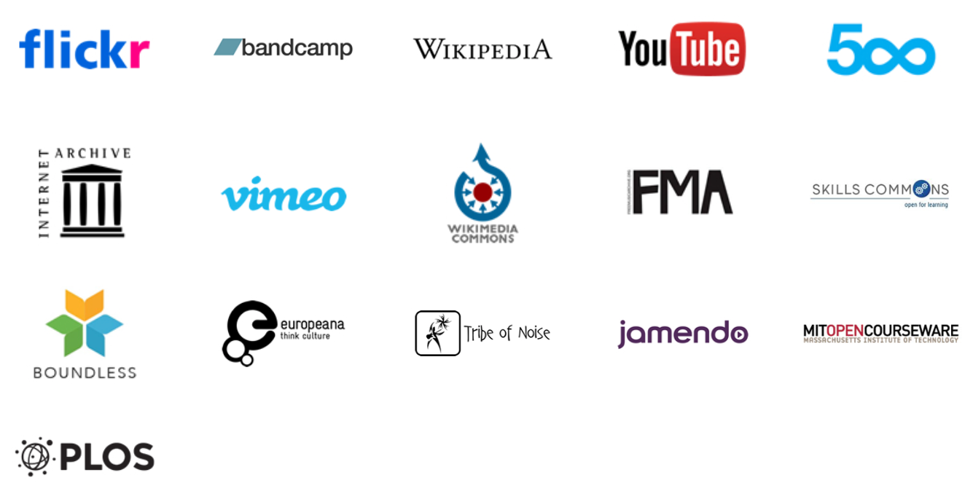
Library staff required to create a learning material?
Lecturers need content for a course package?
You want to prepare a presentation?
Notes:
Creative Commons platforms to share

Slide 32
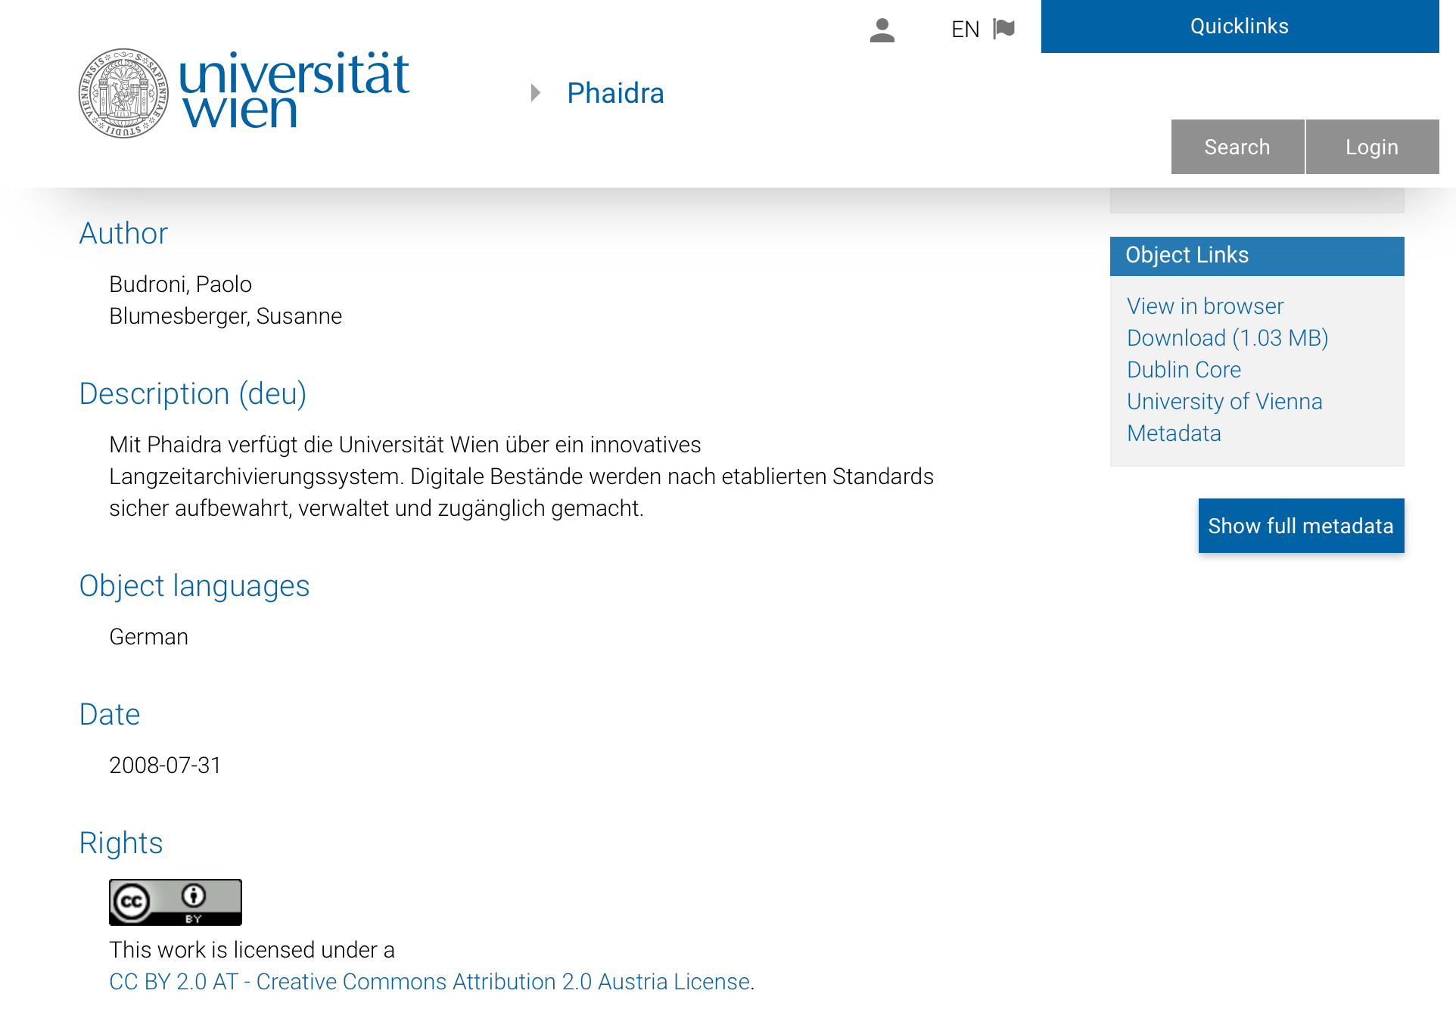
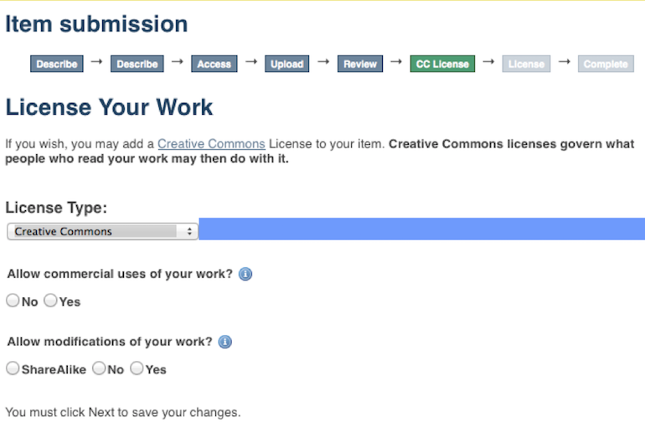
Where to use a CC license?
Repository management

Slide 33
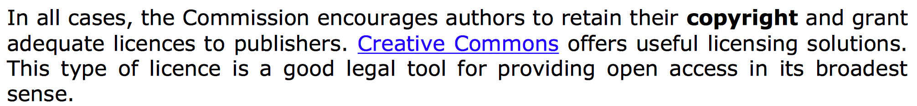
Where to use a CC license?
Research support
EU Commisson promotes use of CC licenses in publication and data sharing. Excerpts from H2020 Programme Guidelines to the Rules on Open Access to Scientific Publications and Open Access to Research Data in Horizon 2020
Notes:
http://ec.europa.eu/research/participants/data/ref/h2020/grants_manual/hi/oa_pilot/h2020-hi-oa-pilot-guide_en.pdf

Slide 34




Where to use a CC license?
Publishing

Slide 35
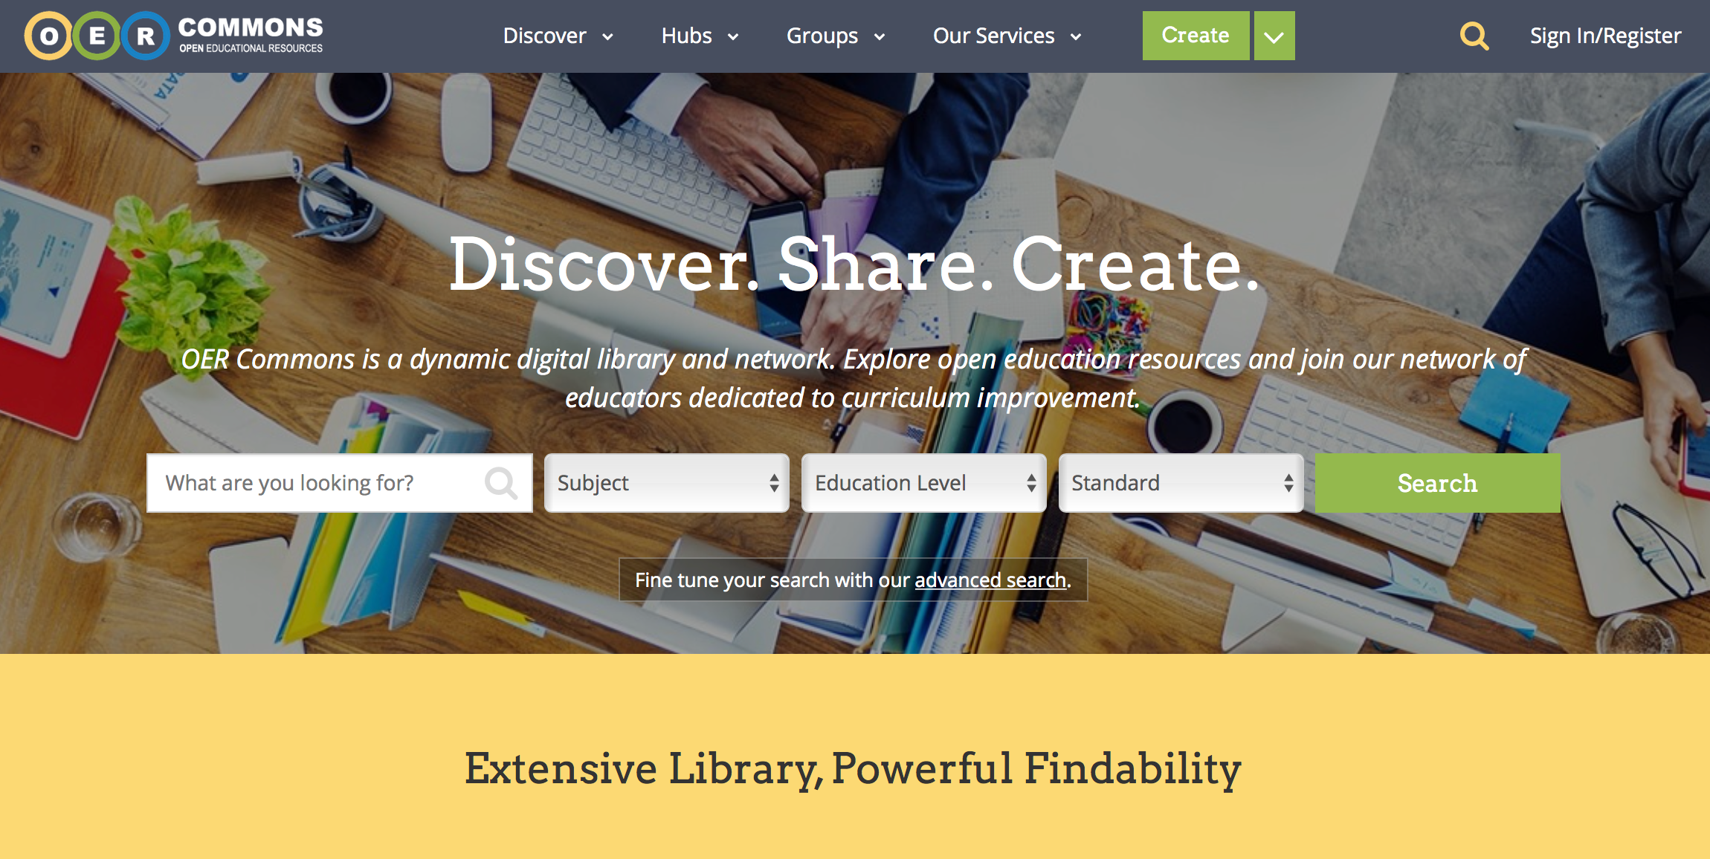
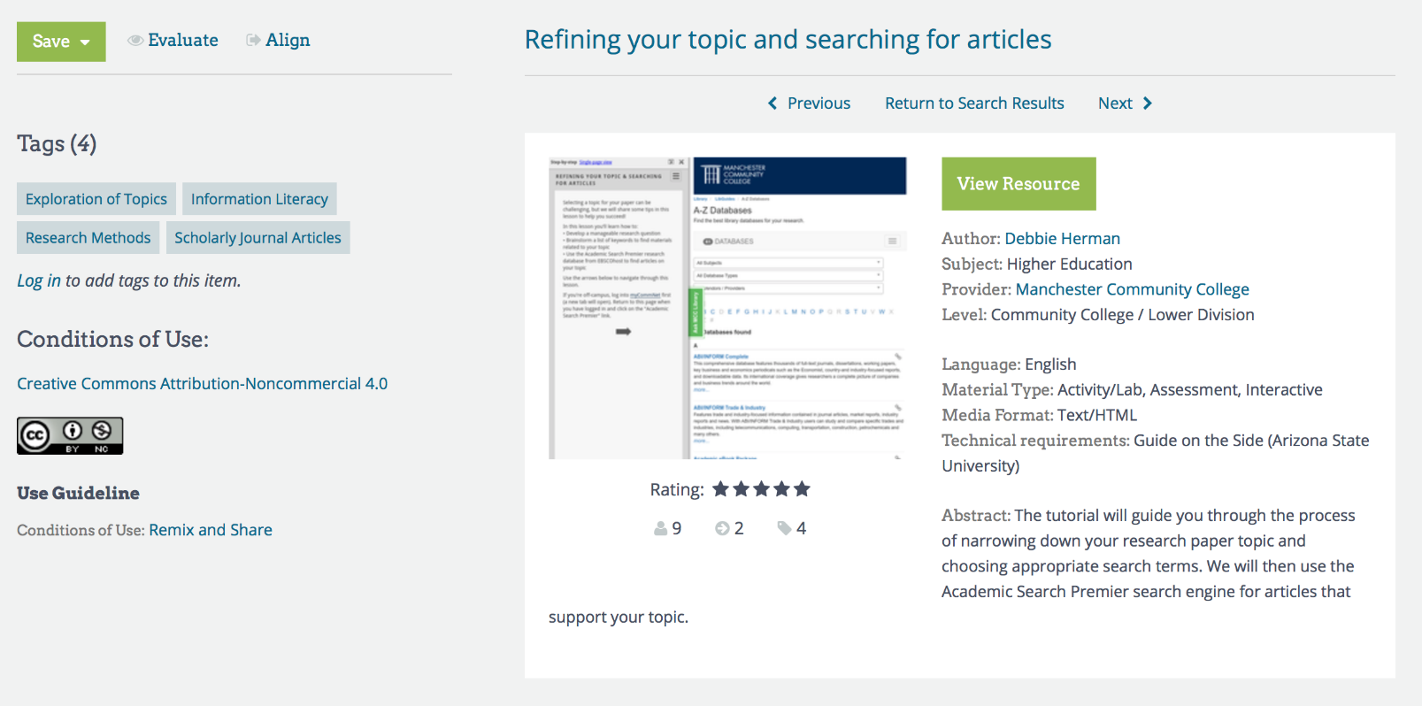
Where to find CC licensed resources? open education resources

Slide 36
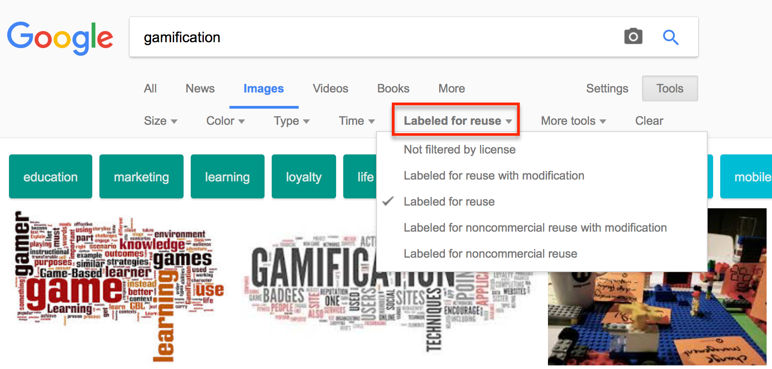
Where to find CC licensed resources? images

Slide 37
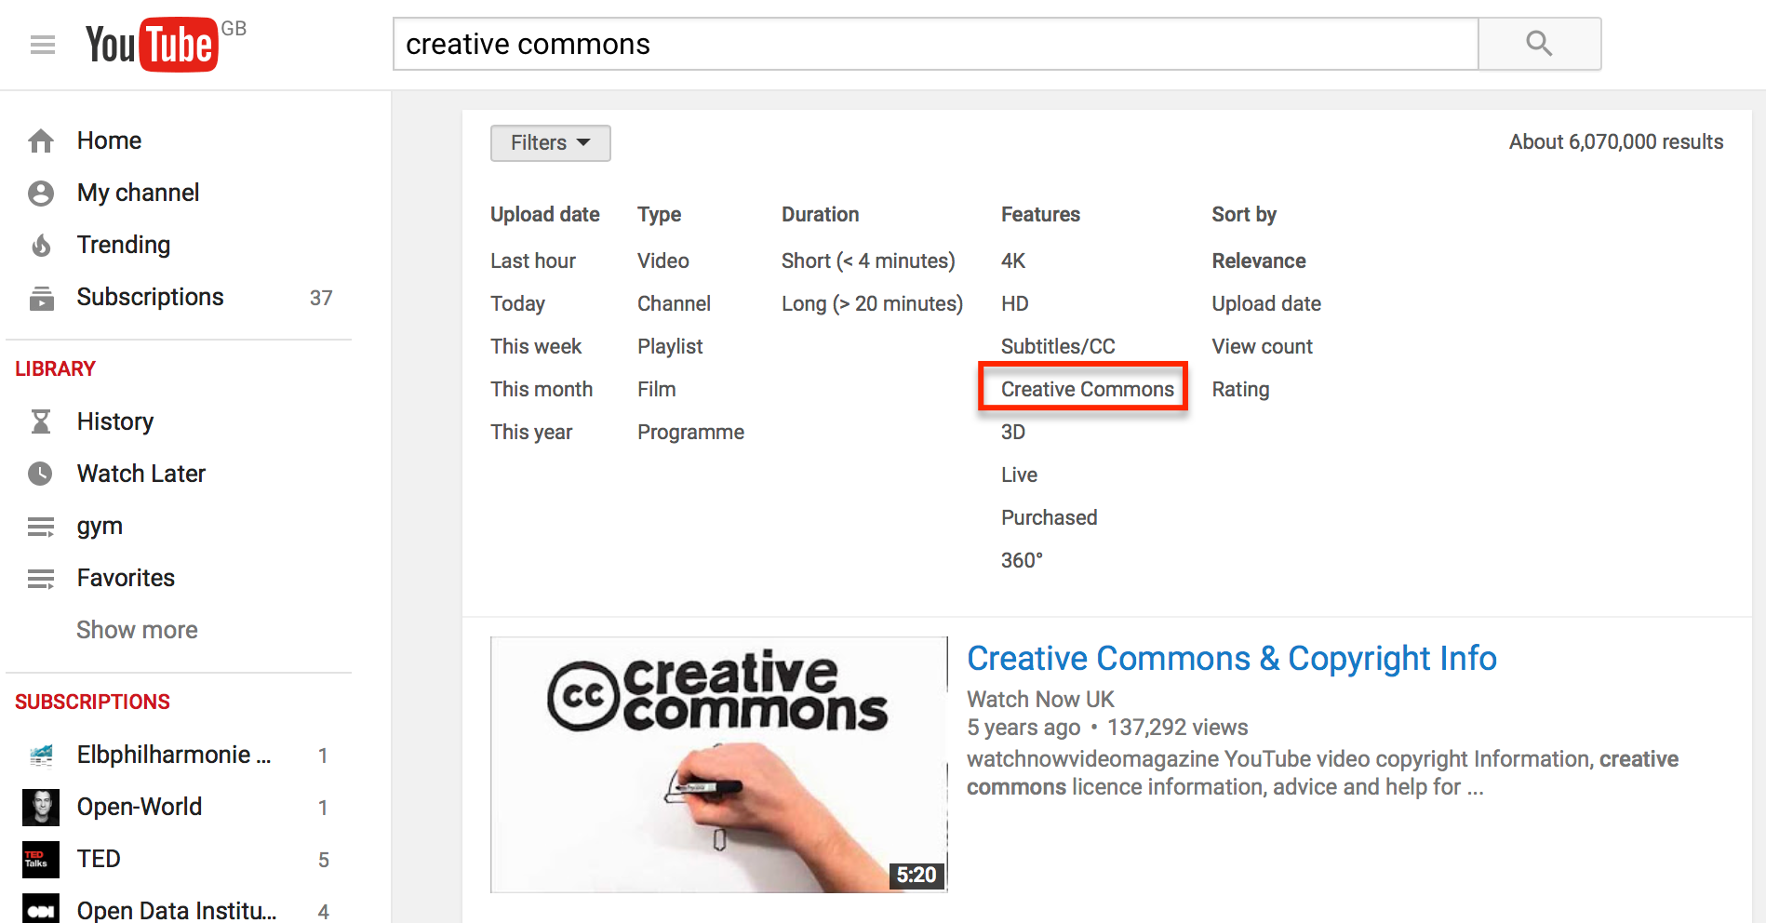
Where to find CC licensed resources? videos

Slide 38
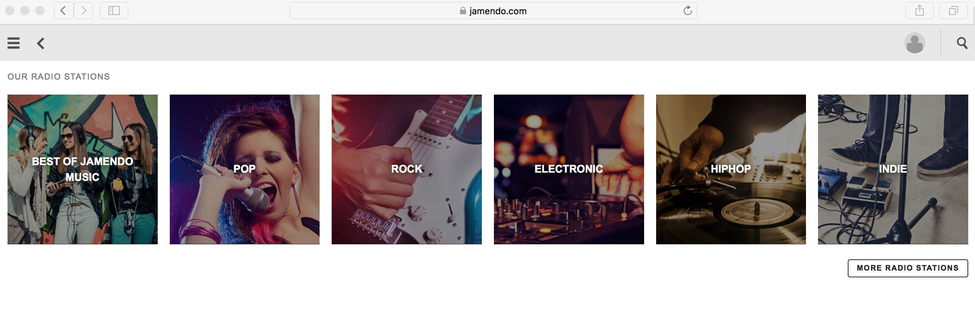
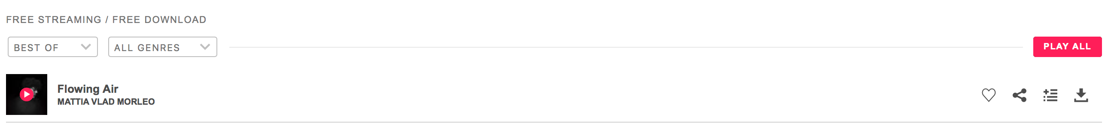
Where to find CC licensed resources? music

Slide 39
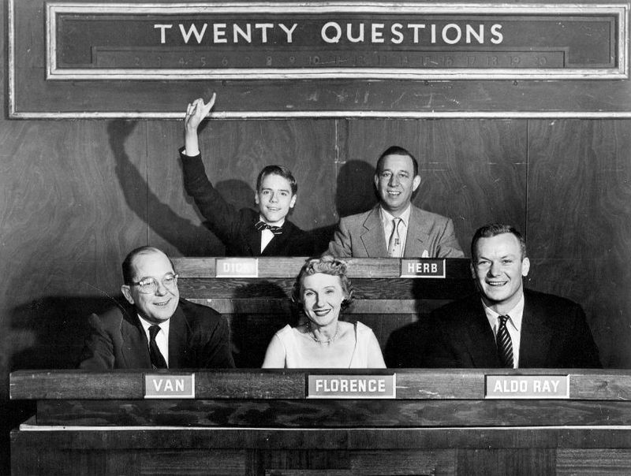

Slide 40
Contact:
Gwen Franck (gwen.franck@eifl.net) @g_fra
Ilkay Gurbuz Holt (ilkayholt@gmail.com ) @ilkayholt
Illustration credits
‘books’ by John Mark Kuznietsov on Unsplash
"Caution Tape" by Eugene Zemlyanskiy on Flickr (CC BY )

