Slide 1
Helping Libraries Make Global Research Discoverable– An EIFL & Digital Science project

Slide 2
Digital Science – a portfolio of innovative companies
Digital Science invests, supports and nurtures small innovative software companies
Rooted in research, most founders come from an academic background, started a company around solving a self encountered problem
Key principle: provide latitude, enable entrepreneurial spirit and activity, mix of ‘leaving alone’, ‘subtle guiding’, ‘having their backs’ and ‘open arguments’ like in every healthy family
Started in 2009, invested and started 12 companies to date about 300 colleagues
Notes:
A lot of text so that it works ‘read only in a hand out.
If you do not want to follow the text, tell your own DS story...

Slide 3
The Digital Science team’s vision
Democratise / commoditise data – a precondition for innovation
Broader view
Rich contextualisation for discovery and research management
Balance of interests – Digital Science in a unique position to do this

Slide 4
Six Digital Science companies decided to work together to do something about these challenges!

Slide 5
What was available within Digital Science?
Research information management system - deep knowledge
about institutional
requirements for
data and metrics
Institution disambiguation,
80k+ organisation IDs,
openly available
Tracking attention in news, social media and policy papers - as an immediate resonance
3.7 M projects in grant database, enrichment services and analytical application core
Global patent database - more than 100M patent records
Allowing researchers and institutions to store, manage and publish research related data
Serving publishers, access to +50M journal articles and books

Slide 6
130+ global partners worked on new Dimensions
Offered important insights
Actual needs in research discovery, administration, and management
Needs within different disciplines
Regional differences
Best practises

Slide 7
Data integrated in multiple dimensions - pun intended
Research
Data sets
Tweets Blogs
Clinical Trials
Policy docs
Grants
Conferences
Publications
Citations
Patents
Pre-publication
Post publication
1-5 years from grant to publication
immediate
2-3 years
years
years
decades

Slide 8
More than just research assessment
Data granularity and looking beyond the numbers can help discover real trends, partners and new KOL
A data provider should not be the one setting the quality standards
The API can automatize and simplify processes, leaving people with time to make real changes

Slide 9
What is key?

Slide 10
Building the publications backbone: Two steps
STEP
01
STEP
02
Getting a metadata backbone in place
Aggregating the large backbone – 91.5M publication records
Increasing discoverability
Enriching records by processing the full text; now done for 60M
* CrossRef, Pubmed, PubMed Central, jstage, arXiv, bioRxiv, Europe PubMed Central, OpenAire, and more

Slide 11
1. Data in Dimensions - publication metadata backbone
PUBLICATIONS
JOURNALS / BOOKS
PRE-PRINT / OA
Pipeline 2018/19
Journal articles, pre-prints and books/book chapters
91+ million records based on metadata
Metadata and citations derived from multiple available databases
OA tagging
Rule-based document type identification

Slide 12
2. Record enrichment from full text processing
PUBLICATIONS
Increased discoverability through
Full text index
Openly available discovery interface
Highly contextualised - freely available
Related grants, publication references, related trials, related patents
Improved representation compared to the ‘backbone’ records
Direct relationships with >100 publishers
Full text for 50M articles currently

Slide 13
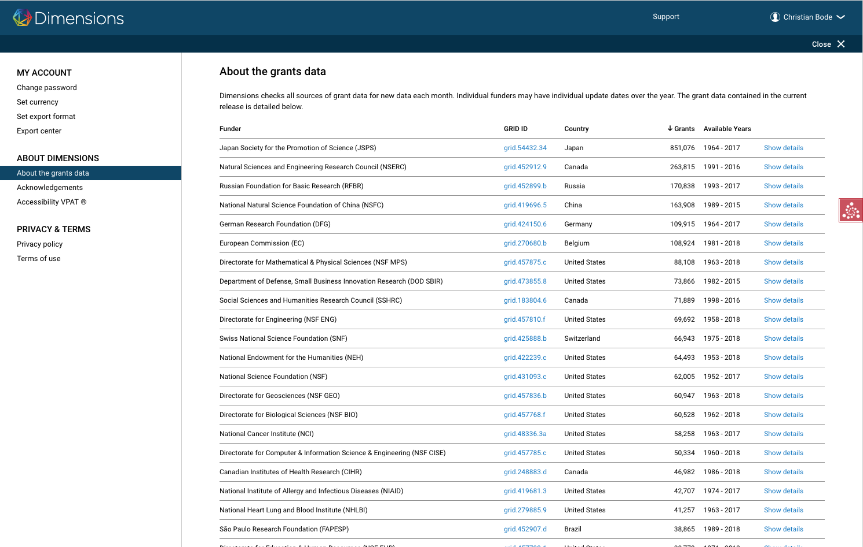
Data in Dimensions - Grants currently
GRANTS
Project funding
3.7M grants, from 250 funders globally
$1.3 trillion of funding
Sourcing
Direct relationships with funders
Data available via APIs
Data available via websites which we crawl

Slide 14
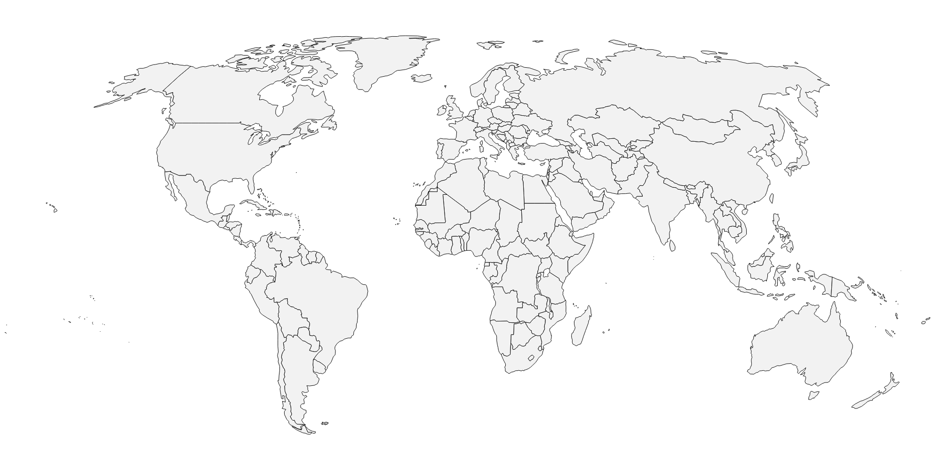
Data in Dimensions - Patents currently
PATENTS
US
EP
WIPO
DE
CA
IN
AU
GB
FR
Hong Kong
… and more is coming

Slide 15
Data in Dimensions - Clinical Trials currently
CLINICAL TRIALS
ClinicalTrials.gov
EU-CTR
UMIN-CTR
ISRCTN
ANZCTR
CHICTR
NTR - new
GCTR - new
… and more are coming

Slide 16
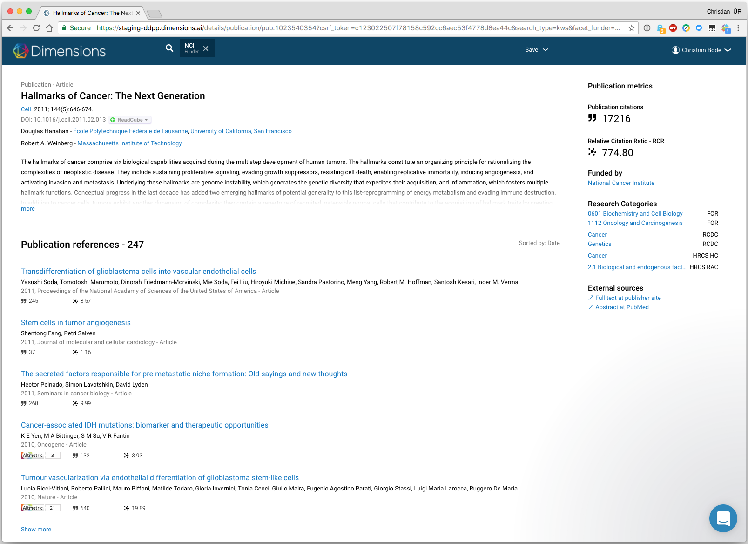
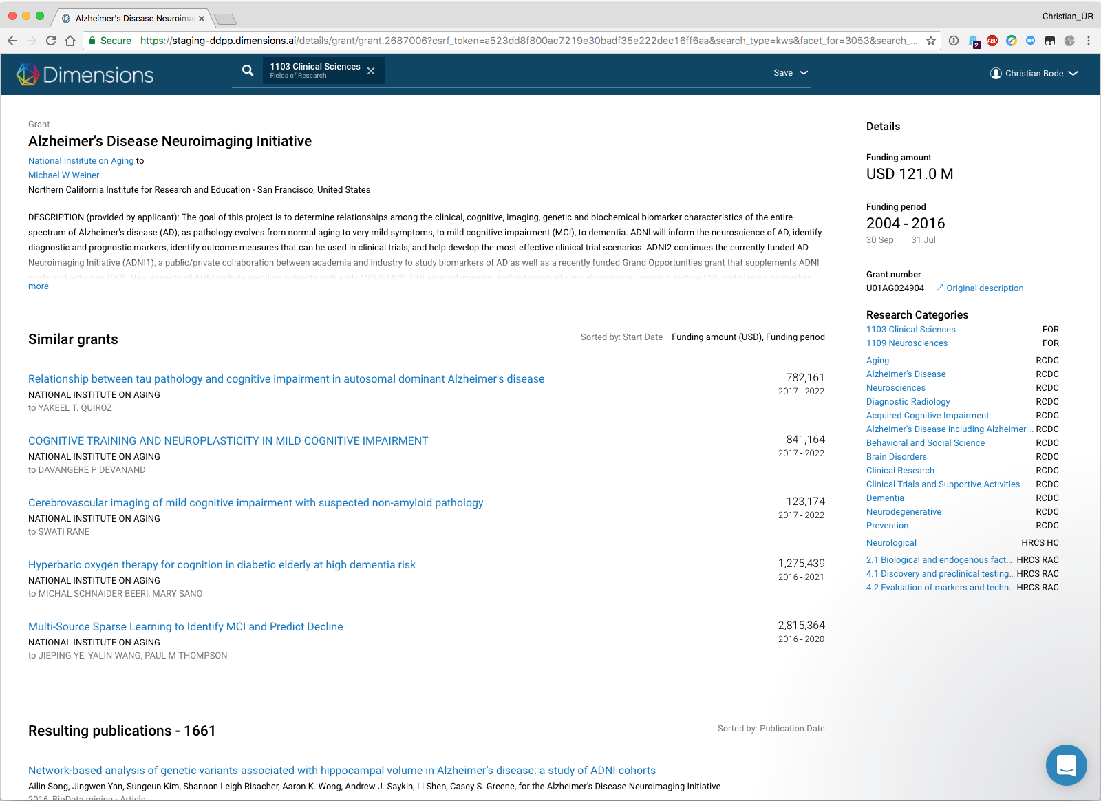
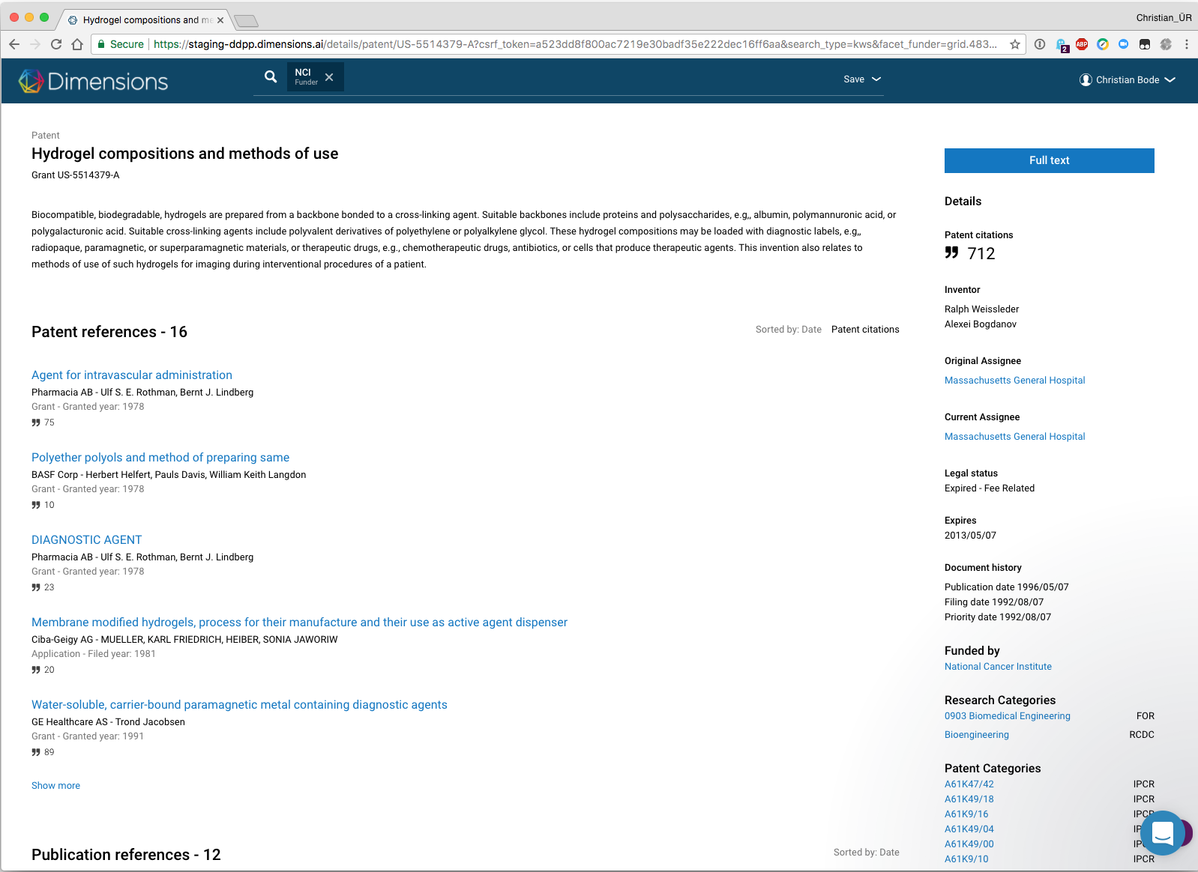
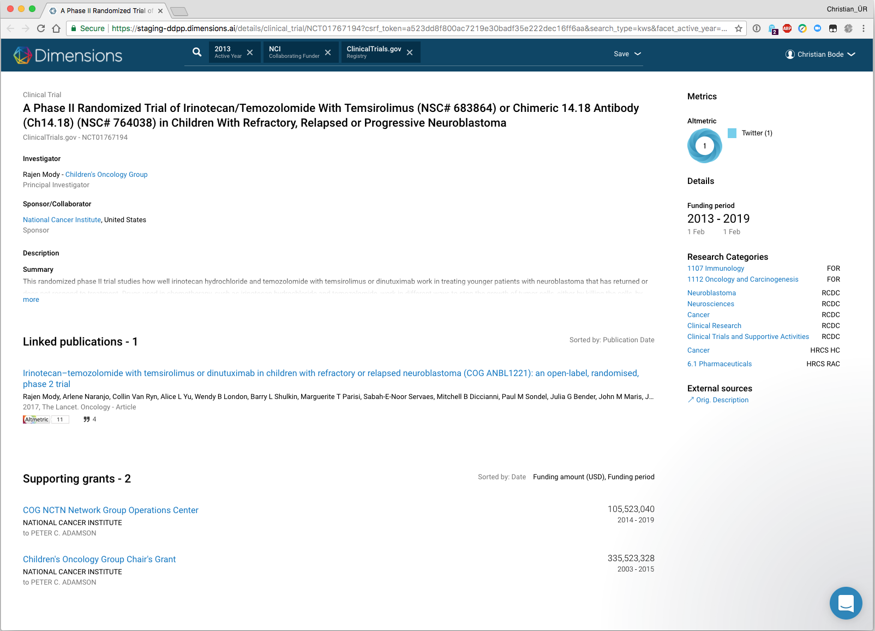
Links between the different content sources
Publication
Grant
Resulting publications
Resulting patents
Resulting clinical trials
Publication references
Publication citations
Supporting grants
Patent citations
Linked clinical trials
Patent
Clinical trial
Patent references
Publication references
Supporting grants
Patent citations
Linked publications
Supporting grants

Slide 17
The data and links driving Dimensions...
139K links
90m
Publications improved metadata
of 50m
380k
Clinical trials
350K links
51 M mentions
873M links
9M links
8m
articles with Altmetric Attention
Scores
34m
patents
11M links
8M links 32M to funders
43K to funders
320M links
170K links
3.7m
grants
$1.3 trillion in funding
320k
Policy papers
(Q2 2018)
Notes:
This slide shows the document types and the connections - the main message is to show the different elements and the links we create.
Explanation links:
The links within a document source are symbolised via the white hexagons and then number in it.
Publications and clinical trials: 139k links from Publications to Trials, and 350k point from a trial to publications.
Policy papers to come, hence the dotted lines.

Slide 18
More information about metrics

Slide 19
Overview: Metrics in Dimensions
Times cited
Number of times a publication was cited by other publications
Article-level
Aggregated
Altmetric
Online mentions in social media, blogs, news outlets, policy documents, wikipedia
Article-level
Aggregated
RCR
Relative citation Ratio - quantifies the influence of a research article by using its co-citation network to field-normalize the number of citations it has received
Article-level
Aggregated
FCR
Field Citation Ratio compares an article’s citations against articles of similar age and in a similar subject area
Article-level
Aggregated
Highly cited
Indicator of strong citation - normalized for subject area, age and publication year
Article-level
Aggregated
Citation recency
Shows the number of citations received by an article in the last two years
Article-level
Aggregated

Slide 20
Overview: Metrics in Dimensions
ACR
Annual citation rate - The average number of citations received in a year, to articles
previously published
Journal-level
SNIP/SJR
Field-normalized journal metrics, calculated by CWTS and Scimago
Research Group
Journal-level
H-index
Author-level metric to measure both productivity and citation impact of the publications of a researcher
Author-level

Slide 21
More information about the web app

Slide 22
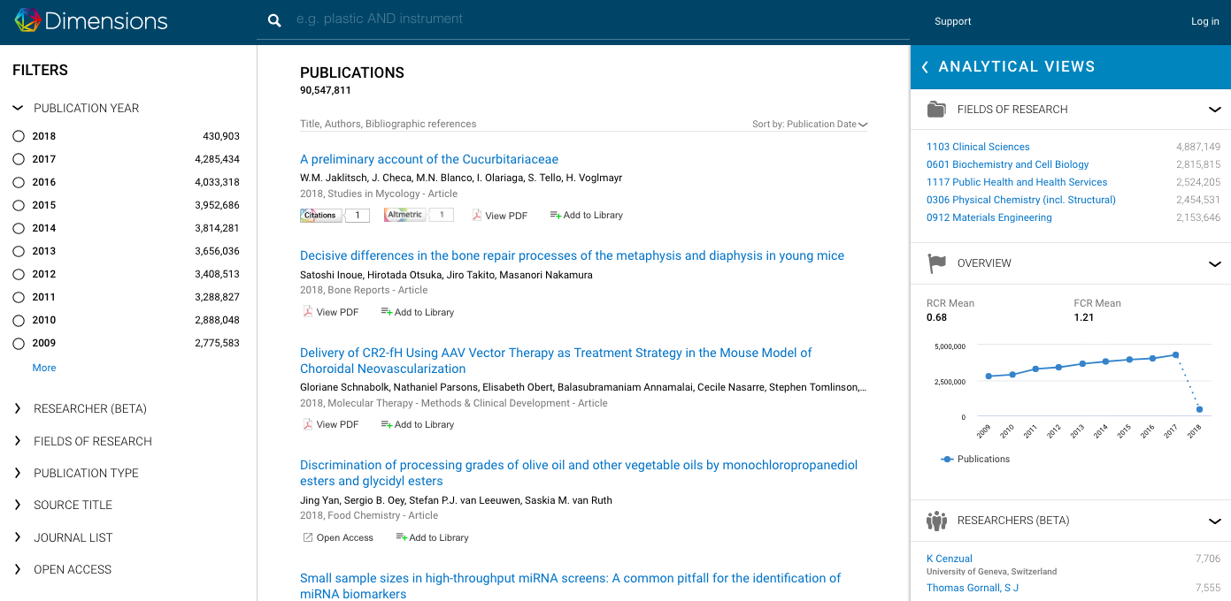
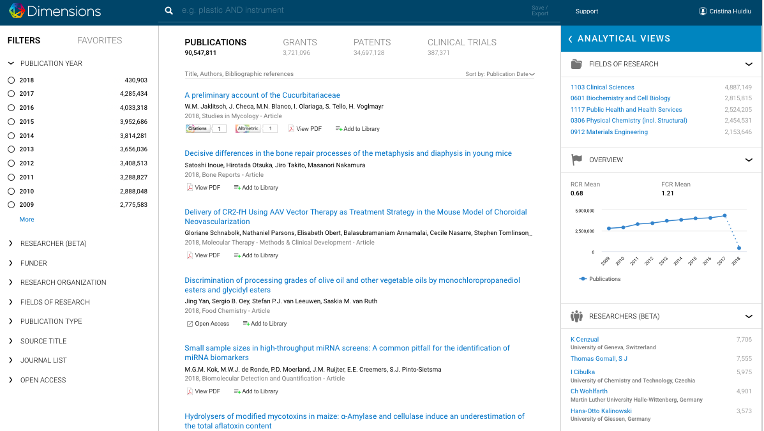
Dimensions free vs Dimensions Plus
Dimensions Free
Dimensions Plus
Publication data
Grants data
Patent data
Clinical trials
Data sets and policy documents –to be added
Interlinked citation data
Altmetric badges (unlocked)
More filters
Publication data
Citation data for publications
Altmetric badges (locked – 4 mentions per type

Slide 23
Search options
Available for the free versions and Dimensions plus

Slide 24
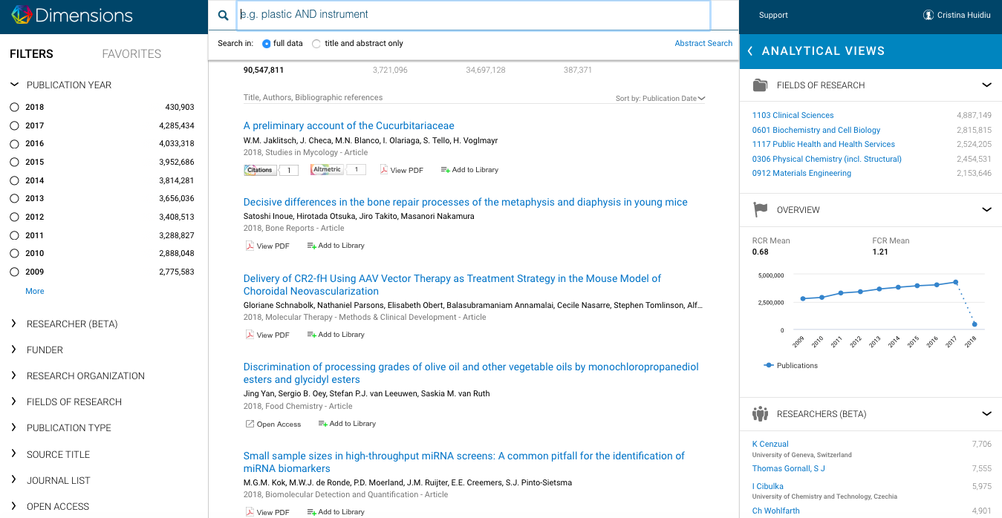
Search by full-text
The powerful AI understands the different concepts within each article and serves you the best results related to your query by mapping the entire body of each publication.
Further filters can be applied either from the left hand side or the top of the search results

Slide 25
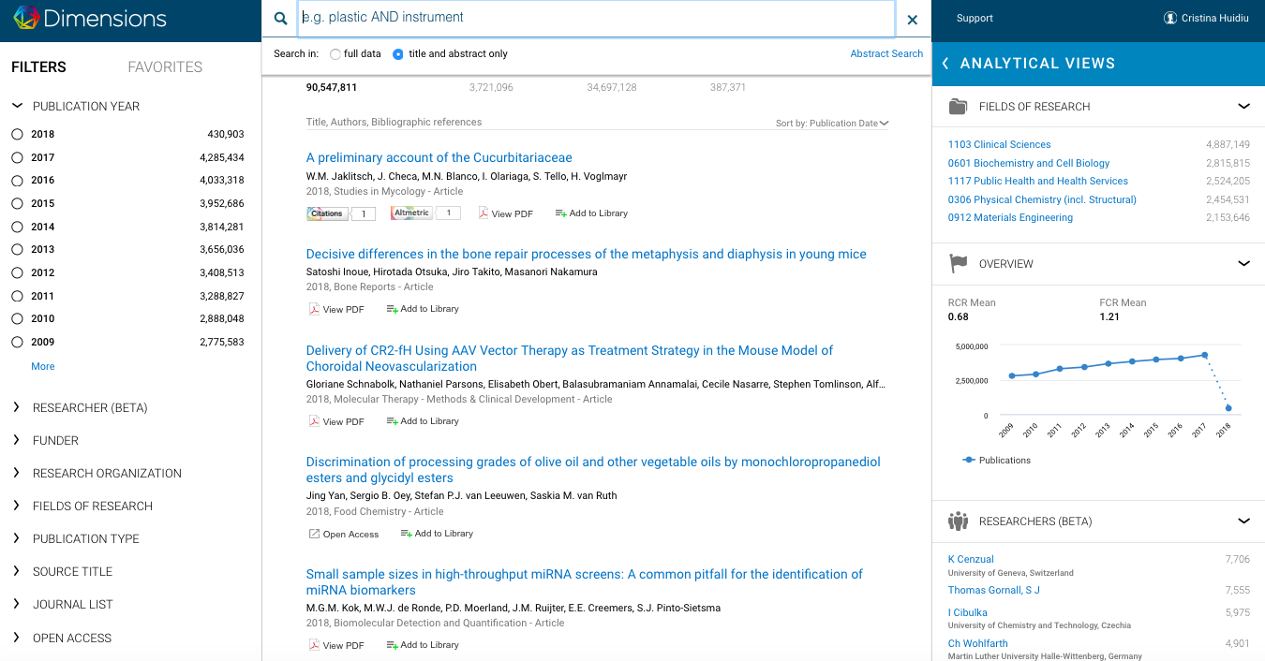
Search by title and abstract
Traditional search option
Further filters can be applied either from the left hand side or the top of the search results

Slide 26
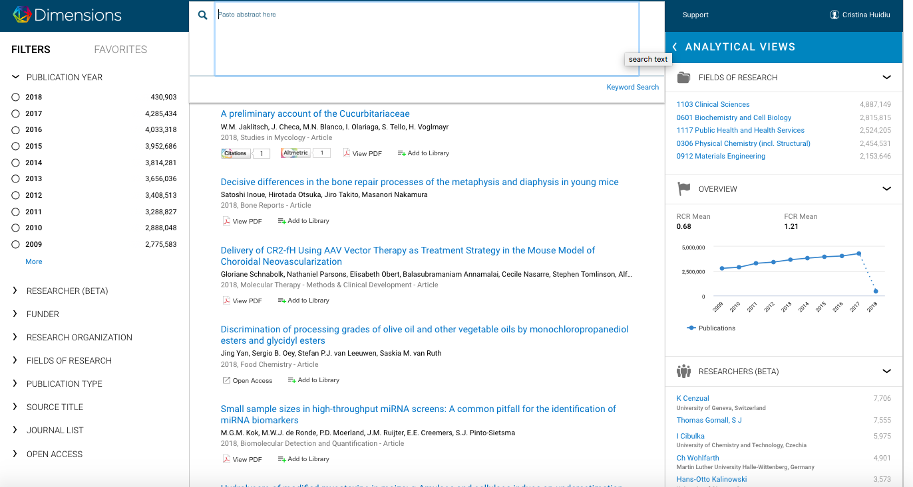
Search by abstract
Paste any abstract in the search tab and the system will find similar articles
Further filters can be applied either from the left hand side or the top of the search results

