Slide 1





Introduction to digital literacy
Dr Jane Secker
Copyright and Digital Literacy Advisor, LSE
Chair: CILIP Information Literacy Group

Slide 2
Overview of session
What is digital literacy and how does it relate to other literacies?
Explore models and frameworks of Digital Literacy
Is digital different?
Strategies for embedding digital literacy in your institution
Digital Literacy in practice: case studies
Notes:
What is digital literacy and how does it relate to other literacies
Models and frameworks of Digital Literacy
Is digital different?
Strategies for embedding digital literacy in your institution
Audits and reviews
Working with students as partners
Digital Literacies in practice: case studies
The Open University (being digital),
LSE (SADL)
UEA Digital Scholar programme

Slide 3
Defining digital literacy
“the ‘savvyness’ that allows young people to participate meaningfully and safely as digital technology becomes ever more pervasive in society.” (Future Learn)
“Digital and information literacies are the skills, knowledge and understanding that underpin our ability to learn, undertake research and to teach in a digital age. It is vital that LSE students and staff develop critical, creative, discerning and safe practises when engaging with information in the academic environment.” (LSE definition)
Notes:
In essence – there are many ways of defining it – no agreed definition
A term currently in vogue but alternatives are:
Digital skills – used in the UK by a House of Lords report from 2015
Digital competencies – used by Jisc in recent work they are doing to inform UK higher education
No one definition and bear in mind it is format specific – it’s about ‘digital’ stuff – but the underpinning skills are very like other literacies
Term UNESCO favour is “Information and media literacy” not digital literacy
And ask yourself do we need new literacies to operate in a digital world? What’s wrong with our ‘old literacies?’
Also be clear what digital literacy is not – for example it’s much broader than computer literacy and IT skills.

Slide 4
Defining digital literacy
“By digital literacy we mean those capabilities which fit an individual for living, learning and working in a digital society; for example, the skills to use digital tools to undertake academic research, writing and critical thinking: as per personal development planning: and as a way of showcasing achievements.” (JISC Definition)
Notes:
In essence – there are many ways of defining it – no agreed definition
A term currently in vogue but alternatives are:
Digital skills – used in the UK by a House of Lords report from 2015
Digital competencies – used by Jisc in recent work they are doing to inform UK higher education
No one definition and bear in mind it is format specific – it’s about ‘digital’ stuff – but the underpinning skills are very like other literacies
Term UNESCO favour is “Information and media literacy” not digital literacy
And ask yourself do we need new literacies to operate in a digital world? What’s wrong with our ‘old literacies?’
Also be clear what digital literacy is not – for example it’s much broader than computer literacy and IT skills.

Slide 5

Digital literacy in the UK
In the UK, there is a strong government focus
  Task Force on Digital Skills Digital Skills for Tomorrow’s World (July 2014)
  House of Lords Report on Digital Skills (June 2015)
  Focus on digital literacy in schools = coding
  Identified by Quality Assurance Agency (QAA) as a focus for the 2015-16 reviews of universities

Slide 6
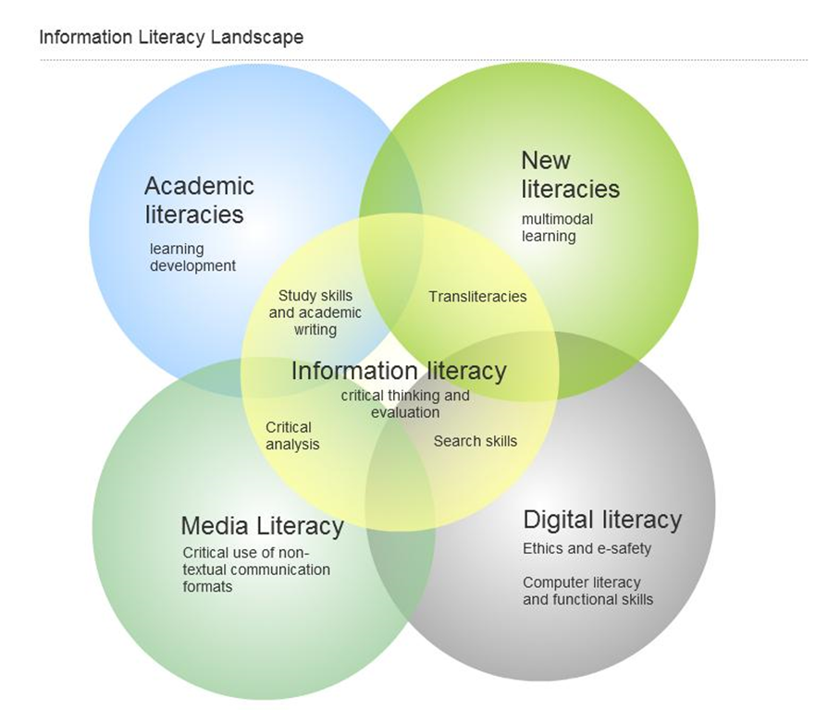
Is digital different?

Slide 7

Technology: a red herring?
http://www.public-domain-image.com
Notes:
We looked hard at whether we needed to include ‘digitalness’ or technology as a discrete strand in our curriculum, but ultimately we figured we were looking at it the wrong way up and that ‘digitalness’ is a bit of a red herring.
Our view is that information literacy refers to all forms of information, including analogue, digital, visual and and anything else as a part of a broad landscape of information. What matters is not the platform or the format, but the context, and the uses to which students are expected to put various types of information at each stage of the scholarly career. Our research doesn't split off digital or other literacies into a separate conceptual container - the focus is rather on developing students' abilities, attitudes and values across all aspects of information use and handling so that they are equipped to deal with information judiciously, no matter what format they encounter it in – and no matter when.

Slide 8
Technology matters
Digital literacy leads to taking a stance on whether technology is neutral or socially constructed
Technology is an area that causes anxiety amongst some discipline teachers
If taught outside the curriculum, digital literacy is disconnected /disassociated with the context or discipline and students don’t transfer what they learn

Slide 9
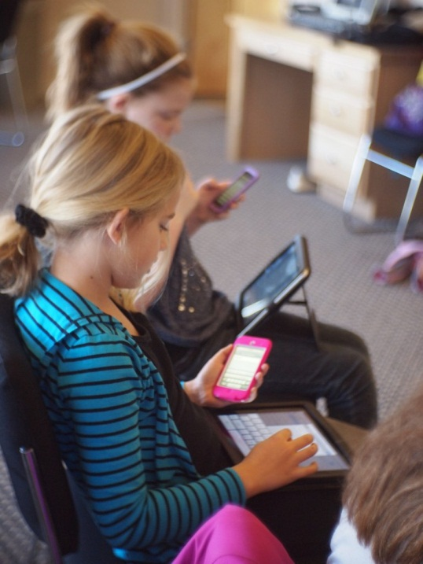

The myth of the digital native
Photo by Flickingerbrad licensed under Creative Commons
Photo by starmanseries licensed under Creative Commons
Notes:
Surely all students are digital natives – they know how to use information? They can find information at the touch of a button?
In fact there is much evidence from reports such as the 2007 CIBER report, that indicates students lack critical evaluation skills and struggle making the transition to working at higher education level. The shift from a dependent way of learning to independence. The current government preoccupation with revamping A levels is partly a recognition that students are not prepared for higher education, for writing longer pieces of work and for thinking critically. (they are good at passing exams!)
The 2011 Demos report , Truth, Lies and the internet argues that helping young people navigate hugely variable Internet sources should be achieved not by tighter controls but by ensuring they can make informed judgements (4). We should think and talk less about the internet causing harm (passive learning model) and instead focus on what helping equip young people and empower themselves with an understanding of how to apply critical judgement.
Guardian’s high-provile digital literacy campaign for radical change to how ICT is taught and thought about in schools.
JISC’s portfolio of projects around the digital library, data management, digital repositories, and Vitae’s events for the ‘Digital Researcher’ – all show that this concept of digital literacy or fluency is becoming of national importance (at last!).
National IL initiatives – Welsh and Scottish projects; UNESCO’s Media and Information Literacy curriculum for schools.
All these campaigns and initiatives show the extent to which information literacy is tied in with lifelong learning, citizenship, employability, social mobility, and the knowledge economy. IL is part of a general movement towards creating not just judicious scholars but informed citizens. It’s individuals using, taking action with information. It is not just to do with access to information – it goes beyond that and into what people do with it, or to it, or through it.
In this environment we have a chance to rehabilitate traditional notions of IL as ‘something the library does’ and look at it as a crucial part of individual lifelong learning instead.

Slide 10
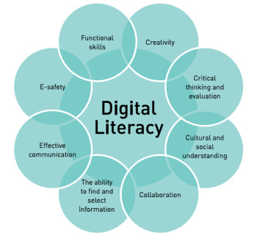
FutureLab Model of Digital Literacy
Notes:
This was a model developed for schools – the focus on embedding in the curriculum. Many of the skills are not ‘digital’ or tech skills. Many overlaps with other literacies.

Slide 11
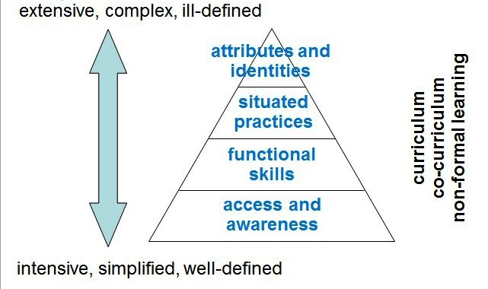
Beetham and Sharpe’s model of digital literacy
Notes:
Meanwhile Beetham and Sharp’s model of digital literacy places access and awareness at the base, with the functional skills above – this model believes that digital literacies happen in a context and are related to practice, attributes and identities.
So how to be ‘digitally literacy’ for a history or arts student is not the same as for an engineer or a medic
The functional skills are also much better defined than the attributes and identities.

Slide 12
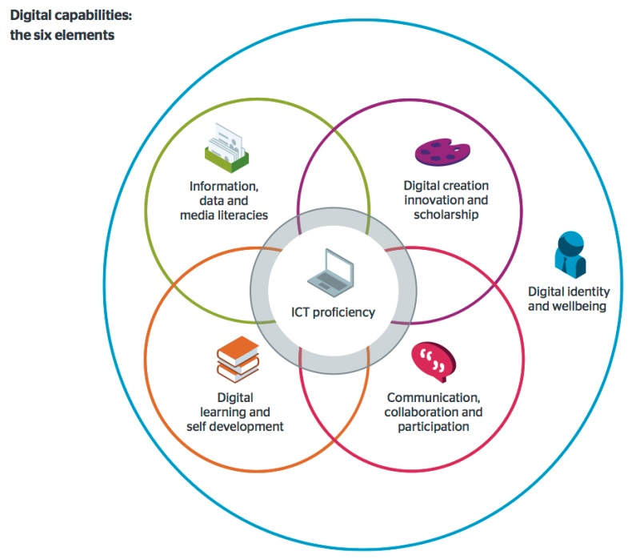
Jisc Digital Capability Model (2015)
Notes:
This model of what is now being called ‘Digital Capabilities sees layer or overlapping literacies with the functional skills in the middle,
Another important part of this model is digital identity and wellbeing

Slide 13
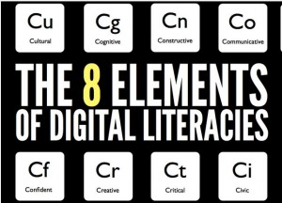
Doug Belshaw’s Model of Digital Literacy
Notes:
Finally Doug Belshaw has provided a model of digital literacy which divided it into 8 attributes. Again, technology and tools do not feature – but it is a model that emphasises the cultural practices, critical and creativity. Confidence (which is very important in digital literacy)

Slide 14
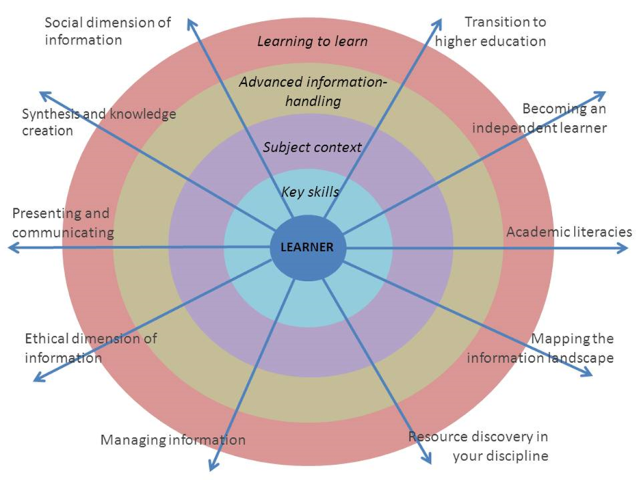
A New Curriculum for Information Literacy
Notes:
This is my own model – interestingly this is not called a digital literacy model
However, this is a curriculum with 10 strands and digital literacy forms a large part of it.
The full curriculum document is 12 pages – it is designed to be learner centred. It has learning outcomes and examples of activities and assssment to develop these abilities in your students, although it is not designed to be prescriptive, so you would adapt the activities depending on the students you are teaching, their level and their discipline. It is also designed to be embedded into the curriculum not something that stands alongside it.
So the most valuable way people have used our curriculum is as a way of reviewing their current teaching and looking at how they can develop these abilities in their students

Slide 15

Your guiding principles
Image: ‘Path path path’ by Hockadilly, CC BY-NC 2.0
Notes:
The wider learning link
Many pathways to information literacy – as many as there are learners engaging with, sensemaking and constructing their own understanding of the information landscape.
“I doubt very much if it is possible to teach anyone to understand anything, that is to say, to see how various parts of it relate to all the other parts, to have a model of the structure in one’s mind. We can give other people names, and lists, but we cannot give them our mental structures; they must build their own.” (Holt, 1982, 145).

Slide 16

Digital literacy: in summary
Many overlaps with information and academic literacies
The focus should be on cognitive abilities & practices
Digital literacy is not a generic skill it is contextual
Digital literacy is not (simply) functional skills or coding.
It covers:
  Critical use of technology – maybe no technology
  Discernment and skepticism about online information
  Consider ethics and respect for the work of others
  Focus on using tools to communicate, creativity & collaboration
  Online identity, safety and wellbeing

Slide 17

Audits and reviews
Before you plan any digital literacy initiatives first establish:
  What are your aims and overall vision?
  What are your drivers and motivations?
  How do you define digital literacy
  Which model of framework will you use?
  Who are the stakeholders?
  What are they currently doing? How will you measure success and impact?

Slide 18
How to audit?
Select or develop a framework
Identify your stakeholders
Decide on a methodology: Survey? Interviews? Workshop?
Map your current activity to a framework
Look for examples of good practice, gaps & overlaps
Identify opportunities to collaborate and enhance provision
Find out more from Using ANCIL in your institution:
https://newcurriculum.wordpress.com/using-ancil/

Slide 19
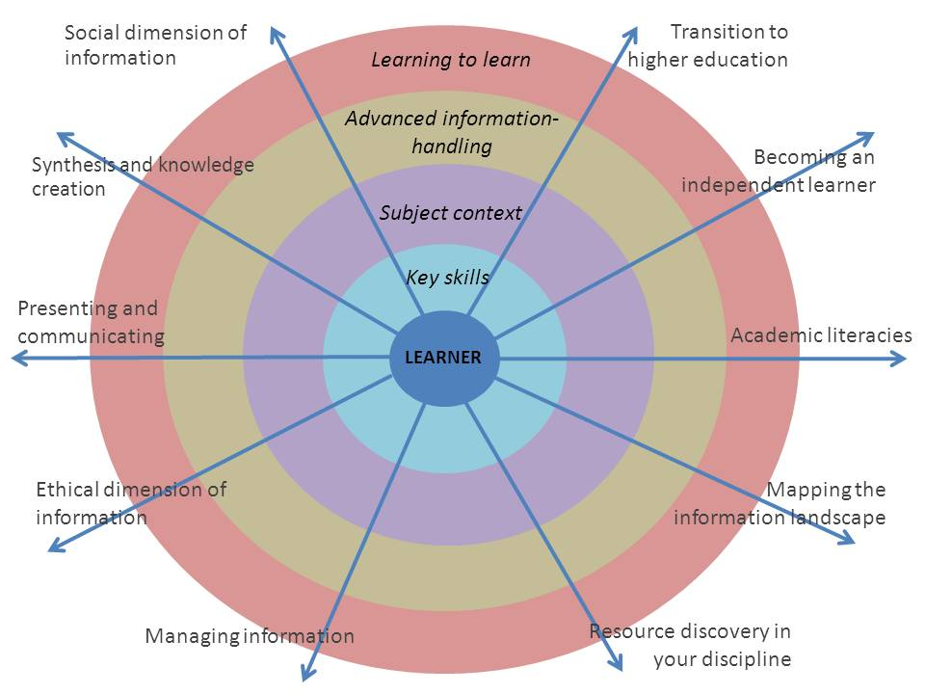
Teaching & Learning Centre
Language Centre
LSE100
Departments
Library
Careers
Language Centre
Teaching & Learning Centre
Departments
Language Centre
Library
Departments
LSE100
Language Centre
Teaching & Learning Centre
Careers
Departments
LSE100
Teaching & Learning Centre
Departments
Language Centre
Library
Centre for Learning
Technology
Library
Library
Library
Notes:
Maria
Where next – we have this map – shows overlaps and areas of expertise. But also areas where people are doing less.
Also support services and departments not always working together and support services not joining up.
Remedial view of skills support persists amongst some academics – sink or swim
What do you we do next though?

Slide 20

Alternative approaches
Top down: Developing a strategy
Top down: Engaging senior managers
Top down: Getting institutional buy-in from all departments
Bottom up: working with students / students’ union
Bottom up: working with one or two departments
Bottom up: champions / change agents network

Slide 21
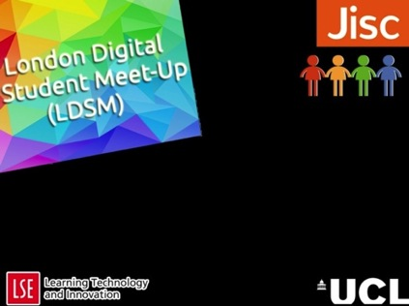
Student partnerships
Key focus of Jisc Change Agents Network
Building student engagement
Working with students as partners
Understanding actual needs
Empowering students
Students sharing experiences with peers and beyond their institution
But consider how much support, guidance and structure they need
Notes:
Students can be empowered e.g. presenting at conferences with staff, developing new skills

Slide 22

Digital Literacies in practice: LSE Student Ambassadors for Digital Literacy
http://blogs.lse.ac.uk/lsesadl

Slide 23
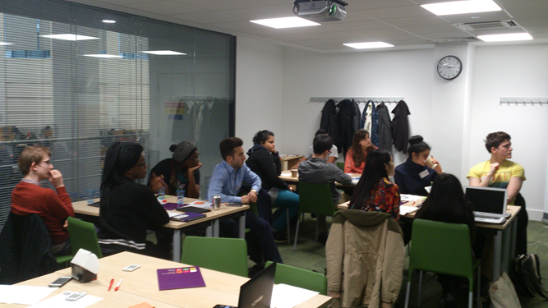
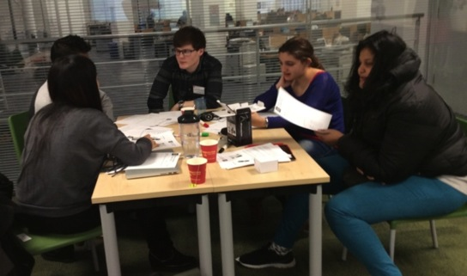
SADL aims:
To understand students’ existing digital and information literacy (DIL) skills.
To explore how best to support students to improve their DIL skills and provide peer support.
Collaborative: Library, Learning Technology, Teaching and Learning, Student Union
Notes:
Originally funded by the HEA as part of their Changing Learning Landscapes programme from Oct 2013 to July 2014.
2012 audit found UG student support for Information/digital literacy was patchy
Staff assumed aspects of IL were covered by others or students would already know it – this is very dangerous given the diverse student population at LSE. Some students may be tech savvy – some are not – students may use Facebook, students are not experts in their discipline and scholarly practices
Approach to transition was often sink or swim and help offered as remedial or targeted at specific groups such as students who’s first language is not English (this is probably half of them!)
High achieving students also struggle
Bit fish in a small pond – the brightest kid in school until they get to LSE! Where the pond is full of big fish!

Slide 24
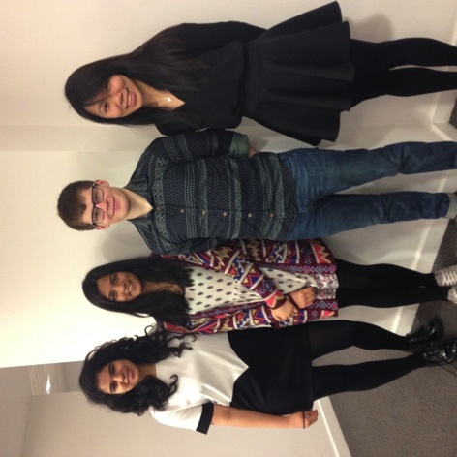
The SADL approach
Open to 50 LSE undergraduates to act as ‘ambassadors’
Interactive, collaborative, discursive workshops
Develop their digital literacy in four key areas
  Finding and evaluating information
  Reading and academic practices
  Managing and sharing information
  Managing your online identity
Expected to provide peer support
The role of Senior Ambassadors

Slide 25
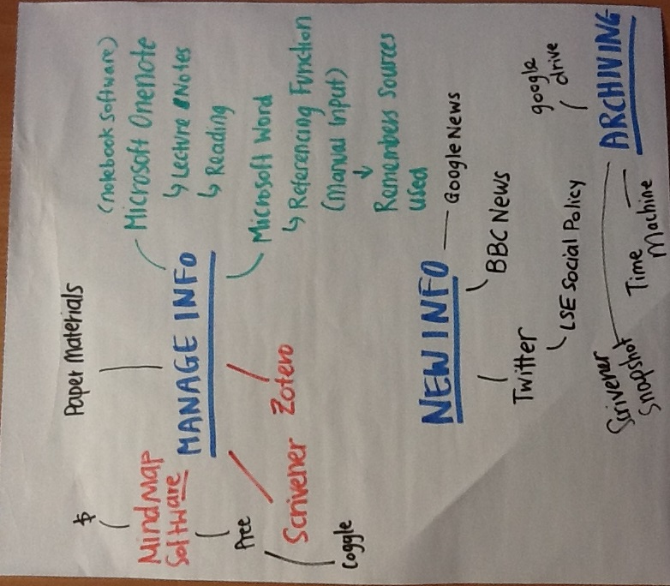
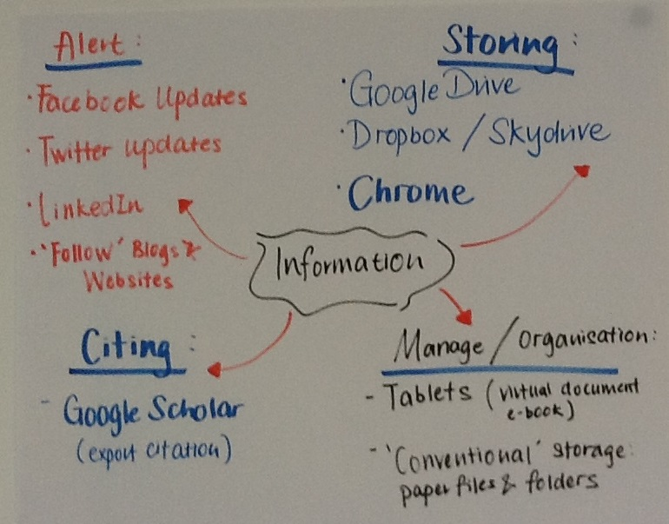
How do you keep up to date, manage your information?
Workshop 3: Managing and sharing information

Slide 26
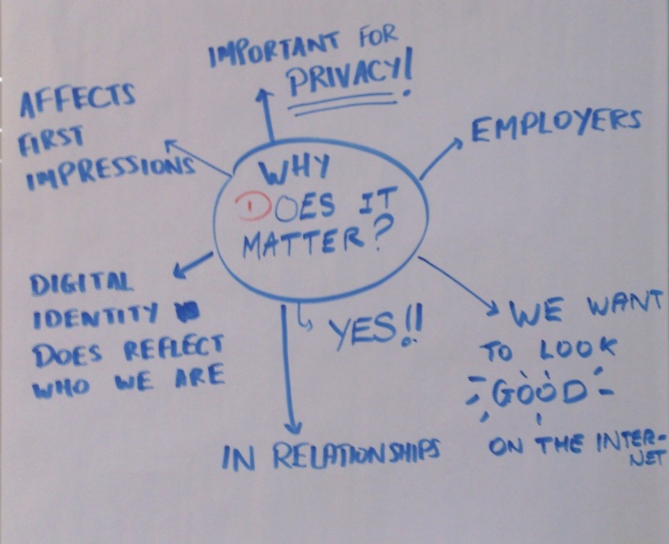
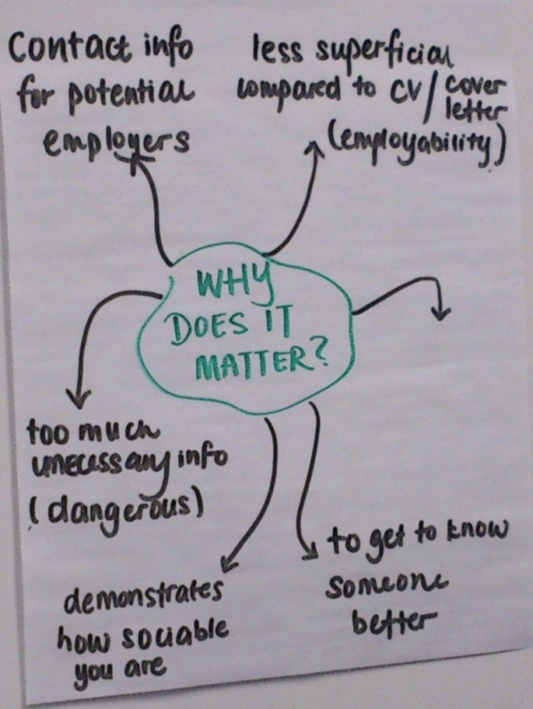
Digital Footprint: why does it matter?
Workshop 4: Managing your digital identity

Slide 27
Evaluation and impact
Students say the digital literacy curriculum supports their studies, is useful personally and for their future careers
The experience is valued for non-tech skills (communication, group working)
The benefit to staff has been significant: better understand UG needs, new approaches to teaching
Academic staff need to be more engaged in SADL
I am glad I joined SADL because I wouldn’t have known anything about copyright or any qualitative skills …. [SADL] really helped me a lot with research and managing information. It helped me through my second year. In my third year I am doing a half quantitative half qualitative module, so I feel more confident, being able to extract the skills from SADL to work on that. And I could actually teach others when they needed help as well.

Slide 28
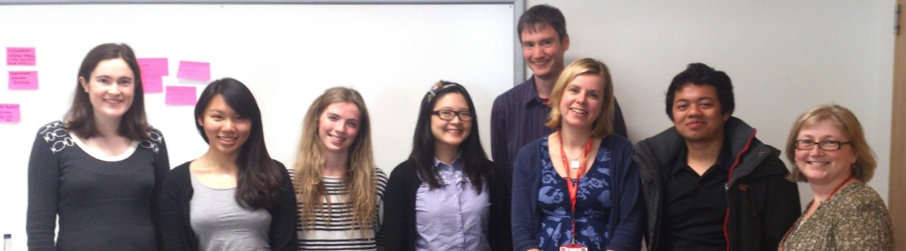
Sustaining SADL….
Our biggest challenges:
  Scaling up: Reaching all undergraduate students at LSE
  Developing the peer learning aspects of SADL
  Keeping it student-led and student focused

Slide 29
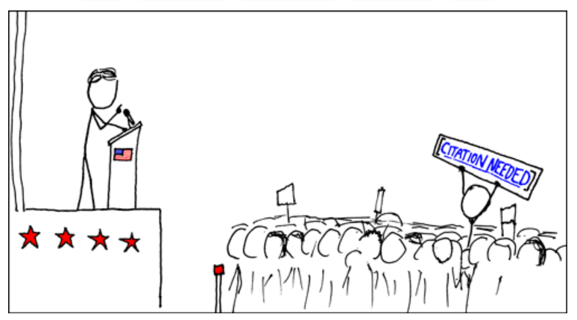
Case Study 2: University of East Anglia Digital Scholar Programme
“You can’t Google your way to a degree …
“ … but your ‘Google brain’ (and your Facebook brain) can help you, if you use them intelligently.”
www.jiscinfonet.ac.uk/checklists/20-tips-for-students/
Notes:
The aim of our programme is to increase our students’ reflective awareness of ‘the digital’ in various spheres of their lives, and also of how digital practices and values may differ in different contexts or communities. So we’re not talking about ‘digital literacy’ as either a singular entity or something that’s discrete and separable from our everyday lives, but as an exploration of something that’s complex and overlapping between different areas of your life.
We explained this to our academic community like this:
The aim of the project is not to offer training but to promote participants’ awareness of digital issues, practices, environments and choices to take control of their digital identities.
Rather than merely teaching software or apps, this approach involves enhancing participants’ awareness or savvyness of the digital environment, how they engage with it, and how they appear in it.

Slide 30
Programme principles
Not just web-based guides
Designed not to tell but to give opportunities for reflective learning
Needs to be sustainable
Fully online programme
Peer-led evaluation & feedback
‘The medium is the message’
Notes:
Underlying principles of teaching and design:
avoid normative design, right/wrong constructions,
don’t tell participants what to do or think
aim to make participants aware of options available
“medium is the message” approach - activities should as far as possible involve digital production rather than simply consuming text or video in a digital environment
But the programme needs to be self-supporting as far as possible!

Slide 31
Programme content
Four units – in the VLE (online)
Digital environment – academic & employment
Creation of artefacts throughout
Approx. 20-40 mins. per unit – optional further reading
Linked to UEA Skills Award
Pilot Autumn 2015 – wider Autumn 2016
Notes:
We’ve broken this down into 4 units – using blackboard – currently
Focusing on the digital environment academically and employability
Creating artefacts throughout – using variety of tools – blackboard & cloud
Needed to be engaging but not onerous – 20 – 40 mins. – but with optional further reading
Linked to UEA skills award – great opportunity to incentivisation and provide certification

Slide 32

Case study : Open University Being Digital course
http://www.open.ac.uk/libraryservices/beingdigital/

Slide 33
The concept
Short, easy to follow online activities
Develops essential skills for study, work and lifelong learning
Arranged A-Z or by Pathways
Each activity takes no more than 10 minutes
Freely available from the Open University website – designed to work on mobiles as well as desktop computers
Based on the Open University Digital and Information Literacy framework

Slide 34

Being Digital curriculum
Activities cover areas such as:
  Presenting yourself to best advantage online and managing your digital identity
  Making the most of online networks
  Knowing who and what to trust online
  Using Wikipedia
  Evaluating and using online tools
  Searching effectively
  Find out more
  http://www.open.ac.uk/libraryservices/beingdigital
Notes:
Some topics include
Avoiding plagiarism
Communicating online
Effective searching
Keeping up to date
Making the most of social networking
Referencing your sources

Slide 35

In conclusion
Digital literacy is a key literacy: underpins learning
Don’t assume that students don’t need this type of support (digital native, Net Generation)
To be meaningful this needs embedding in the curriculum and a collaborative approach with other staff
Be clear about how digital literacy fits into your organisational strategy and how you measure success
Good luck

Slide 36
Futher reading: frameworks
Belshaw, D. The Essential Elements of Digital Literacy. Available at: http://digitalliteraci.es/
FutureLab. Digital Literacy across the curriculum. http://www2.futurelab.org.uk/resources/documents/handbooks/digital_literacy.pdf
Jisc Digital Capabilities blog: http://digitalcapability.jiscinvolve.org/wp/
Secker, J and Coonan, E (2011) A New Curriculum for Information Literacy. Available at: http://newcurriculum.wordpress.com

Slide 37
Further reading: other
Lau, Doriane, Secker, Jane and Bell, Maria (2015) Student ambassadors for digital literacy (SADL): evaluation & impact report. Learning Technology and Innovation (LTI), London, UK. Available at: http://eprints.lse.ac.uk/63357/
LSE SADL Project website and resources (2015) Available at: http://blogs.lse.ac.uk/lsesadl/
SADL Project conference presentations: http://blogs.lse.ac.uk/lsesadl/conferences-presentations-and-staff-development/
UCISA Digital Literacy Capabilities Survey 2014: https://www.ucisa.ac.uk/Digcap/
Article about the digital natives debate: Helsper, Ellen and Eynon, Rebecca (2009) Digital natives: where is the evidence?, British educational research journal. pp. 1-18.http://eprints.lse.ac.uk/27739/1/Digital_natives_%28LSERO%29.pdf
Audit report done ar LSE using the ANCIL framework: Bell, Maria, Moon, Darren and Secker, Jane (2012) Undergraduate support at LSE: the ANCIL report. The London School of Economics and Political Science, London, UK. http://eprints.lse.ac.uk/48058/

Slide 38
Contact
Twitter: @jsecker
Blog: http://janesecker.wordpress.com

