Slide 1
IMechE
SAGE Publishing
Rebecca Evans
Library Training Manager
Notes:
The Publisher of the Social Sciences

Slide 2
Our agenda
Who is SAGE?
A quick history of IMechE
Available IMechE journals
The SAGE Journals platform
Accessing the IMechE journals
Your questions

Slide 3
Who is SAGE?

Slide 5
A quick history of IMechE

Slide 6
Institution of Mechical Engineers
Founded in 1847 by George Stephenson, the father of the railways.
Other distinguished members of the IMechE and contributors to the Proceedings of the IMechE:
Charles William Siemens – established the telegraph network, and was part of the Siemens family who started the famous German company of that name
Joseph Whitworth – famous for precision manufacturing, including rifling of weapons
Frank Whittle – the father of jet propulsion
Charles Algernon Parsons – invented the steam turbine, used in propulsion of ships and power generation (and still used to generate most of our electricity)
Rudolph Diesel – invented the diesel engine

Slide 7
“To enable engineers to meet …and correspond, and by a mutual interchange of ideas respecting improvements in the various branches of mechanical science to increase their knowledge, and to give impulse to inventions likely to be useful to the world.”

Slide 8
The IMechE journals

Slide 9
The IMechE journals
18 journals available
All journals are peer-reviewed
17 have an Impact Factor (IF)
Topics covered include aerospace, maritime, rail, and nanoengineering
Each journal has its own Editorial Board
Access since 1999 for EIFL members

Slide 10
The IMechE journals
International Journal of Engine Research
The Journal of Strain Analysis for Engineering Design
Part A: Journal of Power and Energy
Part B: Journal of Engineering Manufacture
Part C: Journal of Mechanical Engineering Science
Part D: Journal of Automobile Engineering
Part E: Journal of Process Mechanical Engineering
Part F: Journal of Rail and Rapid Transit
Part G: Journal of Aerospace Engineering
Part H: Journal of Engineering Medicine
Part I: Journal of Systems and Control Engineering
Part J: Journal of Engineering Tribology
Part K: Journal of Multi-body Dynamics
Part L: Journal of Materials: Design and Applications
Part M: Journal of Engineering for the Maritime Environment
Part N: Journal of Nanoengineering and Nanosystems
Part O: Journal of Risk and Reliability
Part P: Journal of Sports Engineering and Technology

Slide 11
The IMechE journals on
online.sagepub.com

Slide 12
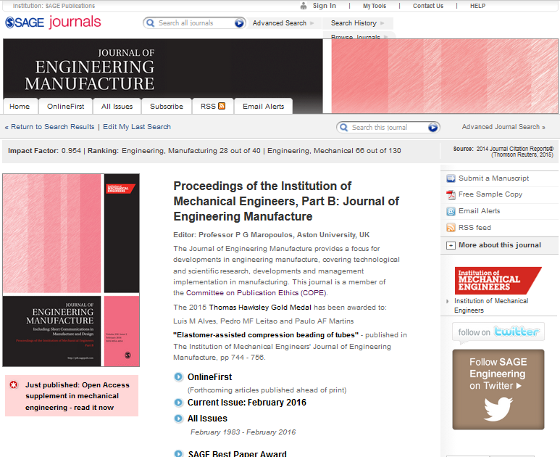
Browse past issues
Search within this journal
Read articles from up-coming print issue
Open current issue

Slide 13
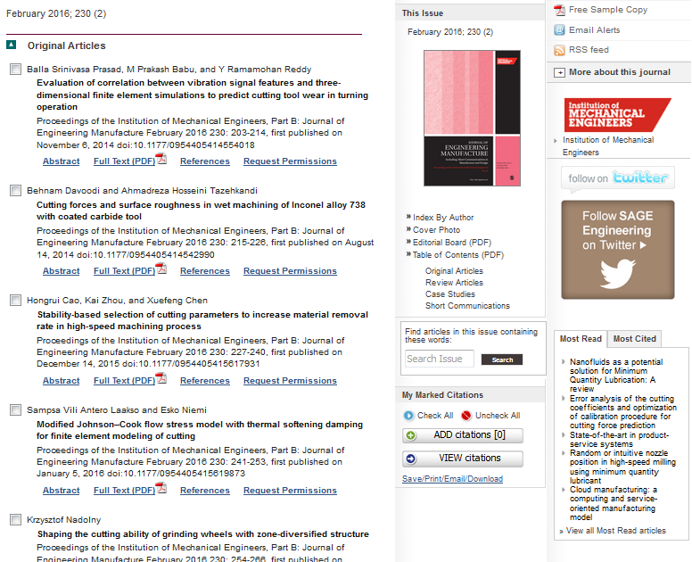
Open the article
Learn about journal’s Editorial Board
Search within this issue
View popular articles from this journal

Slide 14
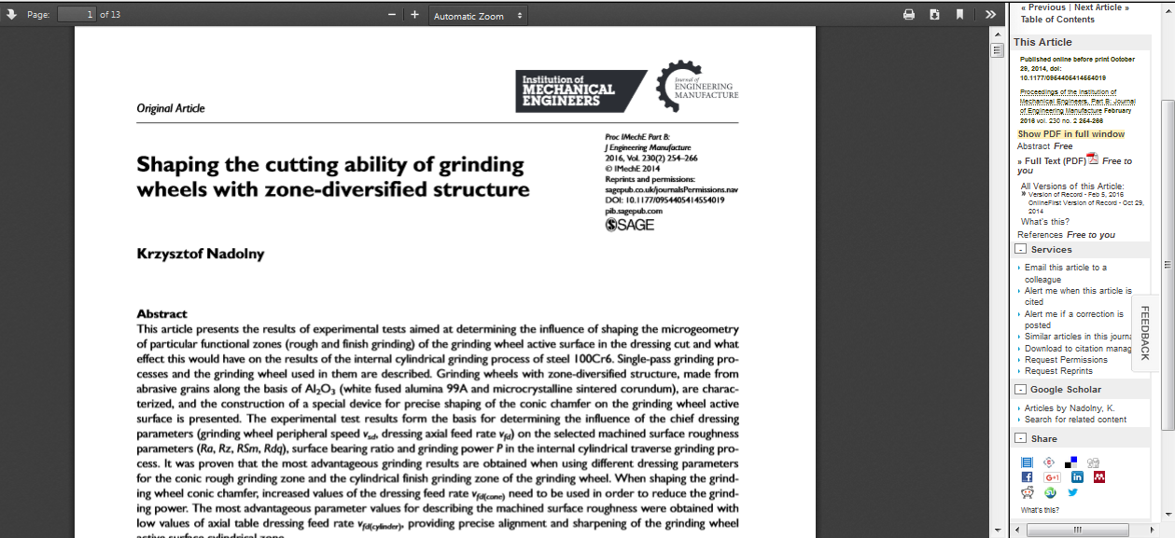
Print and download article PDF to read offline
Find articles on Google by this author
Set up email alerts for citations and corrections
Download reference to your citation manager

Slide 15
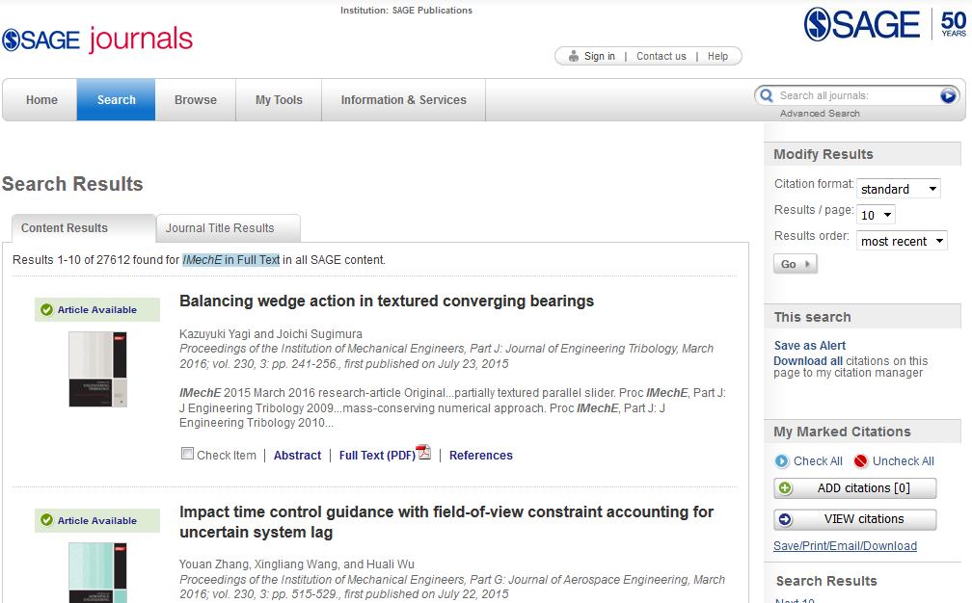
Create your personal profile
Quick or Advanced Search
Journal title search results

Slide 16
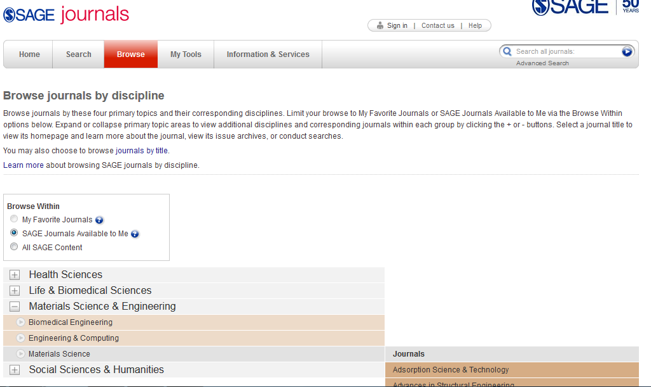
Browse all journals
Select ‘Available to me’
Choose your field and sub-discipline
View your journal results

Slide 17
Accessing the IMechE journals

Slide 18
Accessing the IMechE journals
Institutional access is by IP authentication
Manage your access (i.e. IP ranges, add your logo and institution URL)
Switch on OpenURL link resolvers to increase discovery
Articles/journals open in the SAGE Journals platform
All journals indexed in Summon (ProQuest), World Cat Discovery (OCLC), Primo Central (Ex Libris) and EDS (EBSCO)
Weekly feeds that comply with KBART (Knowledge Bases and Related Tools) to all major ERMs
Also included in databases and discovery tools such as Science Citation Index, Fluidex, Global Mobility Database, and many more
All journal sites available in a mobile optimized format; mobile vouchering allows for off campus access
Alumni registered with subscribing or purchasing libraries will be able to access SAGE Journals at no extra fee

Slide 19
Thank you!
Do you have any questions?
Rebecca Evans

