Slide 1
EIFL
Tuesday 20th June 2017, 11:00 (BST)
Jonathan Wakeford – Online Product Trainer
jonathan.wakeford@oup.com

Slide 2
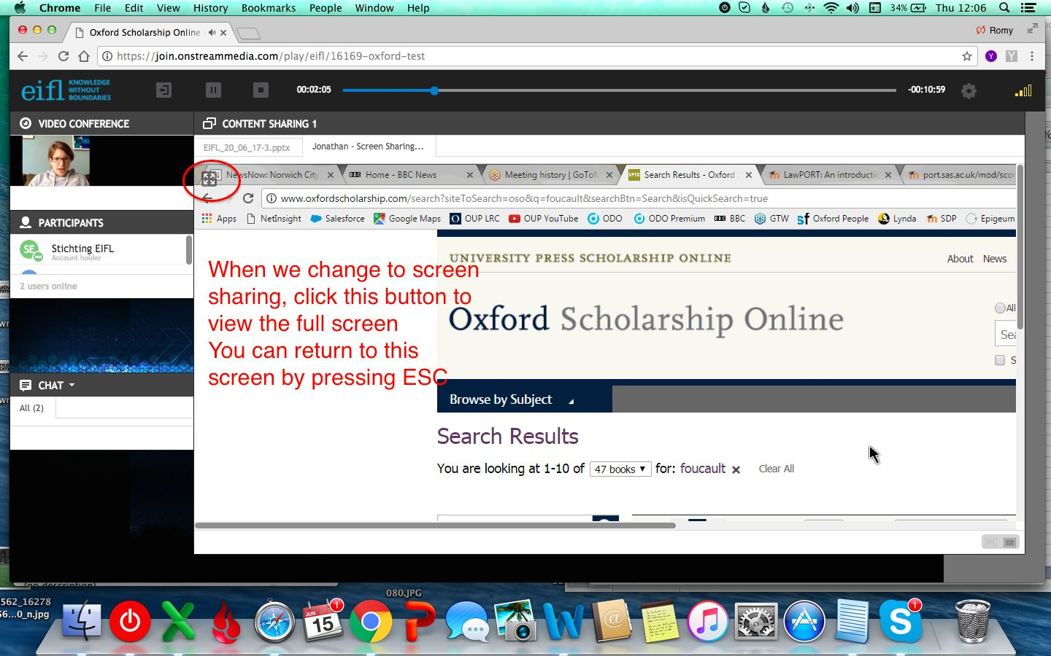

Slide 3
Agenda:
What is Oxford Scholarship Online and what subjects are available?
Live demonstration:
- Browsing and searching the site
- Features and benefits for users
Further support:
Where can I find MARC records and check usage?
Librarian Resource Centre
YouTube
OSO Quiz

Slide 4
Objectives: By the end of the session you should:
Be familiar with the content available on the platform
Understand how OSO can help users with their research
Know how to navigate the platform and use the personalisation features and other useful tools
Be able to share the knowledge acquired with colleagues and/or other interested parties

Slide 5
Quick and easy access to award-winning scholarship
oxfordscholarship.com

Slide 6
Oxford Scholarship Online (OSO) is a vast and rapidly-expanding research library providing access to award-winning Oxford University Press scholarship
Providing access to over 13,500 books across 20 subject areas in the humanities, social sciences, sciences, medicine, and law
With its inclusion in the wider University Press Scholarship Online platform, users are opened up to additional subject areas, including Archaeology, Anthropology, Film, Television, and Radio, and Society and Culture, helping to broaden users' research horizons
Oxford Scholarship Online now updates twelve times a year, bringing books online quicker than ever before
“
Oxford Scholarship Online is easy and intuitive to use ... it relieves pressure on the most sought-after titles and complements ebook collections already in heavy use.
Head of Electronic Services and Systems,
Cambridge University Library
”

Slide 7
Subject areas
Quality content you can trust …
Biology
Business and Management
Classical Studies
Economics and Finance
History
Law
Linguistics
Literature
Mathematics
Music
Neuroscience
Palliative Care
Philosophy
Physics
Psychology
Public Health and Epidemiology
Political Science
Religion
Social Work
Sociology
Scholarly accreditation – each title in Oxford Scholarship Online is extensively peer-reviewed and approved for publication by a board of leading academics from Oxford University
Regularly updated with new titles twelve times a year, ensuring users have access to titles at the forefront of academic research and scholarship
Our list of eminent authors in OSO range from classic thinkers to modern masters, including twentieth-century Nobel Prize winners Angus Deaton, Anthony J. Leggett, and Amartya Sen, along with a wealth of award-winning titles

Slide 8
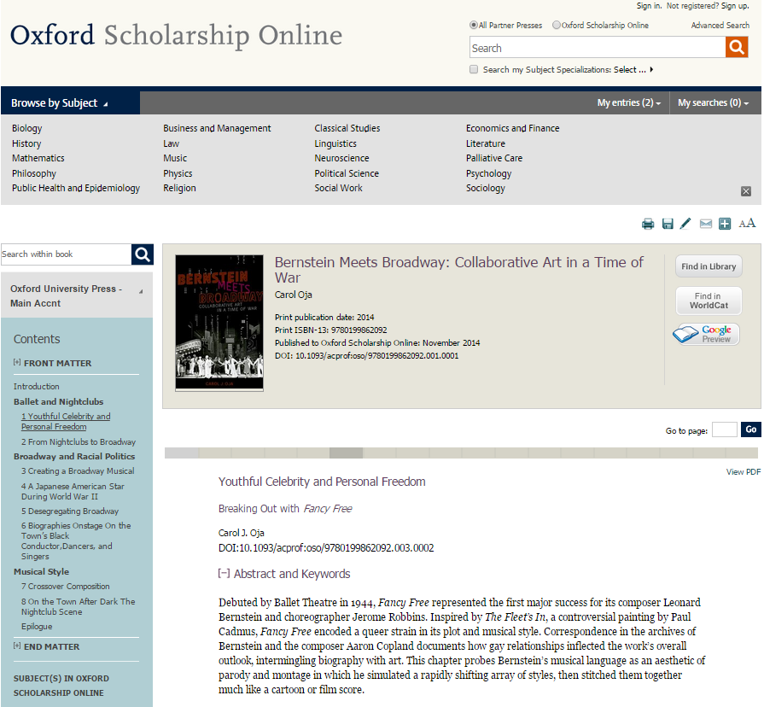
User benefits
Access high quality scholarly content from Oxford University Press
View free abstracts at book and chapter level for all titles – providing at-a-glance access to the content
Download chapters to PDF – enabling research on-the-go
Frequent update schedule ensures access to the latest titles at the forefront of academic scholarship
Share titles, chapters, abstracts, and search results with colleagues using social bookmarking tools and citation export

Slide 9
Live demonstration

Slide 10
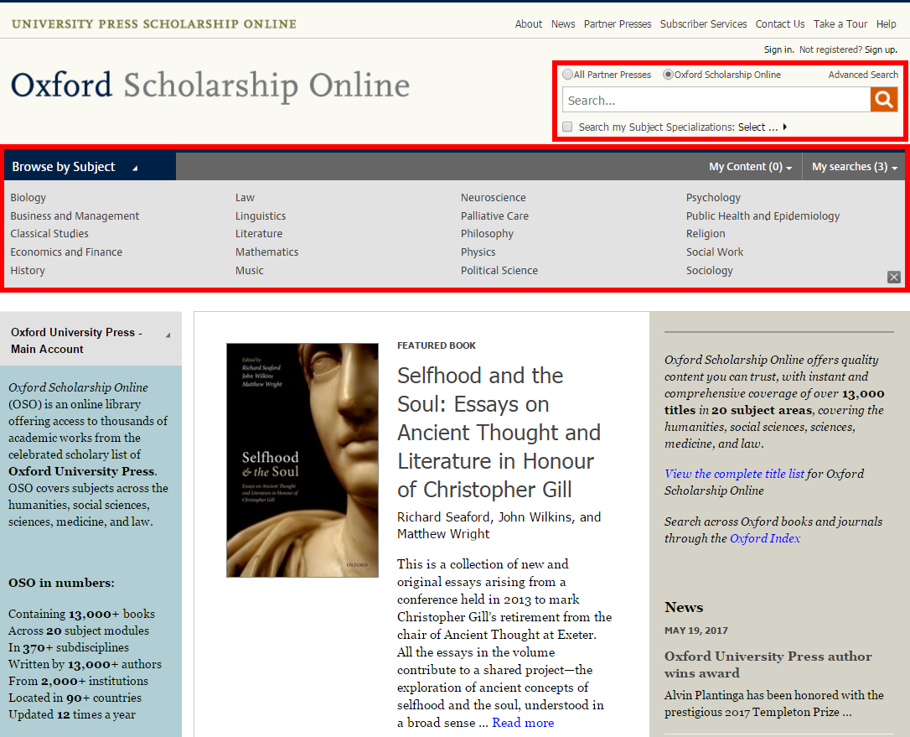
Browse content by subject or type into the search box

Slide 11
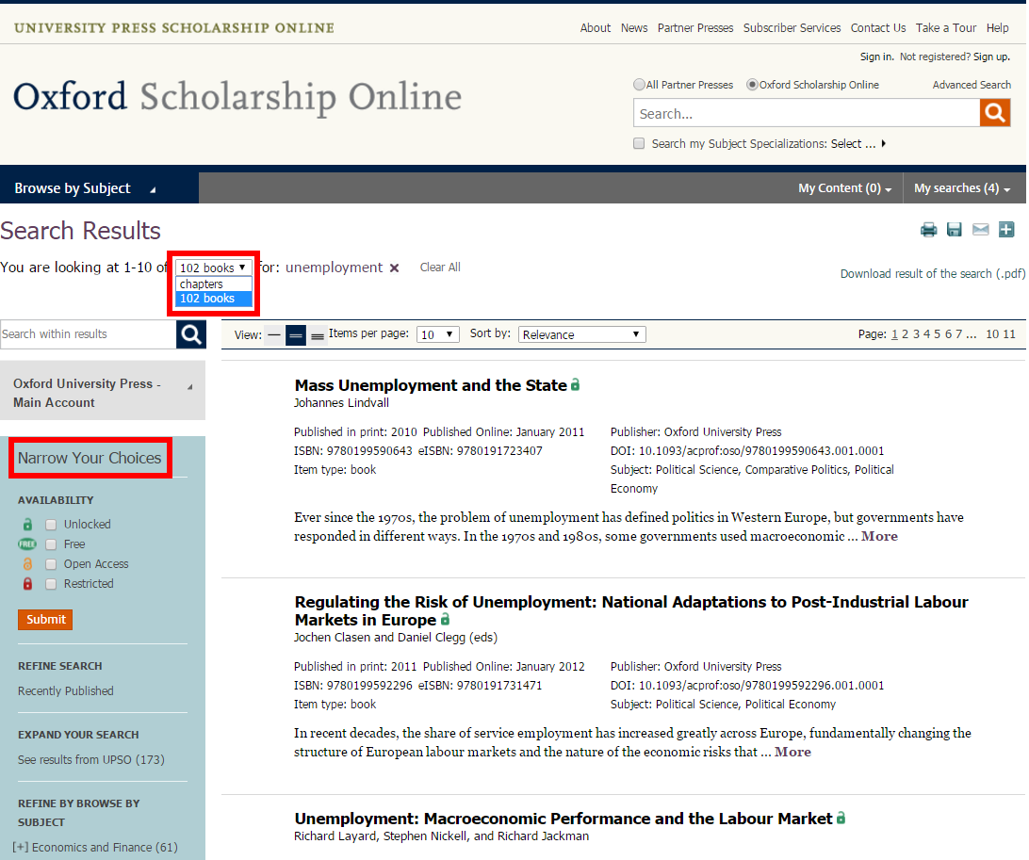
Expand your search to full text or narrow your choices on the left

Slide 12
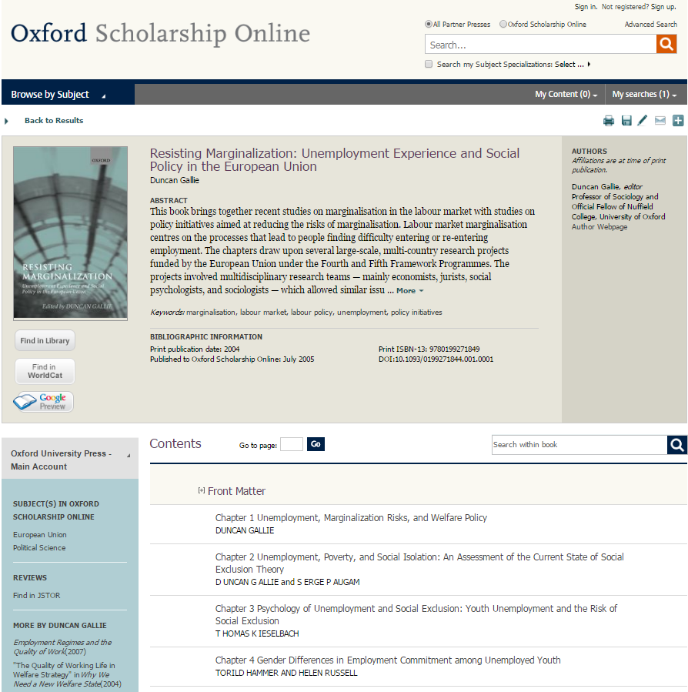
Title page includes abstract, table of contents and more…

Slide 13
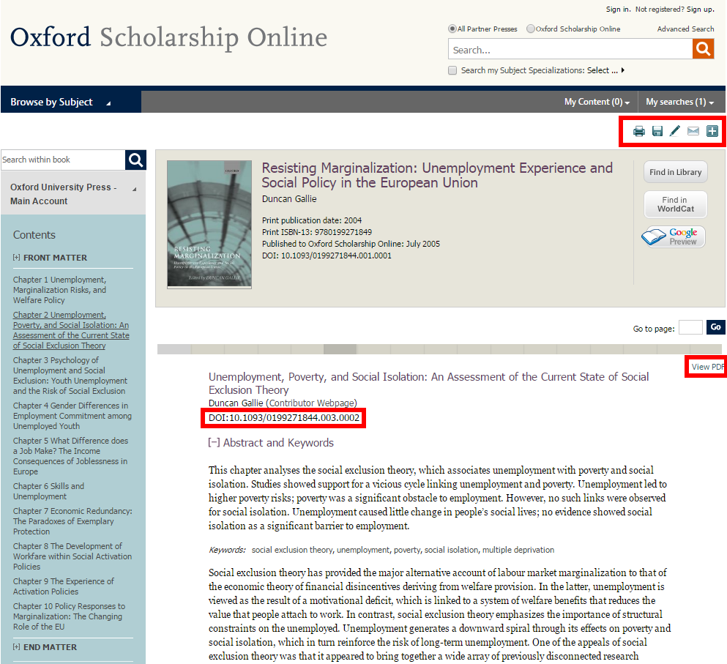
Chapters can be easily downloaded, saved, cited and shared

Slide 14
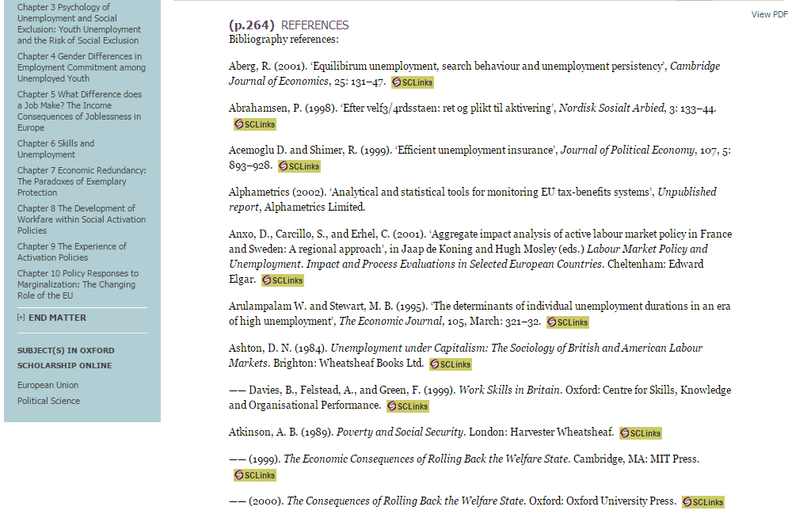
Help your researchers by linking references to your library catalogue

Slide 15
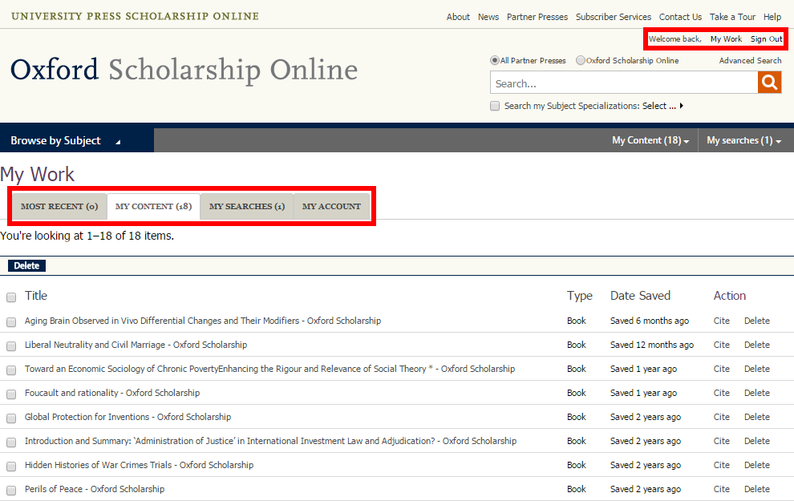
Create a personal profile to save and access your favourite content

Slide 16
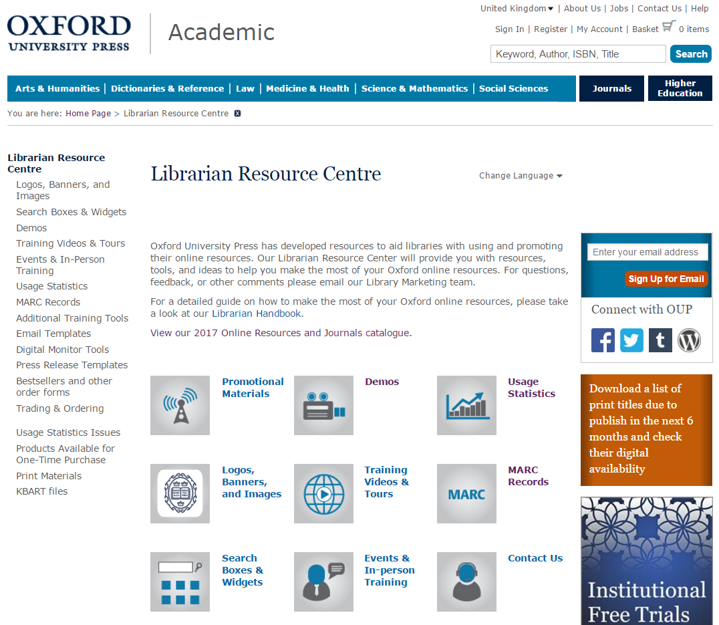
Find promotional and training tools and much more on our LRC!

Slide 17
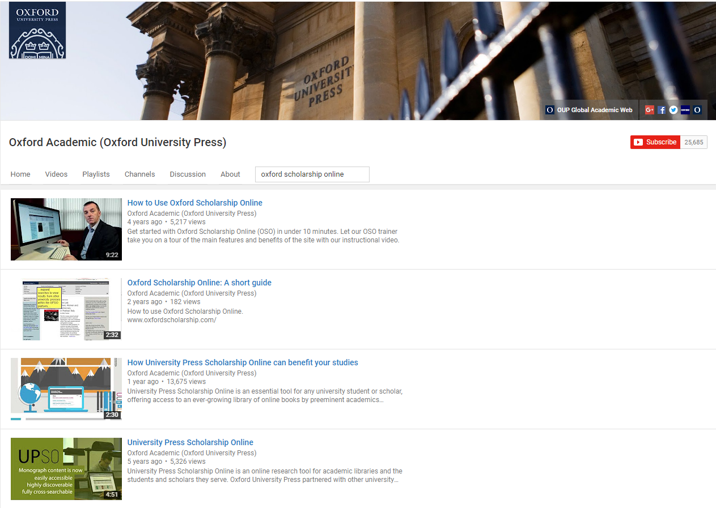

Slide 18
