Slide 1
This is Urkund
A short introduction to who we are, what we do and how it helps you to become a leader in innovative and qualitative education

Slide 2
LIST OF CONTENT:
Who are we
What we do
What is plagiarism
How does a plagiarism checker help you?
How can you get started?

Slide 3
WHO WE ARE AT URKUND?
We are a Swedish company founded in 2000 and located in Stockholm, Sweden
We are over 20 employees from countries all over the world with an average age of 34 years

Slide 4
OUR STORY LINE
2018-2020 Growth plan established
2000
2004
2008
2012
2016
2020
2005
First foreign customer in France HEC
2004
PrioInfo acquired URKUND
2017 Turnover record
2018
Procuritas acquires Urkund. Customers in 60 countries.
2011
Helps Nowegian Security Police to map Breivik’s terrorist network.
2000
The idea of Urkund was formed in 2000.
Uppsala University the first customer.
2017
Urkund helps international press to disclose Bob Dylan’s Nobel Speech
2000-2005
Upper Secondary schools were first customers

Slide 5
WE ARE NORDIC MARKET LEADER IN PLAGIARISM PREVENTION AND DETECTION SOFTWARE
URKUND is the #1 plagiarism prevention and detection software in the Nordic market and #2 in the world.
Solid financials and strong growth of 25 % 2016 and 2017.
2000+ customers consisting of academic institutions, secondary schools and corporations. Global business in +60 countries.
Subscription-based cloud-solution with low churn rate. In-house development and direct sales.
HQ in Stockholm. Entrepreneurial sprit with do-good values.
New owner since 2018 is Procuritas, a Nordic investment fund supporting growth in entrepreneurial businesses

Slide 6
WHY IS PLAGIARISM A PROBLEM FOR ACADEMIA?
LEGAL PROBLEM Plagiarism is consequently a legal problem.
KNOWLEDGE The fact that cheating occurs is a direct threat to the quality of education and research. Plagiarism hinders innovation and the progress of creating NEW knowledge.
ACADEMIC INTEGRITY Academia is built on the tradition of intellectual honesty. Plagiarism risks breaking this trust and poses a basic threat to academic integrity and lowers the perception of quality of any institution allowing it.
WORKING ENVIRONMENT It is an unpleasant task for a teacher to confront a student with suspicions of plagiarism, especially if the teacher does not have access to the original source material.

Slide 7
WHY A PLAGIARISM CHECKER?
Increasing digitization in education makes it easier to detect plagiarism
Urkund helps to maintain quality in academic writing.
Plagiarism is an ever increasing problem in the academic world - the rise of digitization in education makes it easier to detect plagiarism, but also easier to plagiarize
Universities and educational institutions using a plagiarism checker are able to position (establish) themselves as thought and innovation leaders worldwide by providing new knowledge and consistent quality of thought
An automatic plagiarism checker effectively promotes academic integrity because it works both as prevention and as a controlling measure against plagiarism -> leading to more time for the things that matter
Implementing a plagiarism checker promotes academic integrity
…and works as plagiarism prevention

Slide 8
WHY USE URKUND?

Slide 9
Urkund is extremely easy to use. Submission of texts is easy, and you get a very clear report back. This is very valuable to us – the more complicated the system the less willing our staff will be to use it.
“
With its 20,000-plus students, the state-run Copenhagen Business School (CBS) is the biggest school of economics in northern Europe and regularly tops rankings.
It has a very strict policy on plagiarism of research and student theses.
In 2014, following thorough evaluations, CBS decided to start using Urkund to identify textual similarities in submitted student theses.
The number of incidences of plagiarism detected in student essays has increased at CBS since Urkund which has led to increased awareness and quality of education.
”
Joshua Kragh Bruhn, Information specialist, Copenhagen Business School

Slide 10
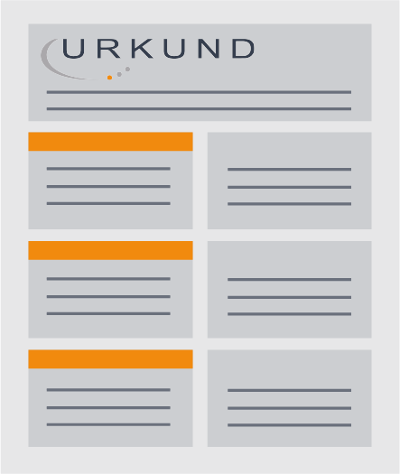
HOW IT WORKS
A document’s journey in Urkund
Published material
Student material
THE RESULT
Once the process is finished, (after about 60 sec.) an analysis overview is created and sent to the teacher. This is done either via the used LMS or by email. The results are presented in a comprehensible, interactive analysis report so that the teacher can make the final judgement if any plagiarism has indeed occurred.
FINDINGS
When a document starts to display similarities to other sources, a matching profile is formed. We do not only record the degree of the matches but take any usages of paraphrasing and synonyms into account.
Internet
THE ANALYSIS
The text is analysed and we begin to check for possible text similarity across our three source areas. Urkund singles out potential matching sources for further analysis.
Email
direct upload
LMS
STUDENT SUBMISSION
The Urkund process starts when a student submits a document to the system. Independently of language, the text is extracted from the document and the processing begins.

Slide 11
OUR SOURCE AREAS
08
We work with an ever expanding database of documents and sources. Roughly, they can be divided into sources found on the Internet, articles published in academic journals and previously submitted documents. This includes everything from Wikipedia to national repositories of theses.
We strongly believe in looking through source areas that students use as research material which appear in a variety of forms and platforms.
Internet
Published
material
Student
material

Slide 12
URKUND CAN BE INTEGRATED INTO ANY LEARNING MANAGEMENT SYSTEM
Integrating Urkund with an existing learning management system (LMS/VLE) extends the value a school already receives without adding complexity whilst increasing the value of the LMS/VLE itself. There are integrations with more than forty commonly used LMS/VLE such as Moodle, Blackboard, D2L etc.
New integration with local LMS
We send full developers kit to developers at the LMS or consultancy firm
Urkund assists in the integration process
3 weeks
3 weeks
Average time ~ 2 weeks
REQUIREMENTS FOR INTEGRATION
Creation of integration is the responsibility of the school.
Fee for using Urkund’s APIs
For a new integration, please contact: support.partner@urkund.com

Slide 13
QUESTIONS

