Slide 1
Djuddah A.J. Leijen
The intricate process of implementing URKUND at the University of Tartu, Estonia
AVOK|Centre for Academic Writing and Communication

Slide 2
Story of intricacies
Needs
Fulfilling these needs
Fulfilled
Contextualise
Understanding and lessons learned / to be learned

Slide 3
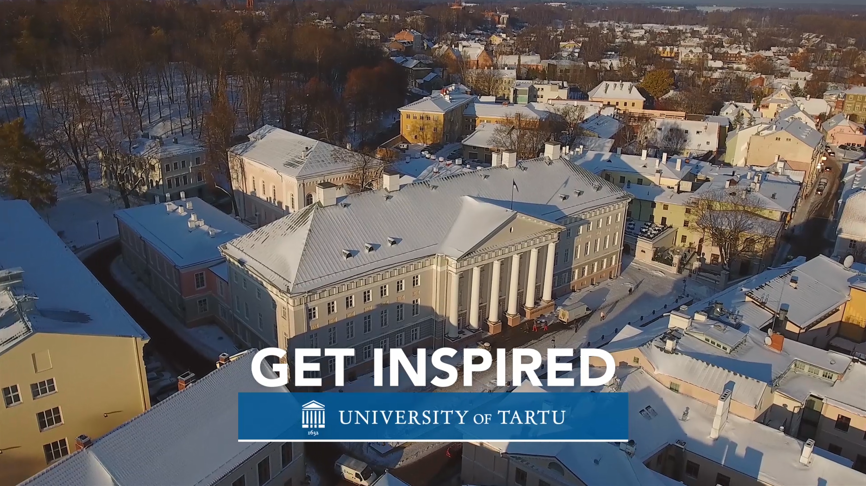
Contextualising needs
1632 University of Tartu, Estonia (modelled after Uppsala)
18th Century — Russian rule (prosperous period - German language)
Post WWI — Independence and National University (Estonian language)
Pre and Post WWII — constant transition between German and Russian
Post WWII — Soviet Occupation crippled the University
1989 - 1992 — re-establishment of national University

Slide 4

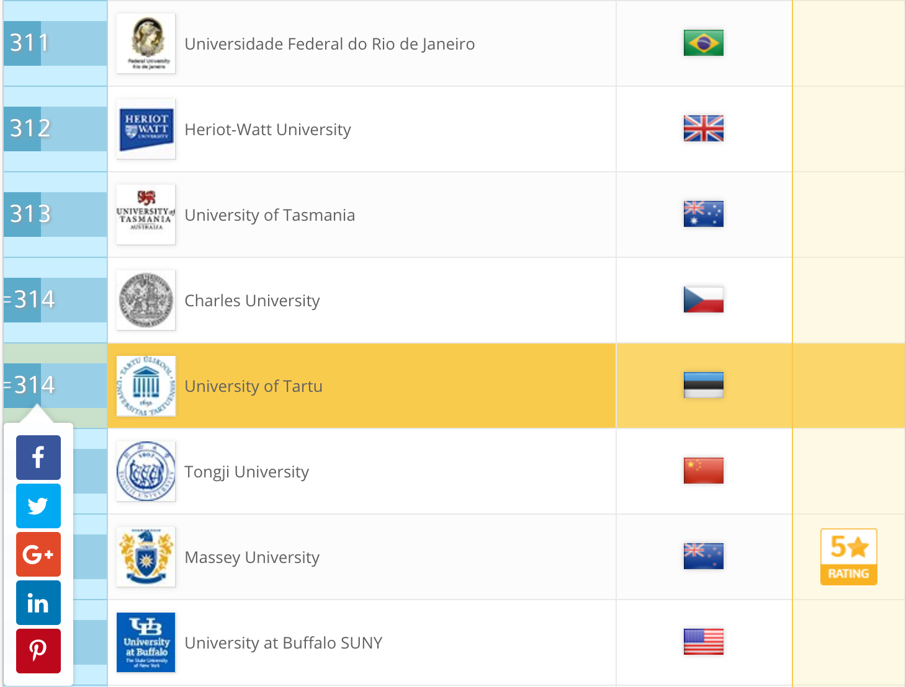
Today
QS Ranking places University of Tartu
  top 1.2% of world’s best

Slide 5
International programmes (BA and MA)
PhD programmes
BA: Business administration / Science and Technology / Medicine
MA: Philosophy / Semiotics / Folkloristics / Education Technology / European Union and Russian studies etc.
1300 PhD students
http://www.ut.ee/en/admissions/masters-degree-programmes-taught-english-0

Slide 6
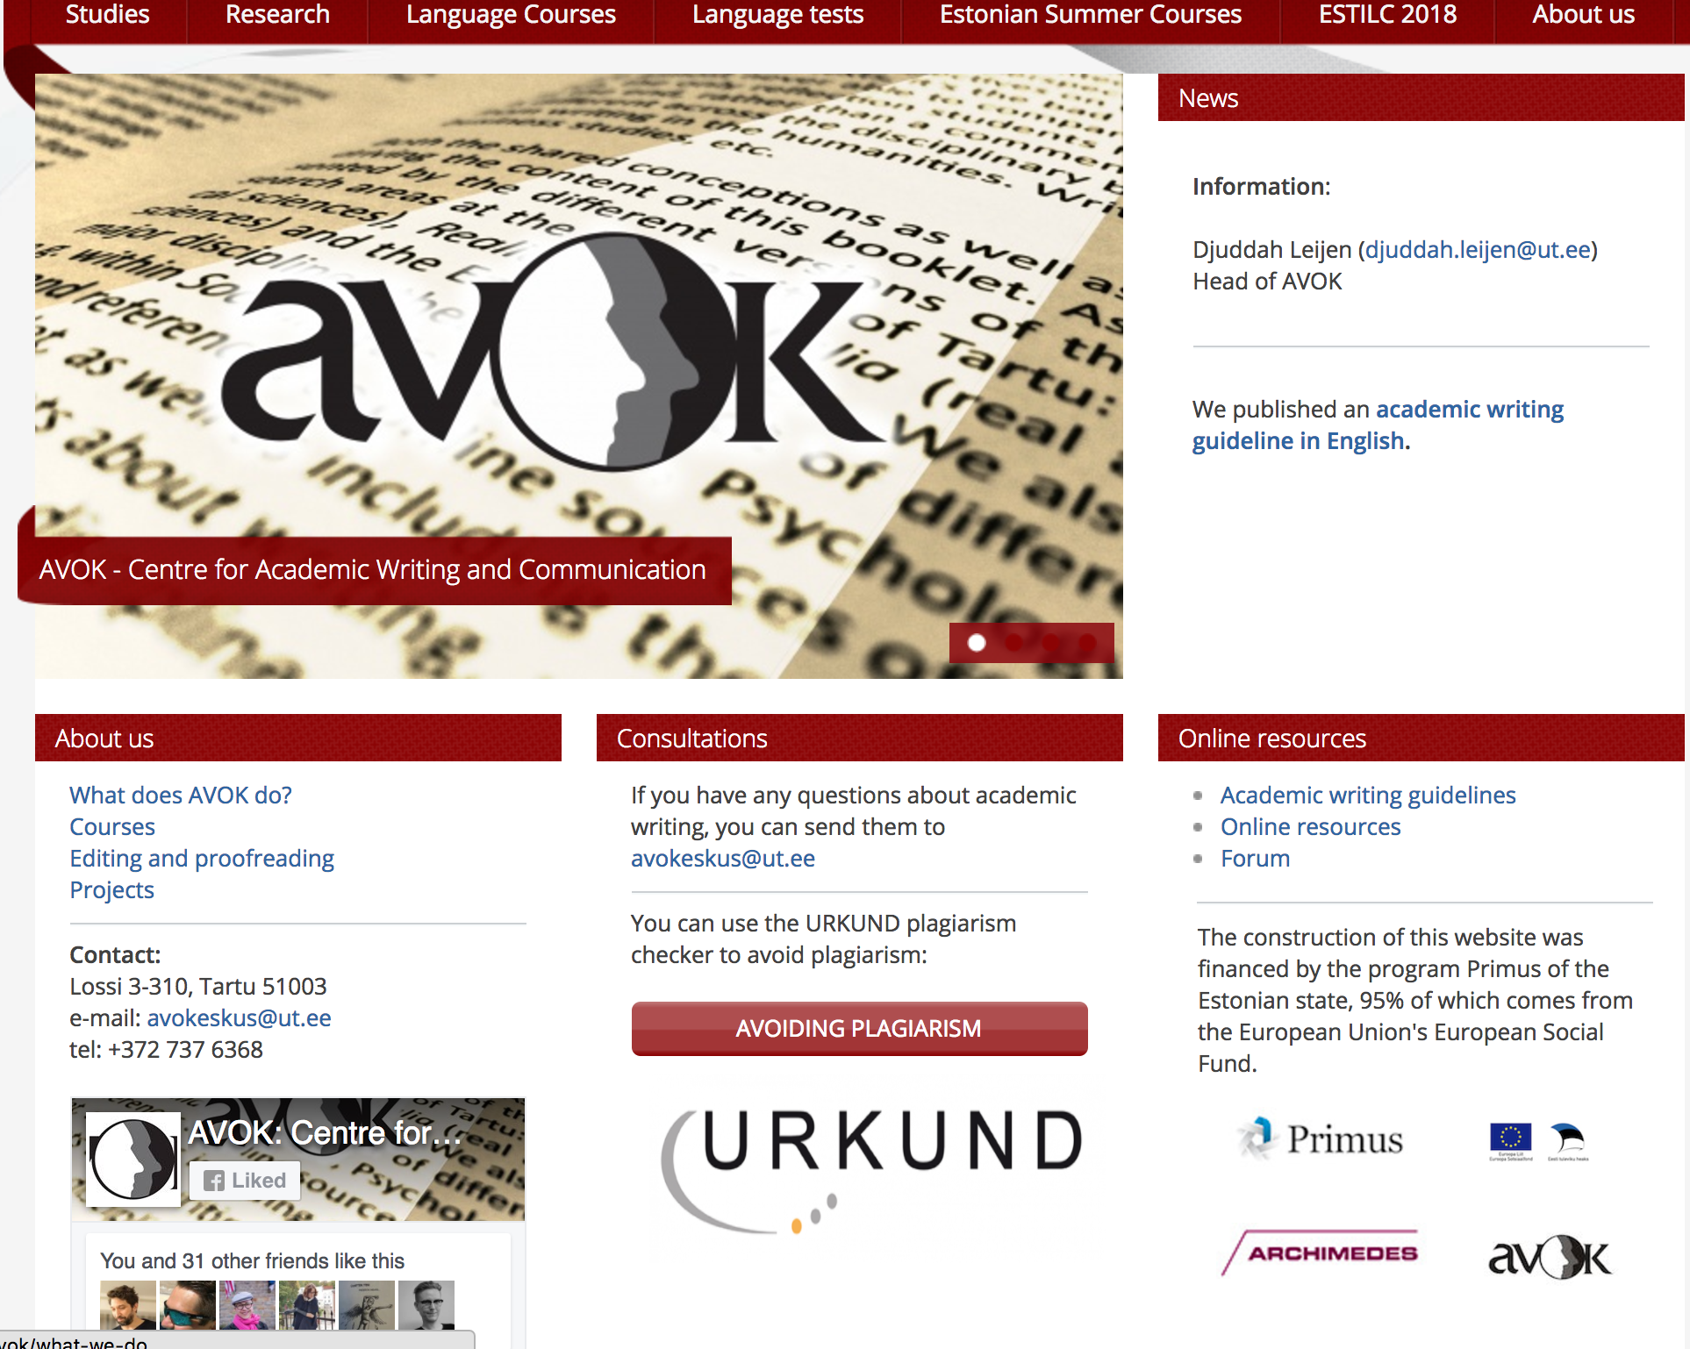
2008
Birth of a small Writing Centre (AVOK)

Slide 7

The responsibility of AVOK is to support writing through:
  good practice (teaching practice)
  research (research informed teaching and learning)
The university of Tartu:
  NEEDS: Internationalisation / Writing in English
  MORE NEEDS: Writing in Estonian (lack of a tradition)
  EVEN MORE NEEDS: Plagiarism education (lack of holistic understanding)

Slide 8

AVOK’s Responsibilities
related to URKUND
Made it our responsibility to teach good writing practice
Understand plagiarism in this equation
WITH some international program managers — we pushed for the University to find a systematic solution

Slide 9
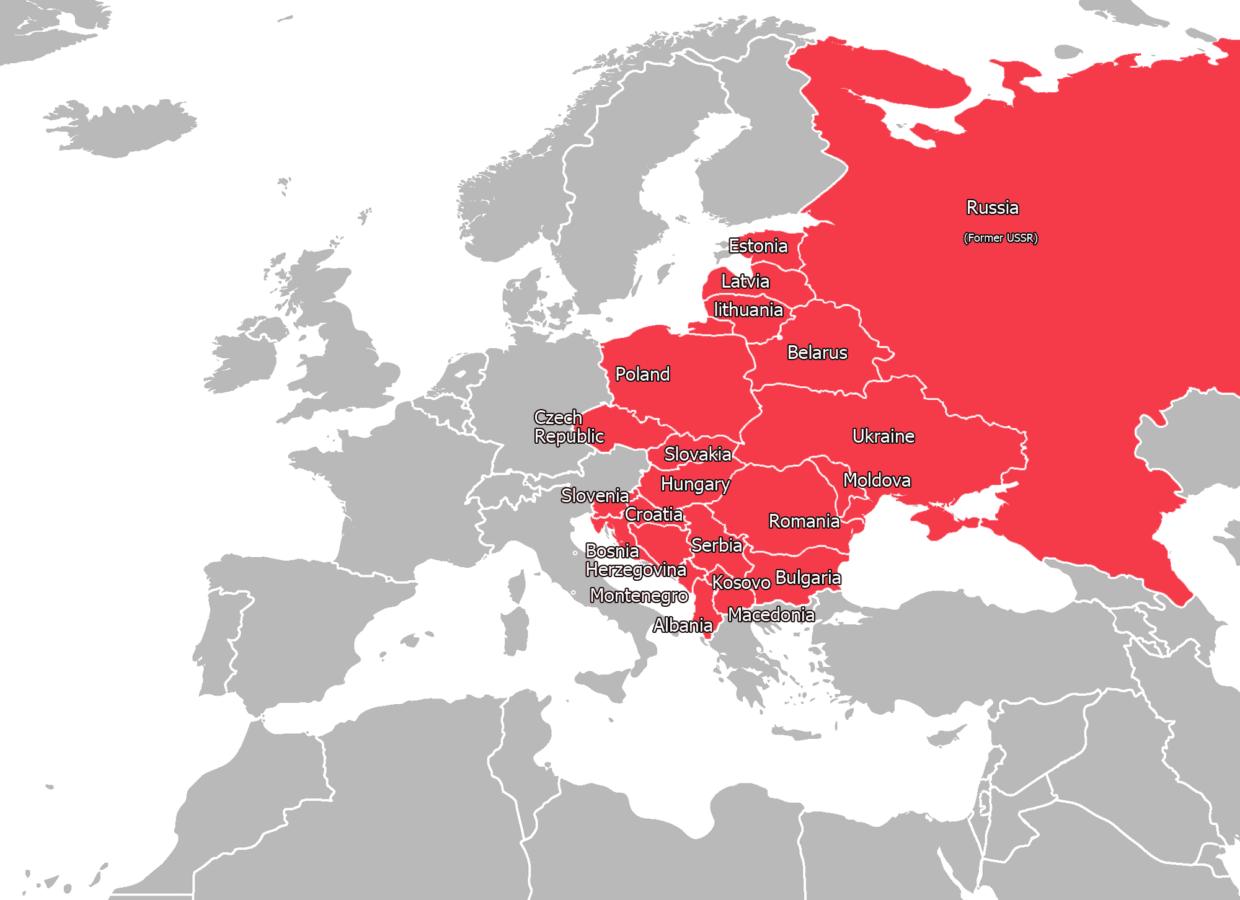

Why was there a need for URKUND?
If the university has a plagiarism policy (academic misconduct)
Individuals (including students) could use online systems and KRATT (Estonian developed system)
However,
No systematic approach (single message) regarding dealing with plagiarism (especially in Estonian)
kratt.edu.ee

Slide 10
Fulfilling the NEEDS
Introduce a (new) system URKUND
but, use the introduction to —
——
Support good practice and awareness through this introduction

Slide 11
Are the needs fulfilled?
What do we know about the
context of plagiarism in our
region?

Slide 12
Are the needs fulfilled?
Eastern European context (is an important context)
Different perspectives on plagiarism (in comparison to western Europe.
“[There are] huge differences in attitude to plagiarism between western and post-communist countries” (Foltýnek & Čech 2012)
Evidence: we see this in their writing (literacy development)

Slide 13
Current situation:
Are the needs fulfilled?
According to the Rector’s office
  YES (we have a system in place)
According to the Office of Academic Affairs (includes legal counselling; quality assurance; lifelong learning; study systems such as Moodle, Panopto, Urkund)
  YES (we have written and translated manuals how to use the system)
According to the The Centre for Professional Development (supports teachers)
  YES (we tell teachers that there is Urkund to check plagiarism)

Slide 14
For example:
In a recent interview with the office of academic affairs
URKUND is the IT app that will solve our plagiarisms problems.
          ““The plagiarism catching net” [URKUND] is so good that nothing gets trough and “the poor student who makes a mistake” will be caught by the programme no matter what.”
Notes:
IT oriented approach — IT will be the solution!

Slide 15
According to literature and previous cases:
Are the needs fulfilled?
Focus should be on developing:
  academic literacy
  related learning processes
NOT on MISCONDUCT
          (Löfström, 2017)
Notes:
FOCUS is on ACADEMIC LITERACY and related learning processes
Not focussing on MISCONDUCT

Slide 16
Needs fulfilled?
    NO! There is no plan to educate everybody about plagiarism! No central stance! No information! No workshops!
    But maybe we are being too critical and too pessimistic?
Notes:
NO LITERACY DEVELOPMENT
NO LEARNING PROCESS APPROACH

Slide 17
Recent survey investigating writing:
  In my opinion, the situation [of academic writing] is bad in the university [of Tartu] - I feel like we do not educate our students in this field enough. Also the Urkund seminars that are being held throughout the university are merely formal. They introduce the system, but the pedagogical aspect is not at all addressed. In my opinion, the teaching consultants who are teaching these seminars are also not competent to do that. I consider it very important that the university has a centre that would advise and support teachers and offer them training sessions that would help them to better develop students' writing skills.

Slide 18

Fulfilled?
Personally — YES! Urkund has come to Tartu and Estonia!
Estonian’s Information Technology Foundation for Education — supporting URKUND for

Slide 19
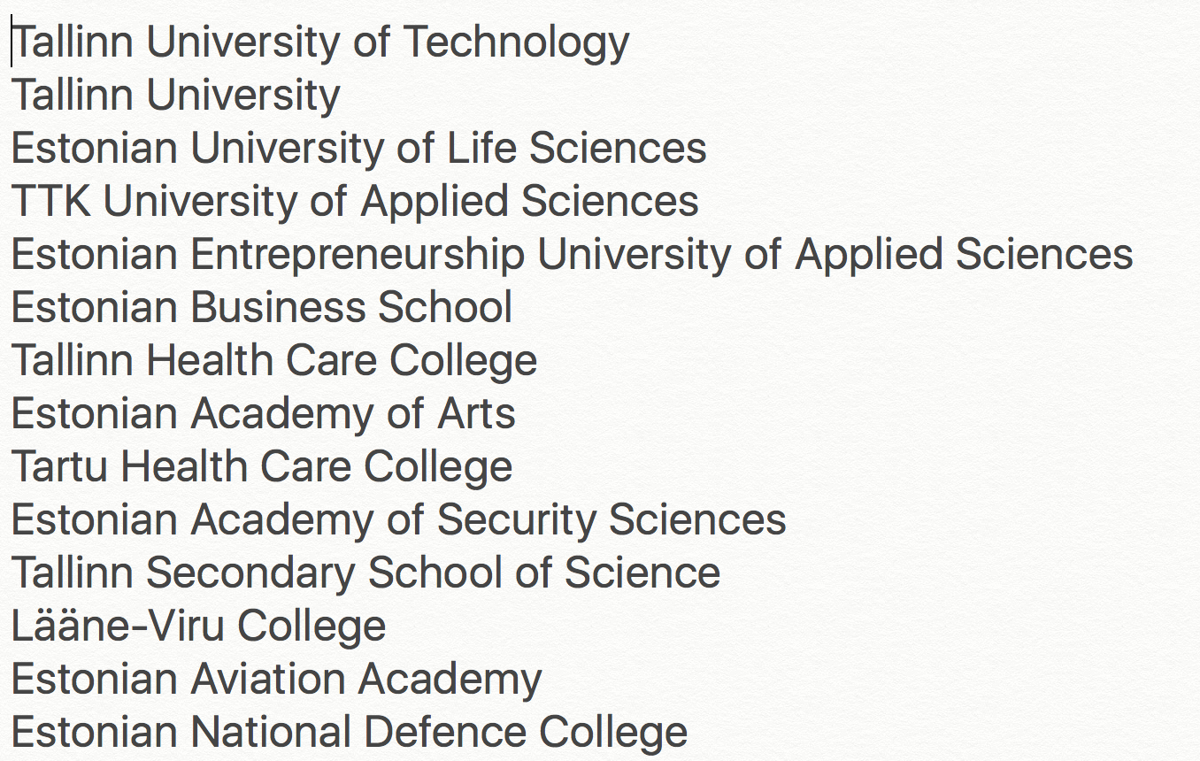
Previously supported KRATT

Slide 20
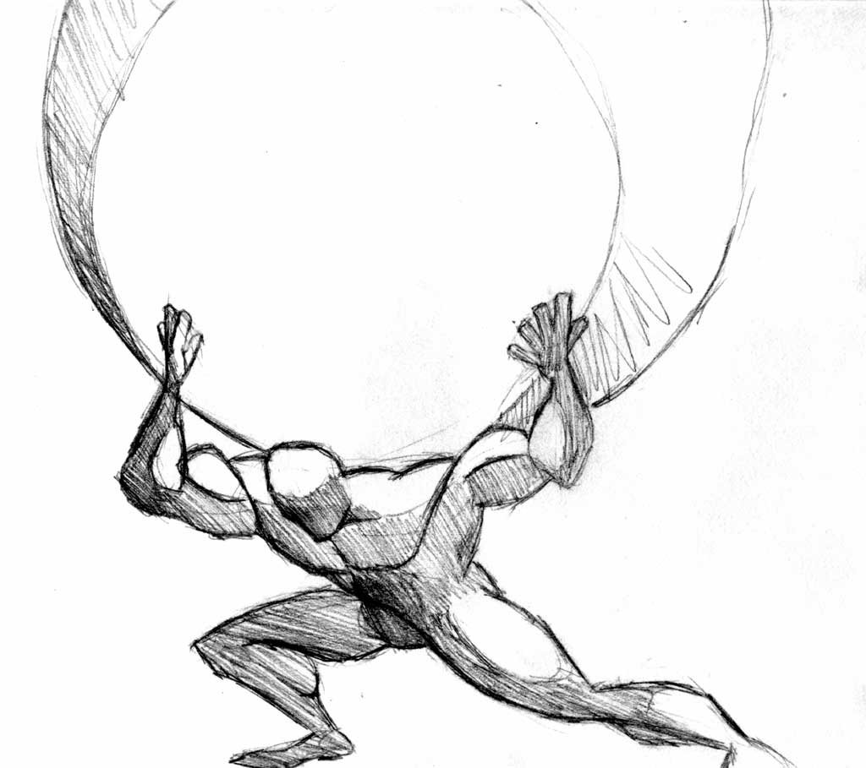
PLAGIARISM
“educational institutions must work towards fostering a culture of integrity that goes beyond deterrence, detection, and punishment of students.” (Bretag, 2013)
Xander Natas from DeviantArt

Slide 21
PLAGIARISM
“Our findings revealed tensions between the ways plagiarism was framed in institutional policy documents, and students’ understandings of plagiarism and academic writing. We suggest that, in order to support students’ acquisition of academic writing skills, plagiarism should be framed in relation to ‘learning to write’, rather than as a moral issue.” (Adam, Anderson, & Spronken-Smith, 2015)
Xander Natas from DeviantArt
Xander Natas from DeviantArt

Slide 22
Who's responsible?
Who will take responsibility?

Slide 23
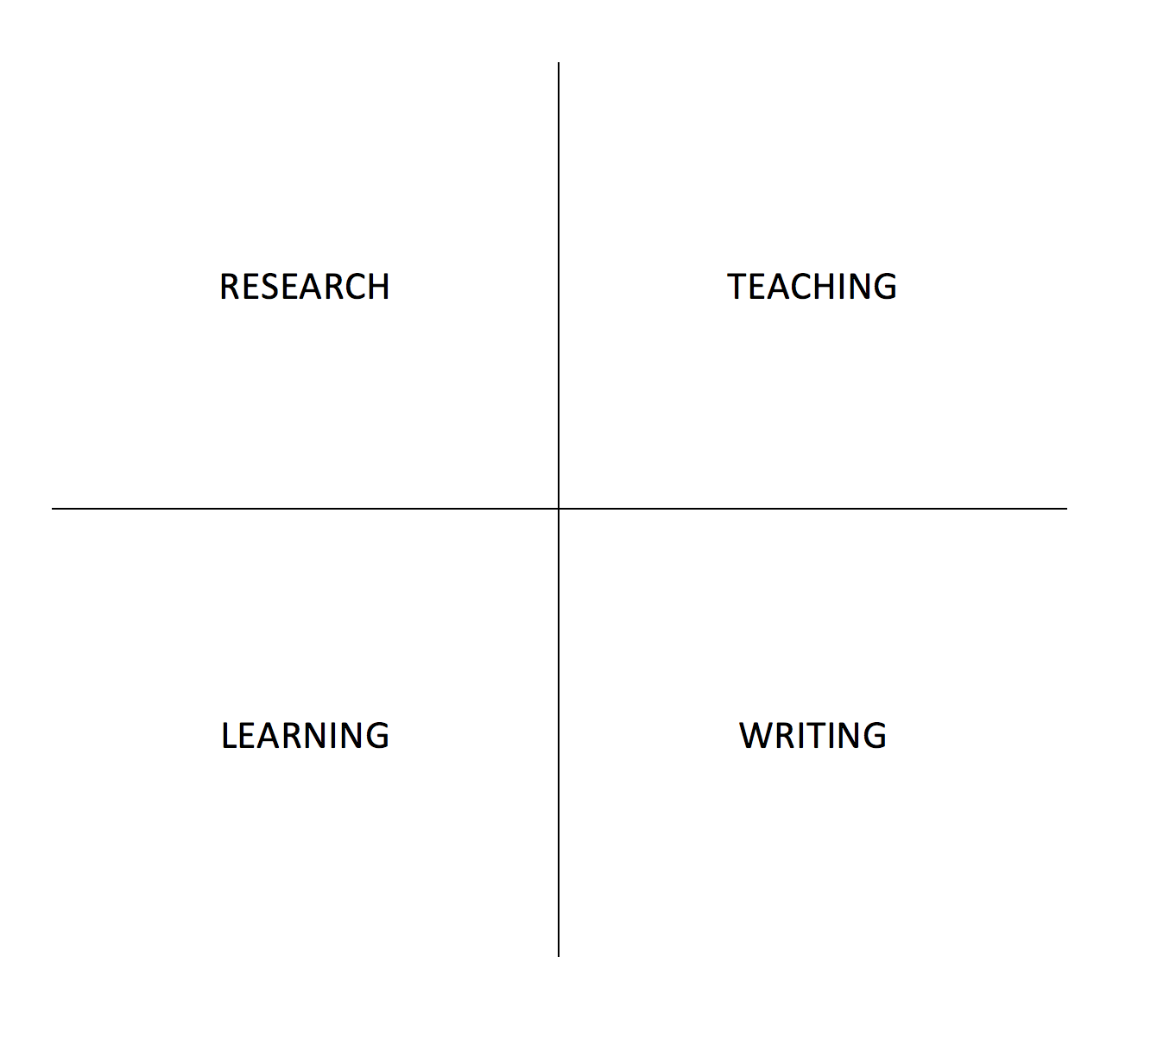
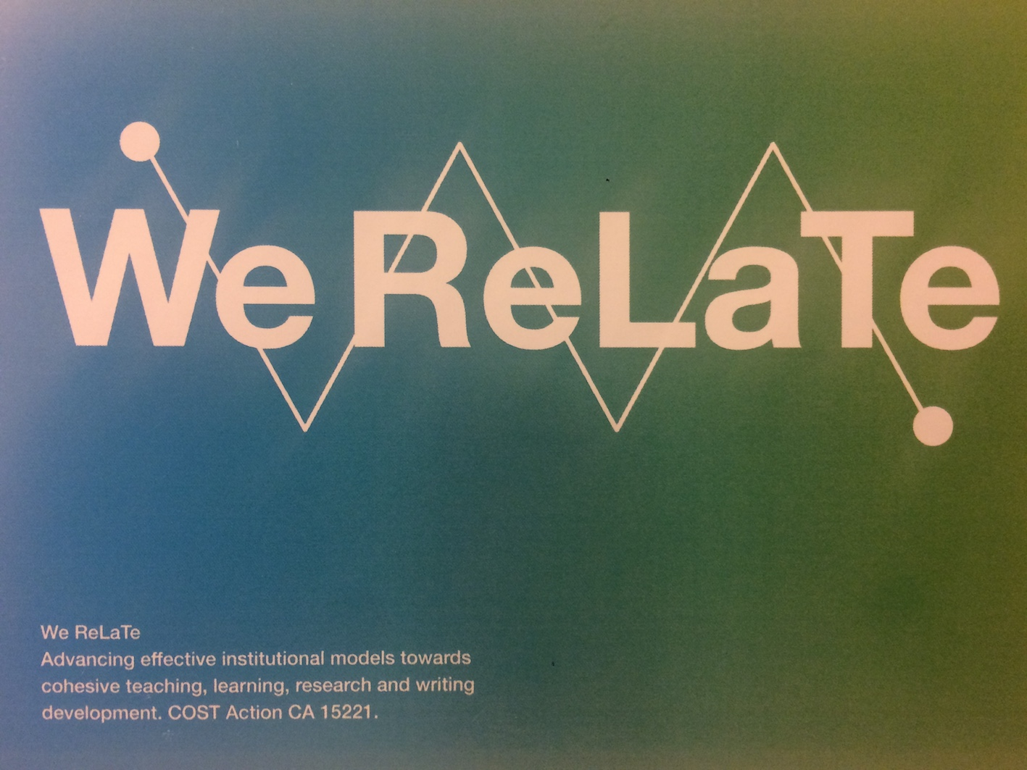


Tensions
COST Action
The Network of Nordic and Baltic Writing

Slide 24
Why discuss this here?
Lessons learned
Many universities have a plagiarism education program
Integration from past to now (e.g. Chalmers) has progressed
Estonia — an consortium supporting all education — [sounds like an opportunity]
But, who is responsible?
Active role of Urkund to ‘push for plagiarism education’
Active role of Research

Slide 25


Slide 26
Djuddah A.J. Leijen
djuddah.leijen@ut.ee
The intricate process of implementing URKUND at the University of Tartu, Estonia

