Slide 1
Oxford University Press Journals Collection 2015

Slide 2
Oxford University Press (OUP)
Our mission
Oxford University Press is a department of the University of Oxford. It furthers the University's objective of excellence in research, scholarship, and education by publishing worldwide.
John Fell
Clarendon Presentation—Tim Barton (November 2011)

Slide 3
OUP’s Mission
What does it mean?
OUP publishes the highest quality journals and delivers this research to the widest possible audience. We achieve this by working closely with our society partners, authors, and subscribers in order to provide them with publishing services that support their research needs

Slide 4
OUP and the Academic Community
Publishing Collaboratively
Nearly 70% of OUP’s journals are published on behalf of societies and academic bodies, and this is increasing
Notes:
Societies and academic bodies include:
American Medical Informatics Association
American Society for Aesthetic Plastic Surgery
Entomological Society of America
Federation of European Microbiological Societies
Royal Society of Tropical Medicine and Hygiene
The Royal Astronomical Society
The Society for the Study of Social Problems
UNIDROIT

Slide 5
Oxford University Press Journals Collection 2015
OUP Journal Joiners

Slide 6
OUP Journal Joiners
Publishing partnerships
We consider our role in the academic community to extend to the publishing we do on behalf of societies
We publish over 300 journals in law, medicine, the humanities, social sciences, life sciences, and mathematics and physical sciences – two-thirds of which are published in partnership with learned and professional societies
Societies want to publish with OUP because we understand and can deliver on shared strategic goals for their titles

Slide 7
OUP Journal Joiners
Excellence in Evidence
Mission Driven – we return the library community’s investment back to the academic community, partnering with non-profit societies who share our mission
Focus on Quality – our strategy is to selectively acquire only the very highest quality journals
Creation of sustainable models - for the future support of academic scholarship and research

Slide 8
New Joiners 2015
What’s New?
25 new titles
15 new in Life Sciences Collection, 7 new in Medicine, 2 new in Social Sciences, 2 new in Law, 1 new in Humanities
New titles in subject areas:
Microbiology
Entomology
Biomedical Informatics (BMI)
9 new society partners including:
Federation of European Microbiological Societies (FEMS)
Entomological Society of America (ESA)
Notes:
Moving into important emerging field – Biomedical Informatics (BMI)
Please note some titles are included in more than one subject collection which is why they don’t add up to 25 above

Slide 9
Federation of European Microbiological Societies (FEMS)
Life Sciences Collection
Official journals of the Federation of European Microbiological Societies (FEMS)
Very well-known in Europe due to the society
Takeaway from Wiley-Blackwell
2013 Impact Factors:
FEMS Microbiology Ecology - 3.875
FEMS Microbiology Letters - 2.723
FEMS Microbiology Reviews - 13.806
FEMS Yeast Research - 2.436

Slide 10
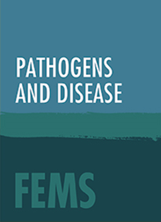
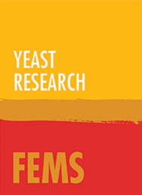
Federation of European Microbiological Societies (FEMS)
Life Sciences Collection

Slide 11
Entomological Society of America
Life Sciences Collection
Official journals of the Entomological Society of America (ESA)
Articles cover subjects of a broad interest to both amateur and professional entomologists
Previously self-published
2013 Impact Factors:
Annals of the Entomological Society of America - 1.174
Environmental Entomology - 1.424
Journal of Economic Entomology - 1.605
Journal of Medical Entomology - 1.815

Slide 12
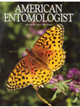
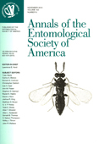
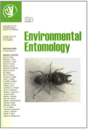
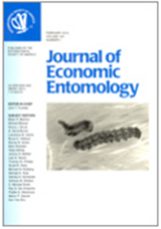
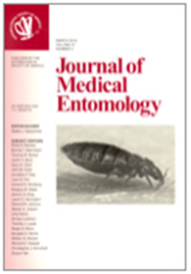
Entomological Society of America
Life Sciences Collection

Slide 13
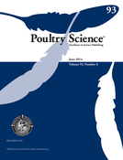
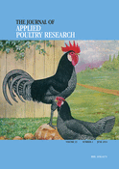
1. Poultry Science and 2. Poultry Research
2014 Takeover
Life Sciences Collection
Owned by the Poultry Science Association (PSA)
Internationally-renowned and the authoritative source for a broad range of poultry information and high-calibre research
Previously self-published
2013 Impact Factors:
Poultry Science - 1.544
Journal of Applied Poultry Research - 0.586

Slide 14
Aesthetic Surgery Journal
New in 2015
Medicine Collection
Official publication of the American Society for Aesthetic Plastic Surgery & 13 major international societies
Internationally recognised Editor - Dr Foad Nahai
Takeaway from SAGE
2013 Impact Factor - 2.034

Slide 15
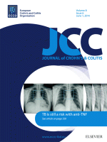
Journal of Crohn’s and Colitis
New in 2015
Medicine Collection
Official journal of the European Crohn’s and Colitis Organisation (ECCO)
Young journal in a niche, but important area
Publishes Chinese local edition
Takeaway from Elsevier
2013 Impact Factor - 3.562

Slide 16
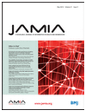
Journal of the American Medical Informatics Association
New in 2015
Medicine Collection
American Medical Informatics Association’s (AMIA) premier peer-reviewed journal
Prominent Editor-in-Chief, Dr. Ohno-Machado
Takeaway from BMJ Group
2013 Impact Factor - 3.932

Slide 17
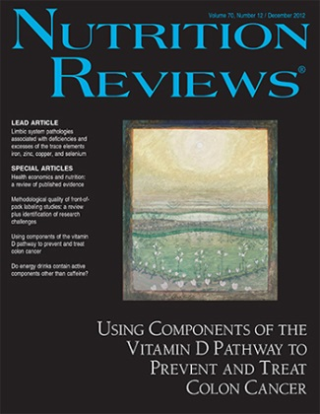
Nutrition Reviews
Medicine Collection
Published by the International Life Sciences Institute
Publishes articles on many topics related to public health
ILSI partners include Nestle, Coca Cola and Proctor and Gamble
Takeaway from Wiley-Blackwell
2013 Impact Factor - 5.541

Slide 18
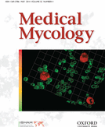
Medical Mycology
2014 Takeover
Medicine Collection
Focuses on fungi and their application within medicine
Official publication of the International Society for Human Animal Mycology, which is a recognised non-governmental affiliate of the World Health Organisation
Takeaway from Informa Healthcare
2013 Impact Factor - 2.261

Slide 19
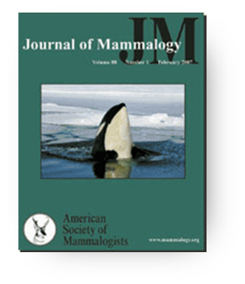
1. Journal of Mammalogy and 2. Mammalian Species
Life Sciences Collection
JM is the flagship publication of the American Society of Mammalogists
Highly respected journal with international scope (pub’d in 1919)
High-profile Editor-in-Chief, Joseph Merritt
MS sold individually and bundled w/ JM
Very social-media savvy society
Takeaway from Allen Press
2013 Impact Factor:
Journal of Mammalogy - 2.225

Slide 20
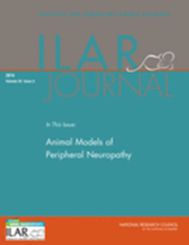
ILAR Journal
2013 Takeover
Life Sciences Collection
Peer-reviewed, theme-orientated publication of the Institute for Laboratory Animal Research (ILAR)
Promotes the high-quality, humane care and use of animals
Previously self-published
2013 Impact Factor - 1.051

Slide 21
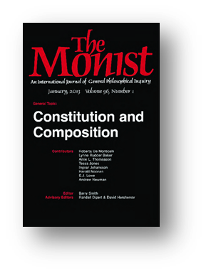
The Monist
Humanities Collection
Founded in 1888, The Monist is one of the world’s oldest and most important journals in philosophy
Affiliated with The Hegeler Institute
Each issue is a themed issue on a specific philosophical topic
Primarily US contributors
Previously self-published

Slide 22
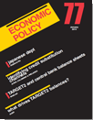
Economic Policy
Social Sciences Collection
Identifies current and emerging policy topics and provides authoritative analysis
Affiliated with three major research institutes (in UK, France, and Germany)
Submissions are almost 100% invited
Takeaway from Wiley-Blackwell
2013 Impact Factor - 2.875

Slide 23
Social Problems
Social Sciences Collection
Official publication of The Society for the Study of Social Problems
Prestigious editorial board and new editors in 2015
90% US authors, followed by Canada, France, Israel and Japan
Takeaway from University of California Press
2013 Impact Factor - 1.36

Slide 24
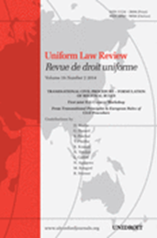
Uniform Law Review
2013 Takeover
Law Collection
Published on behalf of UNIDROIT (inter- national organization with 63 member states focused on private international law)
ULR is a comprehensive source of information for those involved in international private commercial law
Bilingual (English and French)
Previously self-published

Slide 25
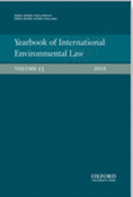
Yearbook of International Environmental Law
2011 Conversion
Law Collection
Yearbook was transitioned to the Journals platform in 2011 (previously print product)
Vital source of information in the rapidly evolving field of environmental law
Format allows reflection on longer-term trends rather than short-term developments

Slide 26
The 2015 Collection
285 titles
25 titles joining the Collection

Slide 27
2015 Collection Overview
Collection increases from 262 to 285
25 joiners
2 leavers

