Slide 1


A Single Window Gateway for
e-Content Access, Delivery and Analysis
EIFLGA 2017
www.remotexs.xyz

Slide 2
RemoteXs Key Features !
Serve & Access e-content from a single portal
Zero IT infrastructure cost (IP address allocation)
Inbuilt Authentication System (One login for all content)
Provides tools for user services & support
Comprehensive Administrator dashboard (Usage Statistics)
Device Compatibility (Works on all devices)

Slide 3
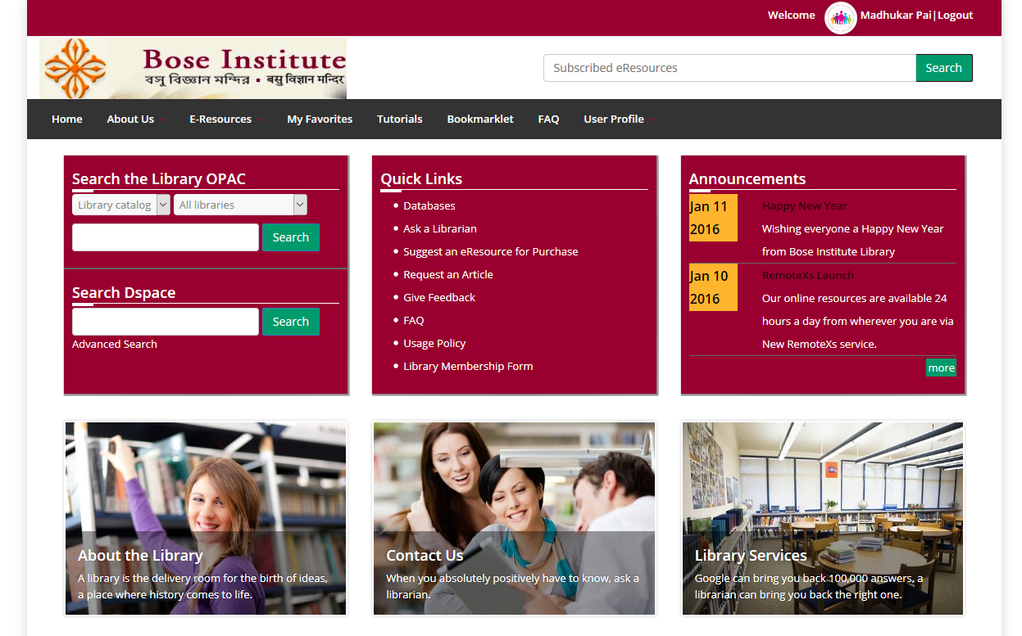
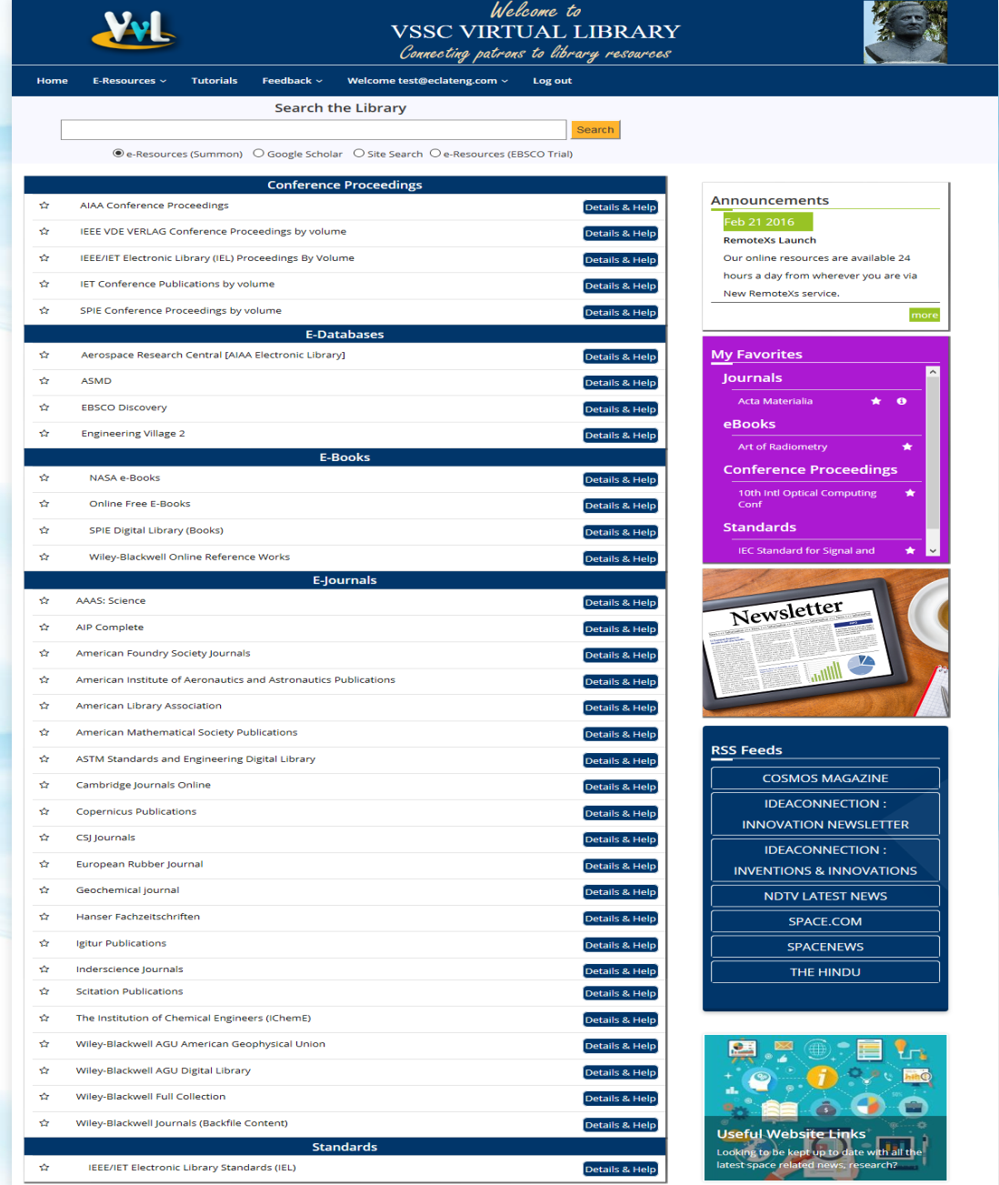
e-Content on a single portal
Challenge: Users struggle to find content across platforms
Customised Library Portal
Federated Search Widget
Library Web OPAC
Single Place to access all EResources
//

Slide 4
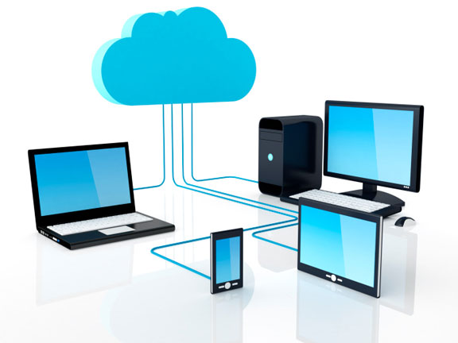

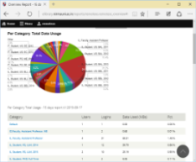
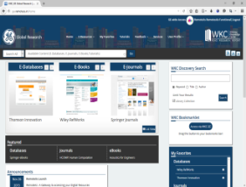
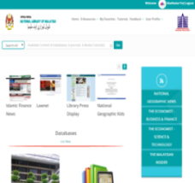

Zero IT infrastructure cost
Challenge: Poor IT infrastructure & support
Cloud Hosted Solution
Dedicated IP & VPS for each Client
No IT Skills required
Automated Data backup

Slide 5
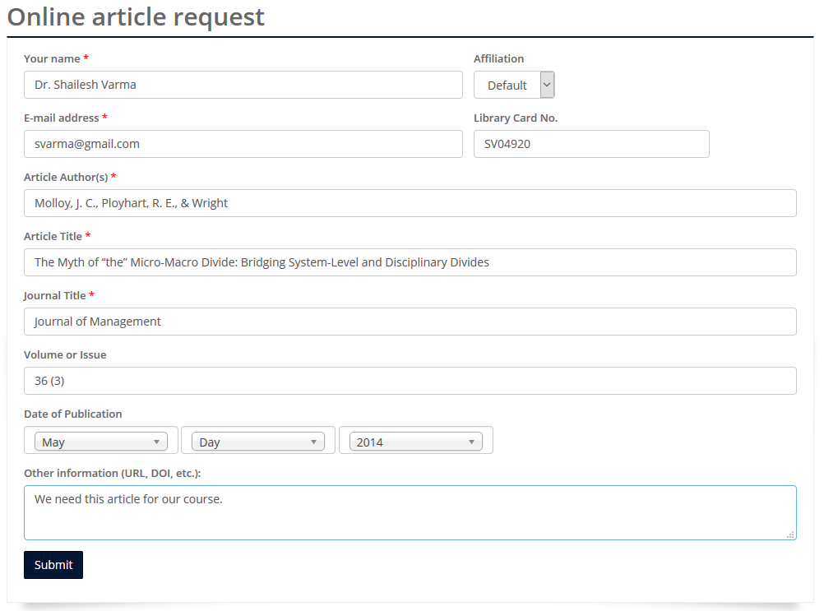
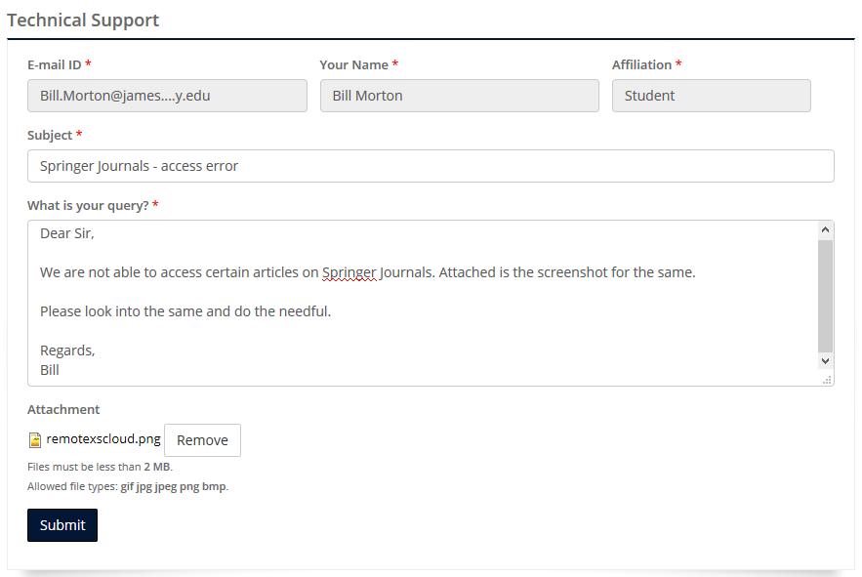
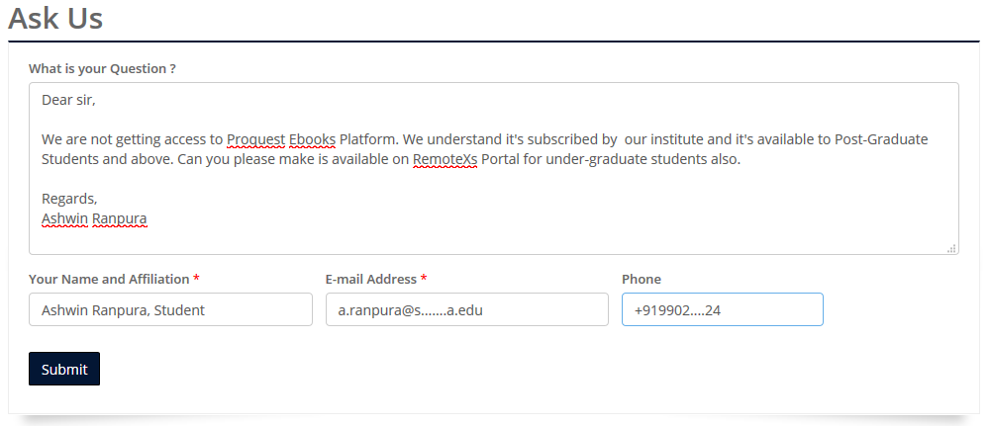
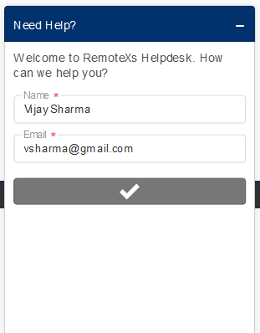
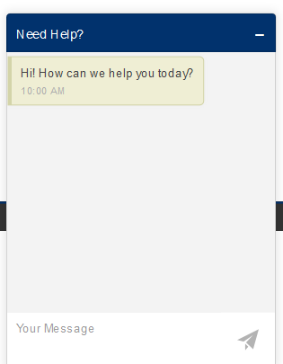
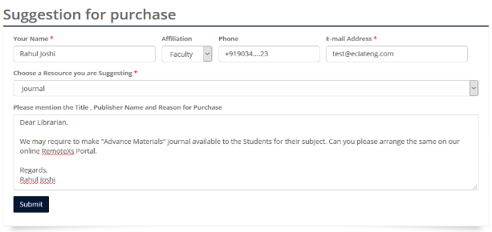
Effective User Services & Support
Challenge: Support & Manage User queries
Online Article Request
Suggestion for purchase
Technical Support
Ask Us
Live Chat Help
Live Chat

Slide 6
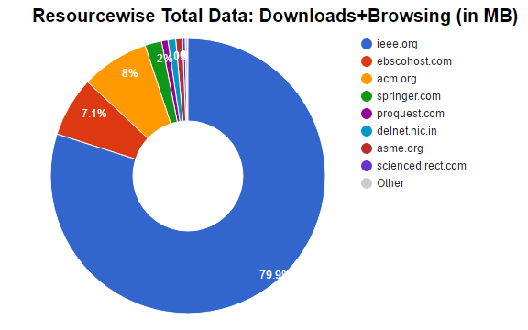
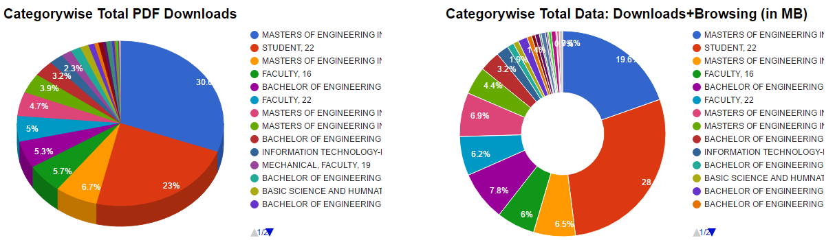
Comprehensive Administrator dashboard
Challenge: Consolidated Usage Statistics
Easy to use Admin Dashboard
Comprehensive Reports

Slide 7
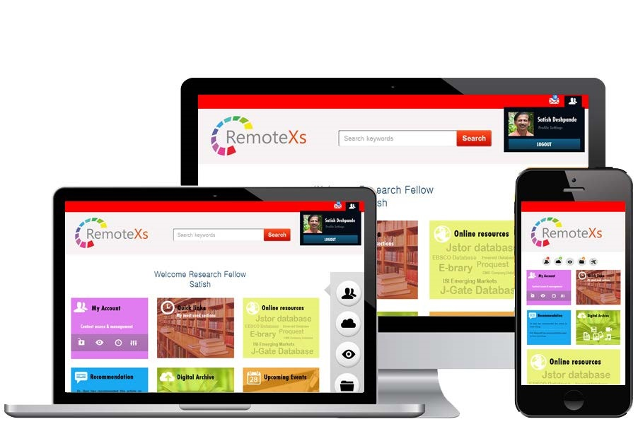
Device Compatibility
Challenge: Content access through multiple devices
Device Compatible
Responsive Portal Design

Slide 8
GTU CASE STUDY
GOAL
Improve Research output and University Ranking
CHALLENGE
Temporary campus, IP and UID – PWD authenticated resources, IT Infrastructure, Skilled IT staff, Implementing Paper review policy
SOLUTION
RemoteXs – 24 X 7 Access, Easy Management & Analysis of subscribed e-Resources
RESULTS
Maximised ROI on subscribed content, Policy implementation; Enhanced Research output
30 days usage in Dec 2015 –
40 downloads / day average | average 15 users / day
30 days usage in Dec 2016 –
180 downloads / day - average | average 41 users /day

Slide 9









Success Stories
CORPORATES
GE GLOBAL
SPECIAL LIBRARIES
KUIS JAPAN; ISN MALAYSIA
RESEARCH LABS
ISRO; DRDO; DAE
B-SCHOOLS
IUKL MY ; ISB ; IIMs
UNIVERSITIES
MSU MY ; VIT

Slide 10
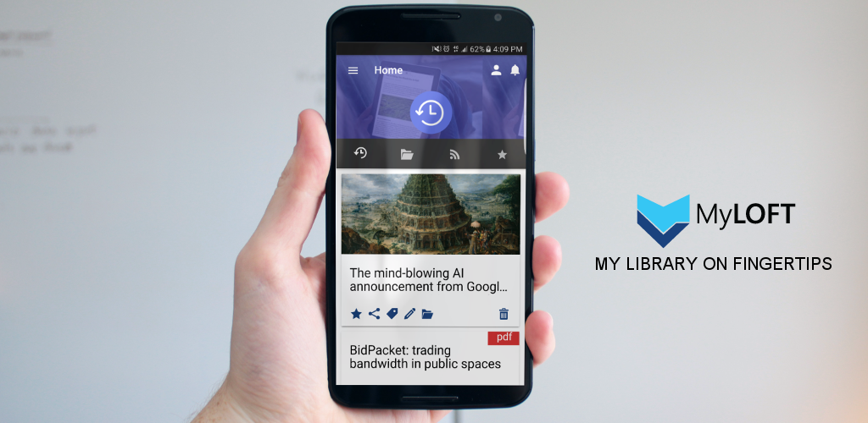
MyLOFT – Mobile App
Access-Organize-Share digital content and E-Resources subscribed by your Library
Save Content and Access it Offline
Access Library subscribed E-Resources
Read/Follow RSS feeds you love
Tag and Organize your content
Highlight & Play your content

Slide 11

Thank you
JATIN BARAIYA
Jatin@eclateng.com
www.remotexs.xyz

