Slide 1

SUNScholar
Stellenbosch University Institutional Repository
Ina Smith & Hilton Gibson
09 September 2011
Open Access Repositories with DSpace and Fedora

Slide 2
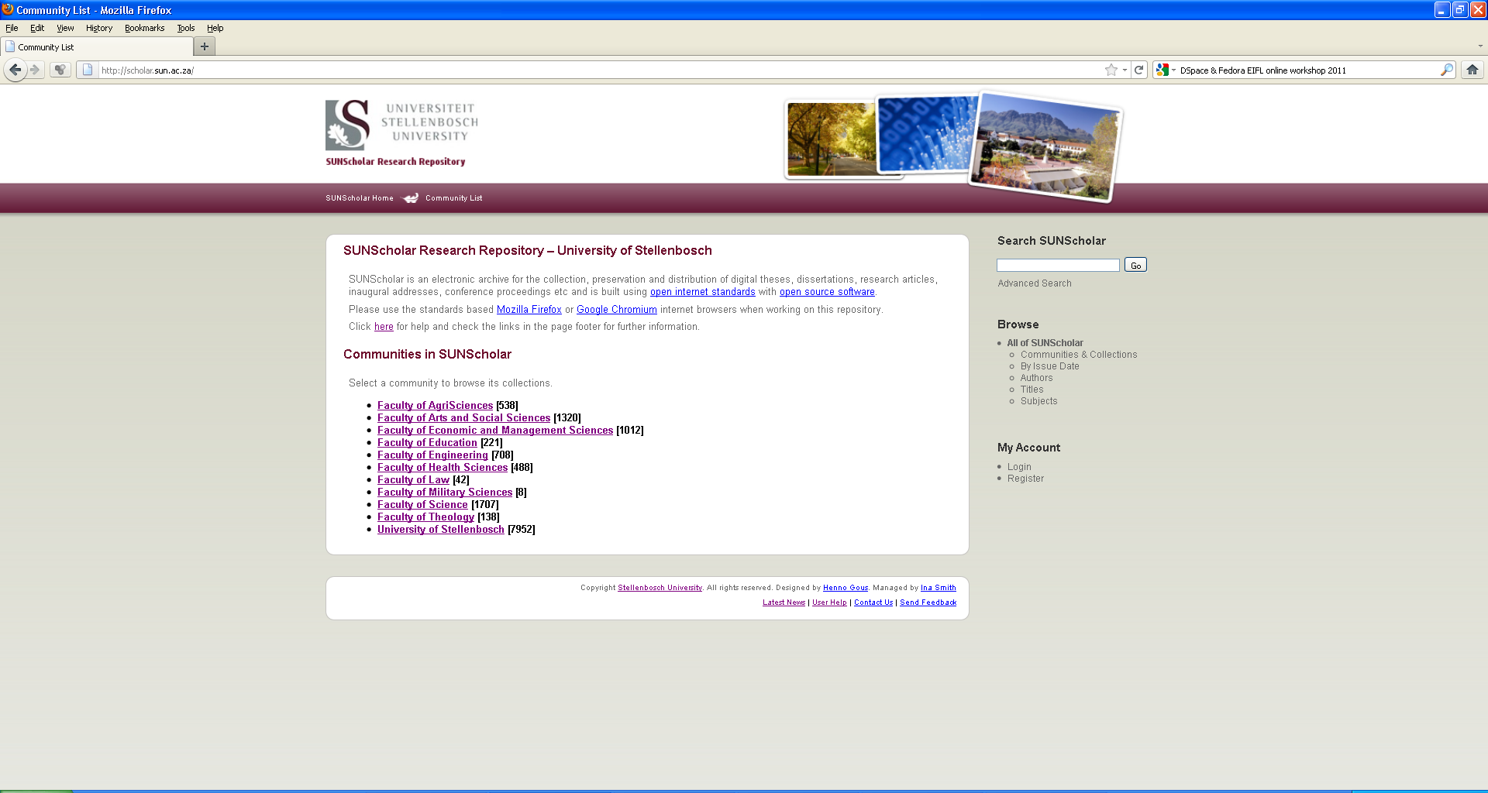
scholar.sun.ac.za

Slide 3
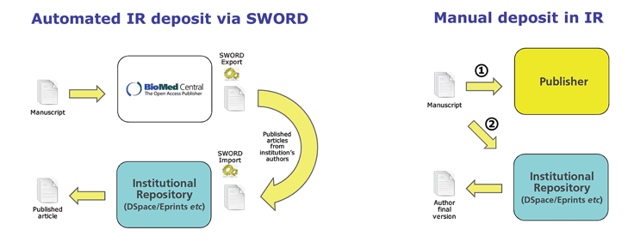

Automated article -deposits

Slide 4
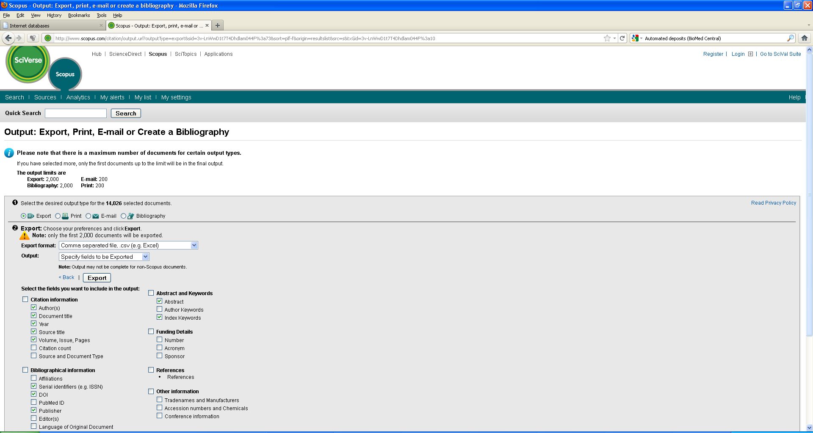
Scopus Imports

Slide 5
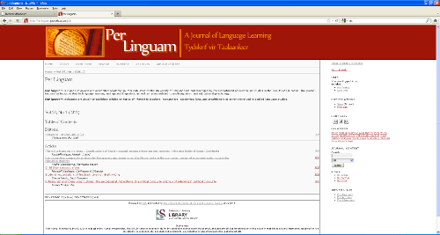
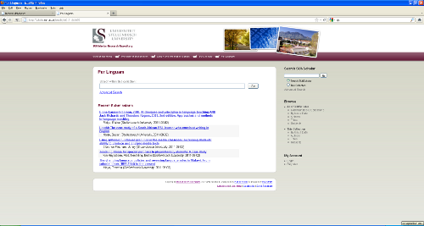
DSpace Harvesting
SUNJournals
Open Journals Systems
www.journals.ac.za
SUNScholar
DSpace
scholar.sun.ac.za
Metadata

Slide 6
Installation Reference Platforms
Hardware specifications
Operating system specifications
Compatible DSpace and Fedora versions
THEN installation wizards – easy to use

Slide 7
Long Term Support Strategy
Service Level Agreements
Technical Staff
Business Model

Slide 8
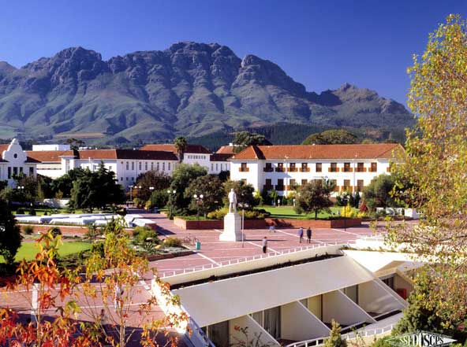
Thank you!

