Slide 1
DSpace @ The University of Hong Kong (HKU)
David Palmer, 9 Sep 2011

Slide 2
Knowledge Exchange (KE),
Emphasizing a two way exchange between HKU and its community

Slide 3
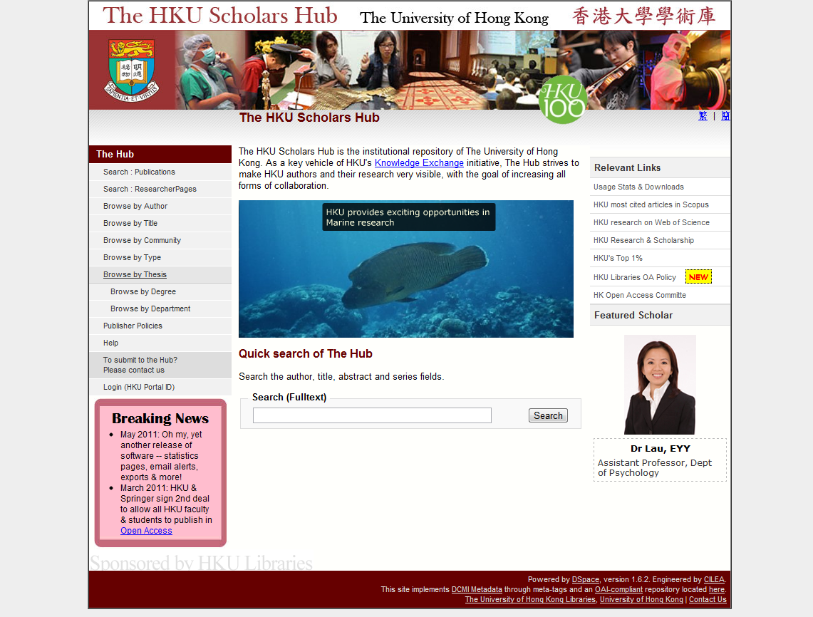

Slide 4
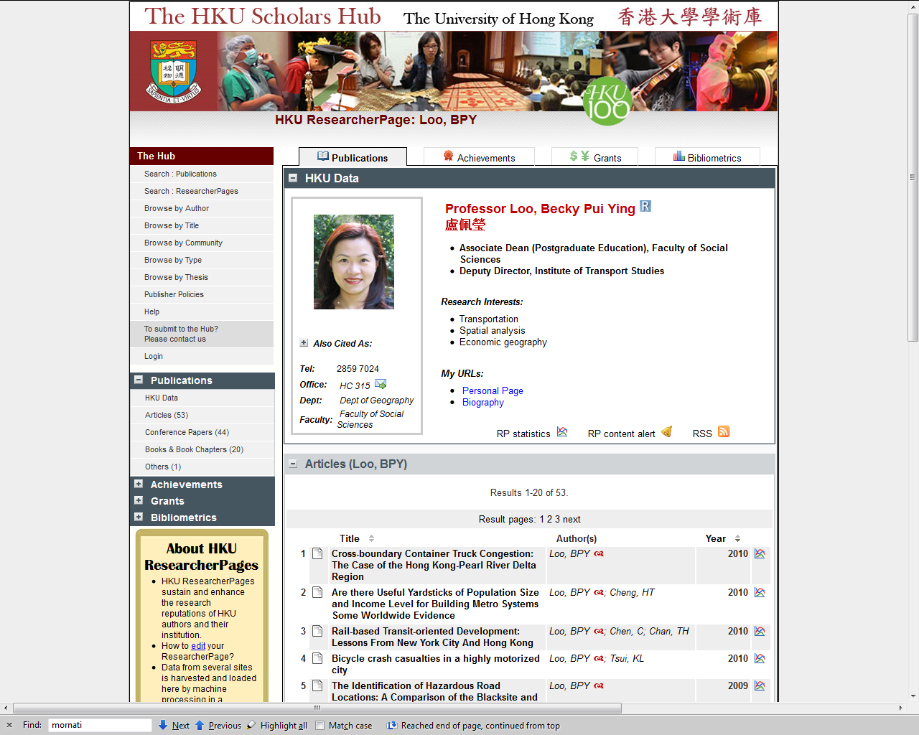

Slide 5
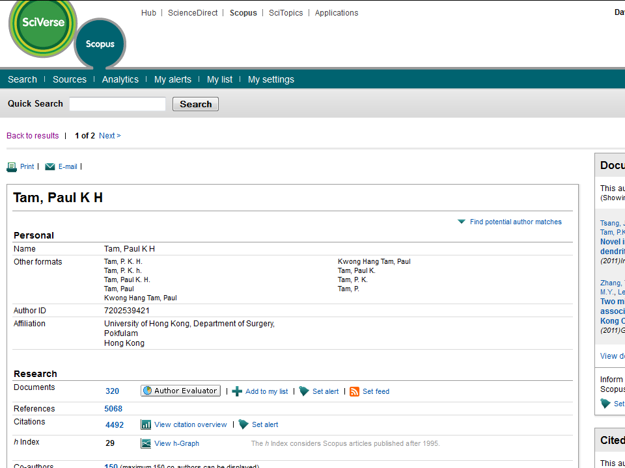

Slide 6
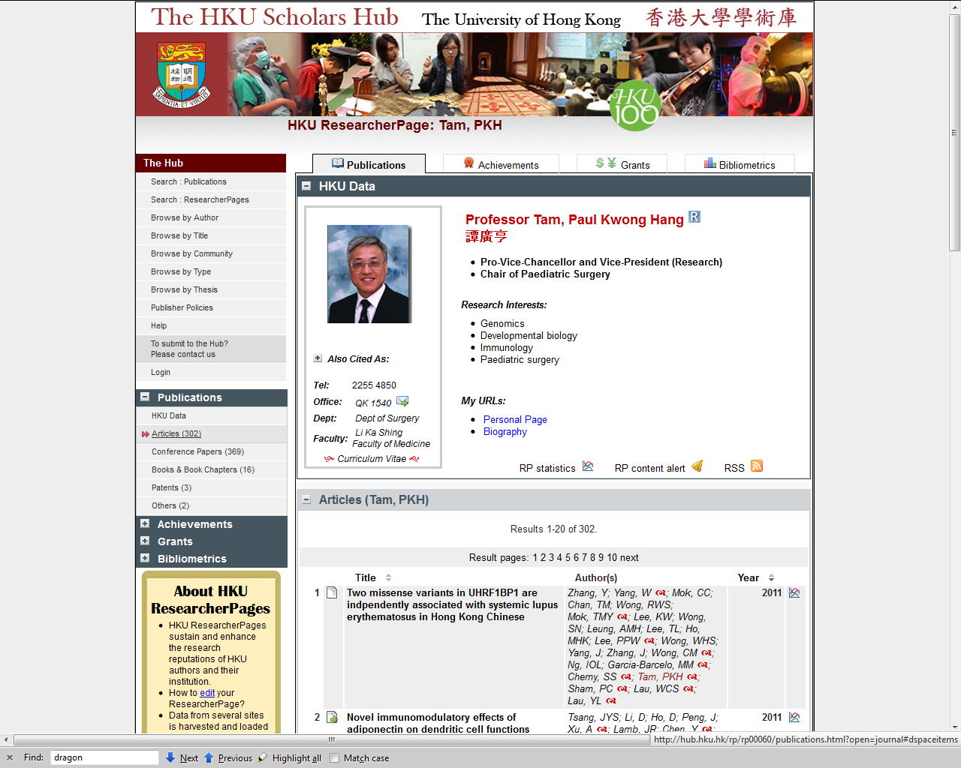

Slide 7
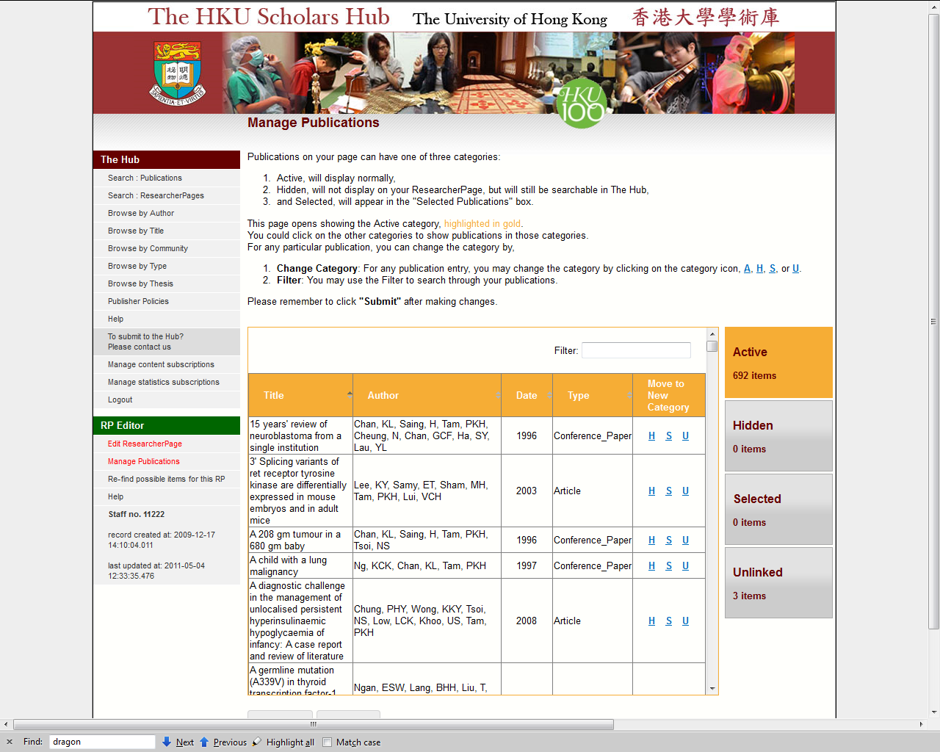


Slide 8
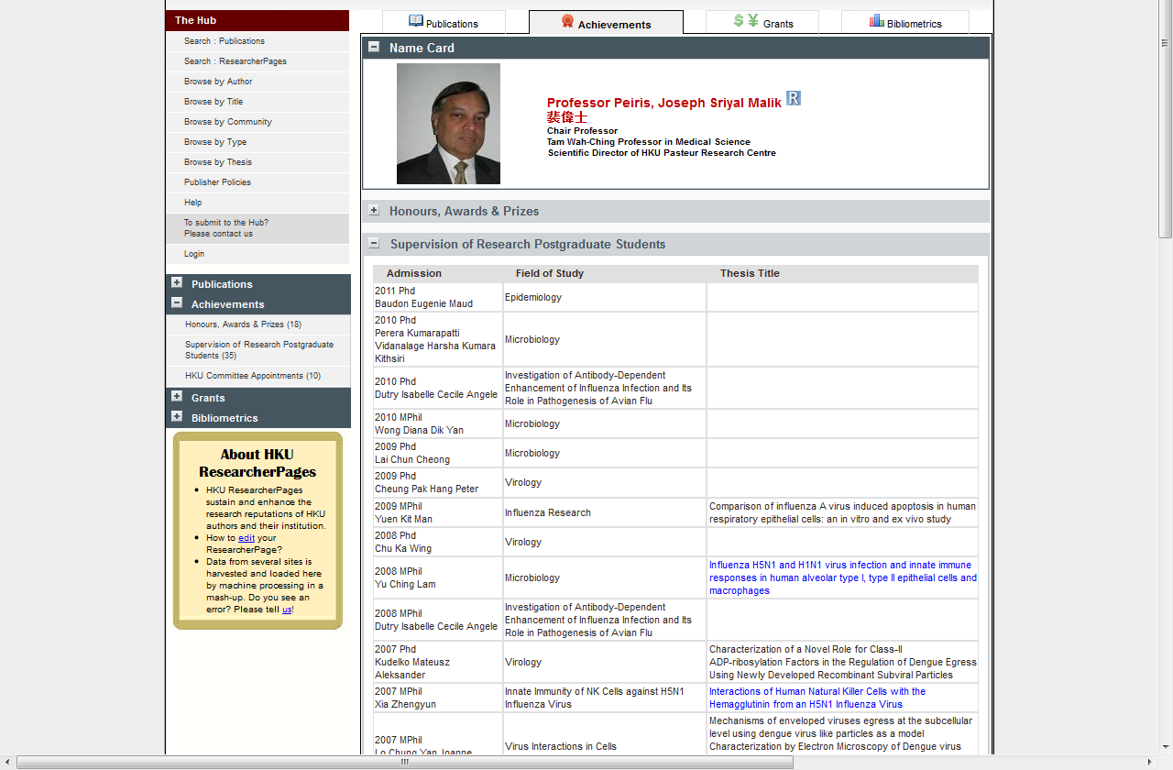

Slide 9
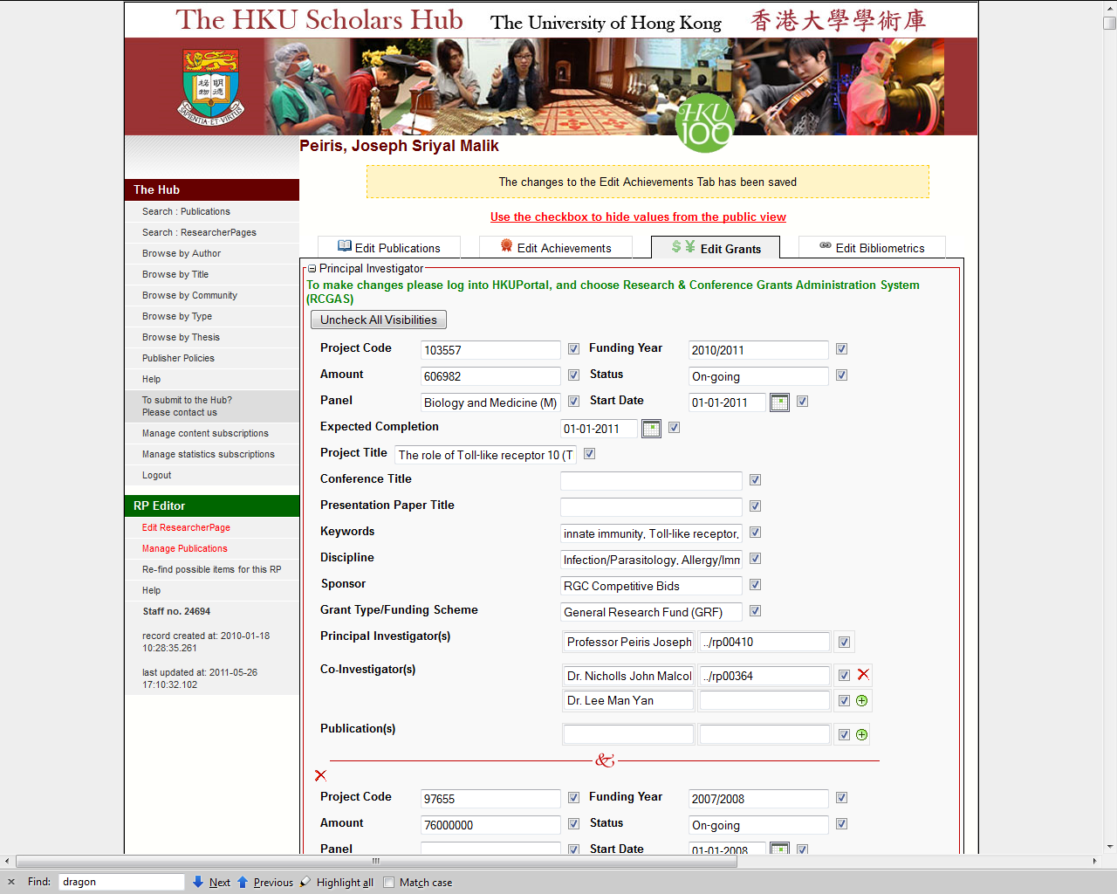

Slide 10
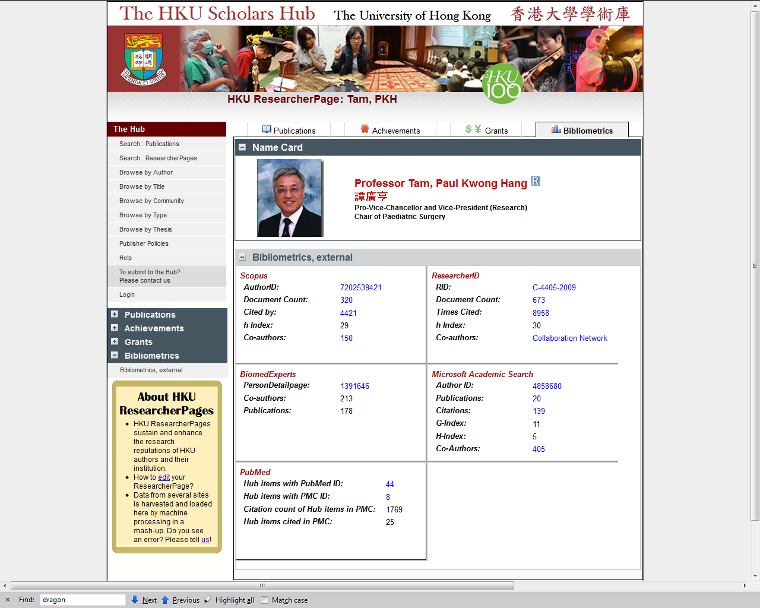

Slide 11
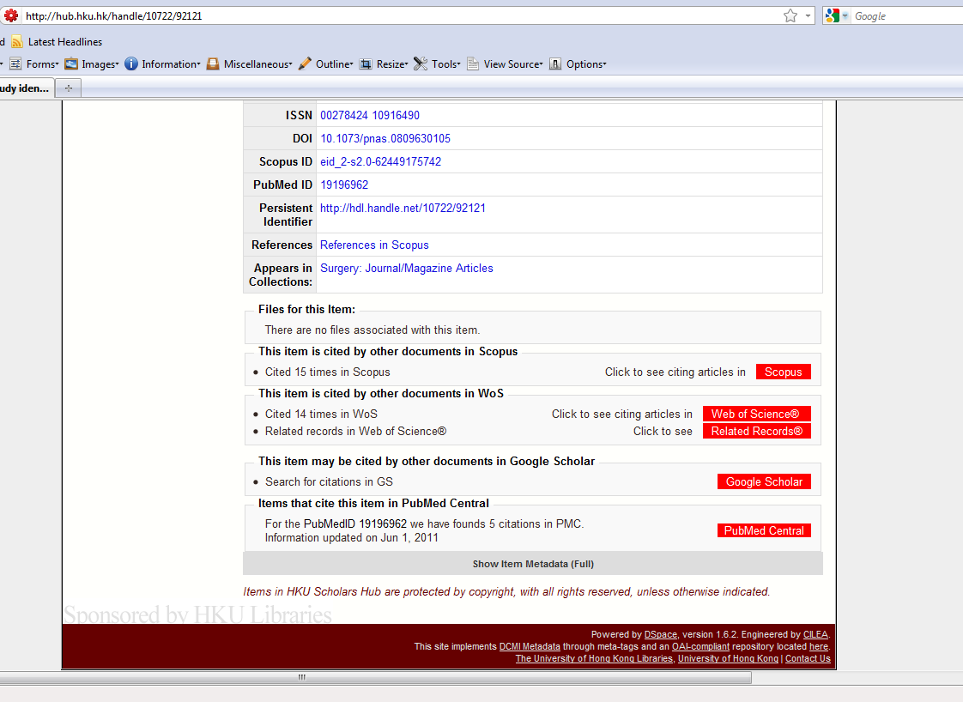
Notes:
1) Links to external, 2) shows citation count, 3) control numbers also hyperlinked, 4) click thru to see references in Scopus.

Slide 12
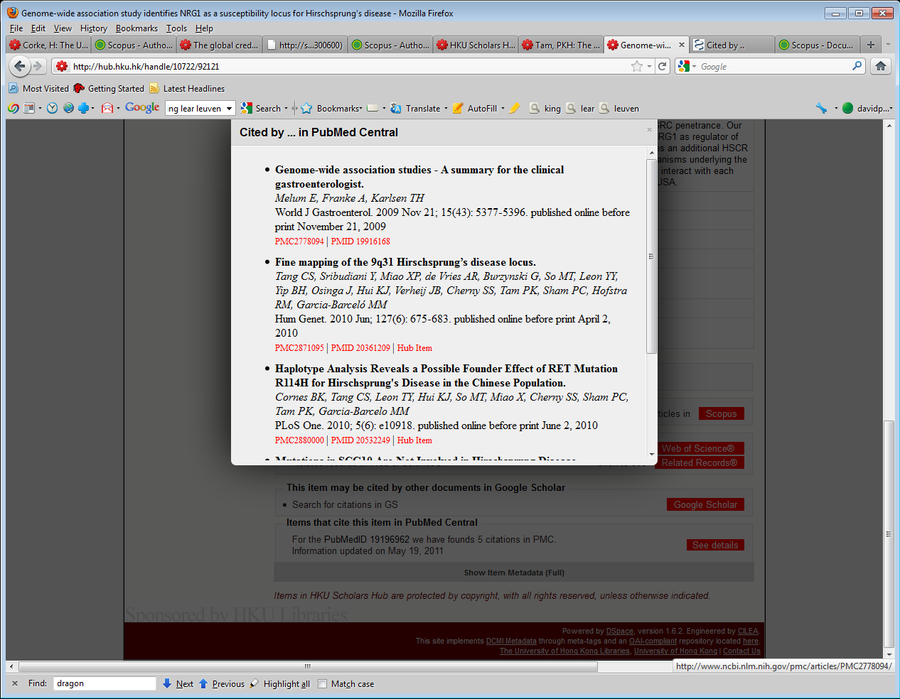

Slide 13
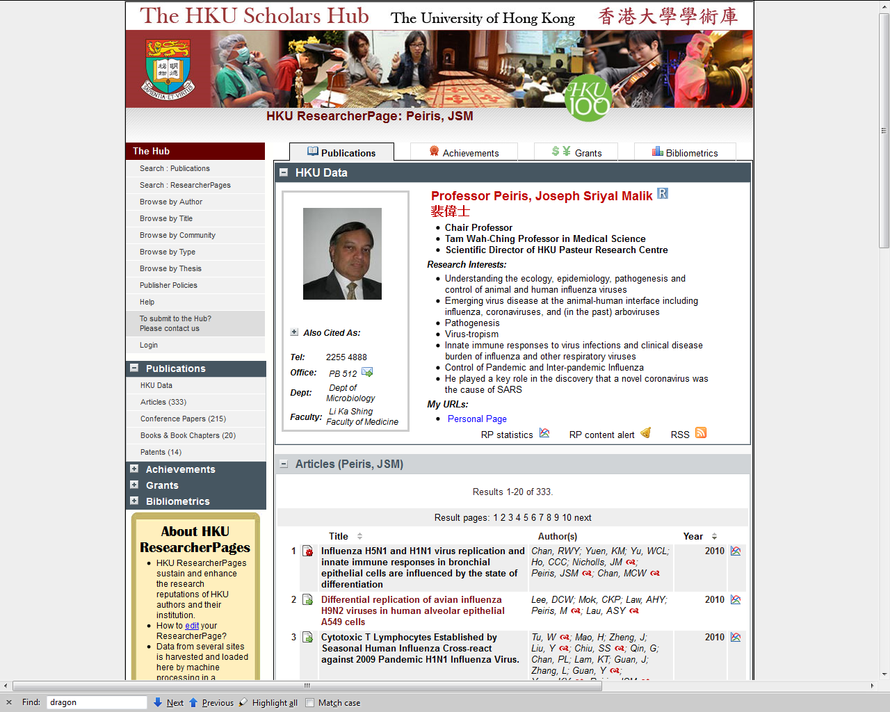

Slide 14
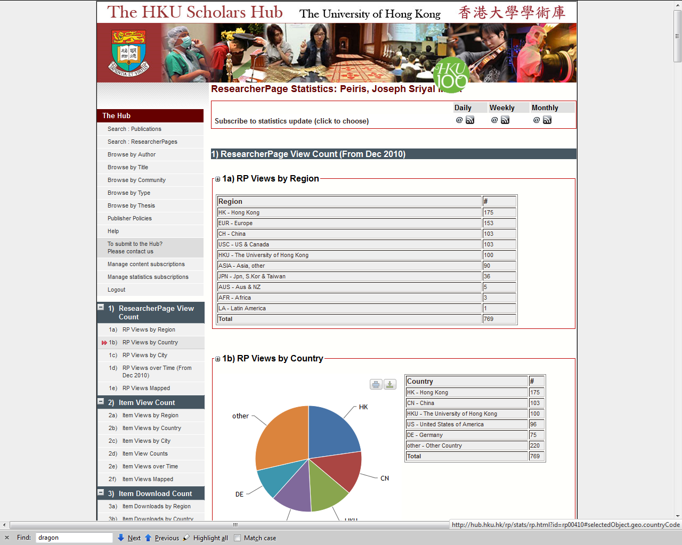

Slide 15
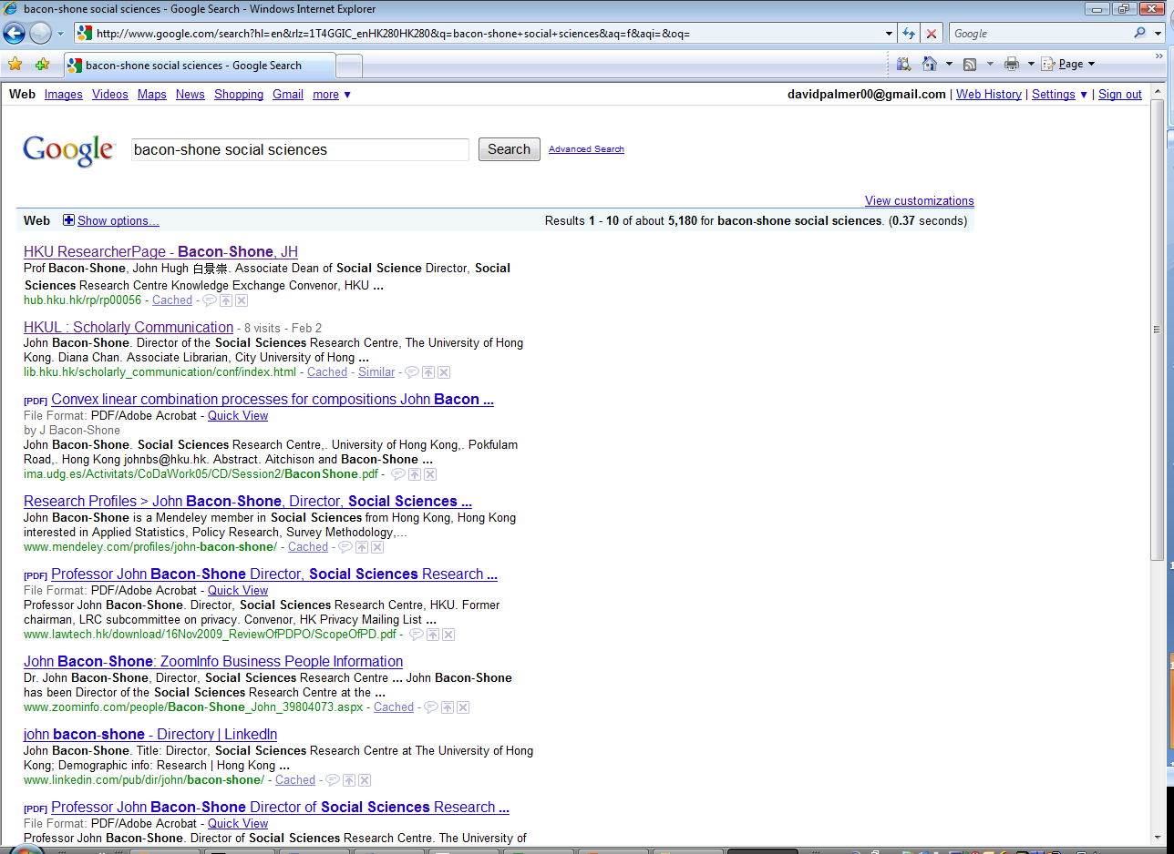
On any relevant search, entry for Hub usually comes at top of page

Slide 16














HKU Colleagues
港大同僚
Thank You
謝謝您
Grazie
спасибо
شكرا لك
감사합니다
cảm ơn bạn
धन्यवाद
Σε ευχαριστώ
תודה
有り難うございます
Notes:
Tell about cilea. On our design, they quickly engineered an elegant product. Easily extensible, into future releases of Dspace. Meet deadlines, without hiring extra staff.

