Slide 1
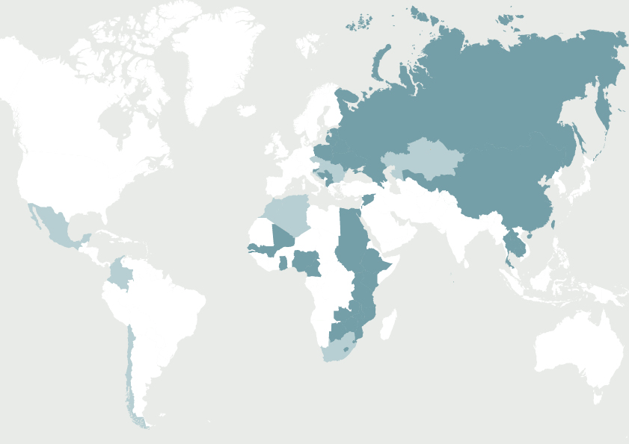

Breakthrough in UK copyright reform:
what does it mean for libraries?
EIFL-IP webinar, 4 July 2014

Slide 2
Five reasons why the reforms to UK copyright law matter to EIFL-partner countries
Teresa Hackett, EIFL-IP Programme Manager
1. The issues are applicable to libraries everywhere.
2. The influence of UK copyright law extends beyond its borders through history and trade. The UK has a strong network of trade relations and bi-lateral trade agreements with non-EU countries, including developing and least developed Commonwealth countries.
3. Many former colonies and territories today have laws that reflect the structure, style and language of British copyright law. So the provisions may be easily adapted to the copyright law in common law countries.
4. Any country wishing to implement similar provisions can be assured that they comply with international and European law. This is because the UK is party all the major international copyright treaties, and is a member of the European Union.
5. The UK library community has valuable lessons to share in successful advocacy.

Slide 3


UK © Reform
@UKLACA
Adaption: Benjamin White
Original: Chris Morrison

Slide 4
Could it be true that laws designed more than three centuries ago with the express purpose of creating economic incentives for innovation by protecting creators’ rights are today obstructing innovation and economic growth?
The short answer is: yes. We have found that the UK’s intellectual property framework, especially with regard to copyright, is falling behind what is needed. Copyright, once the exclusive concern of authors and their publishers, is today preventing medical researchers studying data and text in pursuit of new treatments. Copying has become basic to numerous industrial processes, as well as to a burgeoning service economy based upon the internet. The UK cannot afford to let a legal framework designed around artists impede vigorous participation in these emerging business sectors.

Slide 5
Hargreaves recommendations
Rebalance copyright regime
Format neutral
Future proof
Improve licensing
Representative of digital practices and potential
Evidence based

Slide 6
Improvement of Licensing
Orphan Works UK Licensing
Extended Collective Licensing

Slide 7
Research and Private Study – S29
Limited ‘fair-dealing’
Non-commercial
All copyright works including sound recordings and films
No override by contract

Slide 8
Accessible copies for disabled users
- S31
Widened to all impairments which prevent equal access
All types of copyright work
No contractual override
Requires TPM to be carried over in the copy too!?!?!?!

Slide 9
Library Privilege Copying to
Individuals S.42-43
Non-commercial research or private study
Reasonable proportion of “any published work”
Declaration required
If charged must cover cost of production
No contractual override (other than unpublished works)

Slide 10
Library/Archival Preservation – S42
Reasonable copies of items in “permanent” collection
All types of copyright work including sound recordings, films and broadcasts
No contractual override

Slide 11
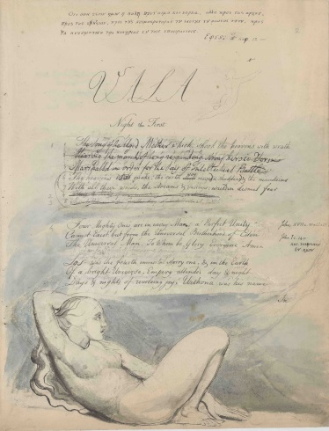
Library Copying of Unpublished Works
– S43
All types of copyright work
For private study / non-commercial research
Contractual Override

Slide 12
Making Works Available Through Dedicated Terminals – S40B
New exception from 2001 EU © Directive
Relates to a publicly accessible library, educational establishment, museum or archive
Allows digitised collection items to be viewed on site through ‘dedicated terminals’
Research or private study
Query on ‘dedicated terminals’ definition – German case.
Is made available in compliance with any purchase or licensing terms to which the material is subject

Slide 13
Text & Data Mining – Big Data
New exception – a real “digital opportunity”
Use of algorithms to determine relationships in data
Non-commercial use (limited by EU © Directive)
Requires legitimate subscription/access to content to be mined
No contractual overrides

Slide 14
HOW DID WE MANAGE THIS?

Slide 15
LOTS OF HARD WORK OVER MANY YEARS

Slide 16
LIBRARIES ONLY MATTER BECAUSE OF WHO THEY SERVE
Researchers, Scientists, Science etc

Slide 17
Responded to Governmental Reviews
Meetings with Civil Servants
Meetings with Parliamentarians
Written Briefings
Speaking Events
Roundtable events with politicians

Slide 18
Evidence
Studies
Reports
Facts
Data
Arguments around money
Economics

Slide 19
Alliances
Universities
Schools, Colleges
Disabled Groups
Technology Companies
Pharmaceutical Companies

Slide 20
Social Media Presence Not a Bad Way of Disseminating Info to Like Minded People

Slide 21

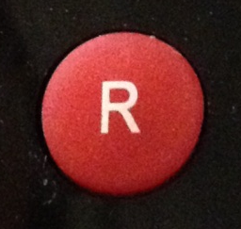

Questions

Slide 22
Thank you
@UKLACA
4.0

Slide 23
Information on EIFL-IP
www.eifl.net/copyright

