Slide 1

POLISH COPYRIGHT LAW 2015
ANALYSIS OF LIBRARY-RELATED PROVISIONS
Barbara Szczepańska
EIFL webinar, 29 June 2016

Slide 2
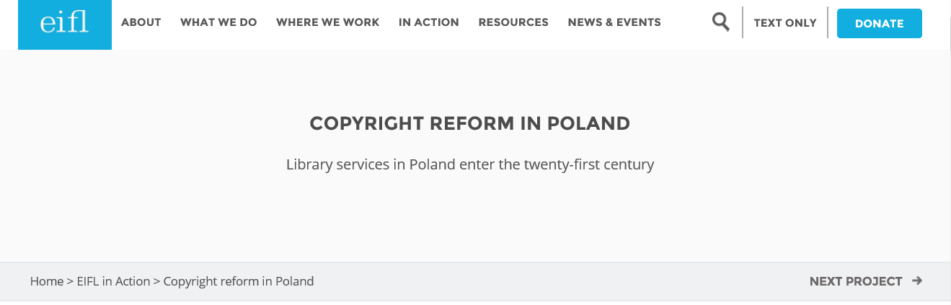
More on the project: http://www.eifl.net/eifl-in-action/copyright-reform-poland

Slide 3
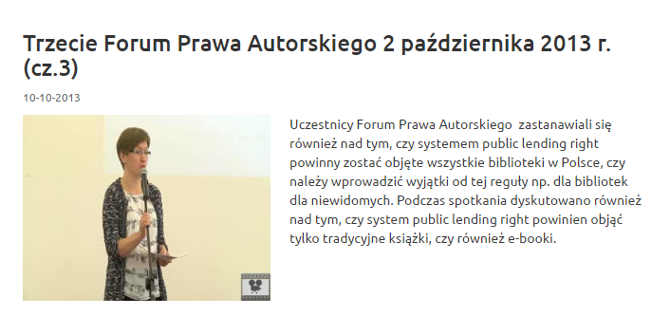
Consultation process
Copyright Forum – permanent platform established by the Ministry of Culture and National Heritage for discussion of copyright issues

Slide 4
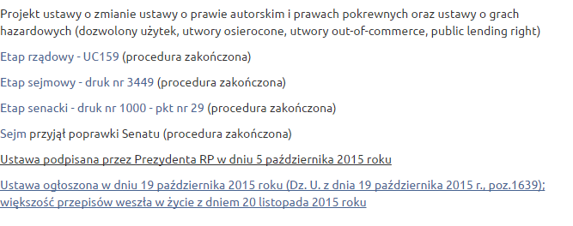
Consultation process
Consultation of the draft law and regulations
  (draft, explanatory note, impact asessment, consultation report)
More on the website: http://www.prawoautorskie.gov.pl/pages/strona-glowna/zmiany-w-prawie/prawo-autorskie/projekt-zmiany-ustawy-o-prawie-autorskim-i-prawach-pokrewnych.php

Slide 5
Legal Framework
Act of 4 February 1994 on Copyright and Related Rights
2004 Poland joined EU
20 November 2015 - the Act of 11th September 2015 on amendments to the Copyright and Related Rights Act and the Law on Gambling
+ regulations
  Regulation on out-of-commerce works: template to apply for the use of out-of-commerce works
  Regulation on orphan works: sources for diligent search and documentation
  Regulation on out-of-commerce works: tender for collecting societies authorized to conclude contracts for use of out-of-commerce works
  Regulation on Public Lending Right payments tender for collecting societies authorized to collect and distribute PLR

Slide 6
EU Legal Framework
„Better” implementation of the Directive 2001/29/EC of the European Parliament and of the Council of 22 May 2001 on the harmonisation of certain aspects of copyright and related rights in the information society
„Revised” implementation of the Directive 2006/115/EC of the European Parliament and of the Council of 12 December 2006 on rental right and lending right and on certain rights related to copyright in the field of intellectual property
Implementation of the Directive 2012/28/EU of the European Parliament and of the Council of 25 October 2012 on certain permitted uses of orphan works
Implementation of the Memorandum of Understanding on Key Principles on the Digitization and Making Available of Out-of-Commerce Works

Slide 7
Key amendments
permitted uses by libraries
permitted uses of orphan works
permitted uses out-of-commerce works
permitted uses in education and science
introduction of a public lending right (PLR)
abolition of the paying public domain

Slide 8
Permitted uses by libraries
extended list of beneficiaries – museums, reaserch and scientific institutions, etc.
requirement - institutions whose activities are not for direct or indirect financial gain
from providing access to lending - new definition
extended preservation exception – digital form and unpublished works
clarification in the provision on the access on premises at the dedicated terminals

Slide 9
Digital preservation
From:
Exception for making copies of disseminated works in order to supplement them, maintain or protect one's own collections
To:
Exception for reproduction of works constituting a part of their own collections to supplement, maintain or protect such collections

Slide 10
Dedicated terminals
TU Darmstadt case
number of copies made available at terminals must not exceed the number of physical copies held by the library
digitisation and making available of physical works on library terminals is permitted only if the resource in question is not already available in the library in digital form (on the basis of contract or licence agreement)
printing from terminals is possible under the private copy exception
  More on TU Darmstadt case www.eifl.net/news/tu-darmstadt-copyright-case-neatly-explained

Slide 11
Orphan works
Types:
works published in a form of books, newspapers, magazines and in other types of printed publications, audiovisual works and other works fixed on video and on phonograms
photographs and pictures embedded into works
Not covered:
standalone photographs and works of art
works which were published anonymously or under a pseudonym
  More on OW directive http://www.eifl.net/resources/european-orphan-works-directive-eifl-guide

Slide 12
Orphan works
Beneficiary organisations:
publically accessible educational institutions, universities, research institutes and scientific institutes of the Polish Academy of Sciences, libraries, archives and museums, government and local authority organization with a statutory obligation to collect, protect and promote film and phonographic heritage, public national and regional radio and television organisations

Slide 13
Orphan works
Permitted uses:
reproduction, including for the purposes of preservation
cataloguing and digitisation of collections, and making available on the Internet for the purpose of culture and education
Uses apply only to works that belong to the collections of the institution.
Limited to non-commercial activities - the entities may charge for the use of orphan works.

Slide 14
Orphan works
Diligent search in good faith:
list of sources broader then in the Directive, ex.
    online film databases
    certain types of libraries
other resources – if the entity carrying out the diligent search concludes that in any given case, information about rightholders may be found in any other source
record keeping
A diligent search may be carried out either by the beneficiary institution itself or it may be sub-contracted to third party.

Slide 15
Orphan works
  End to the orphan works status:
  Final text (2015)
  Fair compensation:
  the nature and manner of use of the work
  possible income derived from its use
  damage suffered by the rightsholder due to such use
  Draft (2014):
  Remuneration only when the entity using the work derived income from its use. In determining the amount to be paid, the public interest was to be taken into account.

Slide 16
Out of commerce works
Works still protected by copyright but no longer available on the market
Works which are not available to commercial end-users in the number that satisfies the reasonable needs of the end users, or by way of making them publicly available in such a manner that everyone could access them at the place and time selected thereby.
licence solution - based on contract between the library and the collecting society
works published in books, newspapers, magazines or other forms of print publishing
only works published for the first time in the territory of the Republic of Poland prior to 24 May 1994
translations into Polish of works created in a foreign language are excluded
non commercial use only
not working yet

Slide 17
Permitted uses in education and science
enumerated list of entities
entities must not be of a commercial nature and their primary objective should not be to obtain financial gain
no remuneration for rightholders
illustrating any content presented for educational purposes or for the purposes of conducting scientific research
  use of disseminated works in the original and in translation
  reproduction of minor works or fragments of larger works
  standalone works, such as photographs and poems, may be used in their entirety
New exception for virtual learning environments

Slide 18
Public Lending Right
Payment for lending by libraries
lending (not e-lending) in public libraries - only
„works expressed in words” created or published in Polish or translated into Polish
special public fund - the Fund for the Promotion of Creativity
amount to be paid for library lending shall be equal to 5% of the value of purchase of library materials
75% to authors (including authors of graphical or photographic elements) and translators into Polish, and 25% to publishers
Based on lending statistics from 60 libraries

Slide 19
Abolition of the Paying Public Domain
The paying public domain system was seen as an anarchonism that discouraged access and did not provide value for money.
Current cultural policy goals of the Republic of Poland are aimed at providing wide legal access to creative content.

Slide 20
Copyright reform in Poland
New copyright law of Poland. Analysis of library-related provisions:
www.eifl.net/sites/default/files/resources/201605/poland_copyright_analysis_online.pdf
Read more about the project:
www.eifl.net/eifl-in-action/copyright-reform-poland

