Slide 1
Open Science Advocacy and Capacity Building in Nigeria
By:
LIBSENSE ECR- Nigeria

Slide 2
Introduction
The Research Data Management (RDM) Advocacy Group is a group of Early Career Researchers (ECRs) from various academic institutions in Nigeria who debuted to develop and implement a coordinated set of activities to inform Research Data Management (RDM) policy, research ethic practices, open access and research assessment reforms in Nigerian institutions.
The group have metamorphosed to be known as the LIBSENSE Open Science Nigeria.

Slide 3
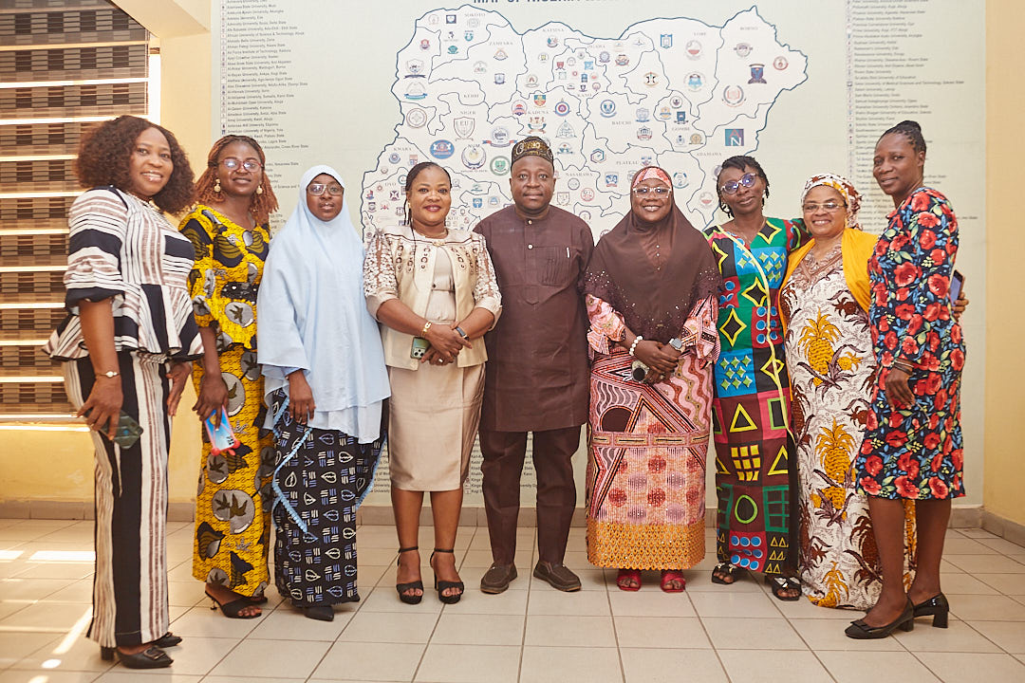
The LIBSENSE Nigeria Group
The founding ECRs and their institutions of affiliation are:
Federal University of Technology Minna (Dr Fatimah Jibril Aduldayan & Dr Sadiat Adetoro)
Redeemers University, Ede (Dr Basiru Adetomiwa)
Lead City University, Ibadan (Dr Sophia Adeyeye)
University of Nigeria, Nsukka (Mrs Ify Obim)
Ignatius Ajuru University of Education, Portharcourt (Mrs Benedicta Uchendu)
Lagos State University of Science & Technology (Dr Taiwo Ajayi).
ABU Zaria (Dr Opeyemi Quadri)
University of Jos (Mrs Tihyaunin Dang)

Slide 4
LIBSENSE Nigeria Priority Areas
Research Data Management Policy
Diamond Open Access Publishing
Responsible Research Assessment Reforms
Capacity Building
Research Infrastructure
Research Ethics
Open Science Governance Structure

Slide 5
LIBSENSE NIGERIA
Contributions at the National Level

Slide 6
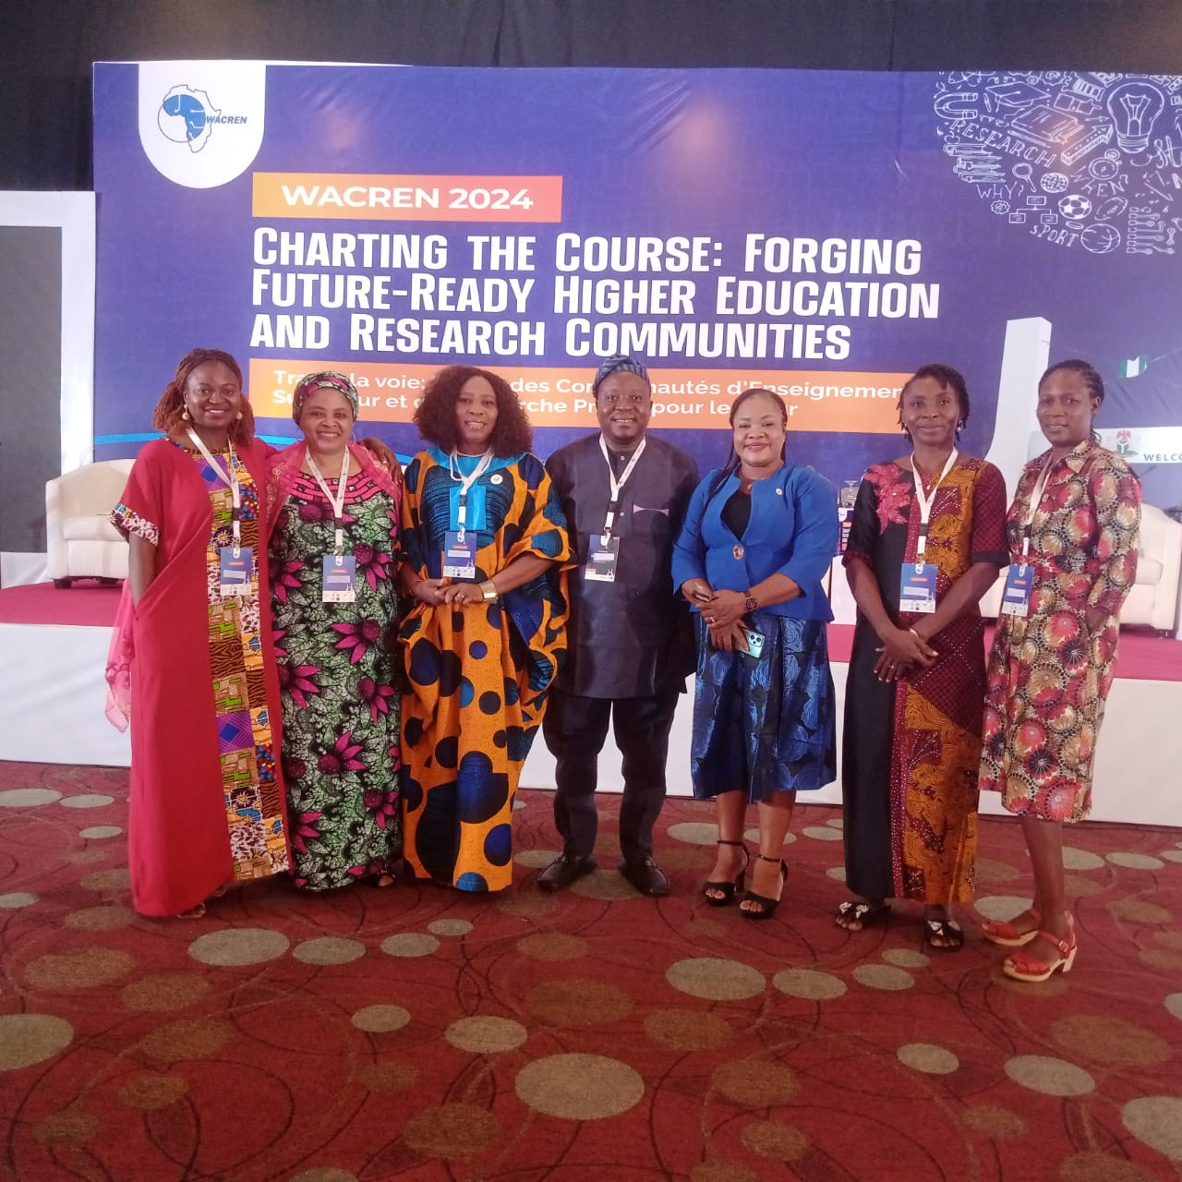
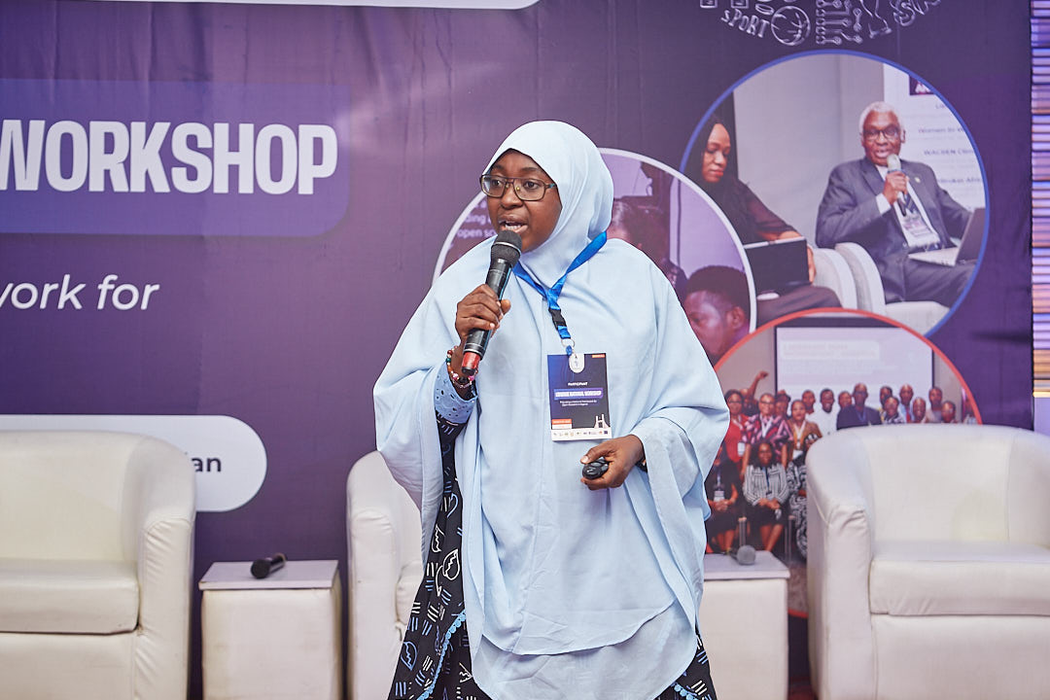
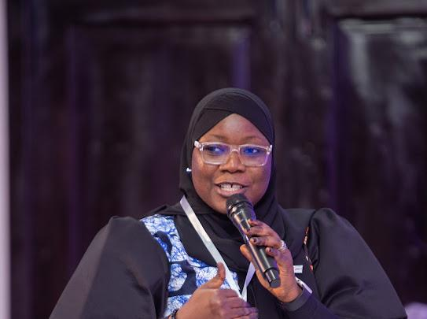
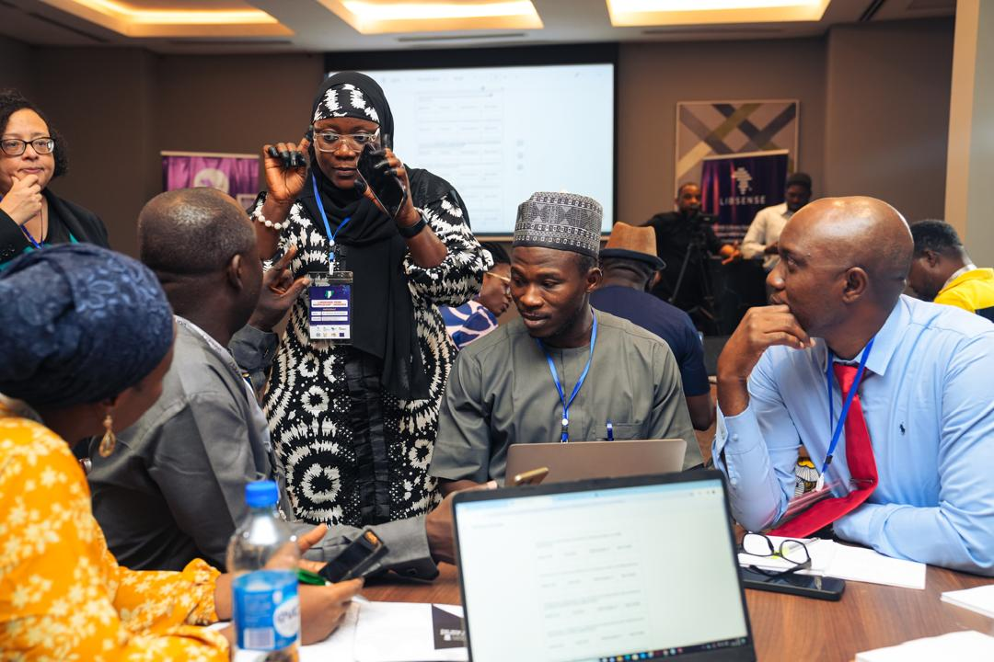
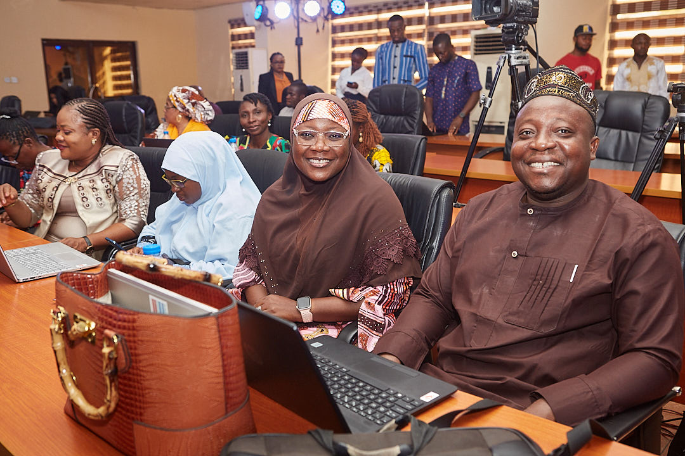
Our Contributions at National Level
The group in collaboration with the Association of University Librarians of Nigerian Universities (AULNU), Committee of Vice Chancellors in Nigerian Universities (CVC-NU), and the LIBSENSE Network of Experts have come out with several outputs:
A new common repository metadata schema
A call to action on assessment systems
Work plans and policy directions derived from a research data management (RDM) workshop
A national report on Diamond Open Access journal
We presented these outputs at priority-setting leadership engagement meetings in Lagos, Abuja, Port Harcourt, and Ghana.

Slide 7
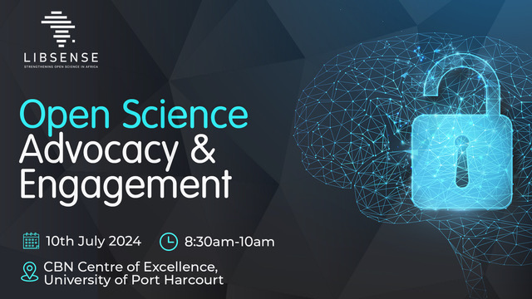
Our Contributions at the National Level
A call to action by librarians on Open Science practices on campuses at the Nigerian Library Association (NLA) Conference in Port Harcourt, Rivers State (NLA Workshop)
Adapting the LIBSENSE Institutional Open Science template at the Summit University Offa and UBEC-DRC Research Grant Cycle (LIBSENSE Open Science Policy Template)

Slide 8
LIBSENSE NIGERIA
Contributions at our various campuses

Slide 9
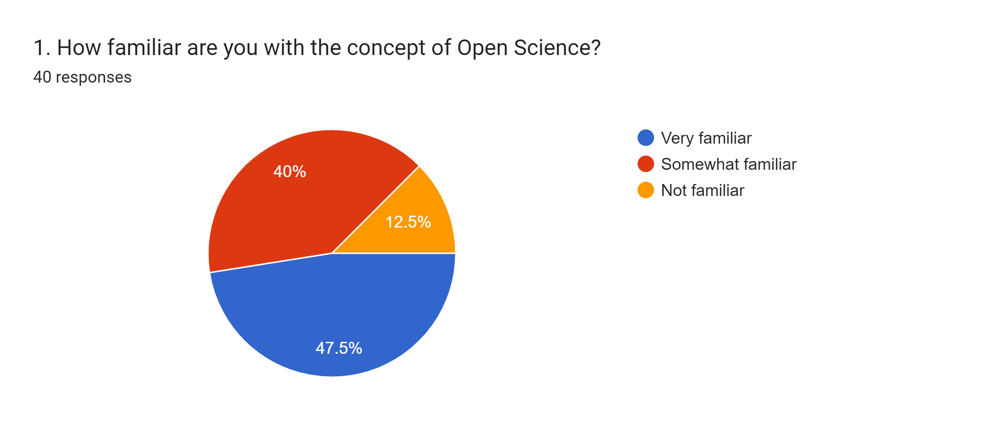
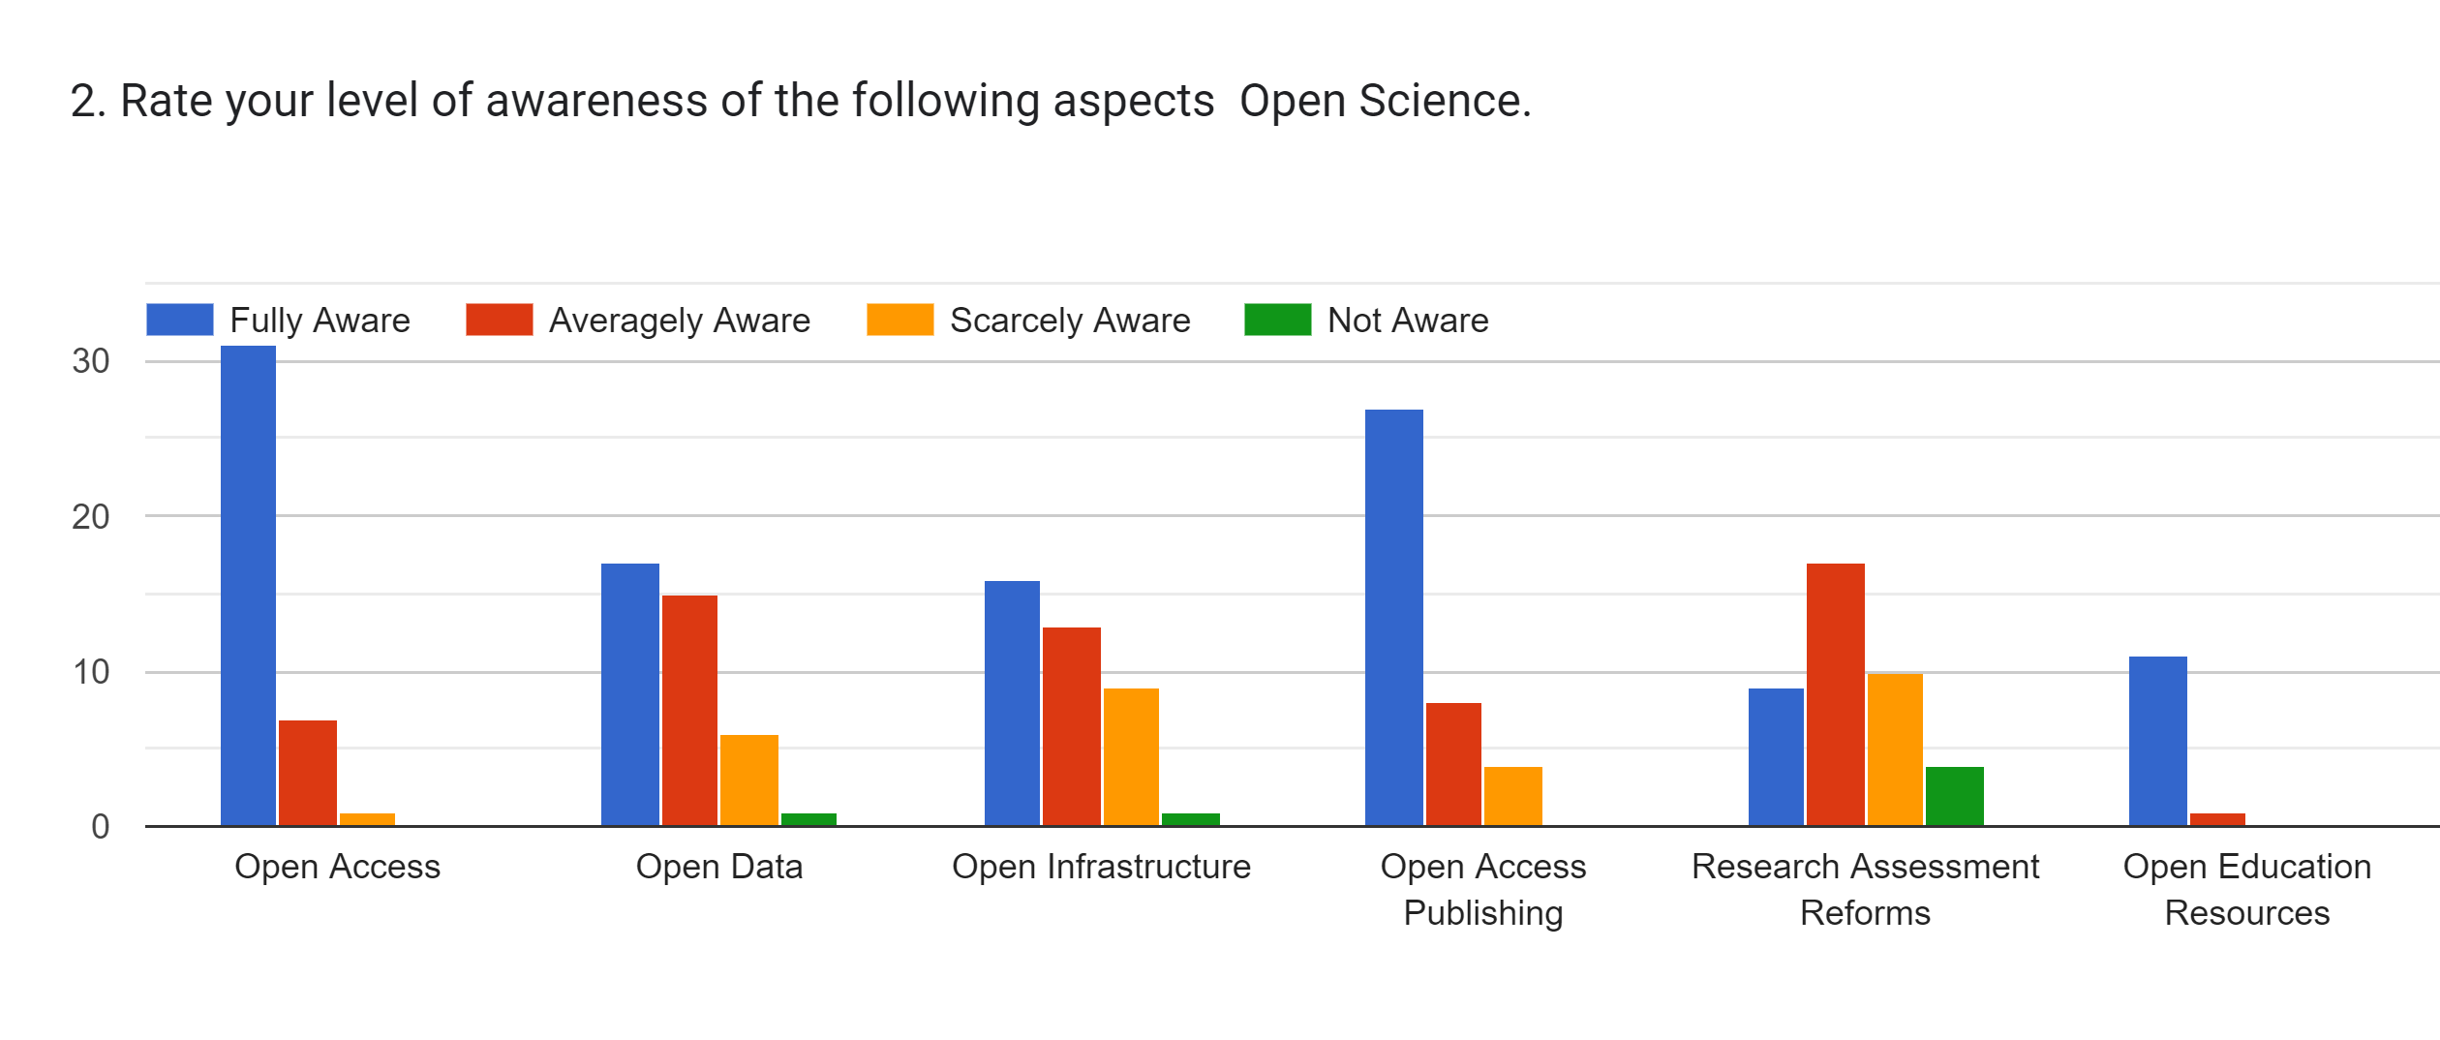
Survey Results on Perception of Librarians on Open Science
– Very Familiar
– Somewhat Familiar
– Not Familiar

Slide 10
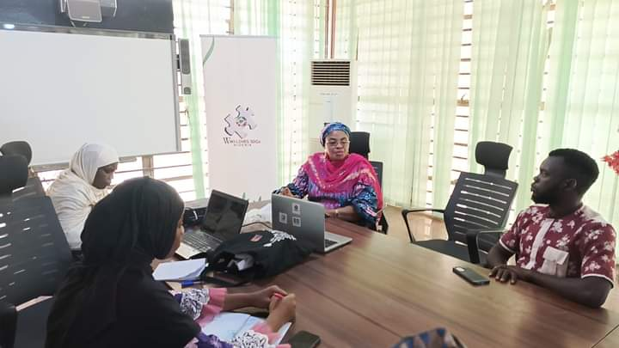
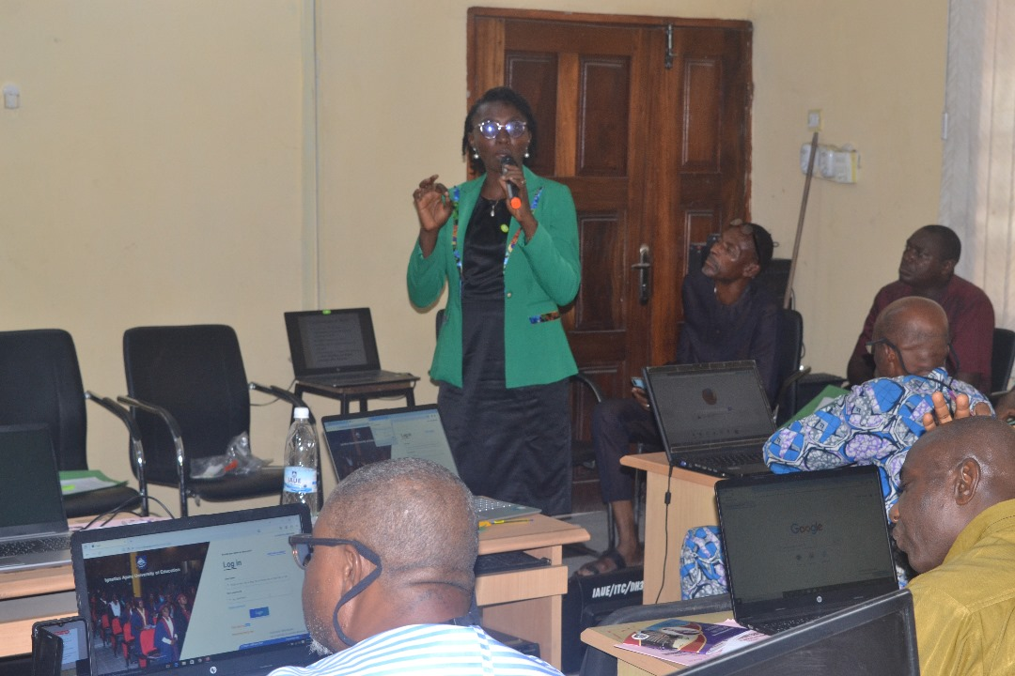
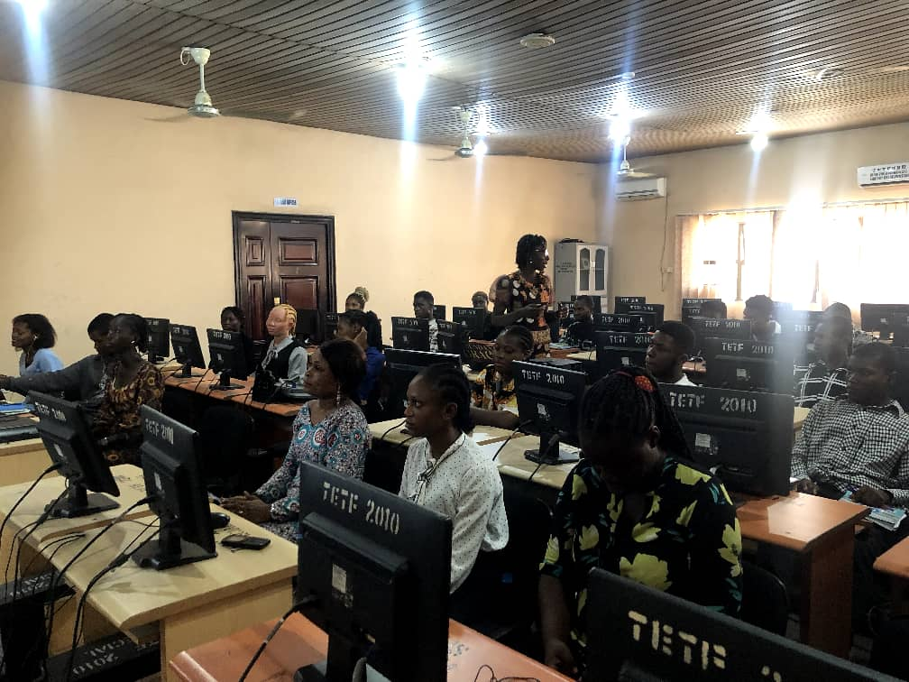
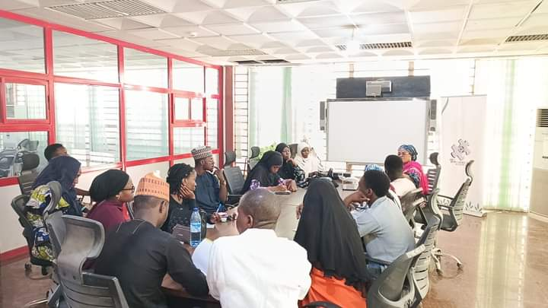
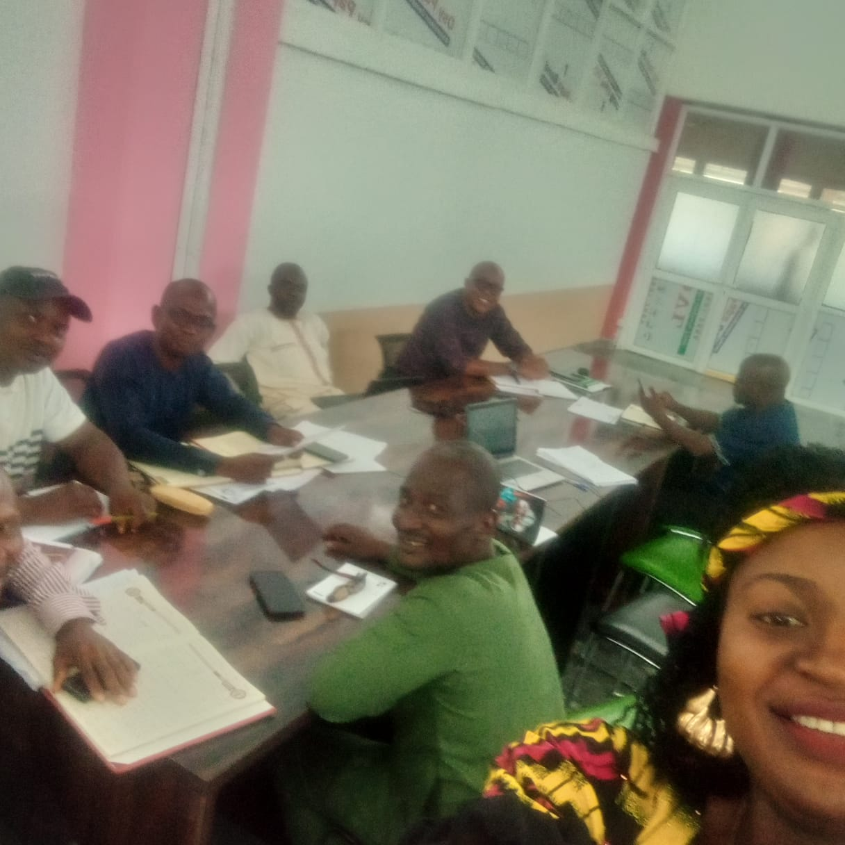
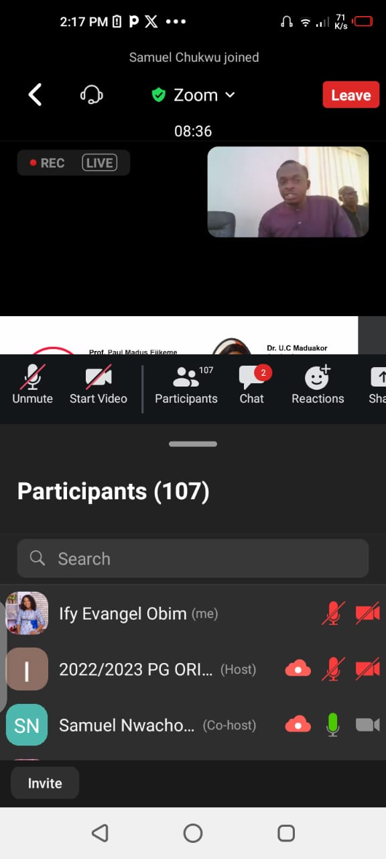
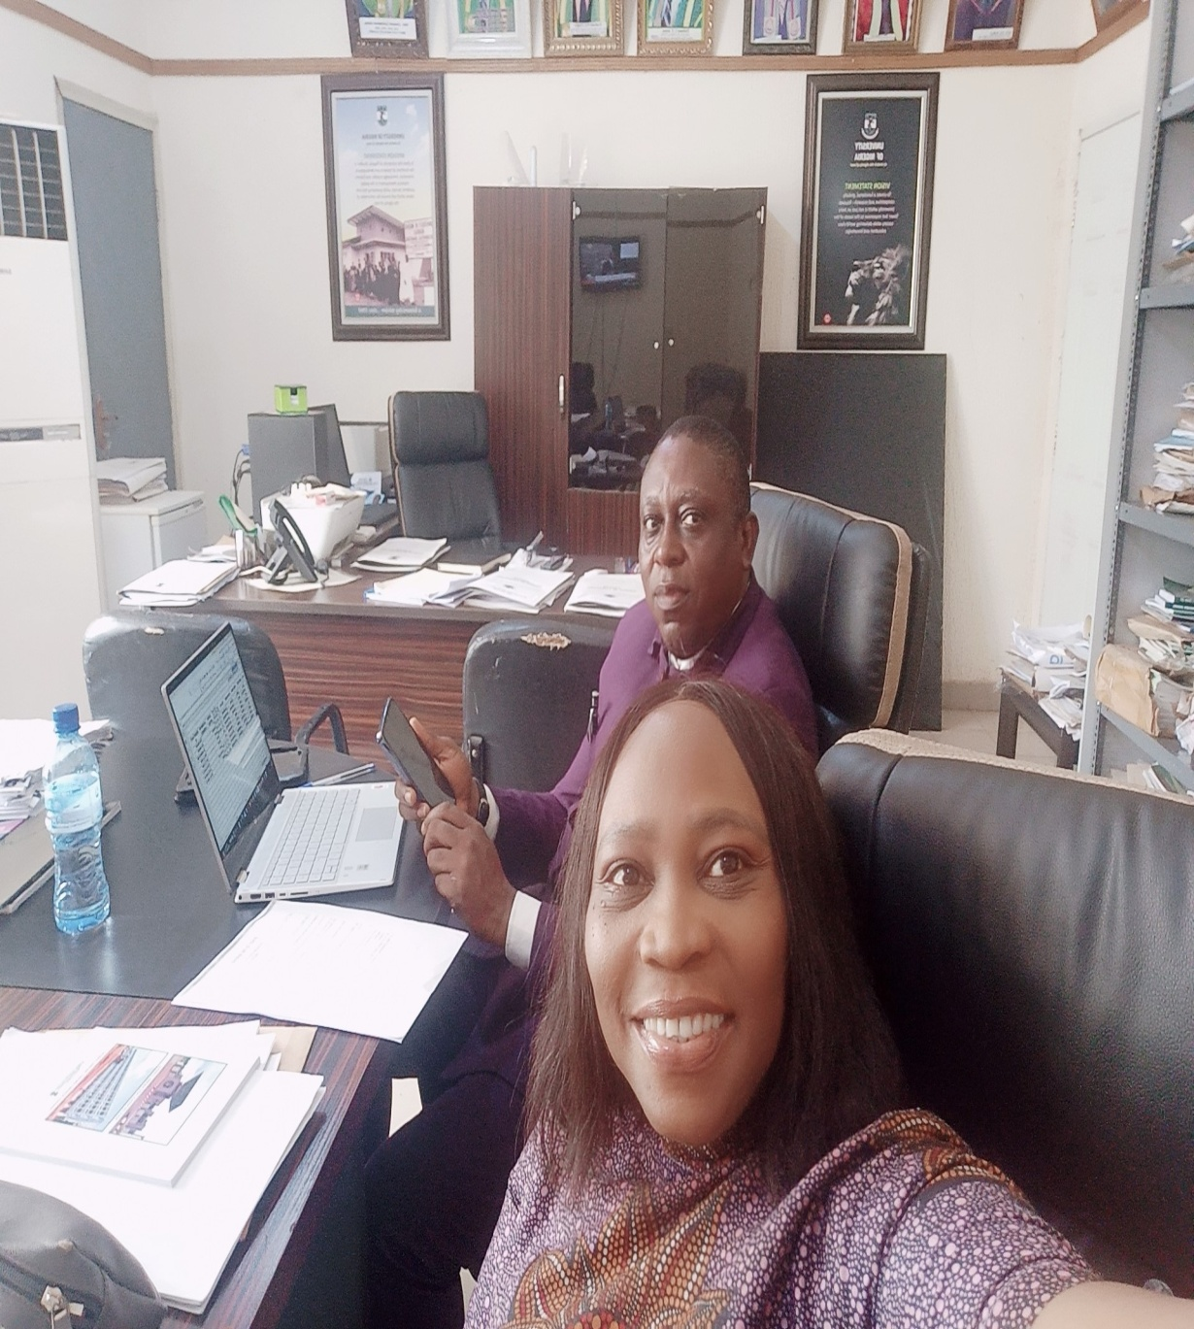
Contributions at our various campuses
Establishing the Research Management Office headed by the Deputy Vice-Chancellor (Research) and deployment of the Institutional Repository online (Lead City University).
Increased awareness and number of researchers with persistent identifiers (ORCID) in our institutions (LASUSTECH, Uni Jos, ABU Zaria).
Capacity building for postgraduate students, librarians, and faculty staff on research data management, open access literature search, open access publishing routes, and use of open data repository and IR (FUT Minna, Redeemers University, UNN, Ignatius Ajuru Uni)
Stakeholder engagement on RDM and Research Ethics policy review and implementation (All universities).

Slide 11
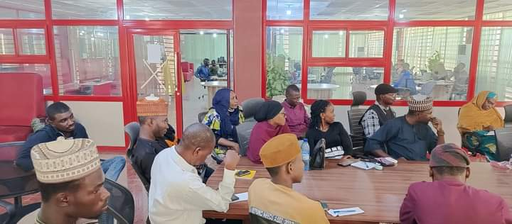
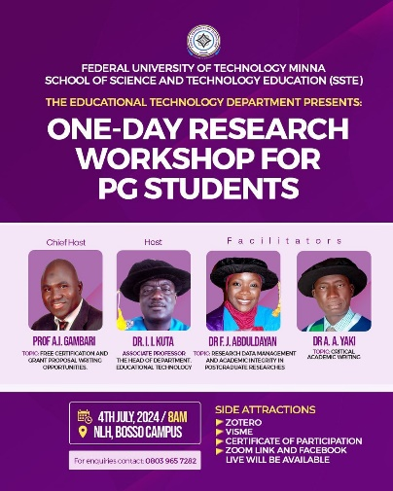
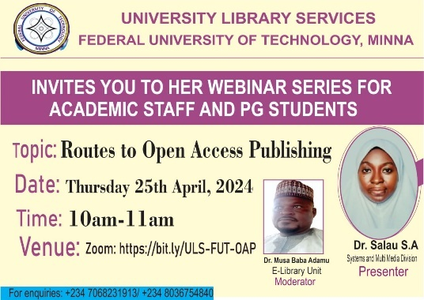
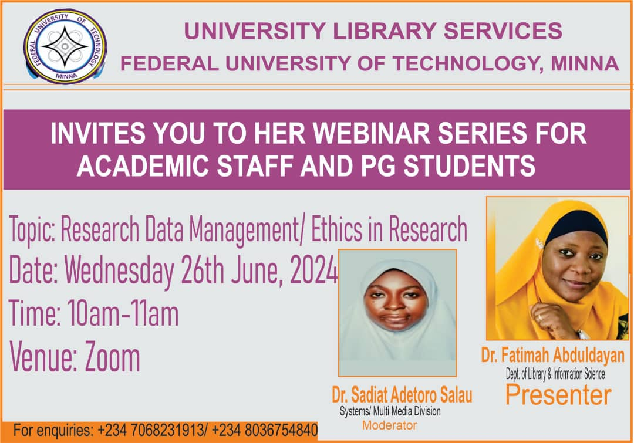
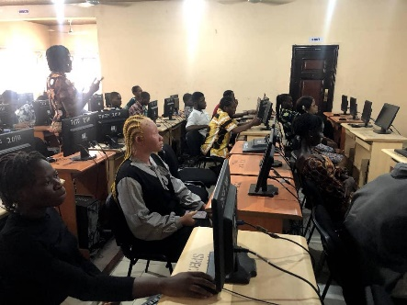
Contributions at our various campuses
5. Capacity building workshop series for postgraduate students and lecturers

Slide 12
Follow our activities on:
LIBSENSE NIGERIA
https://libsense.ren.africa/en/ecr/

Slide 13
for your time!
For further information:
libsensenigeria@gmail.com

