Slide 1
Open Book Publishers
A mission-driven OA book press
Lucy Barnes
openbookpublishers.com

Slide 2
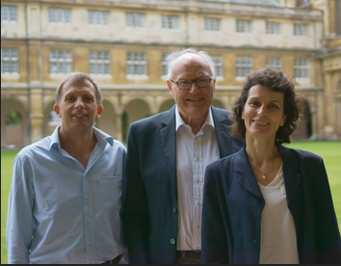
Open Book Publishers
A leading independent open access press, based in the UK
Founded in 2008 in Cambridge
Scholar-led, non-profit
Mission-driven: aim to make high-quality academic books freely accessible everywhere
Rupert Gatti, William St Clair and Alessandra Tosi

Slide 3
Why open access?
Frustrated by experiences as authors: believed open access offered something better
“If academics don’t do anything, who else is going to do it for them?”
Readership numbers and author responses show that there is a demand
Built a reputation as experts in open access book publishing:
Policy contributions, advisory boards: UK committees and white papers, PALOMERA
Consultancy for presses/organisations that ask our advice (we generally don’t charge)
Community-building: ScholarLed, the Open Access Books Network
Infrastructure-building: Copim, Thoth Open Metadata, Open Book Collective
We do these things to support the mission of the press

Slide 4
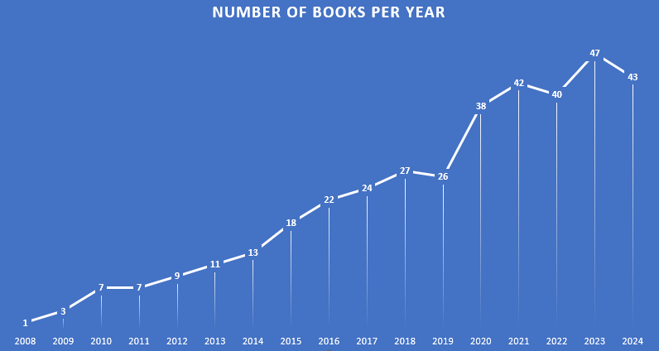
Growth over time

Slide 5
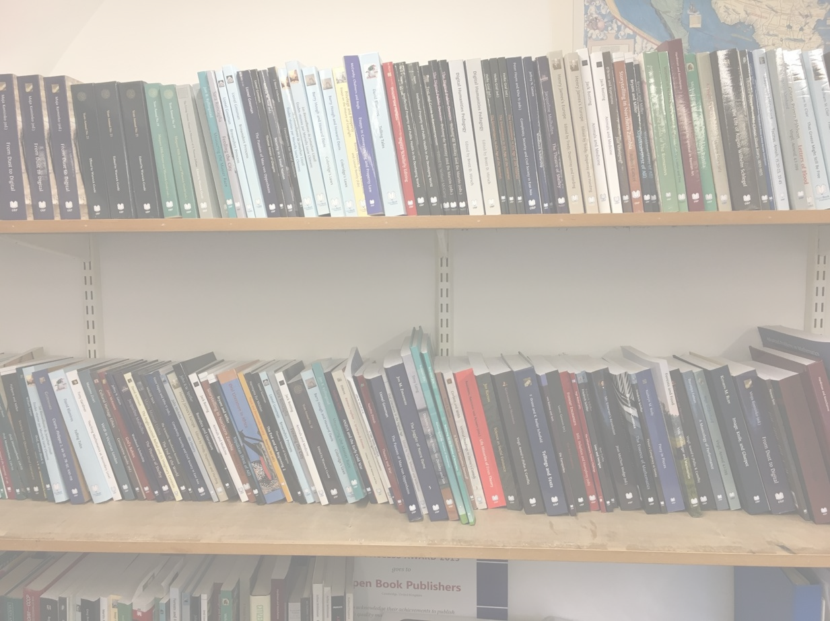
Where are we now?
Around 50 peer-reviewed books per year (over 350 books in total)
All immediate OA:
Creative Commons licences, authors retain copyright, non-exclusive license to publish
No embargo
Free PDF, HTML editions; paid-for paperback, hardback, EPUB
Accessed worldwide over 80,000 times each month
Available via open platforms and sales routes
Google Scholar, OAPEN, Open Edition etc
Amazon, our website, bookshops, museums etc
No charges for authors

Slide 6
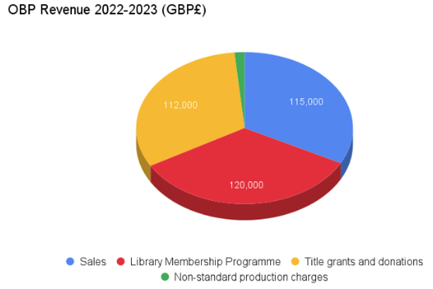
Costs and revenue
Financial year October 2022 – September 2023
Average cost per title: £5,500
49 titles (35 monographs, 15 edited collections & 2 textbooks)
35 books had no funding attached
4 had partial funding; 10 were fully funded
Small surplus of about £13,000

Slide 7
Library Membership Programme
Over 270 library members
Libraries pay an annual fee for membership (tiered) (€400-800)
Free, perpetual access to all our digital editions for anyone on the network, plus discounts on paper copies
Metadata, outreach
Funding open access books for everyone
Now the largest third of our income (35 books published last year with no other funding)

Slide 8
Collective models: Pros and cons
Pros:
Equitable
Predictable (for us)
Sustainable (for libraries)
Enables us not to charge Book Processing Charges
A systemic way of funding an OA publishing programme (not one-off exceptions)
Cons:
Takes staff time and energy to build up relationships and do outreach
Libraries are having to understand and assess more models like this
Not all libraries understand these models: they often don’t fit easily in existing procurement processes
It tends to be the same libraries funding a lot of these models: hard to crack the next ‘layer’ of supporters
Currently not enough for us without grant funding too (but the balance is shifting!)

Slide 9
Impact stories
Notes:
The field of Semitic languages and cultures involves the study of languages and cultures of living communities. In the past, the typical practice of academics was to do fieldwork among living communities and then publish their work in expensive academic books. As a result, the communities whose cultures the academics described could not themselves get access to these descriptions of their own culture. To put it bluntly, it was a form of depredation and asset-stripping that benefited the career of academics but had no benefit for the communities themselves. Open-access publishing is the solution to this immoral practice.

Slide 10
Links
Interview with Alessandra Tosi and Rupert Gatti, 2018: https://blogs.openbookpublishers.com/ten-years-of-obp-an-interview-with-alessandra-tosi-and-rupert-gatti/
Blog post by series editor Geoffrey Khan, 2024: https://openaccessbooksnetwork.hcommons.org/2024/02/20/open-access-book-publishing-a-series-editor-writes/
Author Success Stories collection, Open Access Books Toolkit: https://www.oabooks-toolkit.org/Open-acces-for-books/7555171-author-success-stories

Slide 11
Thank you for listening! Any questions…?
lucy@openbookpublishers.com
www.openbookpublishers.com
@alittleroad.bsky.social

