Slide 1
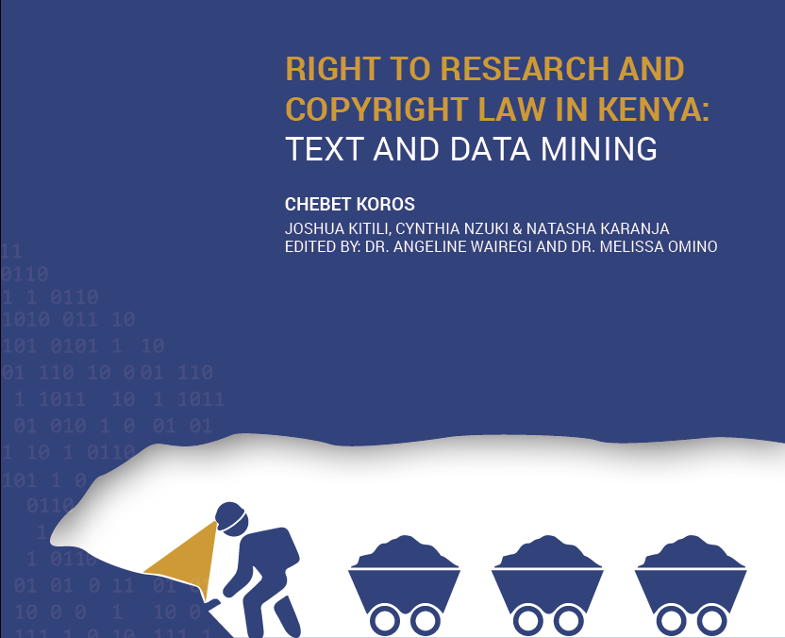
CIPIT POLICY BRIEF
Presentation by Chebet Koros
26 April 2023

Slide 2
Policy Brief Presentation Outline
Introduction
2. Methodology
Key Findings
Policy Recommendations

Slide 3
Introduction
What is Copyright?
A type of intellectual property right that protects an owner’s original literary (written) or artistic works. E.g. compilations of data.
What is the Right to Research?
The right to conduct and receive or access research (material).
What is Text and Data Mining (TDM) Research?
An application of a computational process to materials to derive data from or about those works that is used for research.

Slide 4
Why is it necessary to create a legal environment that supports text and data mining research in Kenya?
Researchers need digital tools, such as TDM, and data access to contribute to human knowledge. Eg. BlueDot AI helped discover the Coronavirus outbreak.
The TDM process involves the use of copyrighted works which may affect the rights of the copyright owner.
The law in which these researchers operate should create an enabling environment for them.
Research Objective:
To determine how Kenya's technology and legal framework affect the use of text and data mining research, and to make recommendations that enable text and data mining research in Kenya.

Slide 5
2. Methodology
Legal Review
Kenyan Constitution, Technology laws and policies, Copyright Act, Case law.
Comparative Analysis
South Africa’s Constitution, Copyright Act 1978 and Copyright Amendment Bill, Case law.
Survey of TDM developers and users in Kenya
Questionnaire

Slide 6
3. Key Findings
Kenya's legal framework for technology has the potential to support TDM research, given appropriate implementation and updates.
Kenya has several technology laws, policies and govt. strategies that have the potential to facilitate digital research technology like text and data mining research. Eg. National ICT Policy, Blockchain and AI Taskforce Report, Data Protection Act, Science, Technology and Innovation Act
Gaps identified in the tech laws:
Lack of implementation.
The current digital environment is not adequately covered.

Slide 7
3. Key Findings Cont’d
Text and data mining research may be allowed under the Kenyan copyright framework if the law is interpreted appropriately, guidelines are established or it is updated.
Kenya’s copyright Act provides for fair dealing, an exception to copyright for specific purposes including ‘scientific research’.
However, there is no definition of ‘fair’ or ‘scientific research’ in the Act. It is therefore uncertain whether TDM research would fall under this exception.
Communications Commission of Kenya & 5 others v Royal Media Services Limited & 5 others [2014] eKLR relied on a 6-factor fairness test. Can this test be applied to TDM? Is there an alternative?
South Africa’s copyright amendment bill seeks to shift from the limited fair dealing to a more flexible fair use exception. This would provide a ‘future-proof’ law that would enable modern research technologies.
Some countries have a specific copyright exception for TDM – Singapore, Japan etc.

Slide 8
3. Key Findings Cont’d
The survey revealed that a significant proportion of TDM developers and users lack awareness regarding copyright laws and the fair dealing exceptions.
Out of all the survey respondents, only 18% recognized the Copyright Act as a law that encourages learning, research, and technology in Kenya.

Slide 9
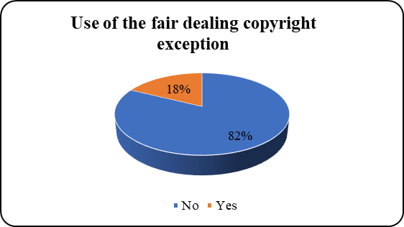
The majority of the respondents had no knowledge of the fair dealing copyright exception, and only 18% reported using it.

Slide 10
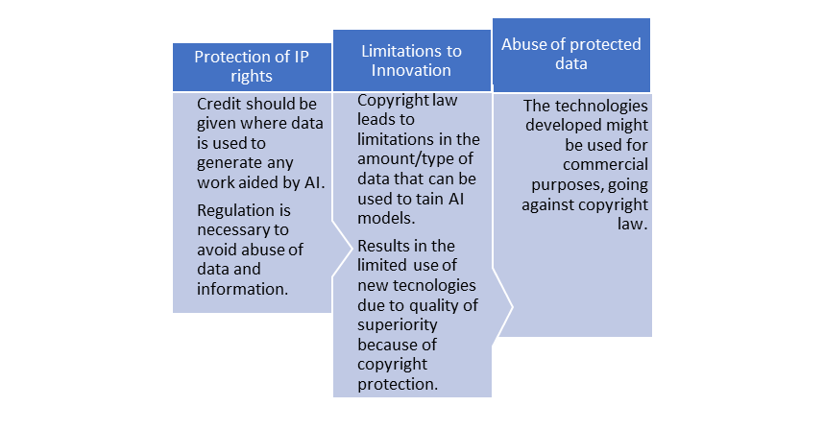
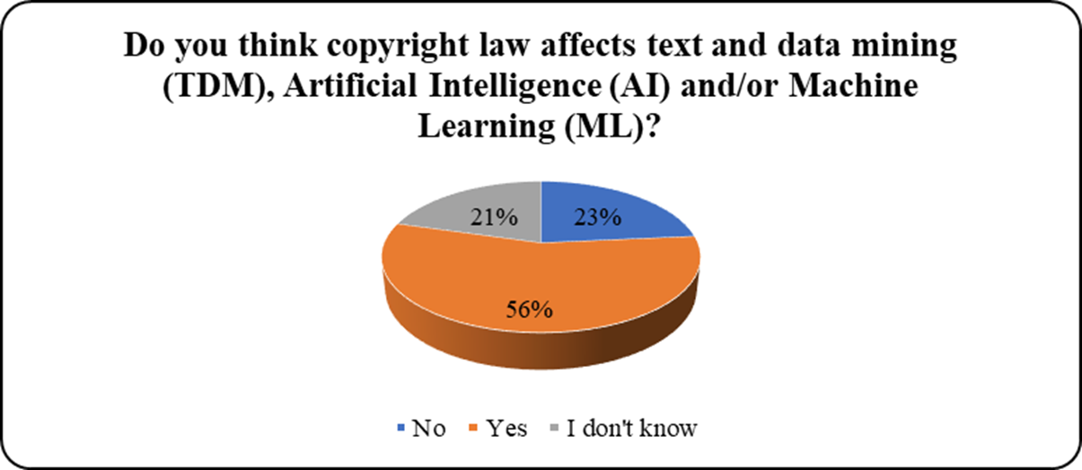
However, most respondents believed that copyright law affects text and data mining research, machine learning, and artificial intelligence in Kenya.

Slide 11
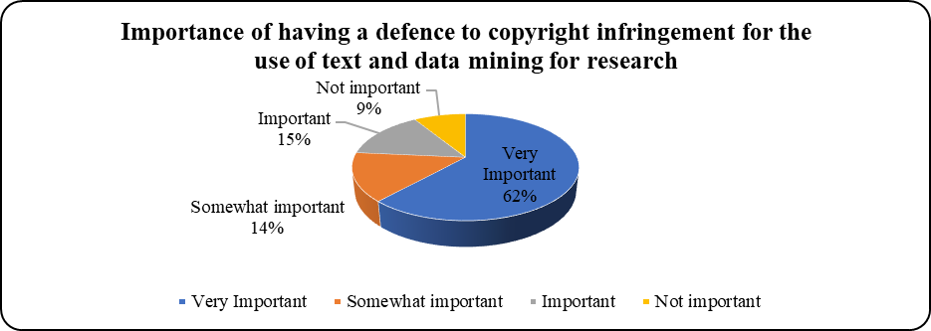
Most respondents believed that it is essential to have an exception to copyright infringement for TDM research purposes.

Slide 12
4. POLICY RECOMMENDATIONS

Slide 13
Policy Recommendations for Kenya’s Technology Legal Framework
Kenyan government ought to enforce existing technology laws and policies that promote research.
  For example, Kenya’s Data Commissioner should prepare a code of practice containing practical guidelines concerning the processing of personal data for purposes of research.
The Kenyan government should reform outdated technology laws and policies to promote research and technology.
  For example, adopting the policy and regulatory framework proposed in the 2019 Report of the Block Chain and Artificial Intelligence Taskforce.

Slide 14
Recommendations for Kenya’s Technology Legal Framework
The Kenyan government should establish clear guidelines and strategies that provide access and use of data for research purposes using modern research technology like TDM.
The Kenyan government should provide financial support for research, the development of high-speed internet and broadband infrastructure, and access to data repositories and data sets, in order to improve Kenya's technology sector.
Collaboration between the government, researchers and industry stakeholders to facilitate the exchange of ideas leading to the development of technology growth and benefit.

Slide 15
Recommendations for Kenya’s Copyright Legal Framework
The Kenyan legislators should amend the copyright law, using the following considerations:
To expand the existing narrow fair dealing framework to enable the digital environment and specifically, to accommodate digital research technologies.
To shift from fair dealing to fair use. This would accommodate modern technology purposes (TDM) under the copyright exceptions and prevent the need to keep amending the law.
To provide a definition of what ‘fair’ and ‘scientific research’ is under the copyright Act.
To provide a specific exception for text and data mining research in the copyright Act.

Slide 16
Recommendations for Kenya’s Copyright Legal Framework
To provide clarity and guidance on the copyright exception for scientific research under Kenya's current copyright law. We recommend that the Kenya Copyright Board (KECOBO) provides guidelines on interpreting and implementing the existing scientific research exception to copyright for modern research technologies like text and data mining.
The government should promote increased awareness and education around copyright exceptions among researchers, judicial officers, and other stakeholders.

Slide 17
Recommendations for Kenya’s Copyright Legal Framework
Survey respondents’ recommendations:
Some respondents recommend improving the TDM process in Kenya by sensitizing people in the field about copyright law and developing guidelines on using data appropriately.
Some respondents recommended developing guidelines on the repercussions of using data obtained inappropriately for commercial research.
We recommend that copyright law is incorporated in the education curriculum for TDM developers, scientists and researchers.

Slide 18
Thank you!
The policy brief can be found at: https://cipit.strathmore.edu
https://shorturl.at/BOS39

