Slide 1



The value of aggregating Open Access research
Dr Nancy Pontika
Open Access Aggregation Officer
CORE
Email: nancy.pontika@open.ac.uk
Twitter: @nancypontika

Slide 2

Agenda
What is Text and Data Mining (TDM):
  benefits,
  why repositories and libraries should support TDM
CORE and TDM
The OpenMinTeD project
Publishers’ connector for open access research papers
How you can use CORE
Ethiopia videos

Slide 3
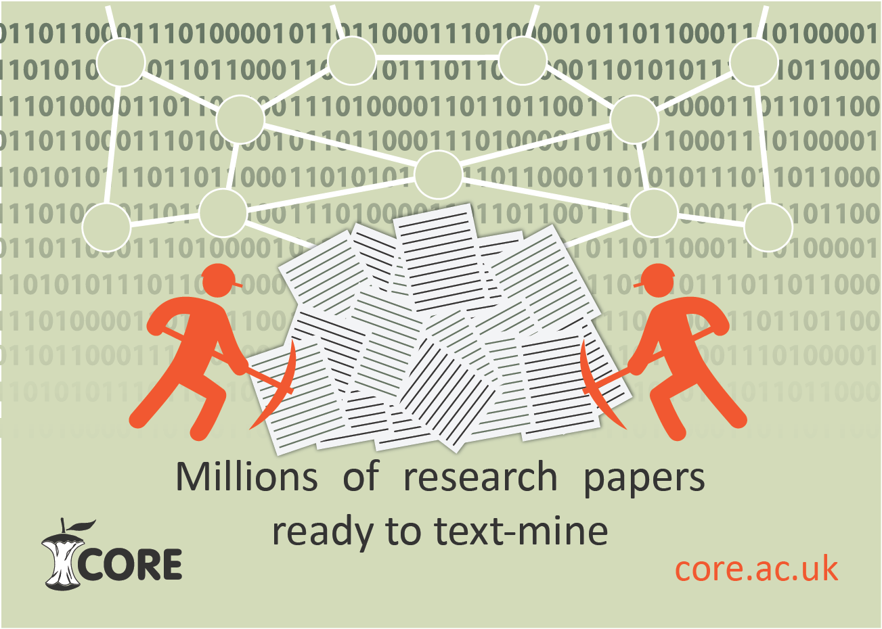
What is text and data mining (TDM)
The process of extracting high quality and meaningful information from text to answer unknown questions.

Slide 4
TDM benefits
Reduces costs of conducting research (access, staff &
infrastructure)
Unlocks hidden information and develops new knowledge
Explores new horizons
Improves research and evidence base
Improve research process quality
Source: Value and benefits of text mining, Jisc, 2015
https://www.jisc.ac.uk/reports/value-and-benefits-of-text-mining

Slide 5
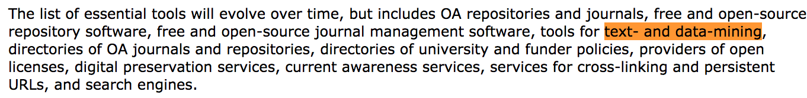
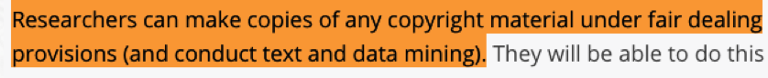
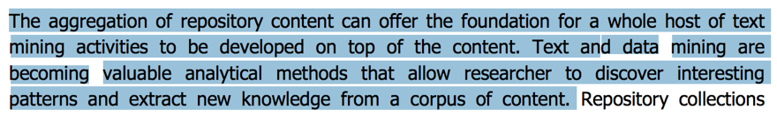
Why should repositories support TDM
BOAI10 Recommendations
http://www.budapestopenaccessinitiative.org/boai-10-recommendations
HEFCE FAQs
http://www.hefce.ac.uk/rsrch/REFimpact/faqs/
COAR
http://www.rcuk.ac.uk/documents/international/coarstateofrepositories-pdf/

Slide 6



Repositories and TDM
Text Mining Services
Other sources:
Research
Networking
Services
Primary Research
Data...
Institutional
Repositories
Subject
Repositories
Publishers/
OA journals

Slide 7
TDM & Libraries (Repository Managers)
Established and maintain a close collaboration with
researchers
Extensive experience in advocacy, i.e. open access
Knowledgeable about the repository’s collection
Participate in the Academic Institution’s Research
Committees
Knowledgeable of your repository’s collection
Familiarity with Copyright issues and Creative Commons Licenses

Slide 8

Open Access research content in CORE
Discover content in the CORE search engine
Use the CORE API https://core.ac.uk/services#api and Dataset to apply TDM practices https://core.ac.uk/services#dataset

Slide 9
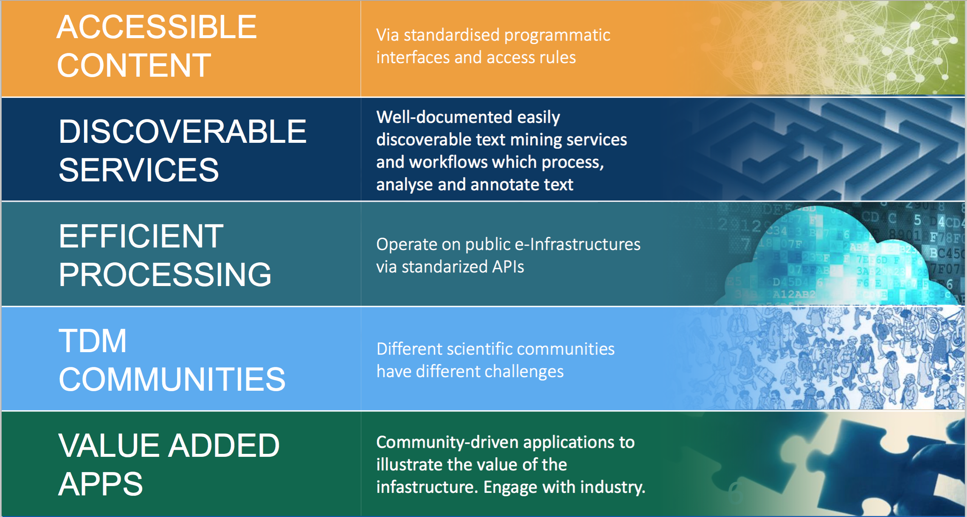
OpenMinTeD project
Image: N.Manola – ICT2015

Slide 10
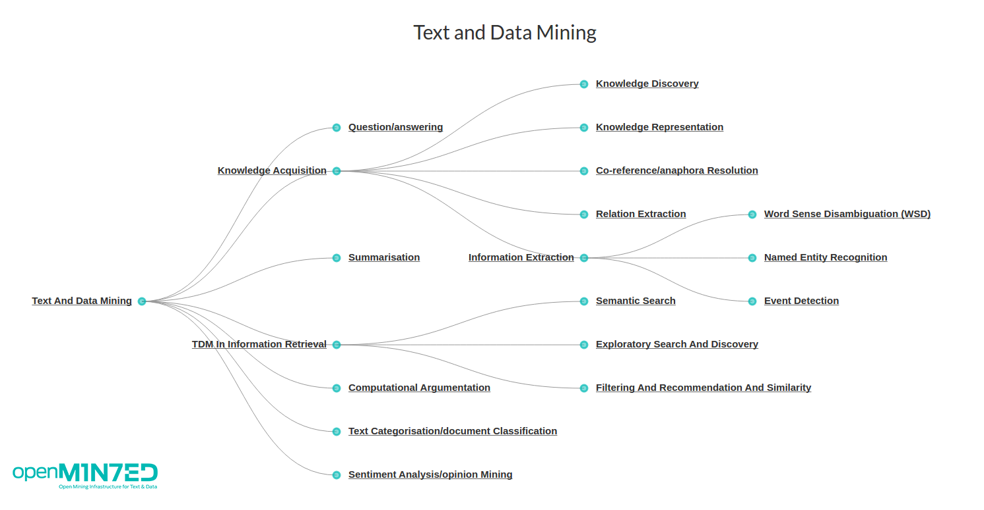
TDM taxonomy

Slide 11
Key players’ interoperability for machine access to metadata
Source: http://interop2016.github.io/pdf/INTEROP-1.pdf

Slide 12
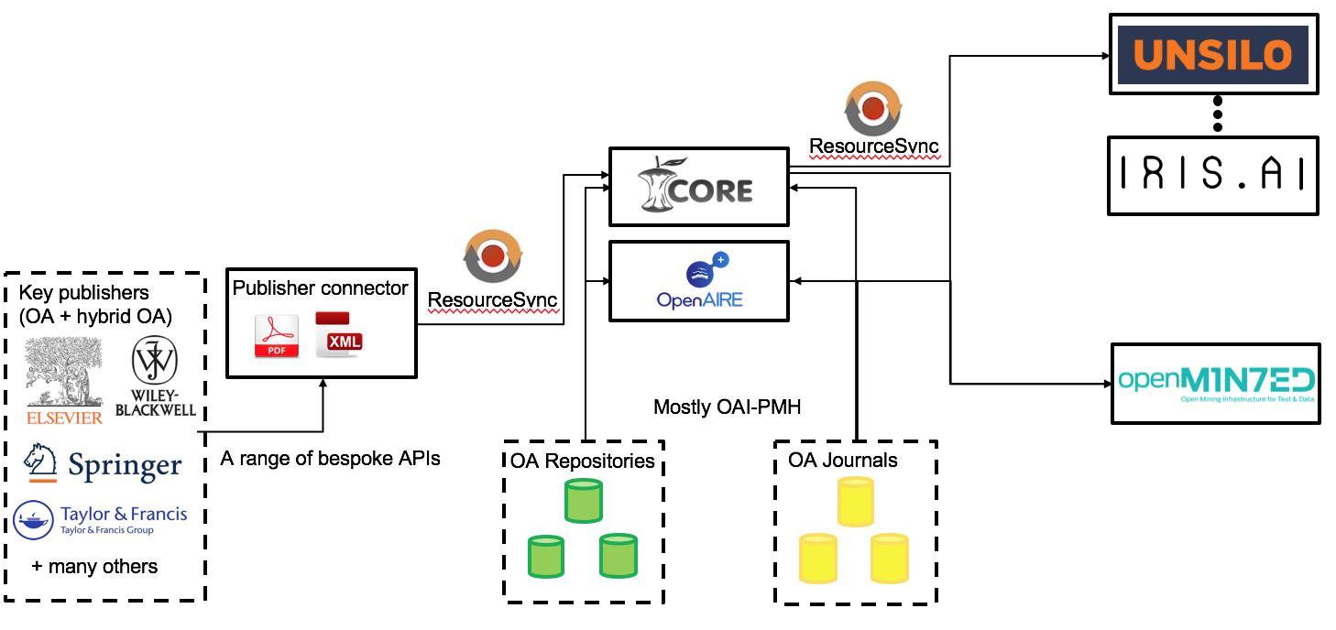
Exposing enriched data for TDM
Image: P.Knoth – DPLA2017

Slide 13
How repository managers can use CORE
CORE has already more than 1,000 data providers https://core.ac.uk/dataproviders
Join CORE as a data provider https://core.ac.uk/join
Ask your library to list the CORE search engine in the library pages
When you become a CORE data provider request access to the CORE Dashboard https://core.ac.uk/services#dashboard
Install the CORE recommender in your repository https://core.ac.uk/services#reccomender
Become a CORE Ambassador https://core.ac.uk/about/ambassadors

Slide 14
Videos at the Ethiopia meeting
We want to hear from you!
Value of CORE
  Librarians
  Research support administrators
  Researchers
  Students
  Life long learners

Slide 15
Thank you!
CORE
Website: http://core.ac.uk
Email: theteam@core.ac.uk
Twitter: @oacore
OpenMinTeD
Website: http://openminted.eu/
Twitter: @openminted_eu
LinkedIn: https://www.linkedin.com/groups/8402199
Slideshare: https://www.slideshare.net/openminted_eu
YouTube Channel: https://www.youtube.com/channel/UCjAgOP2ALi4lHAl-8sWTG8Q
Flickr: https://www.flickr.com/photos/146359736@N07/

