Slide 1
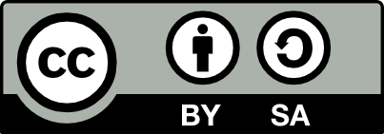
Increasing visibility and impact with DOAJ indexing
Dominic Mitchell
Deputy Director, Platform Manager
dominic@doaj.org

Slide 2
Summary
Why index your journals
Why send us your article metadata
Your publisher dashboard
DOAJ-PKP partnership

Slide 3
Why index your journals

Slide 4
Why index journals in DOAJ?
Demonstrate your journal meets good publishing standards
Attract authors and readers from domestic and global networks
Inclusion of journals in all languages
Increase discoverability of your journal in search engines and indexing services
Enhance the reputation and societal impact of your journal in your country and globally
DOAJ-indexed journals are included in government lists (For example, DHET, South Africa)
https://doaj.org/apply/why-index/

Slide 5
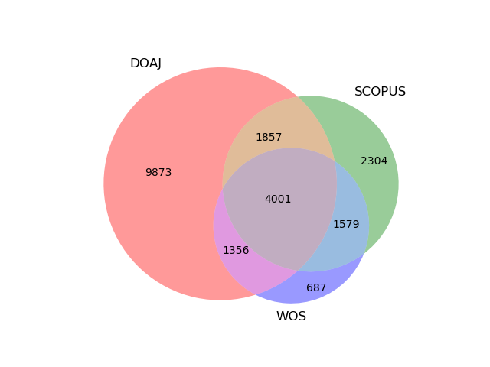
https://blog.doaj.org/2023/07/06/doaj-is-confirmed-as-a-unique-platform-for-many-open-access-journals-and-a-key-index-for-african-journals/
Notes:
In July 2023, Tom Olijhoek, then Editor-in-Chief, reconfirmed that DOAJ is a unique platform for many open access journals and is a key index for African journals. The analysis was done on just over 17,000 journals and found that 9873 of them were *only* in DOAJ. DOAJ is much more inclusive in its global coverage of open access journals than either Web of Science or Scopus. Any study on scholarly publishing or the progress of open access that uses only WoS and Scopus as sources is flawed from the start.

Slide 6
Why send us your article metadata

Slide 7
Why upload your article metadata to DOAJ?
We will ensure that your article metadata is seen around the world. DOAJ
Metadata is found in:
Discovery services and aggregators: OpenAlex, Web of Science, Scopus, Proquest products, EBSCO products, Google Scholar, OCLC, WorldCat, Dimensions, CORE, ROAR, ROAD, Research4Life,
OpenAIRE, university discovery systems and library portals
AI solutions: ChatGPT, Gemini, large language processing models
and AI-based research projects
Journal platforms: Redalyc, Latindex

Slide 8
Why upload your article metadata to DOAJ?
We will ensure that your article metadata is seen around the world. DOAJ
Metadata is found in:
Search engines: Google, Bing, Yahoo, DuckDuckGo, Baidu
National funder tools: Indonesia, Norway, or Austria
Online tools: Plan S' Journal Checker Tool (JCT), B!SON OA Journal Recommender, Open Access Journal Finder from Enago,
SciFree's Journal Search Tool, BASE (Bielefeld Academic Search
Engine), JURN, ChronosHub's journal finder

Slide 9
Your publisher dashboard

Slide 10
Publisher dashboard
We provide a publisher dashboard where you can:
Upload new article metadata
Correct existing article metadata
Review and update your journal records
Review and submit draft applications

Slide 11
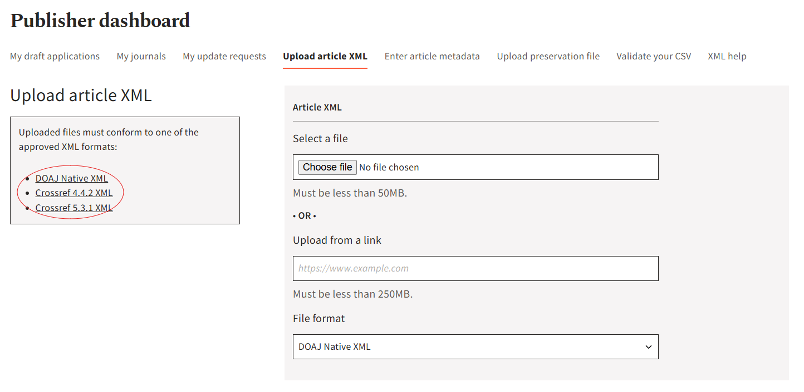
Upload article metadata as XML file

Slide 12
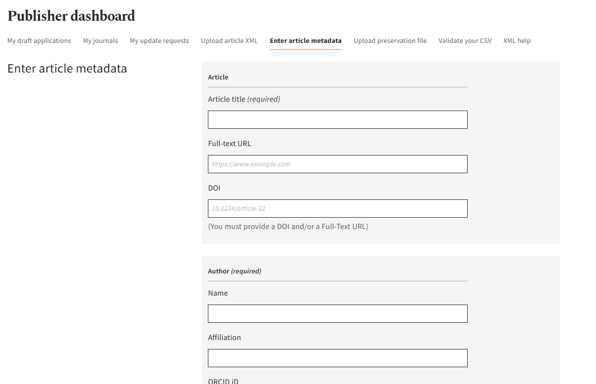
Enter/correct article metadata one by one

Slide 13
A note about article metadata
We display plain text article metadata. We don’t support formatting,
HTML, MathML, etc BUT
we don’t strip it out
If you send us article metadata in more than one language, we
randomly select one.
We aim to improve article display this year and fully support
multilingual article metadata
https://www.helsinki-initiative.org/ - Helsinki Initiative on
Multilingualism in Scholarly Communication

Slide 14
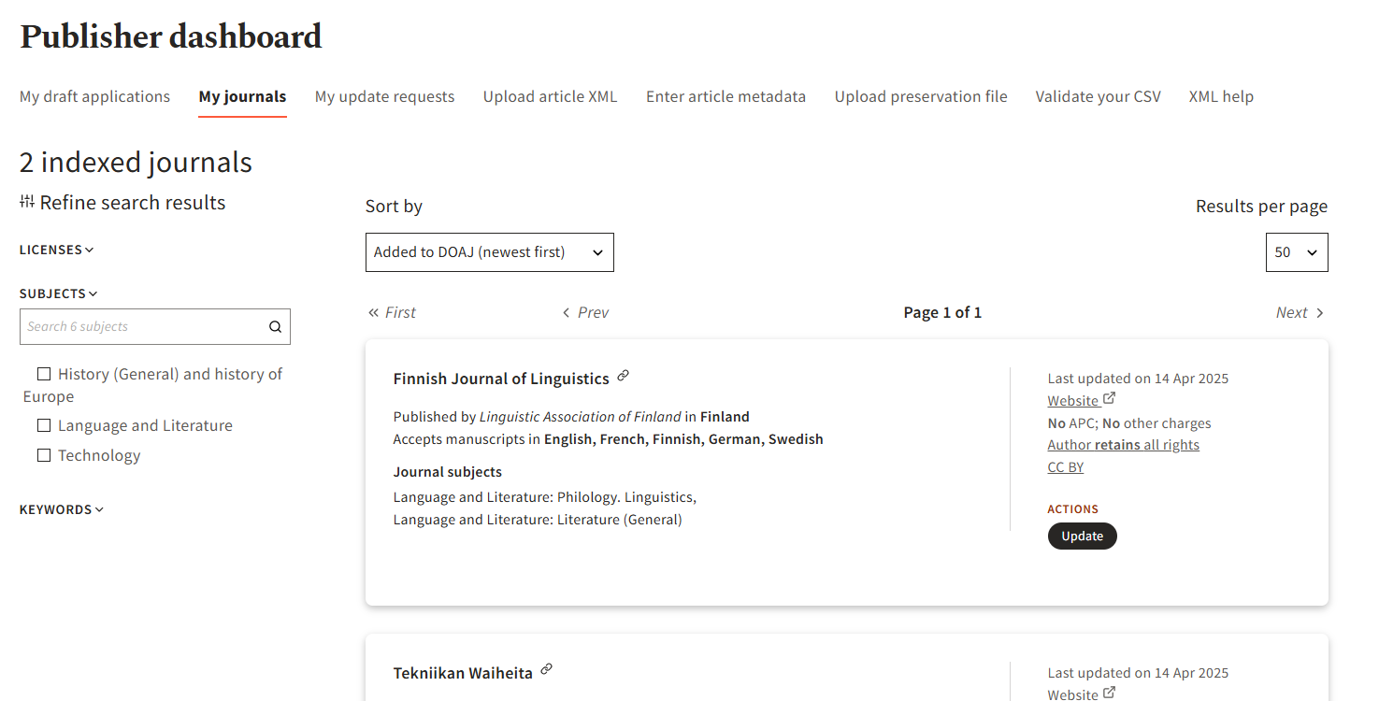
See and update your journals

Slide 15
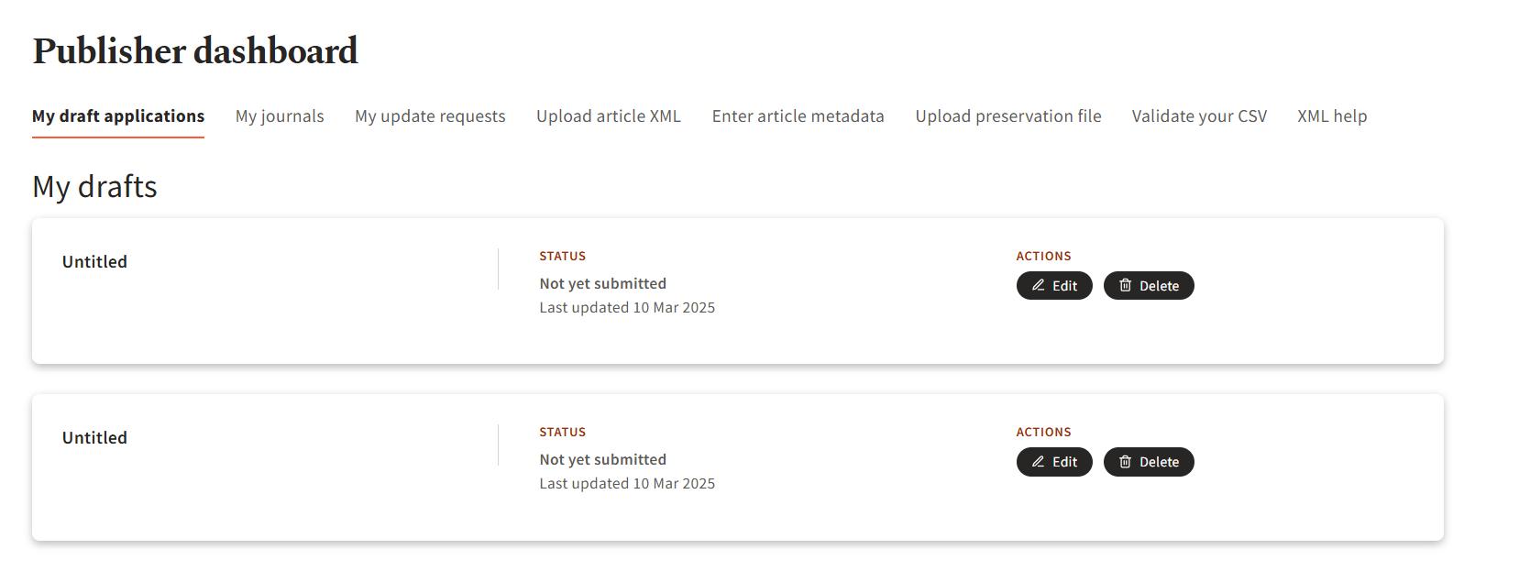
See your draft applications

Slide 16
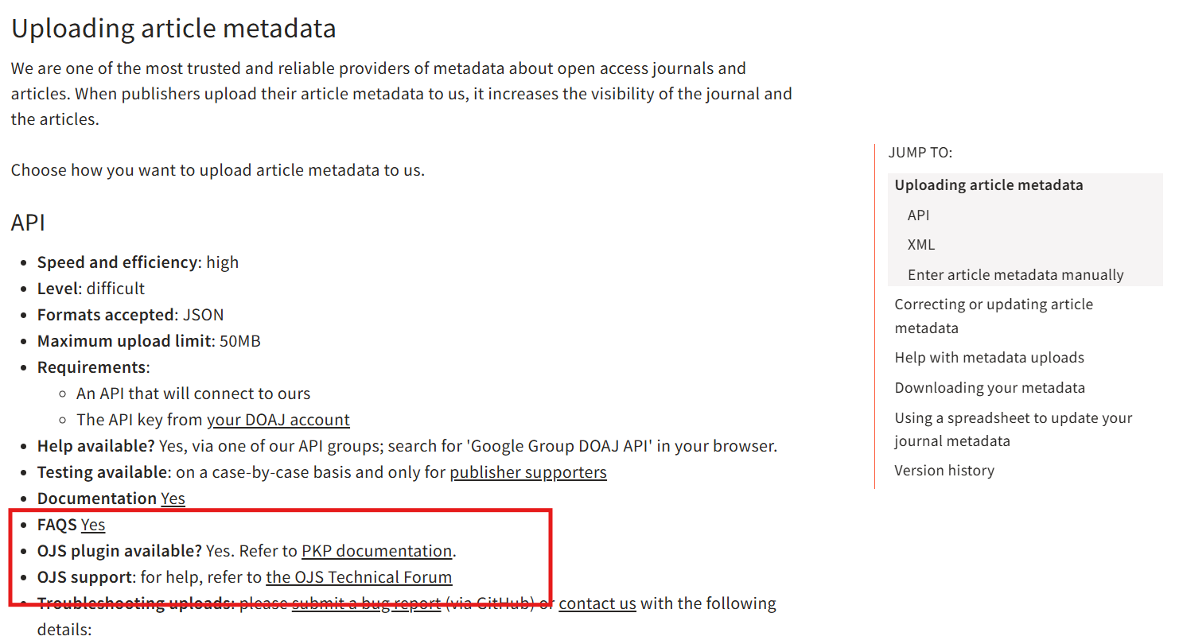
Metadata help
https://doaj.org/docs/faq/
API, OJS-DOAJ plugin

Slide 17
DOAJ-PKP collaboration

Slide 18
Collaboration on many levels
Technical:
Plugins
Software support forum
Journal facts verification
Metadata updates
Feature developments
JASPER
Community:
Knowledge sharing
Outreach
Marketing
Social media

Slide 19
Thank you!
https://doaj.org
https://blog.doaj.org
dominic@doaj.org

