Slide 1
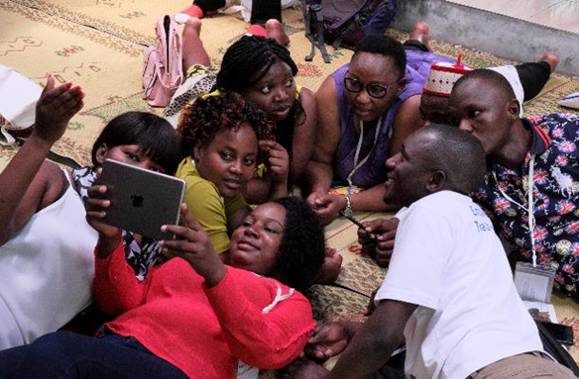
Professional development for young librarians matters!
An Initiative for Young African Library Innovators - IYALI
EIFL Public Library Innovation Programme
plip@eifl.net - @EIFLnet
AfLIA – African Library Summit
May 23, 2019 – Nairobi, Kenya
www.eifl.net

Slide 2
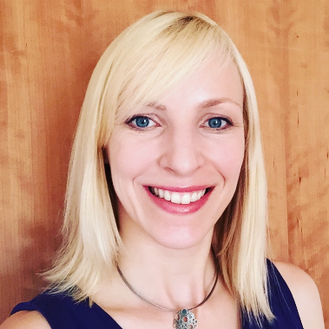
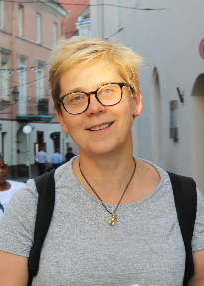
Co-authors
EIFL-PLIP|
@EIFLnet
Ugne Lipeikaite
@ugnelip
Susan Schnuer
@susanschnuer
Ramune
Petuchovaite
@ramupetu
Read full paper at: insert address

Slide 3
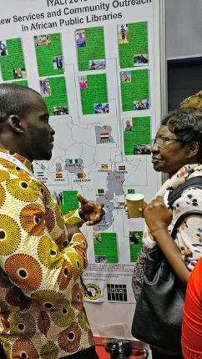
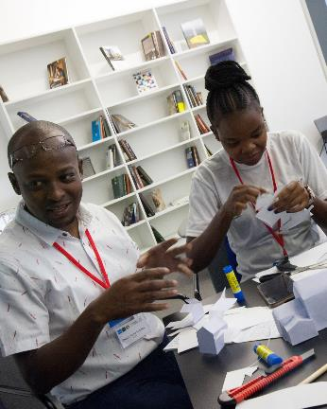
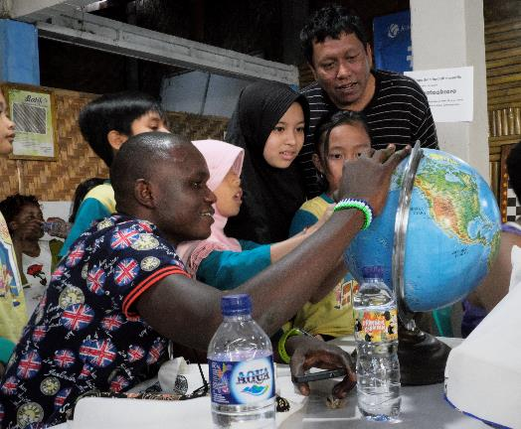
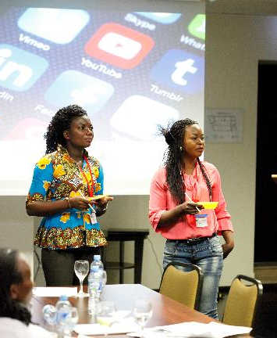
IYALI connects early career public librarians from Africa with their peers in Africa and from other countries to offer a unique learning experience, to explore new ideas and approaches, and to reflect on their own work
@EIFLnet

Slide 4
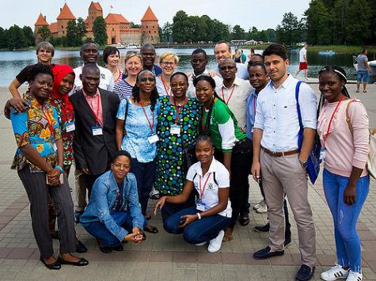
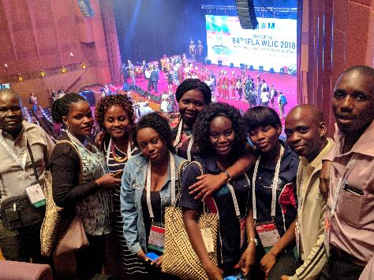
Participants
Overall, 28 young public librarians under 35 years old took part in IYALI learning experience in two years
They were from 13 African countries: Algeria, Cameroon, Egypt, Ghana, Kenya, Namibia, Nigeria, South Africa, Sierra Leone, Tanzania, Uganda, Zambia, Zimbabwe
In 2017 the IYALI group of 13 travelled to Lithuania and Poland; In 2018 fifteen librarians went to Indonesia and Malaysia
www.eifl.net

Slide 5







What makes IYALI unique? – a) Implemented by a partnership
@EIFLnet
EIFL-PLIP |
2017 – Local Partners – 2018
www.eifl.net

Slide 6
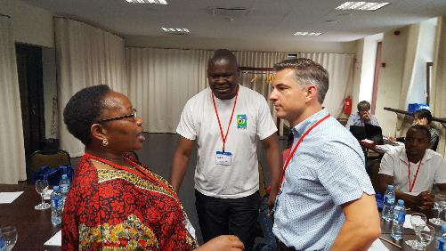
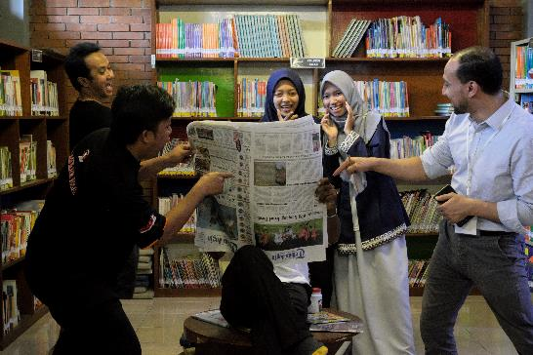
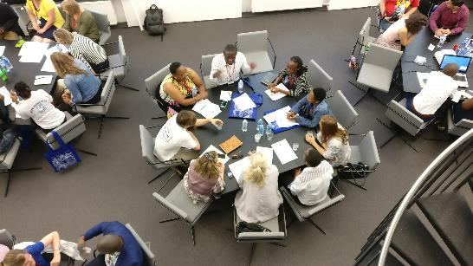
What makes IYALI unique?
b) Diverse & intensive international learning experience
workshop on public library service innovation
library visits and unconference
participation in IFLA World Library and Information Congress
hands-on training on social media communications, innovation leadership and impact
@EIFLnet

Slide 7
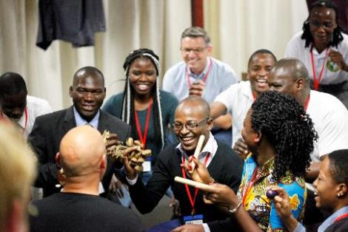
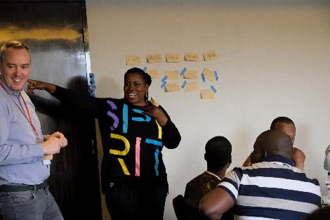
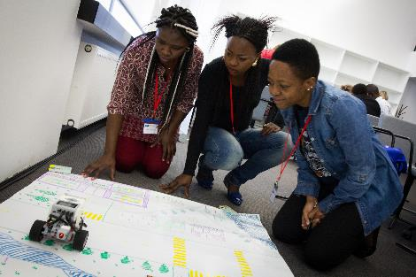
What makes IYALI unique? - c) Curated content and participation
Participatory agenda development
Practical, hands-on, peer learning
Interactive, engaging, fun
@EIFLnet

Slide 8
IYALI results reported by participants
www.eifl.net
EIFL-PLIP |
Changed perceptions of the library and profession
Increased knowledge and gave practical ideas for new library services
Taught new methods and tools for better management of the library
Extended participants’ professional connections and networks
Inspired new services and changes back in libraries
@EIFLnet

Slide 9
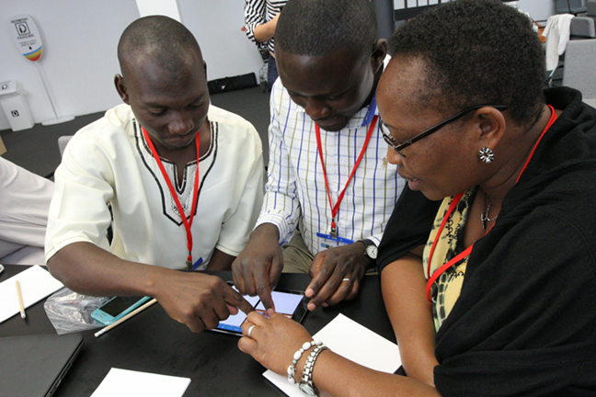
Inspired new services: a) technology skills for all
@EIFLnet
EIFL-PLIP |
Computer and online communication training for women at social risk (South Africa)
Specialized ICT training program for visually impaired people (Zimbabwe)
Child-Coder program, using “Scratch” application (Algeria)
www.eifl.net

Slide 10
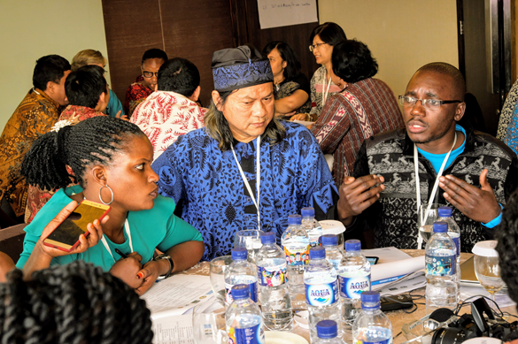
Inspired new services: b) creativity and engagement
www.eifl.net
EIFL-PLIP |
“Discussion bay”, a space for community forums to discuss local issues (Zambia)
Maker space for children and youth to spark their interest, encourage creativity (South Africa)
Use social media dynamic messages to promote library services and engage new users (Ghana)
@EIFLnet

Slide 11
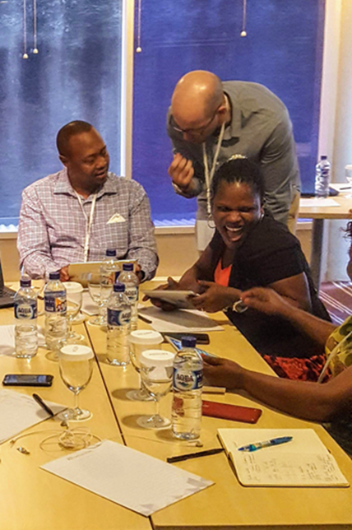
Inspired new services: c) education and learning
Interactive reading promotion program, which uses word search, quizzes, spelling games and other techniques (Ghana)
A location based game for developing English language skills (Egypt)
Organizing comics story telling session for schoolchildren (Ghana)
www.eifl.net

Slide 12
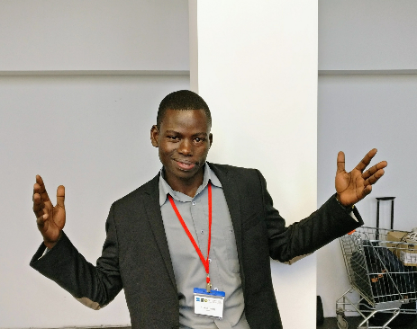
In most cases, it is rare for young librarians, early in their careers, to acquire such an extensive exposure. This has opened my eyes to appreciate the profession far much more than I ever dreamed.
Bonny Olobo, Adult Library Officer at Kampala Public Library, Uganda.
www.eifl.net
EIFL-PLIP |
Professional development for young librarians matters!
@EIFLnet

Slide 13
Thank you & stay connected
Website – www.eifl.net
Online newsletter – www.eifl.net/subscribe
facebook.com/eiflnet
twitter.com/eiflnet
plip@eifl.net

