Slide 1
Building librarians’ skills to offer ICT based services to communities in Africa
Ramune Petuchovaite
EIFL Public Library Innovation Programme
(EIFL-PLIP)
www.eifl.net - @EIFLnet - @ramupetu
DC-PAL workshop at IGF 2015 – Joao Pessoa, Brazil

Slide 2
From June 2014 to March 2015 EIFL-PLIP partnered with locally based organisations to plan, schedule and deliver the EIFL-PLIP capacity building programme to foster new services in public libraries equiped with ICT‘s:
In Ghana: TechAide and the Ghana Library Authority;
in Kenya: Kenya National Library Service;
in Uganda: Maendeleo Foundation and the National Library of Uganda

Slide 3
ICT’s in public libraries in Ghana, Kenya & Uganda: pre-assessment
Governments increasingly consider public libraries as public access venues
84 public librarians have been selected from 80 libraries in three countries
Most librarians said having basic ICT skills
Public libraries provide ‘internet café’ type services to local communities
A few libraries provided value added services, such as ICT skills training for users

Slide 4
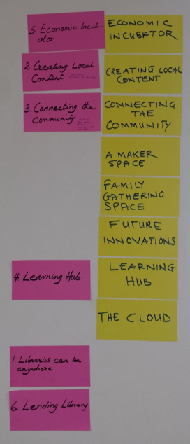
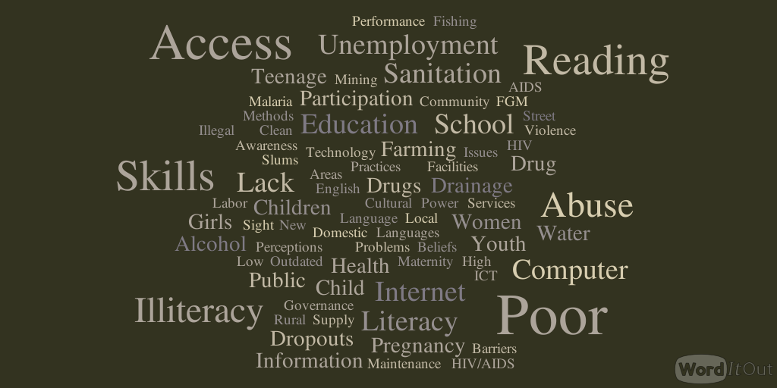
Libraries’ potential roles & community challenges in Ghana, Kenya & Uganda

Slide 5
EIFL-PLIP Public Libraries’ Capacity building to maximize public access in Ghana, Kenya and Uganda
Module 1: Advanced computer literacy for librarians
Module 2: Internet resources and searching
Module 3: New Services in public libraries
Module 4: Communication, Advocacy and Awareness Raising
More information on the programme at: http://www.eifl.net/eifl-in-action/capacity-building-africa

Slide 6
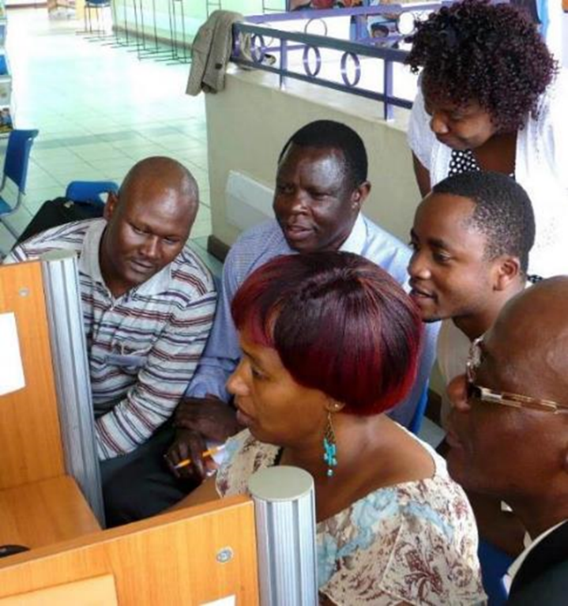
EIFL-PLIP capacity building – key principles
Working with local partners
Assessing librarians’ skills
Using a combination of local and international trainers
Bringing real-life examples of EIFL-PLIP supported library services in Africa
Organizing training in intensive and interactive sessions with ‘homework’ assignments
Photo: EIFL-PLIP

Slide 7
Training results (1): librarians start new services
In less than 2 months, 80% of learners organized ICT skills training for fellow librarians and community members reaching 2000 in Ghana alone
In some cases the ICT skills training targeted certain community groups, such as women and girls, school dropouts, farmers, etc.
Many learners started offering guidance on Internet search in specific areas, e.g. agriculture or health information
“I am proud, because I am empowered and able to offer training to others. I am able to change others through this training”
– trainee from Kenya

Slide 8
Training results (2): librarians take a lead in promoting services
After the training, 2/3 of learners have taken some advocacy or awareness-raising actions aimed at different community groups, local or district government officers and local media
About 1/2 of learners have taken fundraising actions by developing and submitting funding requests to improve infrastructure and provide ICT training
“The training has pushed me to think out of the box […] I now know the Library can be moved to the community and participate in social affairs” - trainee from Uganda

Slide 9
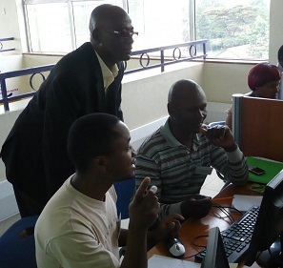
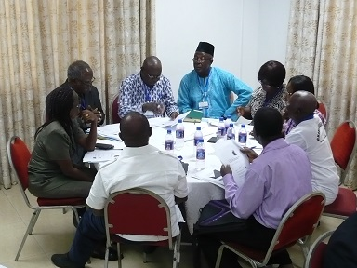
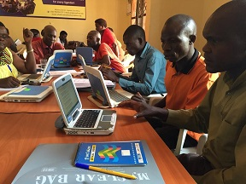
Conclusions
Libraries are well suited to provide public access to knowledge and ICT skills to enable people’s participation in digital society
Librarians’ training should be an integral part of public access initiatives to unleash their potential as ICT trainers and consultants for communities
EIFL is open for dialogue & partnership in public access initiatives, especially in Africa
Photos: EIFL-PLIP

Slide 10
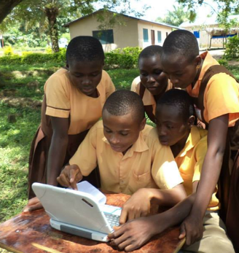
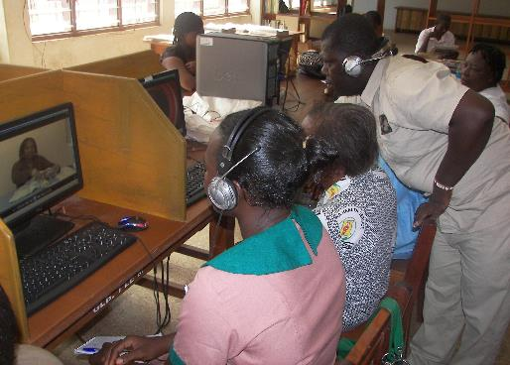
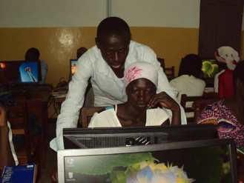
EIFL-PLIP in Action
Spark innovation through library demonstration projects that tackle community needs by using technology
Build librarians’ capacity and encourage knowledge sharing to foster replication
Recognize innovative services through EIFL Public Library Innovation Awards
Learn more at www.eifl.net/plip
Photos: EIFL-PLIP
Photo: EIFL-PLIP
Notes:
Capacity building is just one initiative EIFL-PLIP does.

Slide 11
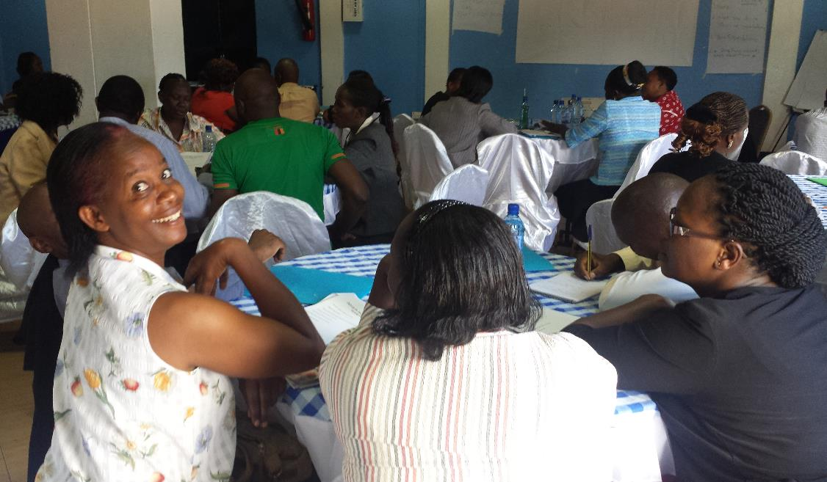
Thank you!
Photo: EIFL-PLIP
www.eifl.net/plip
@EIFLnet
Photo: EIFL-PLIP

