Slide 1


Introduction to the Marrakesh Treaty:
from a Development Perspective
1st National Workshop to Design
the National Disability Strategic Plan
11-12 December 2018
Phnom Penh, Cambodia
Kazuyuki Uji
United Nations Development Programme (UNDP)
Bangkok Regional Hub

Slide 2


The right to knowledge is a human right, vital to the achievement of SDGs
Education
Employment
Good health
Social, economic and political participation
A key prerequisite for realizing full human potential and inclusive development

Slide 3



People with print disability are restricted in their right to knowledge
What is ‘print disability’?
Prevent people from effectively obtaining information from print materials in the conventional way
visual
Learning/developmental
physical
Blindness
Dyslexia
Parkinson’s disease
Low vision
Autism
Arthritis, paralysis
A
Require accessible formats:
A
braille
audiobook
large print
Source: The World Blind Union (2013) and WHO (2014) http://www.who.int/mediacentre/factsheets/fs282/en/

Slide 4
The right to knowledge is restricted by lack of books in accessible formats
Availability of published books in accessible formats
Developed countries
Developing countries
10%
Less than 1%
‘Book famine’
285 million visually-impaired including 39 million blind people in the world
90% in developing countries
21.4 million blind people in Asia
Many more people with other print disabilities
Sources: The World Blind Union (2013) and WHO (2014) http://www.who.int/mediacentre/factsheets/fs282/en/
Bourne, R.R.A et al (2017) http://www.thelancet.com/journals/langlo/article/PIIS2214-109X(17)30293-0/fulltext?elsca1=tlpr

Slide 5
Lack of access to knowledge can cause serious development challenges
Low educational attainment
Student with low vision
Closes the door for realizing human rights and development potentials
No accessible textbooks
Sighted students
Disadvantaged, left behind, marginalized
Exclusion
Unemployment
Poverty
Photos: UNESCO http://en.unesco.org/themes/literacy-all

Slide 6


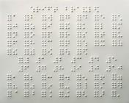






Legal barriers stand in the way of making accessible formats available (1/2)
Legal barriers to sharing of accessible format copies within a country
Cost
A
A
Availability
A
A
A
A
A
A
Icon made by Freepik from www.flaticon.com

Slide 7
Legal barriers stand in the way of making accessible formats available (2/2)
Lack of legal framework to allow cross-border sharing of accessible format copies
Country A
Cost
Country B
Availability
A
A
A
A

Slide 8
What is the Marrakesh Treaty?
‘The Marrakesh Treaty to Facilitate Access to Published Works for Persons Who Are Blind, Visually Impaired, or Otherwise Print Disabled’
Adopted in Marrakesh, Morocco, in June 2013
Entered into force on 30 September 2016
Administered by the World Intellectual Property Organization (UN agency)
47 Contracting Parties to the Marrakesh Treaty, covering 70+ countries (as of Nov 2018) – Cambodia signed but is not yet a party.
More countries need to ratify to maximize the benefits of this Treaty and realize the right to knowledge among blind and other print-disabled people.

Slide 9
Key features of the Marrakesh Treaty (1/3)
Enable production, dissemination, importation and exportation of accessible format copies without having to ask for rights holders’ permission.
Transmission and download of digital contents
Circumvention of technological protection measures (eg. removal of digital locks) that disable accessibility functions

Slide 10
Key features of the Marrakesh Treaty (2/3)
Broad definition of ‘authorized entity’ and ‘beneficiary person’ provides flexibilities
“Authorized entity” – non-profit or government agency that makes accessible format copies for ‘beneficiary persons.’ The Treaty does not require any specific process for qualification. (Art 2)
“Beneficiary person” – basically includes any disability that impedes reading of printed works – people who are blind, visually impaired, have learning or physical disability. ‘People with print disabilities’ (Art 3)

Slide 11
Key features of the Marrakesh Treaty (3/3)
Provide reassurances for the publishing industry and the author
Contracting parties/authorized entity need to ensure that, for example:
accessible format copies are only for the use by beneficiary persons
Only beneficiary persons and/or authorized entities can distribute and make accessible format copies
discourage unauthorized use
maintain due care including records of handling of copies of work. (Art 2)
Also, ‘accessible format copy’ must respect the integrity of the original work (Art 2)
Balancing between the effective protection of authors’ interest and the larger public interest

Slide 12
Some ‘optional’ provisions can go against the overarching objectives of the Treaty
Article 4 (4): Commercial availability
Would allow a country to prohibit the creation of accessible format copies if there are already commercially available format copies in the country
Article 4 (5): Remuneration requirement
Would allow a country to require payment for the creation or distribution of accessible format copies
The World Blind Union encourages countries
NOT to adopt these optional provisions.

Slide 13
Key amendments needed in Cambodia’s copyright law to align with the Treaty
The creation and distribution of accessible format copies for persons who are blind, visually impaired or otherwise print disabled
These provisions and other flexibilities provided by the Treaty need to be written into
the law or regulations
Importation and exportation of copies of accessible format copies by an authorised entity for the purpose of serving print disabled people
Although currently not required, but advisable: Circumvention of technological protection measures to create accessible format copies

Slide 14

Vision impairment is among the most prevalent disability in Cambodia
Disability category breakdown (2013)
Source: The Cambodia Inter-Censal Population Survey 2013 by the Ministry of Planning

Slide 15
Benefits a much larger number of persons with disabilities than just persons who are blind/partially-sighted
People with print disability
Blind, visually-impaired people

Slide 16
Growing elderly population in Cambodia will increase no. of people with print disability
17.6%
People with print disabilities
% elderly (60+)
6.8%
Source: United Nations. (2015). World Population Prospects: The 2015 Revision.

Slide 17
Growing non-communicable diseases (NCDs) increase people with print disability
Number of people with diabetes in Cambodia is projected to nearly double between 2008 and 2018
264,000
People with print disabilities
Number of diabetes
145,000
Source: GIZ (2014) Costing of Type 2 Diabetes Mellitus in Cambodia

Slide 18
The Marrakesh Treaty provides an effective legal framework to address multiple development issues
Education
Employment / Labour productivity
Poverty
Equality
Aging population
Non-communi-cable diseases
Rights protection
Inclusive development

Slide 19
The Marrakesh Treaty can provide an additional tool to help fulfil Cambodia’s CRPD obligations
Access to information (Article 9)
Freedom of expression (Article 21)
The right to education (Article 24)
The right to participate in cultural life (Article 30(1)(a))
Art 30 (3): …”ensure that laws protecting intellectual property rights do not constitute an unreasonable or discriminatory barrier to access by persons with disabilities to cultural materials. “

Slide 20
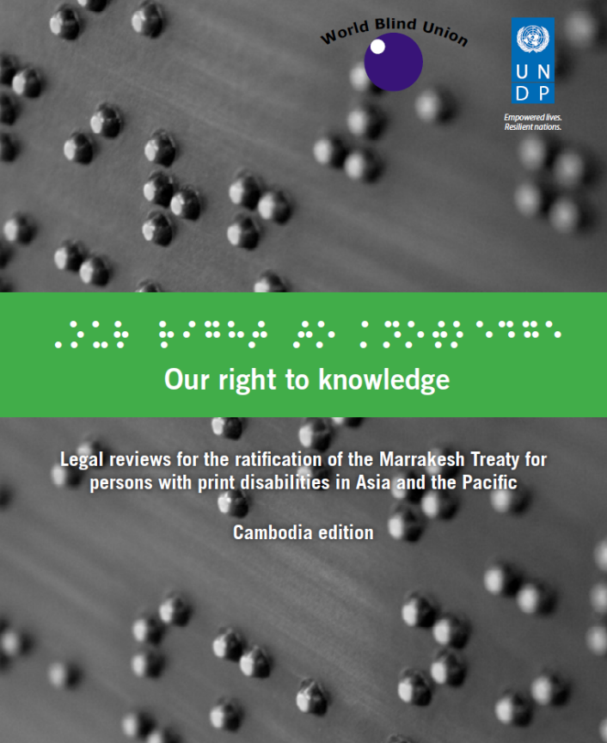
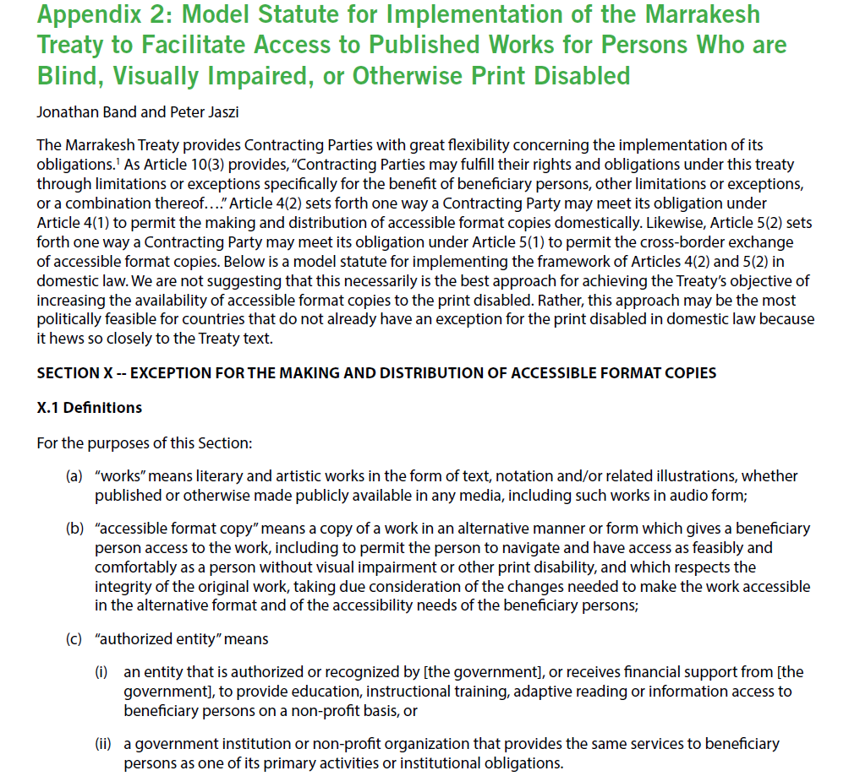

UNDP works together with the blind community to support the Marrakesh Treaty
Including model statute, which can provide a useful reference for legal reform
braille
audio

Slide 21
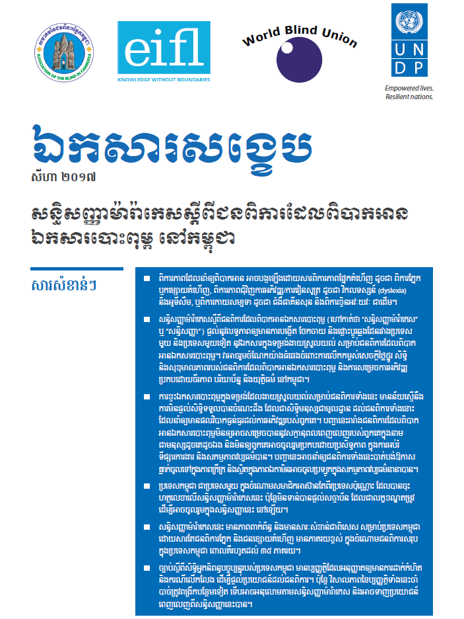
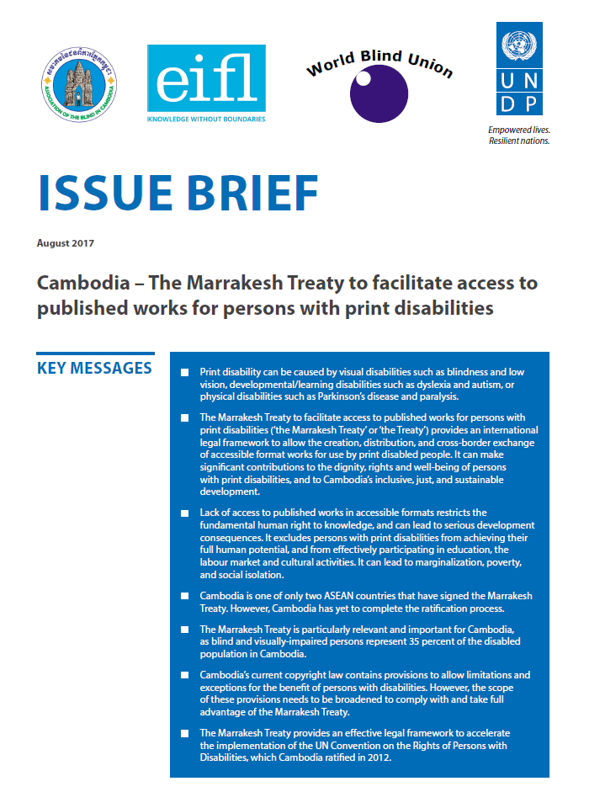
UNDP helps strengthen knowledge base to facilitate policymaking and community engagement
Also available in accessible formats (braille and audio)

Slide 22

The Marrakesh Treaty can make significant contributions to achieving the SDGs
SDG guiding principles
“Leave no one behind”
“Reach the furthest behind first”

Slide 23
Recent progresses on the Marrakesh Treaty ratification/accession
The EU ratified the Marrakesh Treaty in October 2018
Japan acceded to the Marrakesh Treaty in October 2018
US President Trump signed the Marrakesh Treaty Implementation act in October 2018
NEXT!

Slide 24
Mao Meas mao.meas@undp.org
Amara Bow amara.bow@undp.org
Kazuyuki Uji Kazuyuki.uji@undp.org

Slide 25
Issue Brief for Cambodia – The Marrakesh Treaty to facilitate access to published works for persons with print disabilities
http://www.kh.undp.org/content/cambodia/en/home/library/democratic_governance/cambodia-_-the-marrakesh-treaty-to-facilitate-access-to-publishe.html
The World Blind Union Marrakesh Treaty Ratification and Implementation Campaign
http://www.worldblindunion.org/English/our-work/our-priorities/Pages/right-2-read-campaign.aspx
WIPO Marrakesh Treaty website
http://www.wipo.int/treaties/en/ip/marrakesh/

Slide 26
The publishing industry is also satisfied with the Marrakesh Treaty
“The IPA (International Publishers Association) which represents world publishers, is very happy about the Marrakesh Treaty coming into force.
We were part of the discussions for the whole of the debates, and we, of course, wanted some reassurances that publishers and authors’ copyright wouldn’t be abused and we think that the Marrakesh Treaty actually delivers on that.”
Jose Borghino, Secretary General, IPA

Slide 27
Definition: ‘Works’
Article 2 (a): “Works” means literary and artistic works within the meaning of Article 2(1) of the Berne Convention for the protection of Literary and Artistic Works, in the form of text, notation and/or related illustrations, whether published or otherwise made publicly available in any media.

Slide 28
Definition: ‘Accessible format copy’
Article 2 (b): “Accessible format copy” means a copy of a work in an alternative manner or form which gives a beneficiary person access to work, including to permit the person to have access as feasibly and comfortably as a person without visual impairment or other print disability.
The accessible format copy is used exclusively by beneficiary persons and it must respect the integrity of the original work, taking due consideration o f the changes needed to make the work accessible in the alternative format and of the accessibility needs of the beneficiary persons;
The broad definition allows flexibility to create any format necessary to meet the unique needs of a person with print disability.

Slide 29
Definition: ‘beneficiary persons’
Article 3: A beneficiary person is a person who:
Is blind;
Has a visual impairment or a perceptual or reading disability which cannot be improved to give visual function substantially equivalent to that of a person who has no such impairment or disability and so is unable to read printed works to substantially the same degree as a person without an impairment or disability; or
Is otherwise unable, through physical disability, to hold or manipulate a book or to focus or move the eyes to the extent that would be normally acceptable for reading;
regardless of any other disabilities

Slide 30
Definition: ‘Authorized entity’
Article 2 (c): “authorized entity” means an entity that is authorized or recognized by the government to provide education, instructional training, adaptive reading or information access to beneficiary persons on a non-profit basis. It also includes a government institution or non-profit organization that provides the same services to beneficiary persons as one of its primary activities or institutional obligations.
Footnote: ’For the purpose of this Treaty, it is understood that “entities recognized by the government” may include entities receiving financial support from the government to provide education, instructional training, adaptive reading or information access to beneficiary persons on a non-profit basis’

Slide 31
TRIPS agreement
Article 8: Principles
Members may, in formulating or amending their laws and regulations, adopt measures necessary to protect public health and nutrition, and to promote the public interest in sectors of vital importance to their socio-economic and technological development, provided that such measures are consistent with the provisions of this Agreement.
Article 13: Limitations and Exceptions
Members shall confine limitations or exceptions to exclusive rights to certain special cases which do not conflict with a normal exploitation of the work and do not unreasonably prejudice the legitimate
interests of the right holder.

Slide 32
Countries may also enact to allow translation
“The Agreed Statement to the Marrakesh Treaty Article 4 (3) clarifies that the enactment of E&L (exceptions and limitations) pursuant to this provision “neither reduces nor extends the scope of applicability” of E&Ls states may enact to the exclusive right of translation pursuant to the Berne Convention. In other words, the MT affirms both the scope of the translation right recognized in the Berne Convention as well as the preexisting exceptions to that right. States may therefore adopt an exception or limitation that enables beneficiaries and authorized entities to translate a work from one language to another to facilitate access to print-disabled individuals, provided that they do so consistently with the Berne Convention”
Source: The World Blind Union Guide to the Marrakesh Treaty, Oxford University Press, 2017

Slide 33
Cambodia and international intellectual property agreements
Cambodia is not a party to the WIPO Copyright Treaty and therefore does not currently have any obligations under this treaty, including the provision of legal protection and remedies against the circumvention of technological measures used to protect rights under the WCT or Bern Convention. Cambodia is also not a party to the Bern Convention.
Cambodia is a member of WTO and TRIPS. However, because of its status as a least developed country, it is afforded an extension of waiver with respect to most articles of the TRIPS agreement until 2021.
While this extension may be further extended at some future date, eventual.ly Cambodia will be required to en sure that its laws are TRIPS compliant. Significantly, Cambodia’s current copyright law is designed to comply with the TRIPS Agreement
Source: Our Right to Knowledge

Slide 34
TRIPS agreement
Article 8: Principles
Members may, in formulating or amending their laws and regulations, adopt measures necessary to protect public health and nutrition, and to promote the public interest in sectors of vital importance to their socio-economic and technological development, provided that such measures are consistent with the provisions of this Agreement.
Article 13: Limitations and Exceptions
Members shall confine limitations or exceptions to exclusive rights to certain special cases which do not conflict with a normal exploitation of the work and do not unreasonably prejudice the legitimate
interests of the right holder.

