Slide 1
Introduction to OAPEN and the Directory of Open Access Books (DOAB)
Jordy Findanis, Project Manager
Wednesday 23 October 2024

Slide 2
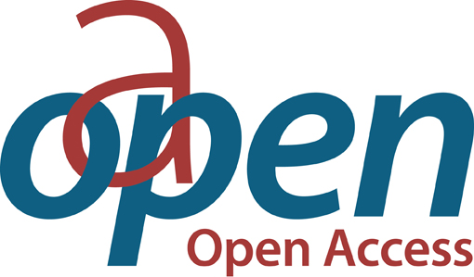


OAPEN Foundation
OAPEN promotes and supports the global transition to open access (OA) for academic books by providing services to publishers, funders, libraries, and researchers.
OAPEN operates the following three platforms:
OAPEN Library (https://oapen.org)
Directory of Open Access Books (https://doabooks.org)
OAPEN OA Books Toolkit (https://oabooks-toolkit.org/)

Slide 3
OAPEN’s mission and values
Increase discoverability of peer-reviewed OA books
Promote and build trust in OA book publishing
Independent and not-for-profit
Cannot be sold or acquired
Follow the Principles of Open Scholarly Infrastructure (POSI)
  Conducted self-audit in May 2023 (to be reviewed in May 2025)

Slide 4




Our strategic ambitions include supporting the Sustainable Development Goals (SDGs)

Slide 5
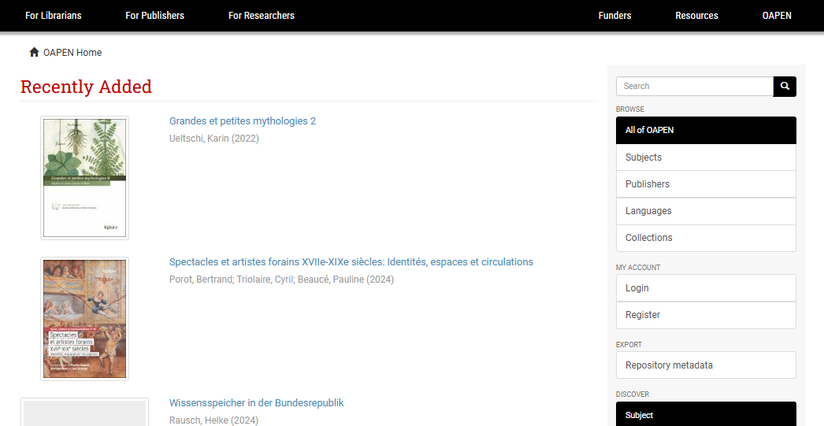
About the OAPEN Library
Launched in 2010
Provides hosting, distribution, preservation, quality assurance and reporting services for publishers
Collection of 37,500+ peer-reviewed OA books from 450+ publishers and 75+ languages
Built on the open-source platform DSpace 6 and server soon to be hosted in CERN’s Data Center
On average, 1.5 million COUNTER downloads per month
Explore the collection: https://library.oapen.org/
Notes:
Hosting - We host books for publishers and a variety of partners.
Dissemination - We provide freely-available metadata feeds in various formats and work with intermediaries to optimise dissemination of the collection.
Digital preservation - We work with partners to provide a stable repository infrastructure and digital preservation service.
Discovery - We improve discovery in collaboration with DOAB.
Reporting - We provide the OAPEN Dashboard, based on the COUNTER standard.
Publishers can join OAPEN if
they publish academic, peer reviewed books
that are made freely available or published under an open license
OAPEN requires publishers to describe their peer review procedures and make these descriptions available for publication on the OAPEN website

Slide 6
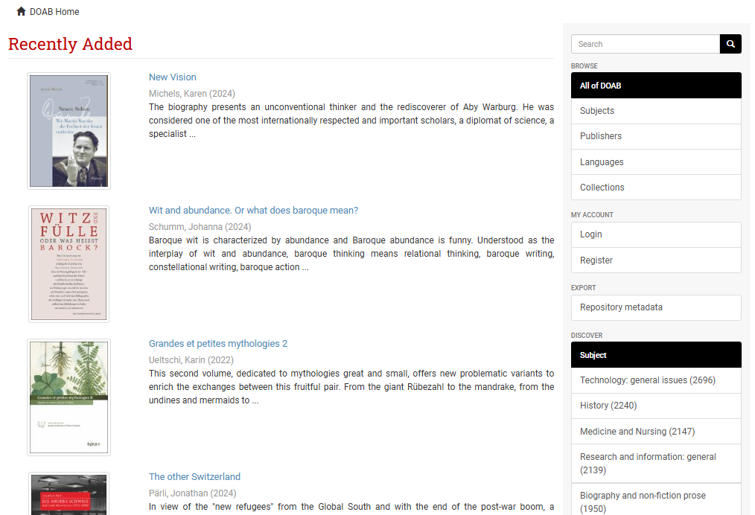
About the Directory of Open Access Books
Launched in 2013, in cooperation with OpenEdition
A community-driven discovery service, providing access to scholarly, peer-reviewed OA books
Helps users to find trusted OA book publishers
DOAB contains 88,000+ peer-reviewed OA books and chapters from 750+ publishers and 95+ languages
Built on the open-source platform DSpace 6 and server soon to be hosted in CERN’s Data Center
All metadata is freely available under a CC0 license (access DOAB metadata)
Explore DOAB: https://directory.doabooks.org/
Notes:
Publishers can participate in DOAB for free if they meet the following two requirements (at a minimum):
their books are published under an open license (e.g., Creative Commons)
their books have undergone independent and external peer review prior to publication
If they meet the above two requirements, they can complete the application form
Application review can take several months and publishers are informed of the outcome (accepted, rejected, further information required) after the first evaluation

Slide 7
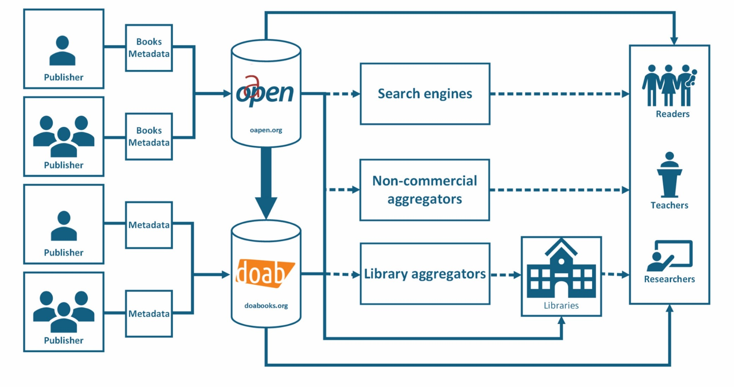
The workflow of OAPEN and DOAB

Slide 8













Our metadata is used by
and many more…

Slide 9
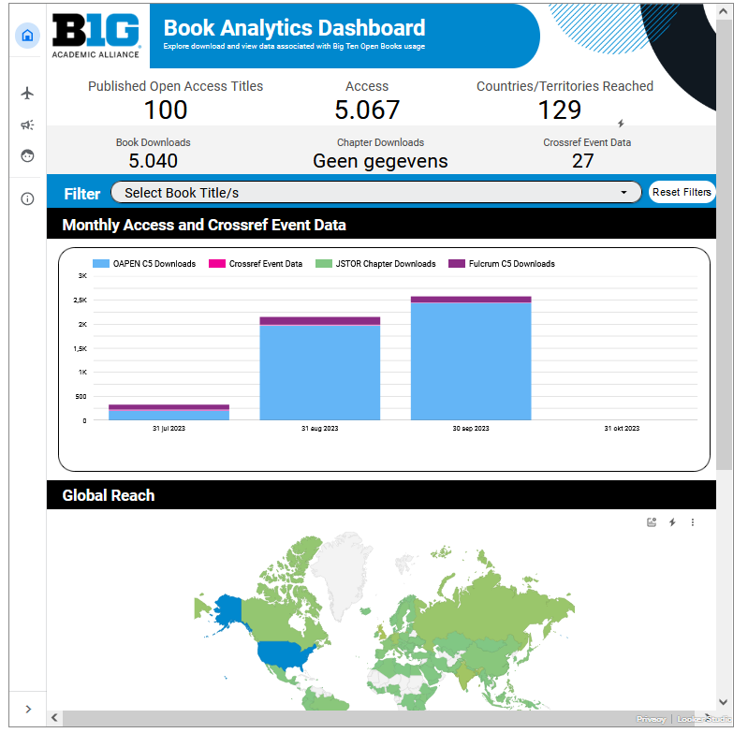
The Books Analytics Service (BAS)
BAS aggregates standardised usage data from a range of sources, including: OAPEN, Google Books, Crossref, JSTOR, Fulcrum
BAS can help you:
  Understand usage, by platform, subject, country, and titles
  Easily synthesise and consolidate data and save time on manual data collection
  Inform publishing decisions
  Explain the value of open access publishing to authors and funders
View our live demo dashboard: https://template.book-analytics.org/

Slide 10


Additional services of DOAB
Peer Review Information Service for Monographs (PRISM):
  PRISM provides publishers with the opportunity to display information about their peer review procedures at a publisher level and an individual title level
  Supports transparency around the quality assurance process of academic book publishing
  There is a PRISM widget available for publishers to use on their own websites
DOAB Trusted Platform Network
  A seamless process for publishers to list their OA books in DOAB
  Publishers who add their OA books to any of the platforms (see next slide) can request them to check which of their OA books meet the DOAB criteria
  Verified books are then automatically listed in DOAB
Notes:
We understand peer review procedures vary widely depending on the discipline, and even between series, so we want publishers to have the opportunity to present the differences in as transparent a way as possible

Slide 11








Hosting Indexing

Slide 12
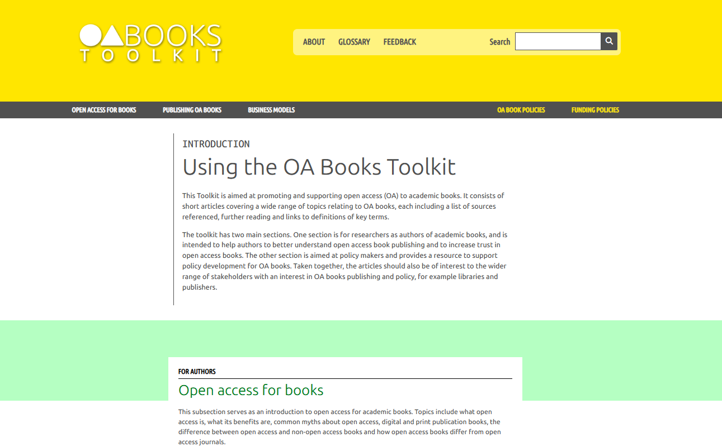
OAPEN Open Access Books Toolkit
https://oabooks-toolkit.org
https://knowledgebase.oabooks-toolkit.org/home
Notes:
A collection of around 50 articles about OA book publishing, based around the research life cycle
A free information resource to help authors better understand OA book publishing and tackle common myths
Guided by a global, multi-stakeholder Editorial Advisory Board
Relaunched this month with a new design, new features, updates articles and new articles
A new Knowledge Base to support policy development for OA books, in cooperation with the PALOMERA project, was added

Slide 13
Contact us
Jordy Findanis, Project Manager, OAPEN Foundation: j.findanis@oapen.org

