Slide 1

Right to Research & Comparative Copyright Limitations and Exceptions
Sean Flynn, American University Washington College of Law
(CC) (BY)
Notes:
My intent here is to provide a little bit of historical background for the limitations and exceptions issues being discussed at the 43rd meeting of the SCCR.

Slide 2
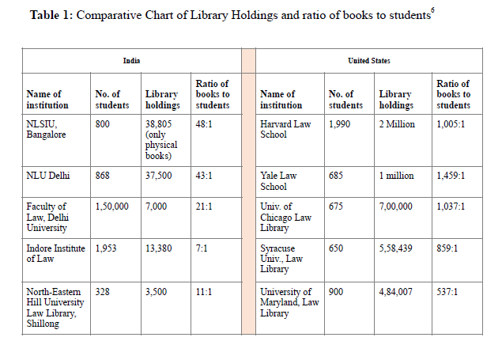
Controlled Lending by Public Libraries Under Indian Law Lawrence Liang and Carl Malamud
Notes:
We live in a world with radically unequal distribution of educational and research resources. A recent publication, for example, documented the radical inequality in access to library holdings. A mid tier law school in t he US for example, has over 10 times as many books per student that the top law school in India.
One response may be that developing countries should buy more books. But the public fisc is not the only tool at he disposal of countries to promote access to knowledge. Copyright law is another.

Slide 3
States have duties to “respect,” “protect,” and “fulfill” human rights, including:
Article 19 Everyone has the right to freedom of opinion and expression; this right includes freedom to hold opinions without interference and to seek, receive and impart information and ideas through any media and regardless of frontiers.
Article 26 1. Everyone has the right to education. …
Article 27
1. Everyone has the right freely to participate in the cultural life of the community, to enjoy the arts and to share in scientific advancement and its benefits.
2. Everyone has the right to the protection of the moral and material interests resulting from any scientific, literary or artistic production of which he is the author.
-UDHR
Notes:
The balance between the interests of authors and the general public were later explicitly addressed in human rights law. On the one hand, Article 27 of the UDHR requires that states act to protect the rights of authors to moral and material interests in their creations. On the other hand, states have duties as well to ensure that the public benefits from science and has freedom to receive and impart information ands to education.

Slide 4
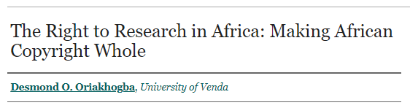
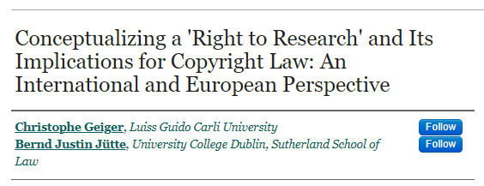
Notes:
At PIJIP we have been producing academic work that describes the rights to freedom of information and to benefit from science as constituting what can be called the right to research. That is – governments have duties to protect authors on the one side. But also to facilitate research uses of works on the other.

Slide 5
Respect
“States must refrain from interfering directly or indirectly with your rights.”
Protect
“States must take measures to make sure that others, such as businesses, political groups or other people do not interfere with your rights.”
Fulfil
“States must take steps to realize rights.”
Justification
Any limit to rights must be narrowly tailored and promote an important government interest.

Slide 6
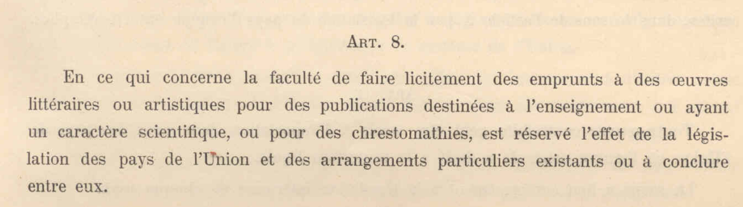
Berne Convention, Original Text 1886
“the liberty of extracting portions from literary or artistic works for use in publications destined for educational or scientific purposes, or for chrestomathies, is reserved to the legislature”
Notes:
Copyright has always promoted the balance that human rights requires by on the one hand granting authors certain rights to reproduce and sell their works in markets and on the other hand protecting important public interest uses from those exclusive rights.
In the original 1886 version of the Berne convention two essential public interests were mentioned – educational and scientific purposes.

Slide 7
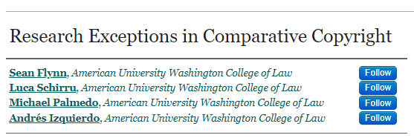
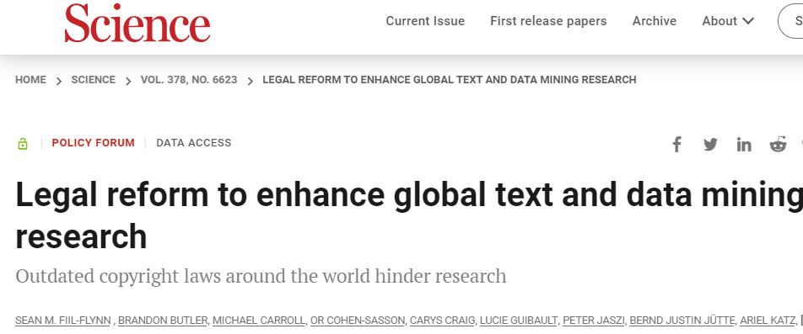
Notes:
Our research at PIJIP shows that today nearly every copyright law in the world protects rights to research uses in some way. But there is much variation in how extensive those protections are.

Slide 8
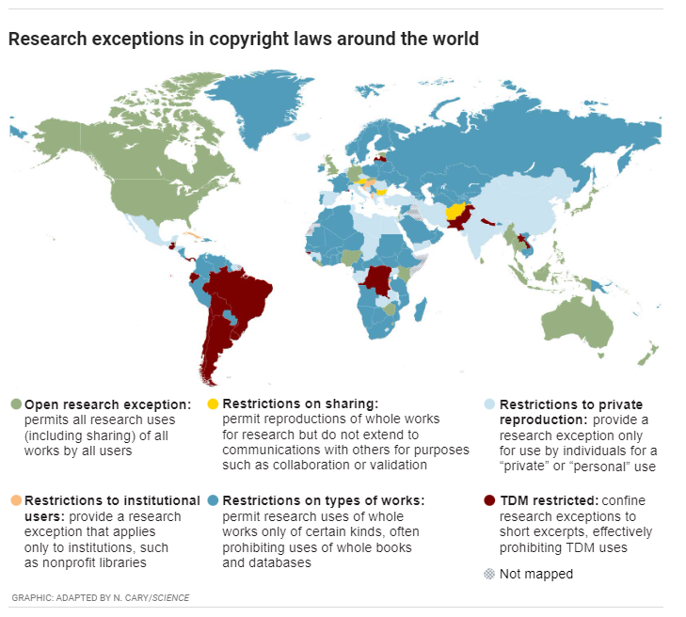
Notes:
This map, from our science magazine article, measures whether the research exceptions in laws around the world are what we call “open.” We define open exceptions as those are open to any protected use (reproduction, communication, etc.), of any protected work, by any user for a research purpose.

Slide 9
Kenya Copyright Act
Act No. 20 of 2019
SECOND SCHEDULE
General exceptions and limitations
1. The exclusive rights … shall not include the right to control ---
(a) the doing of any of those acts by way of fair dealing for the purposes of scientific research, private use, criticism or review, or the reporting of current events;
Notes:
We categorize Kenya as an open exception for research uses in our mapping because of its fair dealing exception.
Open to all acts, with all works, by users, for purposes including scientific research.

Slide 10
Possible improvements
Define “scientific” research
Expressly include computational research
Protect from contract override
Open fair dealing to all purposes (“such as”)

