Slide 1
NomadLite
Enrich your DSpace repository with customized tools webinar
Milica Ševkušić
Institute of Technical Sciences of SASA
Belgrade, Serbia

Slide 2
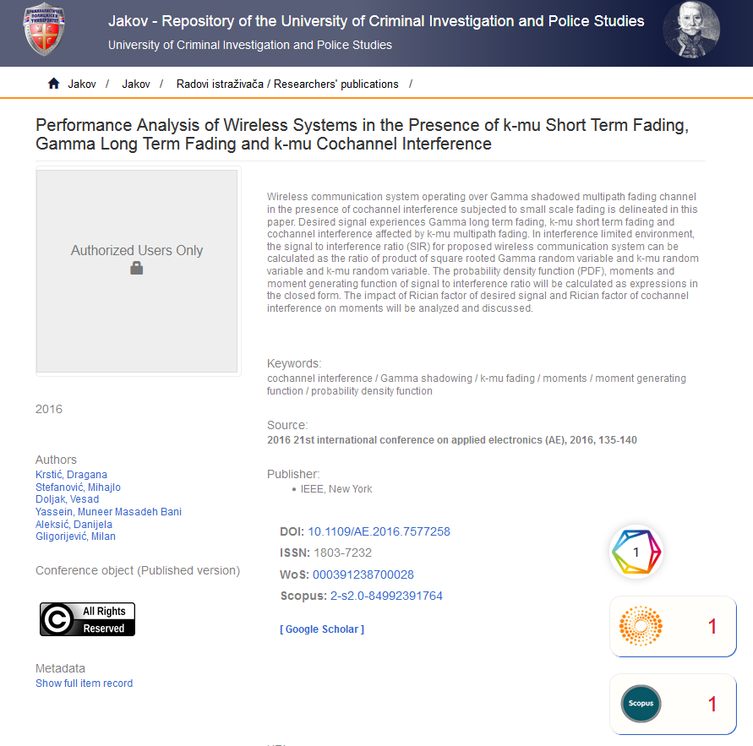
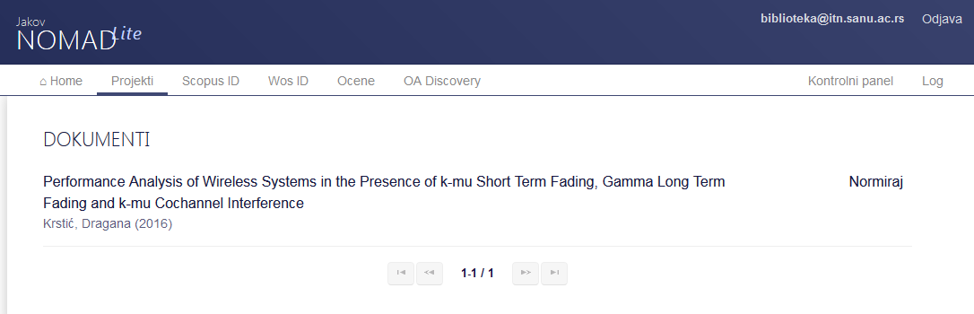
Text mining: funding info
No funding info

Slide 3
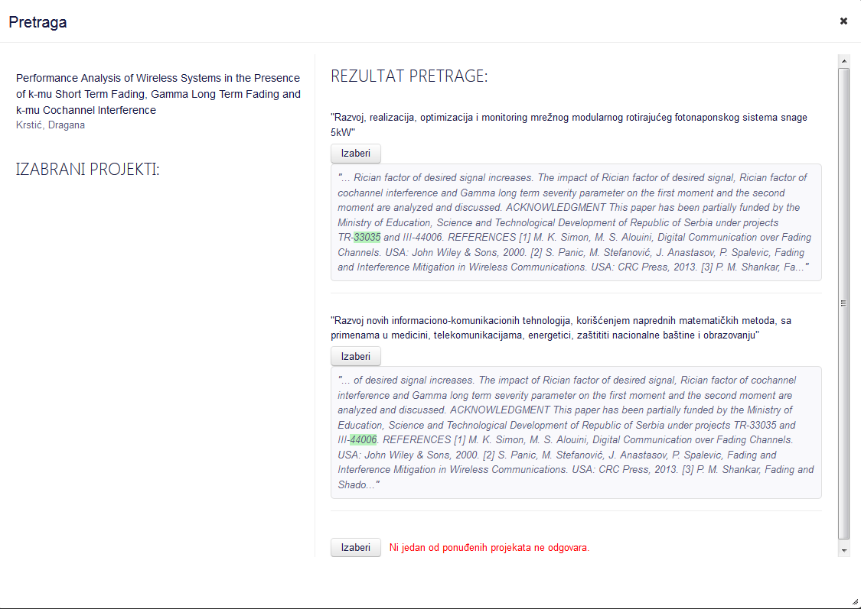

Slide 4
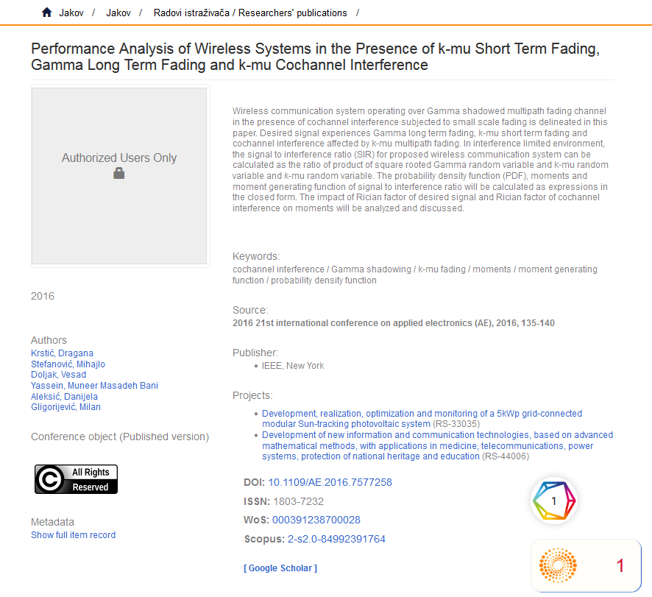
Funding info added

Slide 5
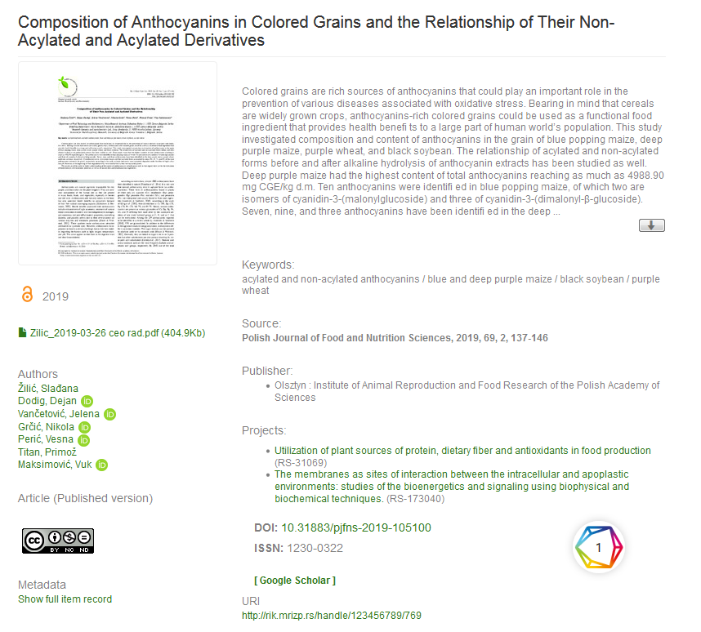
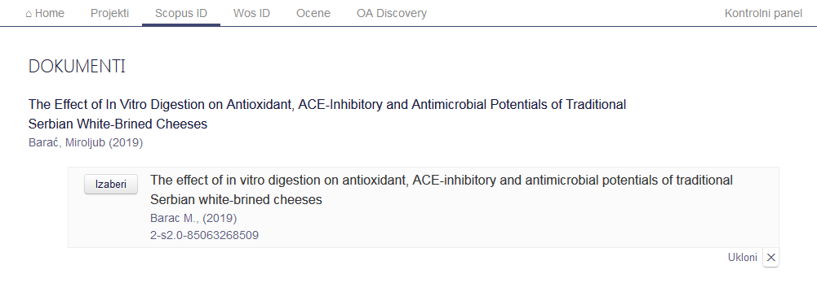
Adding identifiers
No Scopus ID

Slide 6
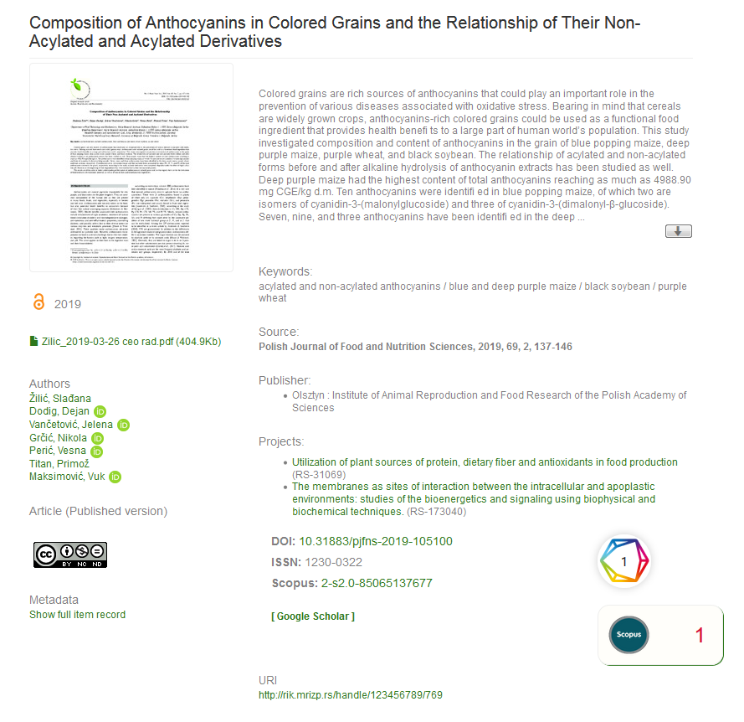
Scopus ID added

Slide 7
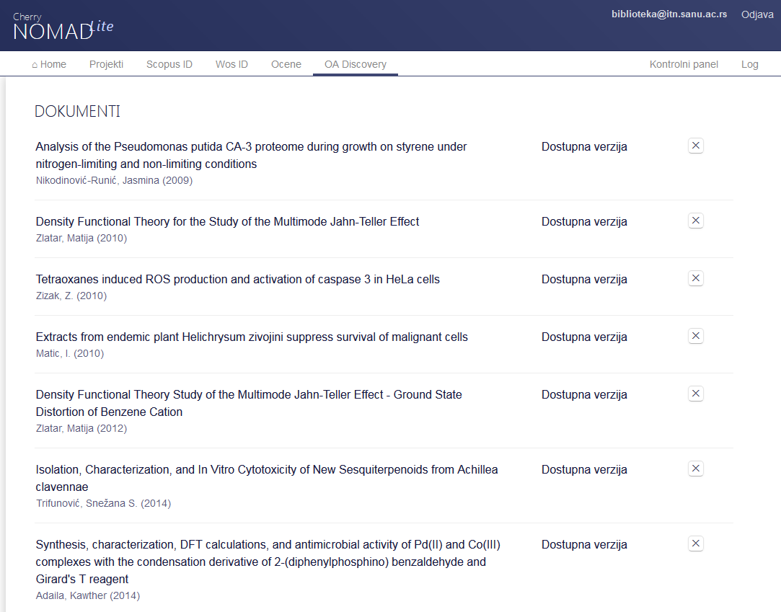
OA Discovery

Slide 8
Repository policies

Slide 9
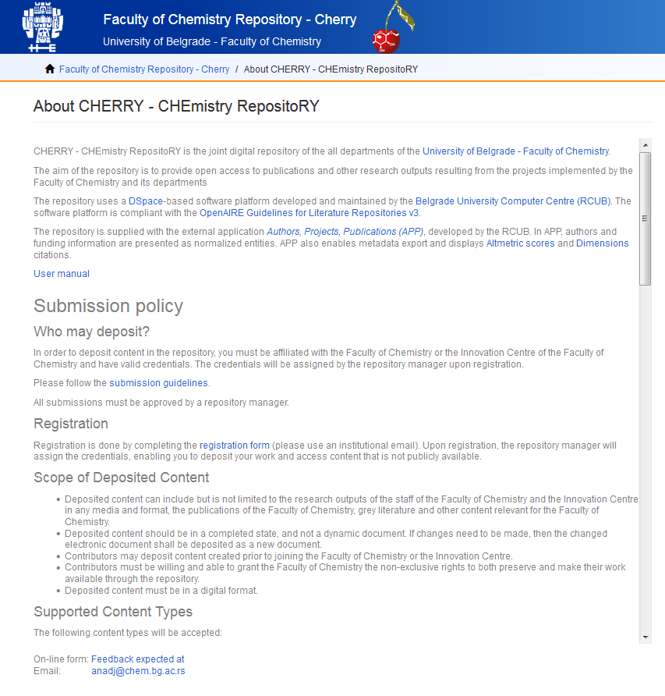
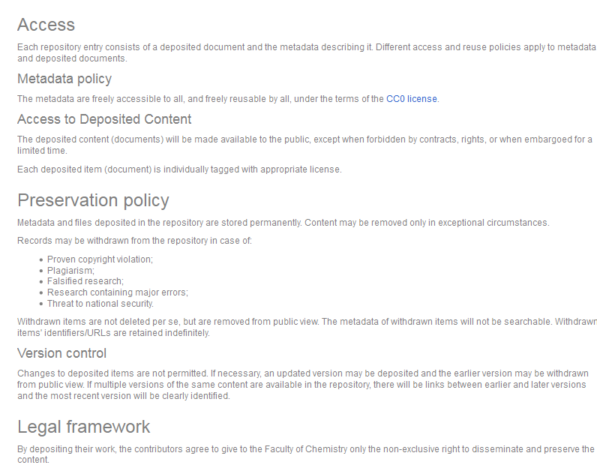

Slide 10
Integration and interoperability

Slide 11
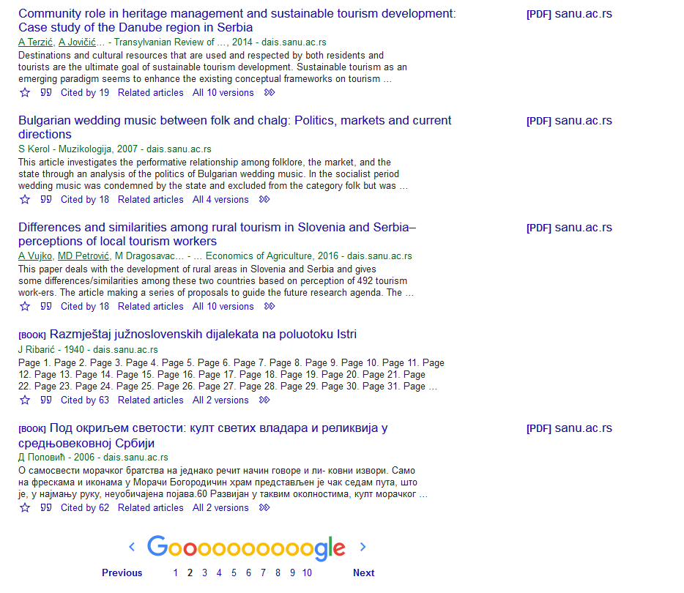
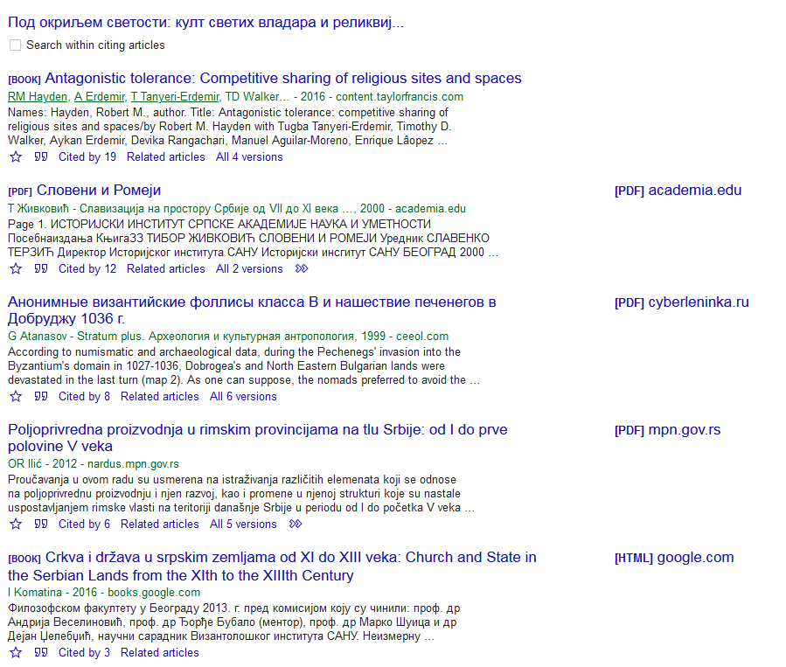
Google Scholar

Slide 12
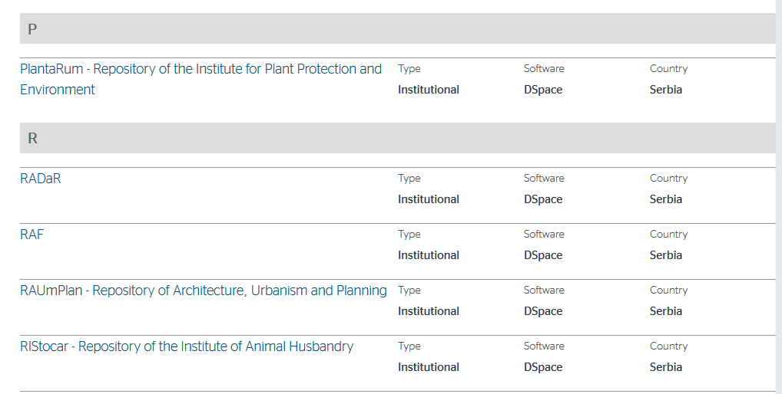
OpenDOAR

Slide 13
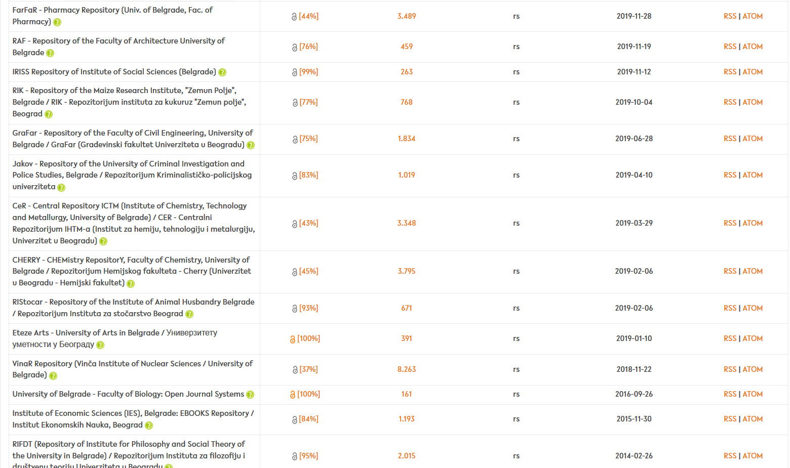

Slide 14
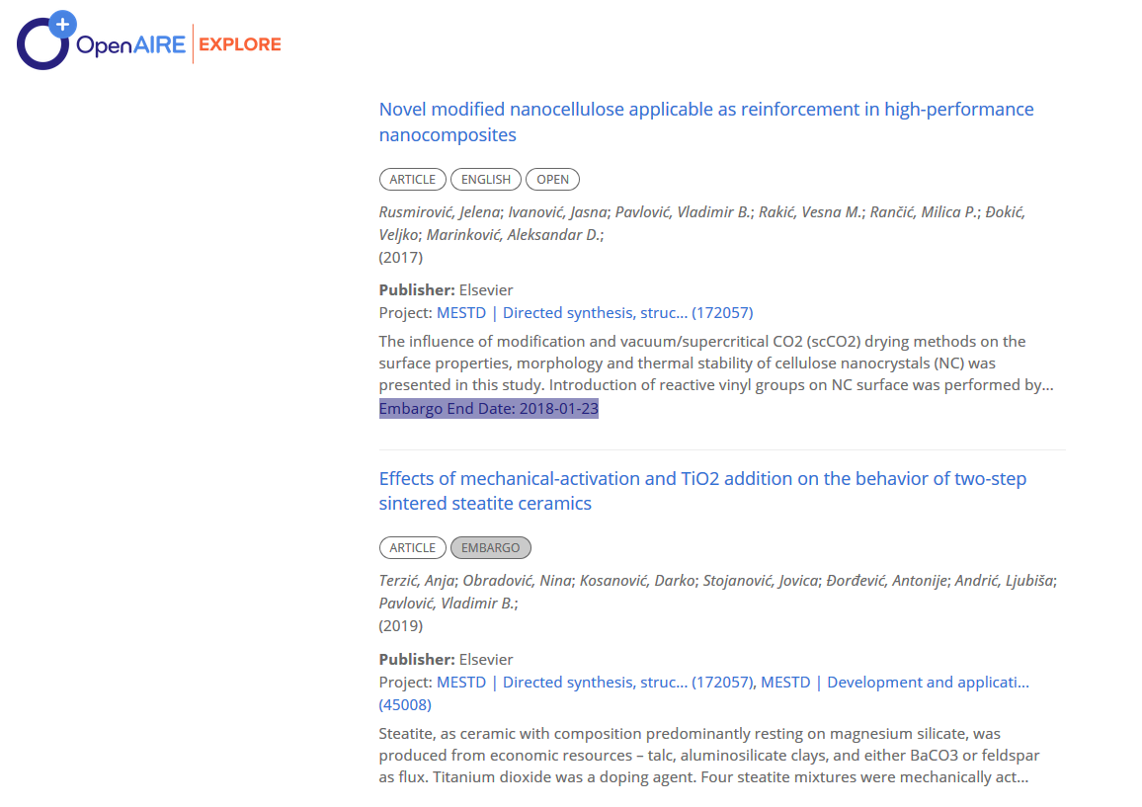

Slide 15
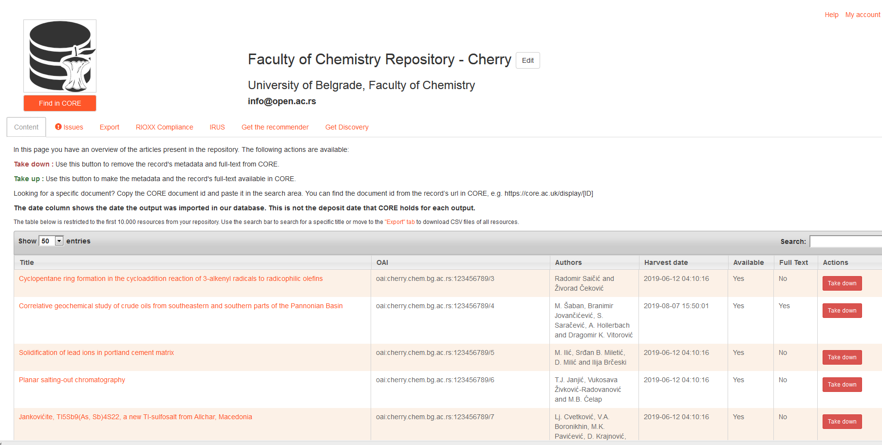
CORE Dashboard

Slide 16
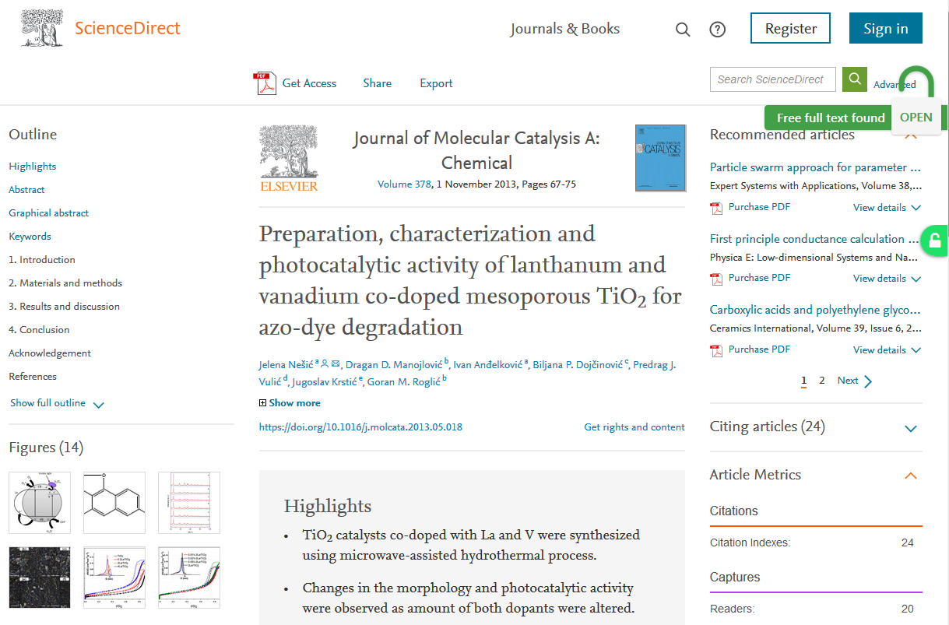
Unpaywall
and
CORE Discovery
https://www.sciencedirect.com/science/article/pii/S1381116913002240?via%3Dihub

Slide 17
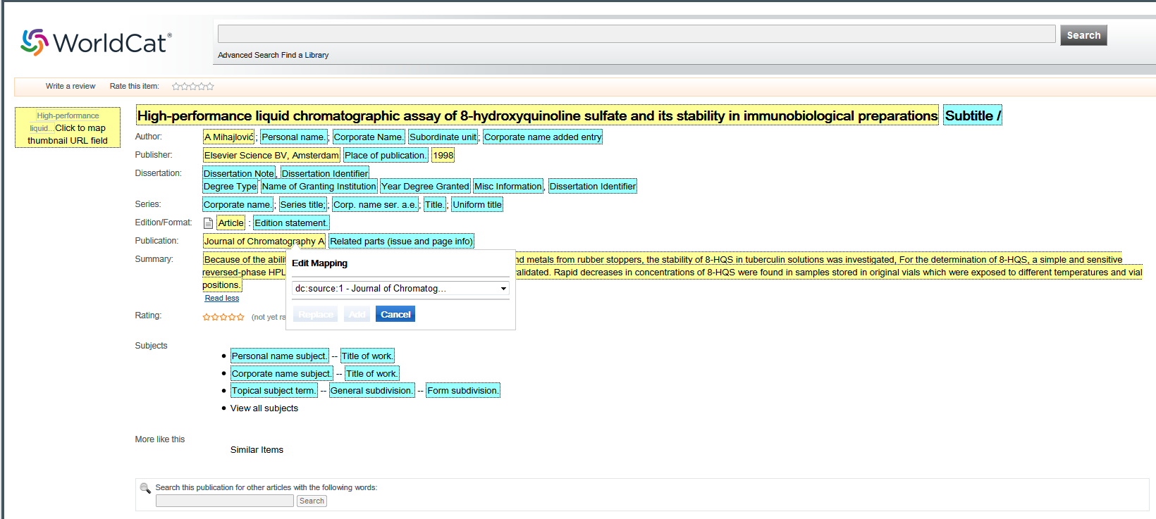
WorldCat

Slide 18
OpenDOAR: http://sherpa.ac.uk/forms/new-repository.php?service-identifier=opendoar2
BASE - Suggest a source: https://www.base-search.net/about/en/suggest.php
Add a repository to the Unpaywall database: https://docs.google.com/forms/d/e/1FAIpQLSf86ozWOlLPmlP9wsSyL7LBdjn867ydLsbcEEAb_4wE1Ug2NQ/viewform
CORE Discovery: https://core.ac.uk/services/discovery/
Register with Digital Collection Gateway: https://help.oclc.org/Metadata_Services/CONTENTdm/CONTENTdm_Administration/WorldCat_sync/Register_with_Digital_Collection_Gateway
Google Scholar: https://partnerdash.google.com/partnerdash/d/scholarinclusions#p:id=new

