Slide 1
SAGE Research Methods Training
Jenny Hopkins – Group Marketing Manager
jennifer.hopkins@sagepub.co.uk

Slide 3
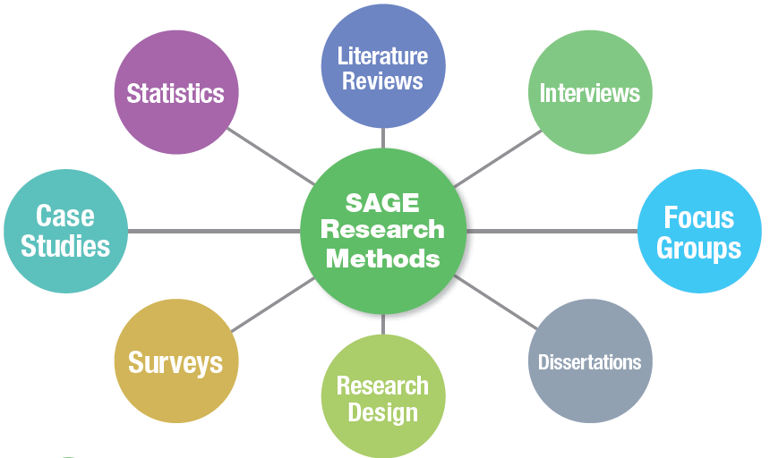
What are Research Methods?
Rigorous and systematic tools used to design a research project
Notes:
Research Methods are the systematic tools used to design a research project. These are quantitative, qualitative, and mixed methods, and include case studies, statistics, interviews, focus groups, and surveys.

Slide 4

Students and research
Undergraduate:
  Intro Research Methods and Intro Statistics courses
  Conduct research projects and theses using research
Masters:
  Theses and dissertations
PhD:
  Candidates conduct research for their dissertations
  Teaching and taking courses
  Cover qual methods, quant methods and stats
Notes:
Research Methods hit students at every level: Undergrads are taking RM courses and conducting projects, grad students are conducting research for their these and dissertation, and post grads are teaching and taking research methods courses

Slide 5

Librarians and research
Helping students
  Drafting research question
  Finding research content
  Conducting literature review
Supporting information and data literacy
Doing your own research
  Evidence Based Librarianship
Notes:
Librarians support students doing research with reference interviews that help students refine their research question, finding content on how to do research and to support students research, and assisting with the literature review phase.
Teach information/data literacy
More and more, librarians are conducting their own research

Slide 6
Why are they important?
The study of these methods helps researchers gather data in an accepted manner in order to produce accurate results
Without research we have no way of confirming what we think we know
Replication of research validates findings
They are broadly applicable to all social and behavioural science disciplines
Notes:
Psychology: undergrad/graduate levels
Sociology: undergrad/graduate levels
Education: graduate level
Criminology/Crim. Justice: undergrad/graduate levels
Health/Nursing: graduate levels
Business/Marketing: undergrad/graduate levels
Social Work: graduate level

Slide 7
Research Methods at SAGE
SAGE is market leader in Research Methods
Research methods have always been at the core of SAGE’s publishing program
SAGE’s first methods book, Public Policy Evaluation was published in 1970
Notes:
SAGE has been the leading publisher of research methods since its inception in 1965, and our founder Sara Miller McCune publisher SAGE’s first methods book in 1970

Slide 8
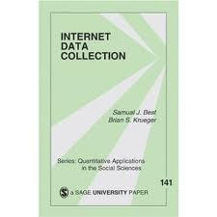
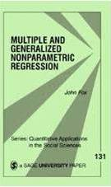

Research Methods at SAGE
QASS series – “Little Green Books”
  Quantitative Applications in the Social
  Sciences launched in 1976
  In the 1980s SAGE invested heavily in publishing qualitative methods titles at a time when the field
  was regarded as outside of the mainstream
    “Little Blue Books” – Qualitative Research
    Methods series
    1994 publication of the first edition of Denzin & Lincoln’s qualitative research handbook
  SAGE launched the Journal of Mixed Methods Research in 2007

Slide 9



The next logical step…
Assembled a SAGE research methods Editorial Board
Conducted market research
Discovered there was a real need for more research methods material to be online
Our focus in online delivery should be to support browse and discovery
Desire for content to support a breadth of queries from a wide range of researchers

Slide 10
Content and Features
Content
185,000+ pages of book, journal and reference material
Over 750 books
Specially commissioned videos
Links to free web resources
51 titles added for 2014
Product Features
Search
Methods Map
Methods Lists
Content Recommendation Engine
Search widget into SAGE Journals
Integration with Methodspace
About this Title / Author
Evolving functionality year on year in response to user needs
Notes:
Evolving functionality in response to user needs.
- Allow search content books, ref, jnls, video
- Link directly to relevant content
- Discover new methods/ delve into known methods
- All levels of researcher
Can be used across social sciences
Content growing annually.
Aim of all product features is to get researcher to the right content.

Slide 11
Unique Taxonomy
SAGE developed a new taxonomy of social science research methods to support this product
Contains more than 1,400 terms
Every chapter, reference entry and article tagged
Links together SAGE’s content like never before
Includes not only methods terms and concepts, but also key people in the field
Notes:
Driven by the most comprehensive taxonomy of its kind
Every chapter and reference entry has been tagged with terms from the ontology, an operation that has been editorially reviewed for every single item
This one-of-a-kind taxonomy links together SAGE’s content like never before provides truly targeted search results

Slide 12
Unique Taxonomy
Philosophies and Concepts
Quantitative Methods
Qualitative Methods
Mixed Methods
Research Design
Literature Review
Writing Up
Notes:
To support researchers at all stages – search and review to writing up
- Answer methods questions
- Helps understand options
- Helps researchers complete project successfully

Slide 13
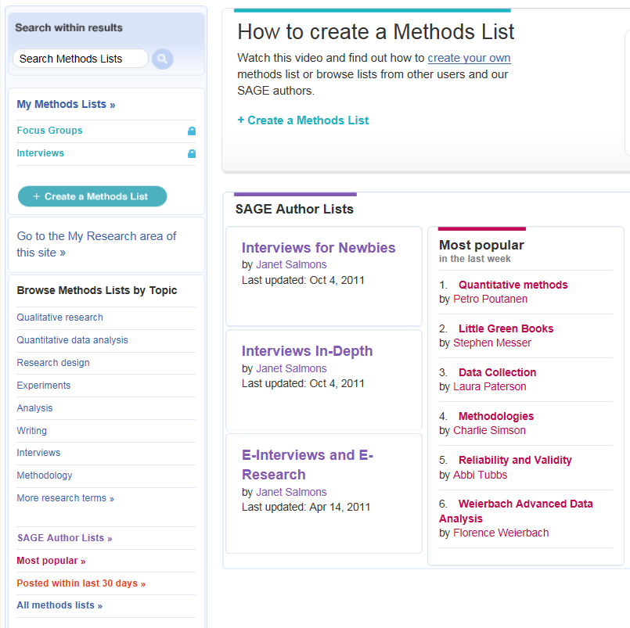
Methods Lists
Group together content relevant to your search and share with others
  >> Teachers can share reading materials with students
  >> Researchers who are collaborating can share their findings
  >> The community can provide a new level of recommendations
Notes:
Create “favourites” lists with selected content
Share a list with others by making it public
Teachers can share reading materials with students
Researchers who are collaborating can share their findings
The community can provide a new level of recommendations
Search other users’ lists
Lists from key SAGE research methods authors that have compiled content in key topics

Slide 14
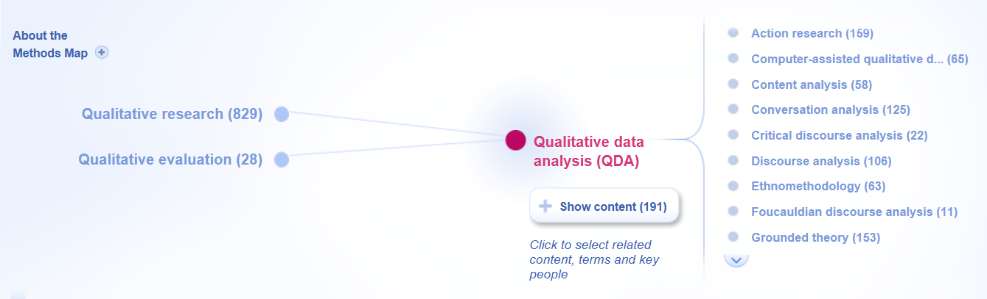
Methods Map
Create a visual search “map” from the taxonomy that links methods or authors
Notes:
Visualises the relationships between methods terms, concepts, people and literature, supported by the taxonomy.
It has a visualised search map linking methods and authors.
Save/download/print feature.
Breadcrumb trail to easily return to previous place in the search.

Slide 15


Slide 16

SAGE Research Methods Cases
Material on research methods can often be
very theoretical and dry

Slide 17
Cases provide . . .
Practical, real-world examples of methods in action
Exploration of difficulties, nuances, and real-life decisions researchers face
Colour and context to otherwise dry material
Examples of how methods are used within specific disciplines or areas of study

Slide 18
SAGE Research Methods Cases
More than 400 specially commissioned cases of real social research
Searchable by research method, discipline, or academic level
Each Case includes learning objectives, keywords, and discussion questions
Notes:
The cases are seamlessly integrated with the features of the SRM platform.

Slide 19
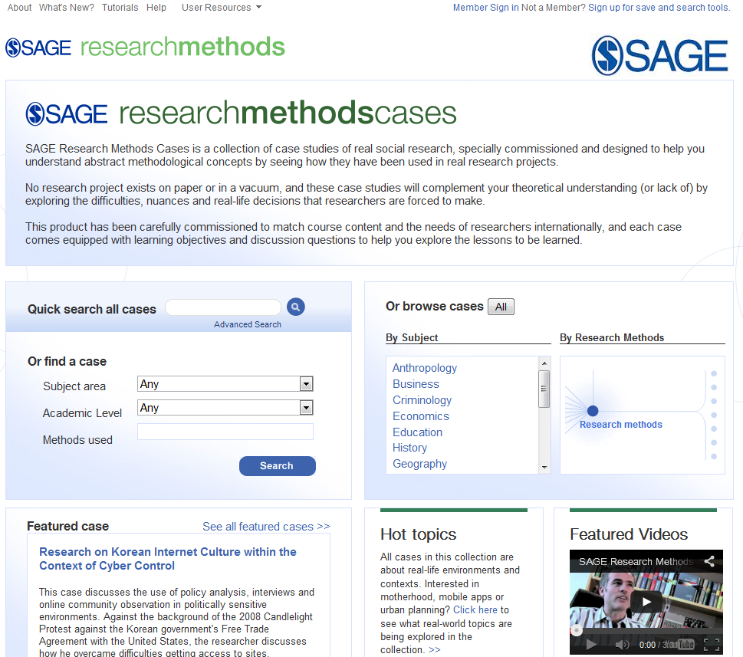
Browse by Methods Map or discipline
Search by discipline, academic level, or method

Slide 20
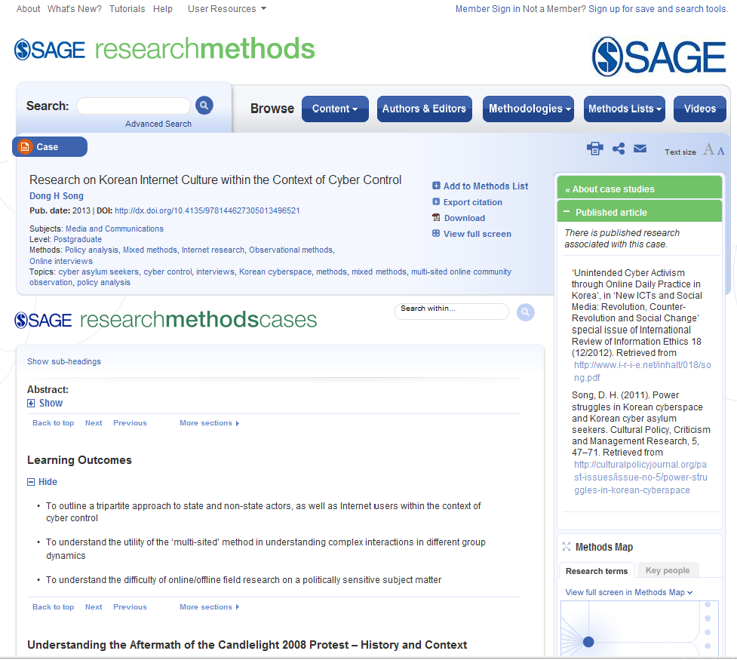
Metadata with discipline, level, methods, and topics covered
Link to published research
Learning Objectives

Slide 21
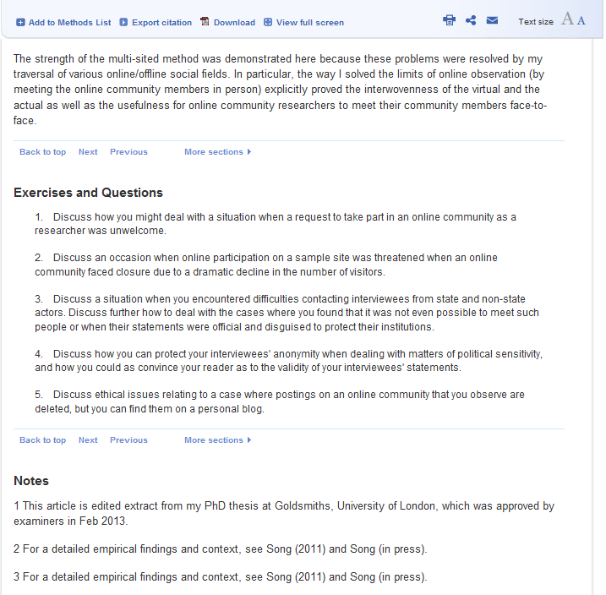
Discussion questions

Slide 22
www.sageresearchmethods.com

