Slide 1
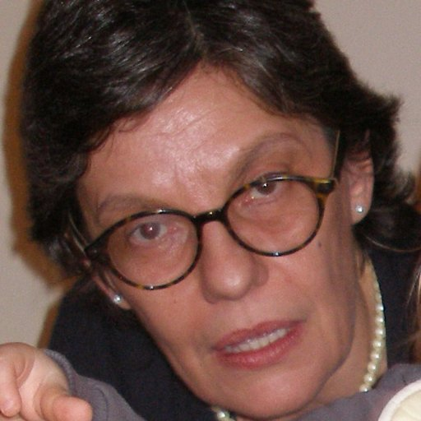
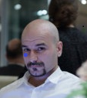
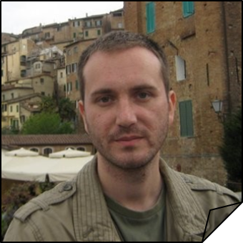
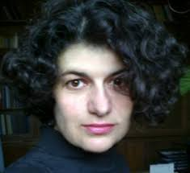
Enrich your DSpace Repository with Customized Tools Case: Serbia
Team for Repository Development (TRAP)
Biljana, Vasilije, Obrad, Milica (+3 more)
February, 2020.

Slide 2
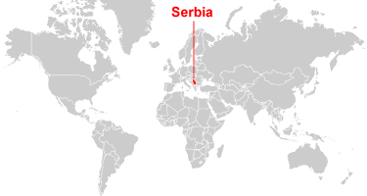
Serbia – Scientific Community
Few facts:
small scientific community (up to 25000 researchers)
participate in cca 270 (150 current) EU-H2020 projects
7000 articles/year in WoS, 1200 PhD
80% of research is funded by the Serbian Government
Serbia has adopted National science policy on July 14th, 2018

Slide 3
Repozitorization of Serbia
Program, not funded by the Government (yet:), but by:
the institutions
and EU (OpenAIRE, NI4OS)
Increased visibility of Serbian research outputs
Growing awareness in the local research community about repositories’ potential in enhancing scholarly communication
Integration of repositories in international infrastructures (BASE, CORE, OpenAIRE, Unpaywall and WorldCat);
(modern) Librarians become important (again) because they keep one step ahead

Slide 4
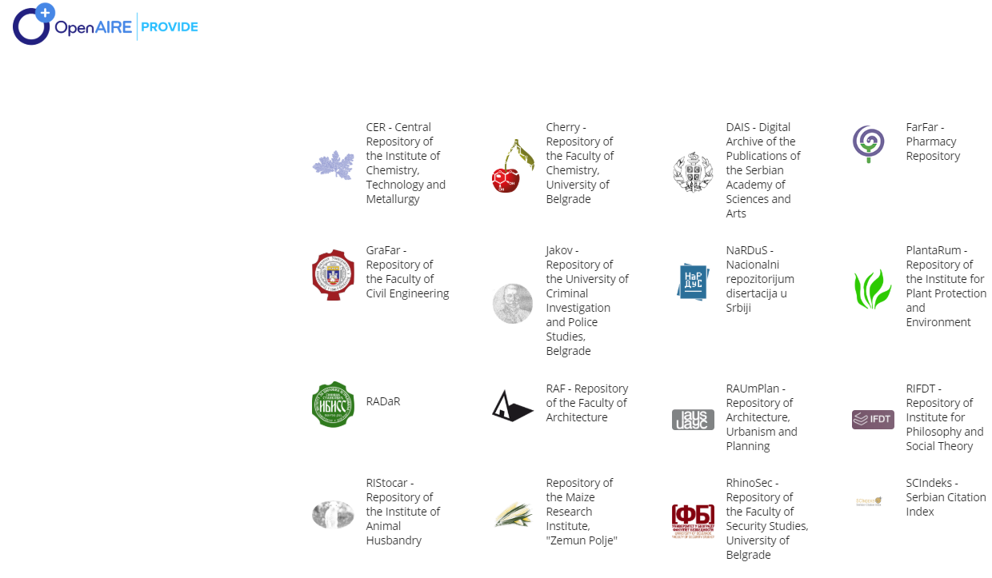
Dozen of Repositories (growing)
Institutions key motivations:
pre-filled
(with everything we could find)
connected into the World
(interoperability)
more visibility
(Google Scholar)

Slide 5
Our Way
Repository is not just software, it is the whole service
customized repository platform based on DSpace (ver. 5.10, waiting for ver. 7)
lot of tools
multidisciplinary team:
Vasilije – IT support (we have +2)
Obrad – librarian
Milica – end-user support (and much more)
+ repository managers

