Slide 1



Slide 2

Peer-reviewed stories of how real research projects have been conducted
Emphasis on project design and methods application
Each case includes learning objectives and discussion questions

Slide 3
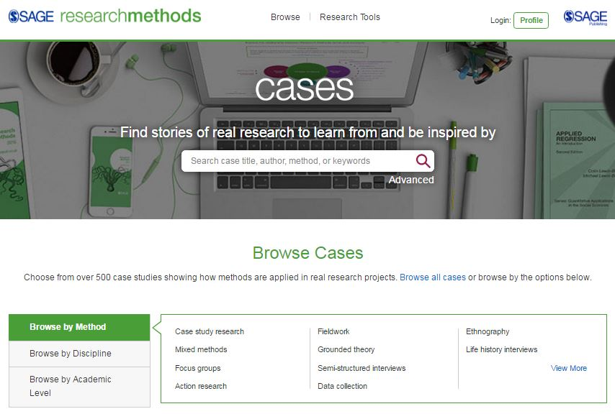
Modern interface, optimized for mobile use
Find cases by method, discipline, or level
Main site search, with advanced options

Slide 4
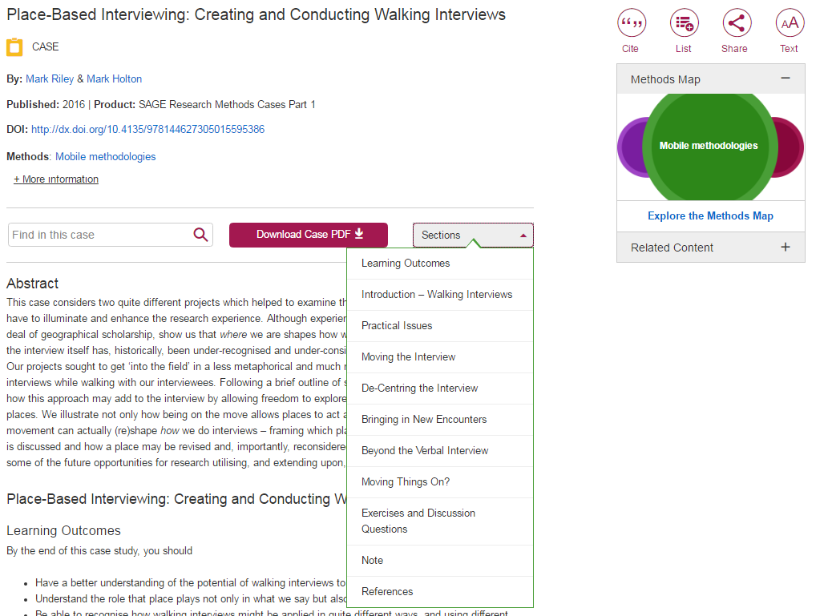
Metadata with discipline, level, method and topic(s)
Search case, download a pdf or find specific sections
Place it in the methods map or find related content
Notes:
Sections include learning outcomes and debate questions

Slide 5
Cite, add to your reading list, or share
Notes:
Sections include learning outcomes and debate questions

Slide 6
Free trials available!
Sagepub.com/trial
journalsales@sagepub.co.uk
Notes:
The Publisher of the Social Sciences

