Slide 1
EIFL webinar: Discounted & waived apcS from Taylor & francis
Romy beard
Licensing programme manager

Slide 2
agenda
Context
The Taylor & Francis offer
How to find the journals included in the offer
Finding the exact cost of the APC to be paid for those authors that qualify for a discount
Submitting journals for publication and requesting for the discount or waiver to be applied
Questions & Answers

Slide 3
1. context
The EIFL Licensing Programme negotiates agreements with publishers and service providers on behalf of EIFL member consortia and their institutions
To support the global move to OA and help speed up the transition to OA we have started negotiating agreements for discounted and waived APCs for EIFL researchers

Slide 4
What are apcs?
An Article Processing Charge (APC) is a fee that authors pay in order to have their article published in open access
APCs cover the cost of article publication including but not limited to running peer-review systems, copyediting and typesetting, hosting the article in perpetuity on dedicated servers and marketing.
The APC is paid after an article has been peer-reviewed and accepted for publication.

Slide 5
Open access vs closed access
If an author publishes their article in a subscription (closed access) journal, they do not pay an APC – however, only those with a subscription to the content can read the article
If an author publishes their article in an open access (either in a fully open access journal, or within a hybrid journal), they usually have to pay an APC – then everyone can read the article, no need to pay for access
Note: some open access journals do not charge article processing charges

Slide 6
Advantages of publishing in open access
Anyone from around the world can read the published article
No subscription costs for libraries
Greater exposure means a higher usage of open access content (more downloads), more citations, more references… more impact on other researchers!

Slide 7
Who pays the apcs?
APCs are paid by research funders, through research grants
Authors paying APCs out of their own pocket
Institutions paying APCs on behalf of their researchers
Within the transition to open access, increasingly libraries are taking charge of the APC spend in their discussions with publishers, through transformative agreements

Slide 8
EIFL agreements for discounted and waived APCs
Taylor & Francishttps://eifl.net/e-resources/taylor-francis-apcs-open-access-journals
SAGE
https://eifl.net/e-resources/sage-apcs-open-access-journals
Webinar on 3rd June, 10am UK time/11 CET

Slide 9
2. The Taylor & Francis offer
Waived article processing charges for corresponding authors from: Cambodia, Ethiopia, Ghana, Kenya, Kyrgyzstan, Laos, Lesotho, Malawi, Namibia, Nepal, Senegal, Tanzania, Uganda, Uzbekistan, Zambia, Zimbabwe
50% discount for corresponding authors from: Armenia, Azerbaijan, Belarus, Botswana, Congo, Estonia, Fiji, Georgia, Ivory Coast, Kosovo, Latvia, Lithuania, Macedonia, Maldives, Moldova, Palestine, Serbia, Thailand, Ukraine
132 titles included – fully open access journals

Slide 10
Corresponding author
Corresponding author:
the main contact, if more than one author work on article together
the author who receives email updates about the article’s process during the peer review and production process
the assigned author who will receive the peer review decision on the article and production proofs to check.

Slide 11
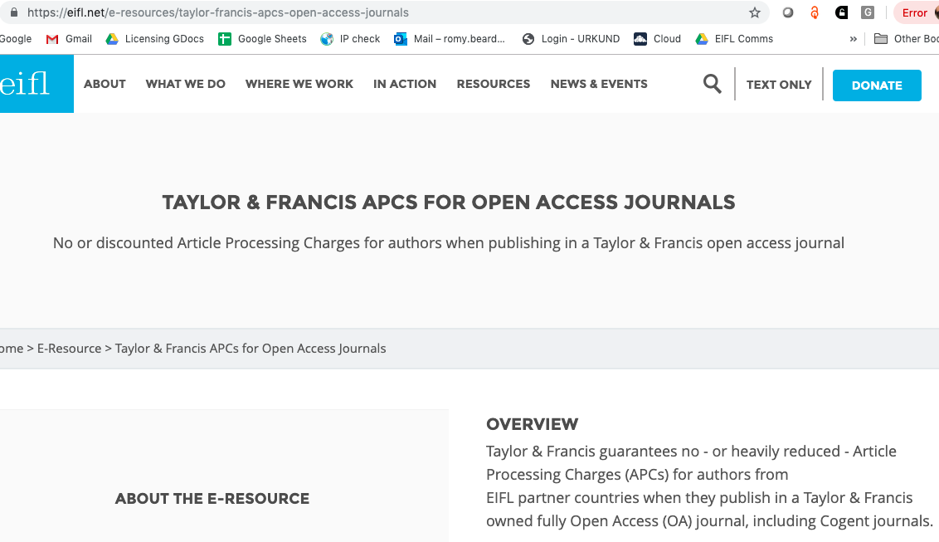

Slide 12
3. How to find the journals included in the offer

Slide 13
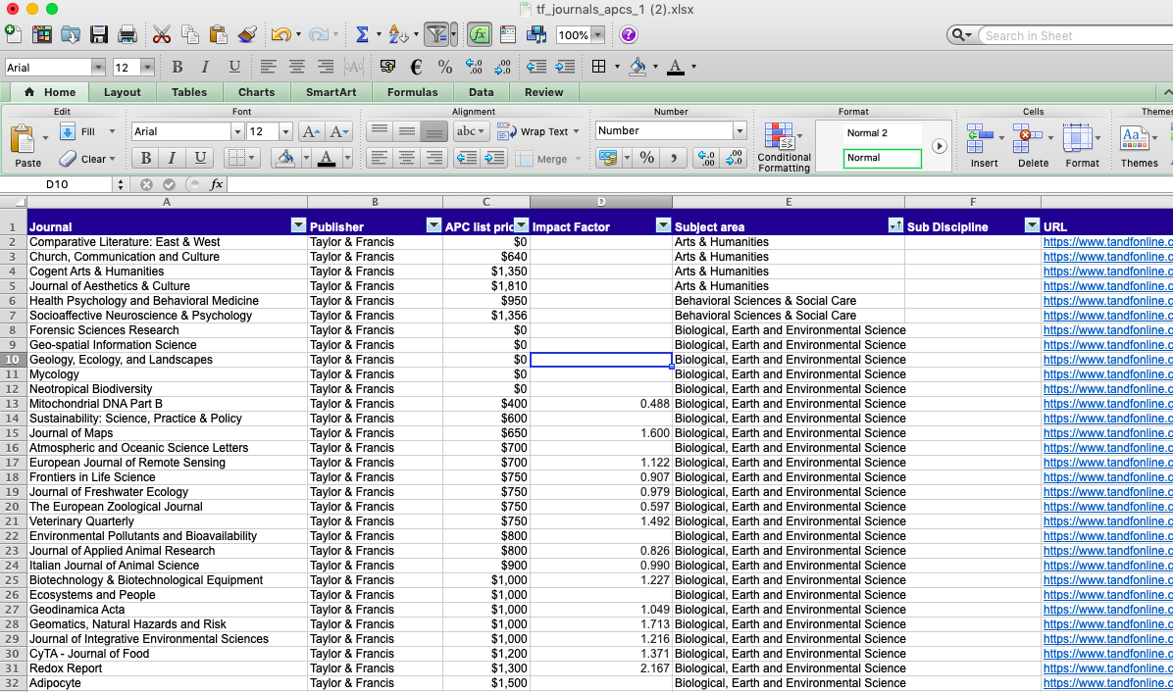

Slide 14
Finding the exact cost of the APC to be paid for those authors that qualify for a discount
Submitting journals for publication and requesting for the discount or waiver to be applied

Slide 15
Questions?
Romy Beard
Licensing Programme Manager
romy.beard@eifl.net

