Slide 1
Understanding community needs:
A golden pathway to successful public library service
Ramune Petuchovaite – Manager of Public Library Innovation Programme, EIFL (EIFL-PLIP)
@ramupetu – plip@eifl.net – @EIFLnet
2nd African Public Libraries Summit – Swaziland – 2016

Slide 2
EIFL-PLIP base of evidence
EIFL-PLIP |
www.eifl.net
Case studies of new technlogy based services
Awarded innovative services from Africa, Asia, Europe, Latin America
Research on public library perceptions and innovation
Advocacy for public access internet and new services
Capacity building for public librarians to start new services
Notes:
Case studies: 49 new public library services in 27 developing and transition economy countries
Award winning: 29 success stories from 16 countries recognized by EIFL Public Library Innovation award
Studies of ‘Perceptions of Public Libraries in six African countries (2011) and ‘What inspires librarians to innovate’ (2014)
Advocacy work with multi-stakeholder advocacy & awareness-raising groups in Kenya, Ghana and Uganda
Training programmes for public librarians in Ghana, Kenya, Uganda and Ethiopia

Slide 3
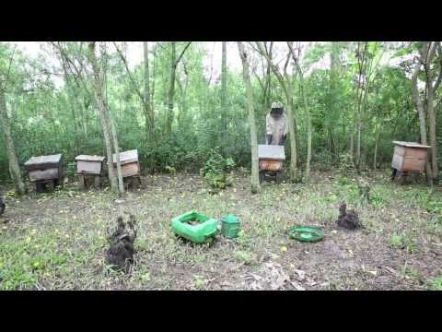
EIFL-PLIP supported services in Africa
@EIFLnet
EIFL-PLIP |
Through grants, EIFL-PLIP has supported pilots of 21 new services in eight African countries
See video example – project ‘Connect Uganda’ by Maendeleo foundation
More case studies are online: http://bit.ly/25ym5HO
Video: EIFL-PLIP, 2014

Slide 4
A common pathway of new service development in libraries
@EIFLnet
EIFL-PLIP |
Assessing community needs
Capturing the impact
Advocating for sustainability
Building relevant partnerships
Selecting relevant technologies
Introducing the new service
Picture: EIFL-PLIP new service development model, 2014

Slide 5
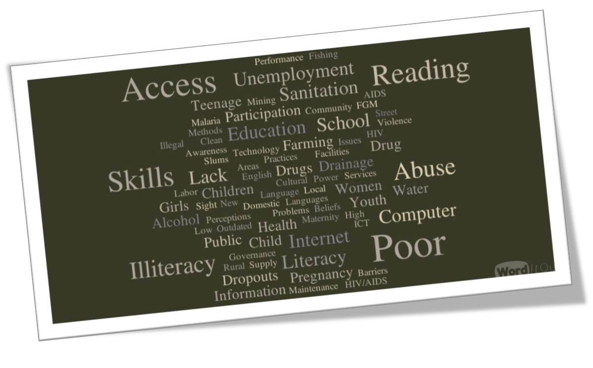
Particular community needs and local circumstances are the main reasons for different approaches taken by grantee libraries in new services
2016
EIFL-PLIP |
Picture: A word cloud of community challenges by regional public library managers in Ghana, 2015

Slide 6
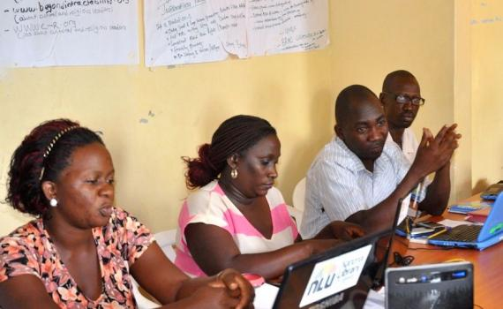
How to conduct community needs assessment for new library services
www.eifl.net
EIFL-PLIP |
Photo: EIFL-PLIP training in Uganda, 2015

Slide 7
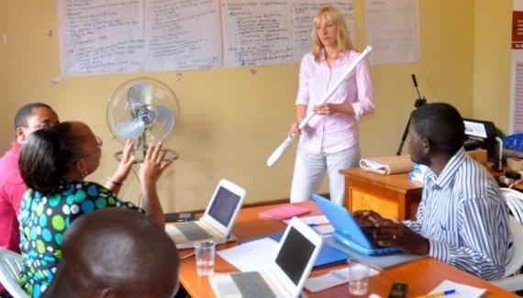
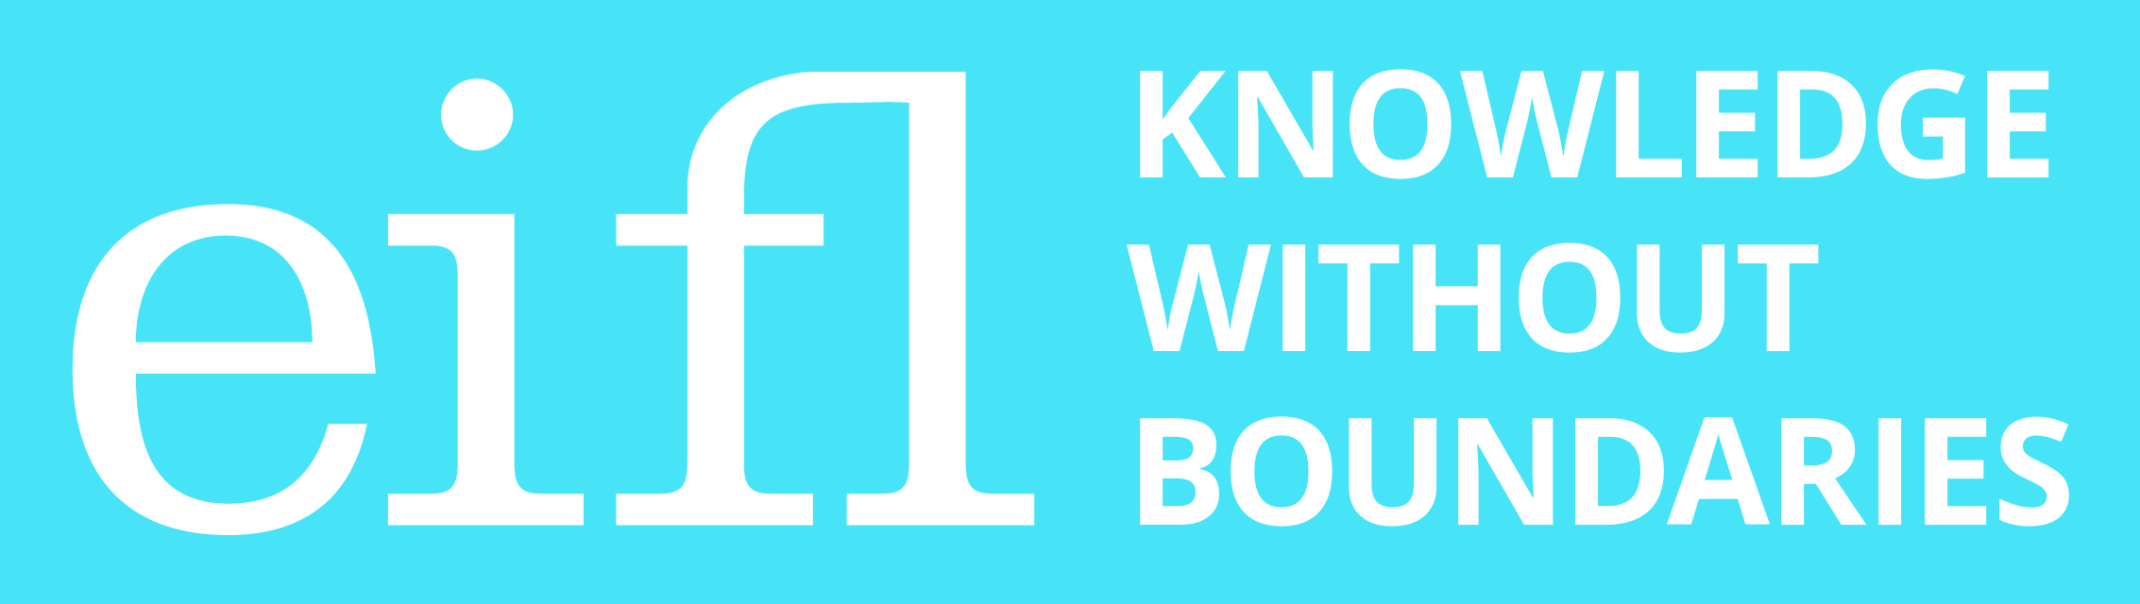
Turn to EIFL-PLIP tip sheet –
Resource created for a grant call ‘Innovative libraries preparing children and youth for the future’ (2014)
@EIFLnet
EIFL-PLIP |
Photo: EIFL-PLIP training in Uganda, 2015

Slide 8
How to get evidence on community needs for library service
@EIFLnet
EIFL-PLIP |
Casual converstations and more structured interviews with users, non-users or stakeholders [e.g. youth, community leaders]
Anecdotal stories / hearsay/ impressions from community meetings
Observations of community members‘ behaviour
Surveys of users, non-users or stakeholders
Focus groups with users, non-users or stakeholders, including relevant community organizations
Study of success of similar services elsewhere
Statistics - Source: EIFL-PLIP Tip Sheet, 2014

Slide 9
Who can help you understand the need for library service?
2016
EIFL-PLIP |
Users of current library services
Non-users and former users
Members of the specifically targeted group(s), e.g. illiterate parents
Stakeholders related to the targeted groups, who can speak on their behalf, e.g. teachers, social workers
Other service providers in the community, e.g. youth organization, regional education office
Source: EIFL-PLIP tip sheet, 2014
Notes:
Stakeholders related to the targeted groups, who can speak on their behalf: teachers, parents, social workers, health workers
political or financial stakeholders/ funders
Other service providers from the community: e.g. other librarians who have implemented similar services targeted at alike development issues
Authoritative statements about policy priorities of local, regional or national government, for example, the regional chairman says “Our top priority this year is to ensure that all young school leavers can use the internet for research and communication.”

Slide 10
What characteristics of the target group are likely to make a difference to the service?
2016
EIFL-PLIP |
Gender and age
Ethnicity and language
Physical abilities
Skills and knowledge
Social status
Occupation
Income
A combination of above characteristics
Source: EIFL-PLIP tip Sheet, 2014

Slide 11
Useful resource – Community-Led Libraries Toolkit
@EIFLnet
EIFL-PLIP |
The result of the Working Together Project funded by Human Resources and Skills Development Canada
  bit.ly/22REeS3
Based on practical experience of five public libraries
Discusses barriers to the library service and includes useful tools to develop / improve library services
Includes background and contextual information, case studies, issues to consider, and reﬂections
Source: Working Together Project, 2008

Slide 12
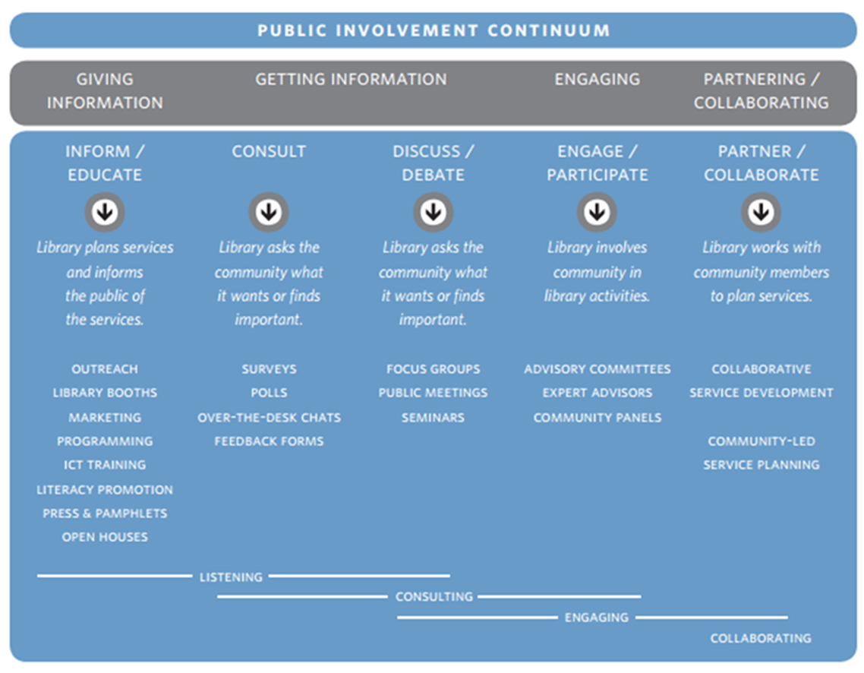
EIFL-PLIP |
2016
Source: Working Together Project. Community-Led Libraries Toolkit, 2008

Slide 13
Useful resource – the Design Thinking Toolkit for Libraries
2016
EIFL-PLIP |
Created by international design company IDEO in collaboration of Aarhus Public Libraries (Denmark) and Chicago Public Libraries (U.S.) with the support by Bill and Melinda Gates foundation
  www.designthinkingforlibraries.com
Based of the human-centered design methodology adapted for libraries
Includes practical examples and case studies to guide in developing new services or adapting library’s spaces
Source: Design thinking for libraries, 2015
Notes:
Based of the human-centered design methodology that was adapted for libraries, taking into account practical experience of public librarians from 10 countries, including developing and transition economy countries
Includes practical examples, case studies and useful exercises that guide library staff in creative processes of developing new services or adapting library’s spaces to community needs

Slide 14
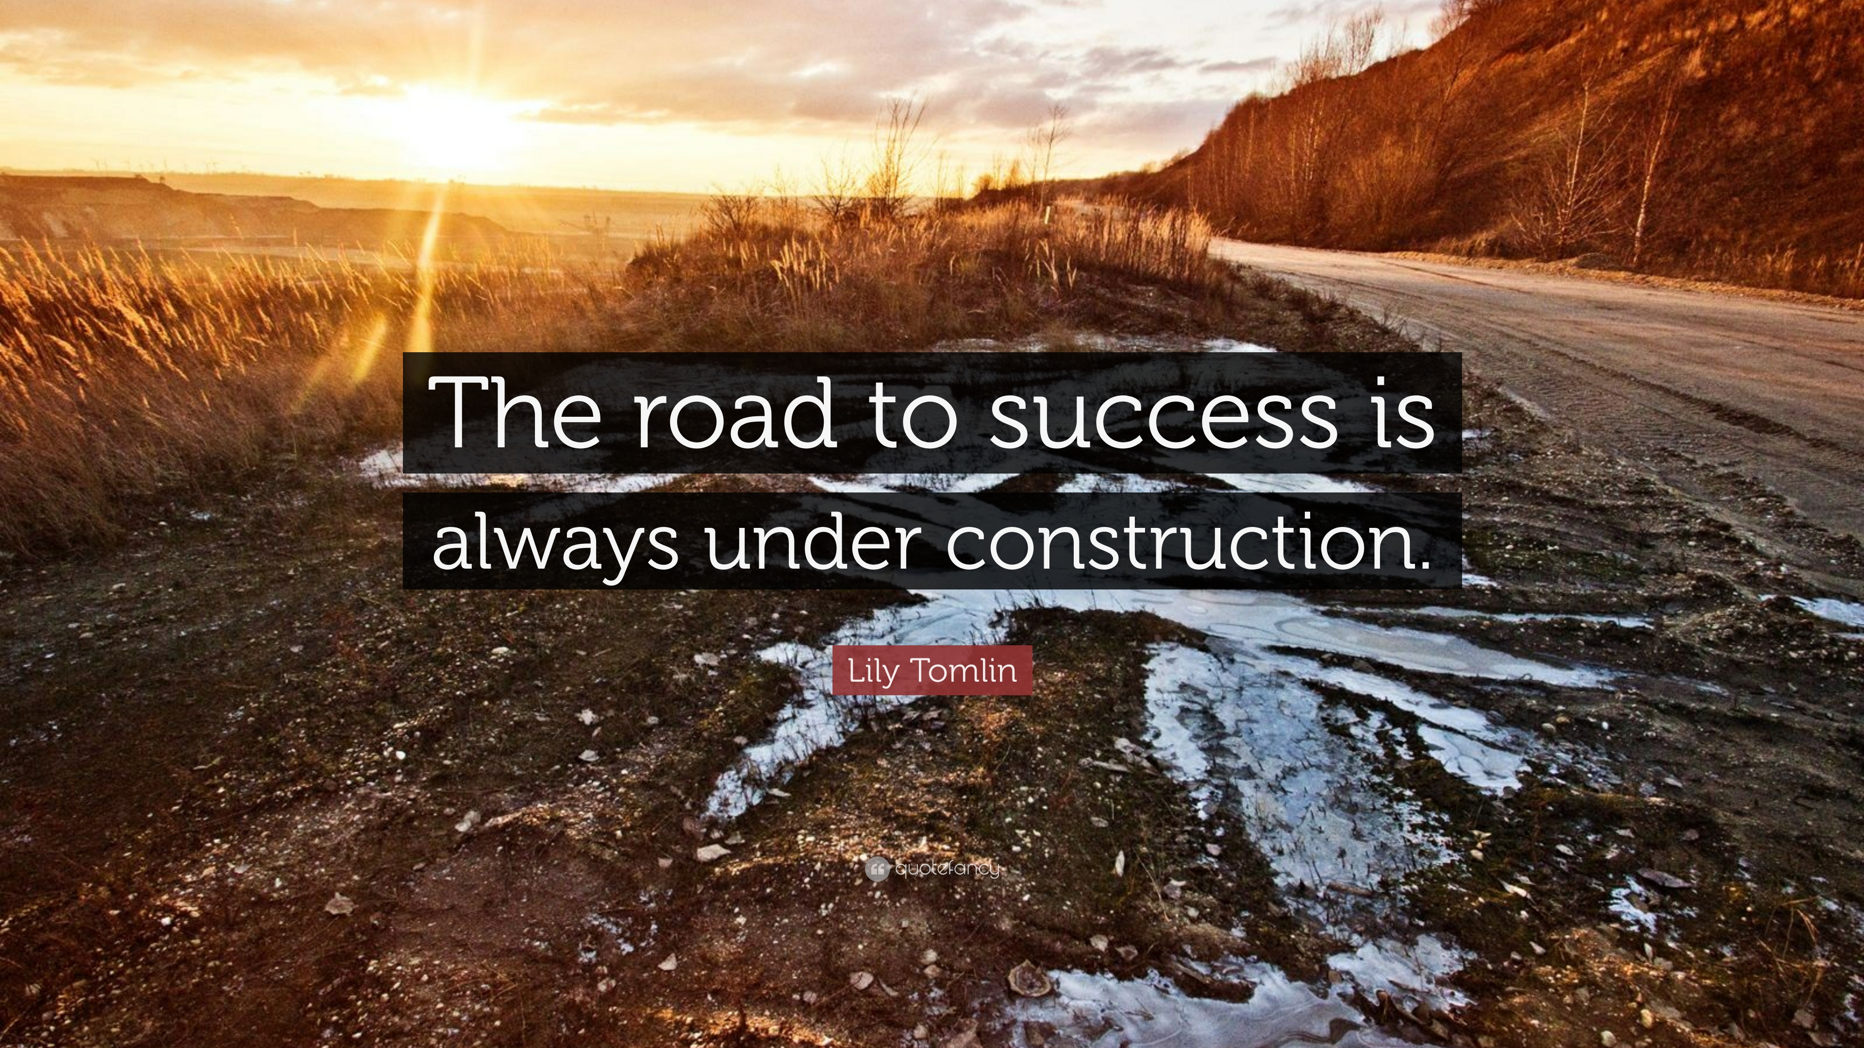
Picture: quotefancy.com
Notes:
Understanding your community needs is never ending. Library can grant success only if community is actively involved in the construction.

Slide 15
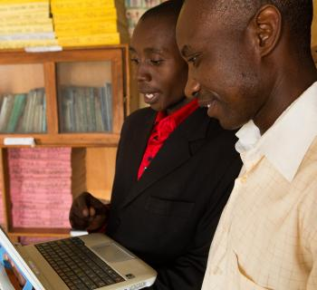
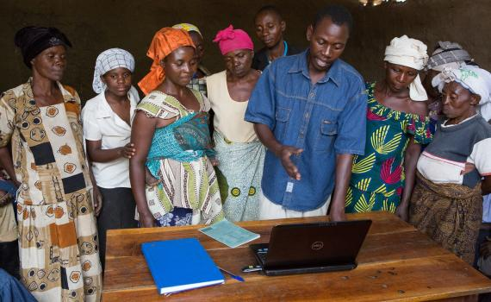
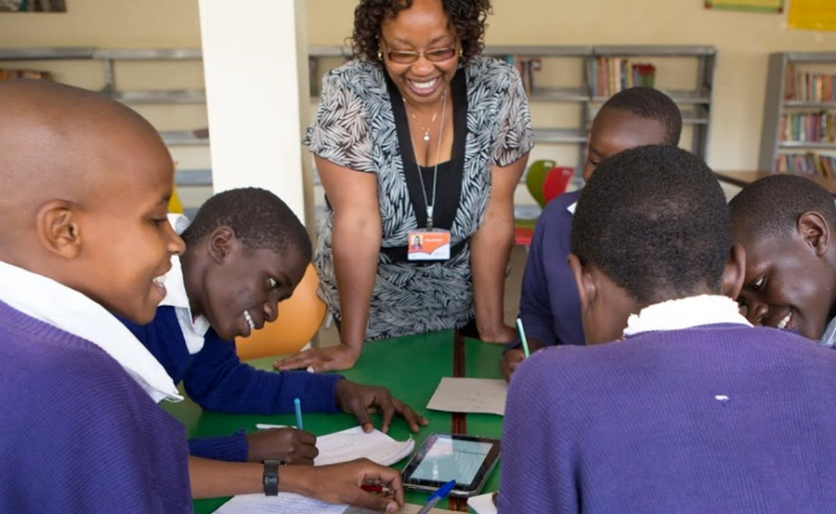
Thank you!
www.eifl.net
www.facebook.com/eIFL.net/
@EIFLnet

